Slide 1
From Market Data to Risk Insight
Data Engineering, Daily Risk Monitoring & Distress Analysis
Candidate Case Study | FlatexDEGIRO Risk Data Engineering & Analytics Expert
Reproducible Pipelines • Full Non-Linear Repricing (1/S) • Kupiec & Christoffersen Backtesting • Correlation Breakdown

Slide 2
TASK 1A • DATA ENGINEERING
Resilient & Idempotent Data Architecture in DuckDB
Official ECB Source (SDMX-CSV): Series EXR.D.USD.EUR.SP00.A (indirect quote: USD per 1 EUR) ingested via RESTful API with exponential backoff (5 retries on 429/5xx).
Local Columnar Storage (DuckDB): Embedded in 'data/market_data.duckdb'. Strict typing (PRIMARY KEY on rate_date) and UTC audit timestamps (ingested_at) for lineage.
Dual Execution Modes & Idempotency: --mode initial (historical load 2015-2026, 3,030 rows in 3.5s) and --mode daily incremental (MAX(date)+1) via INSERT OR REPLACE without duplicates.
TARGET2 Calendar (No Imputation): Clean handling of HTTP 404 / empty payload on banking holidays (INFO log without crashes). Deliberately avoided Fed mixing to prevent timezone mismatch (14:15 CET vs 16:00 ET).
Production Orchestration: Designed for automated scheduling in Apache Airflow or GitHub Actions Monday to Friday at 16:30 CET (post-ECB reference rate release).
TOTAL INGESTED VOLUME
3,030 Observations
Continuous history 2015-01-02 to 2026-11-02
HISTORICAL EXCHANGE RATE RANGE
0.9565 — 1.2493
Sanity check passed (0.50 < S < 2.50)
LATEST OFFICIAL FIXING
1 EUR = 1.1216 USD
Base currency valuation for Task 1b
Notes:
Good morning everyone. Starting with Task 1a: in a regulated European financial institution, the foundation of any credible risk model is reproducible, high-integrity data engineering. I built a modular ETL pipeline in Python connected directly to the ECB's official SDMX API, storing data in DuckDB with a primary key on the rate date and UTC lineage timestamps.
Two architectural decisions stand out: first, strict idempotency via INSERT OR REPLACE, guaranteeing that rerunning any pipeline never creates duplicate rows; second, rigorous adherence to the TARGET2 European banking calendar. If the pipeline runs on a holiday or before 16:00 CET, it gracefully captures the 404 response as an expected business event. I intentionally avoided filling gaps with Federal Reserve data to prevent timing mismatches between Frankfurt's 14:15 CET fixing and New York's 16:00 ET close.

Slide 3
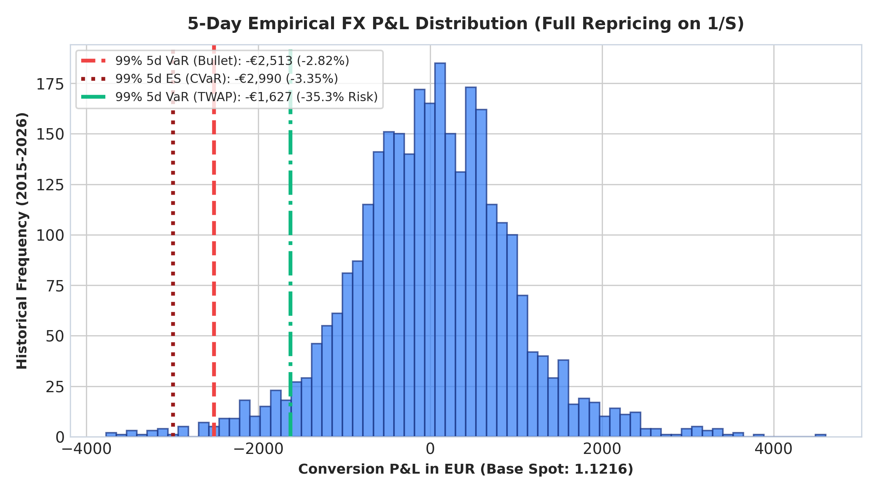
TASK 1B • QUANTITATIVE RISK MODELING
FX Risk Modeling: Full Repricing on 1/S (5-Day Horizon)
Active Balance Sheet Exposure: Treasury holds USD 100,000 to convert into EUR within 5 business days for Euro payments. Spot value: V₀ = 100,000 / 1.1216 = €89,158.35.
Asymmetric Risk & Non-Linear Convexity: ECB quotes indirect (S = USD/EUR). When S rises, USD weakens and the bank receives fewer euros. Full non-linear repricing: L = V₀ - 100k / (S₀ · exp(r₅d)). Linear Delta approximations discarded.
Empirical 5d Horizon vs √5 Shortcut: Direct 5-day empirical log returns (ln(S_t / S_t-5)). The square-root-of-time rule underestimates tail risk by falsely assuming i.i.d. Gaussian returns.
Coherent Risk Measures (Basel III / FRTB): 99% 5d Historical VaR = -€2,513.33 (-2.82%) and 99% Expected Shortfall (CVaR) = -€2,990.32 (-3.35%) capturing tail fatness.
TTC vs PiT Dual Perspective: Through-the-Cycle VaR (11 years, anti-cyclical) = €2,513 vs EWMA (λ=0.94) = €1,350 (reflecting current low volatility of 4.66% annualized).
Notes:
In Task 1b, we evaluate currency risk from the balance sheet perspective of an institution reporting in Euros. Because the ECB quotes how many dollars one euro buys, our position value is 100,000 / S. The bank faces economic loss when S goes up —that is, when the US dollar depreciates—.
Instead of relying on linear Delta approximations or scaling 1-day volatility by the square root of 5 —which assumes independent Gaussian returns— we revalue the exact 1/S hyperbola scenario-by-scenario using direct 5-day empirical returns.
Following Basel III (FRTB) standards, we report both 99% VaR (€2,513) and Expected Shortfall (€2,990) to measure tail severity. Furthermore, contrasting the 11-year Through-the-Cycle VaR (€2,513) against the EWMA regime-sensitive model (€1,350) informs the Board that while recent markets are calm (4.66% annualized volatility), our capital cushion remains resilient to historical shocks like Brexit or COVID.

Slide 4
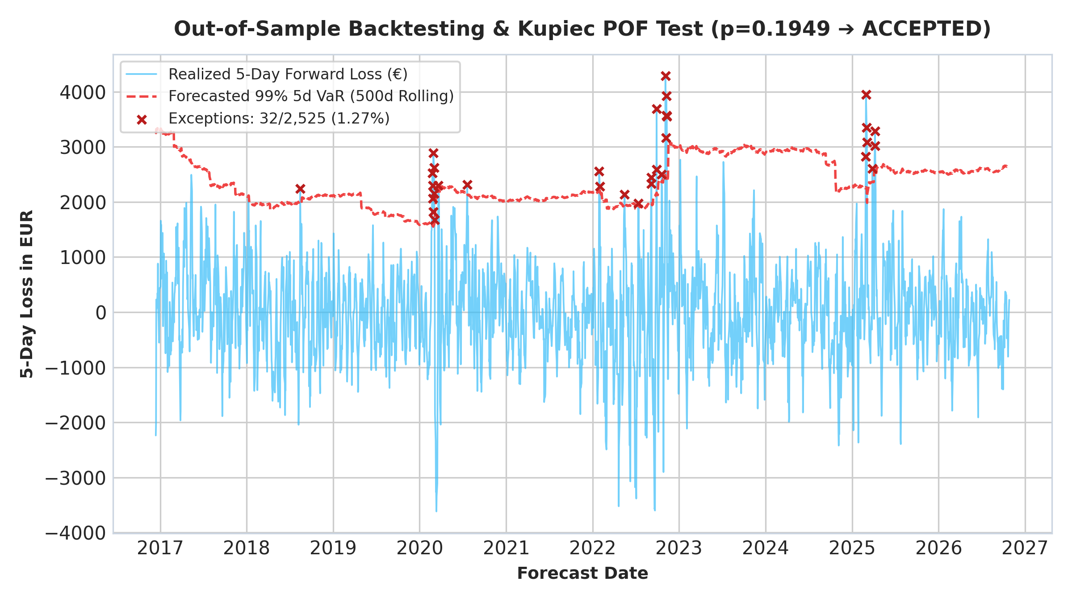
TASK 1B • EXECUTIVE DECISION & MODEL VALIDATION
Executive Dashboard, Treasury Decisions & Model Validation
Risk Traffic Light (🟢 Green): Recent 21-day annualized volatility at 4.93% (17.2th historical percentile). Calm regime; standard treasury operations.
Trigger Rate (S_VaR = 1.1541): Exact operational stop-loss: if EUR/USD rises by +2.90% over 5 days, the full €2,513 VaR budget is depleted.
Operational TWAP Execution (5d): Converting USD 20k/day reduces 5d VaR to -€1,627 (-35.3% risk reduction, saving €886 in capital at risk) at zero derivative cost.
Hedging Benchmark (FX Forward): Locking the rate today via 5d Outright Forward costs €28.38 (SOFR/€STR carry + spread), less than 1% of the €2,990 Expected Shortfall.
Kupiec & Christoffersen Validation: 2,525 out-of-sample windows: 32 breaches (1.27%), Kupiec p=0.1949 (ACCEPTED). In non-overlapping blocks (step=5d), Kupiec p=0.3213 and 94% reduction in MA(4) clustering.
Notes:
The Streamlit dashboard is designed to provide actionable business levers for the Management Board:
First: we calculate the Trigger Rate at 1.1541 USD/EUR. Treasury immediately sees the threshold that exhausts our risk tolerance.
Second: we demonstrate quantitatively that a TWAP execution strategy of USD 20,000 per day reduces VaR by 35.3% for free.
Third: we quantify that eliminating 100% of the €2,990 tail risk via an FX Forward costs merely €28.
Regarding statistical validation, the model comfortably passes the Kupiec POF Test with a p-value of 0.1949. And to address the econometric critique that 5-day overlapping windows induce artificial MA(4) autocorrelation in the Christoffersen independence test, we demonstrate that evaluating on non-overlapping 5-day blocks eliminates consecutive clustering (dropping from 18 to 1 consecutive breach) and Kupiec's p-value rises to 0.3213.

Slide 5
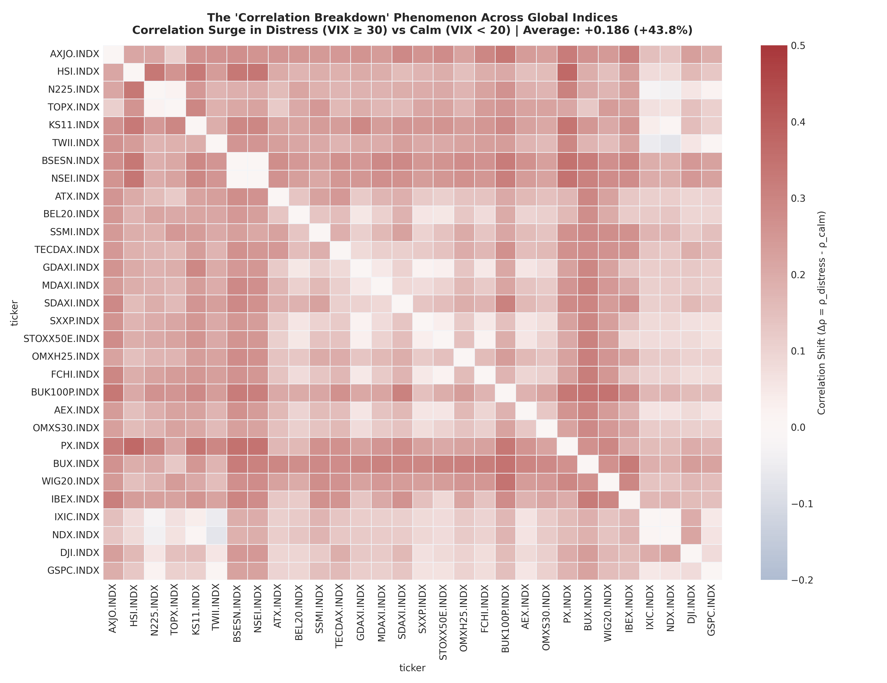
TASK 2 • CROSS-ASSET DISTRESS DYNAMICS
Empirical Evidence of 'Correlation Breakdown' in Global Indices
Forensic Data Hygiene: Resolved dim_master collision: key US6311011026 duplicated NASDAQ Composite (IXIC) and NASDAQ 100 (NDX), interleaved in Parquet. Cleanly decoupled into 31 assets across 4,895 dates.
Market Regimes (VIX): Calm (VIX < 20, 61.6% of sessions), Distress (VIX ≥ 30, 9.2%), and Extreme Panic (VIX ≥ 40, 3.7%).
Loss of Diversification (+43.8%): Mean global pairwise correlation jumps from ρ=0.4247 in calm to ρ=0.6109 in distress (Δρ = +0.1861). 'Diversification melts away when you need it most'.
Severe Regional Co-movement: Intra-US correlation reaches 0.966; Intra-Europe Core reaches 0.930. Massive contagion into Eastern Europe (Δρ = +0.271, a +63.8% surge driven by sudden capital stops).
Forbes & Rigobon (2002) Perspective: We acknowledge the statistical conditioning bias due to common factor variance spikes, while proving true asymmetric lower tail dependence.
Notes:
Turning to Task 2, we conducted an empirical investigation spanning 18 years of market history (2008 to 2026). Before modeling, our forensic data audit identified that asset key US6311011026 duplicated both the NASDAQ Composite and NASDAQ 100, with alternating rows in the Parquet file. We cleanly decoupled them by verifying their historical price levels from 2008 through 2026.
Segmenting the history by VIX regimes reveals unmistakable proof of Correlation Breakdown: when VIX exceeds 30, average pairwise global correlation surges from 0.425 to 0.611 (+43.8%). Within US and Core European equities, correlations exceed 0.93, and Eastern Europe experiences a +64% contagion spike as international liquidity retreats.
Even taking into account the Forbes and Rigobon adjustment for market variance expansion, the practical implication for risk management is clear: international geographic diversification breaks down precisely during systemic market shocks.

Slide 6
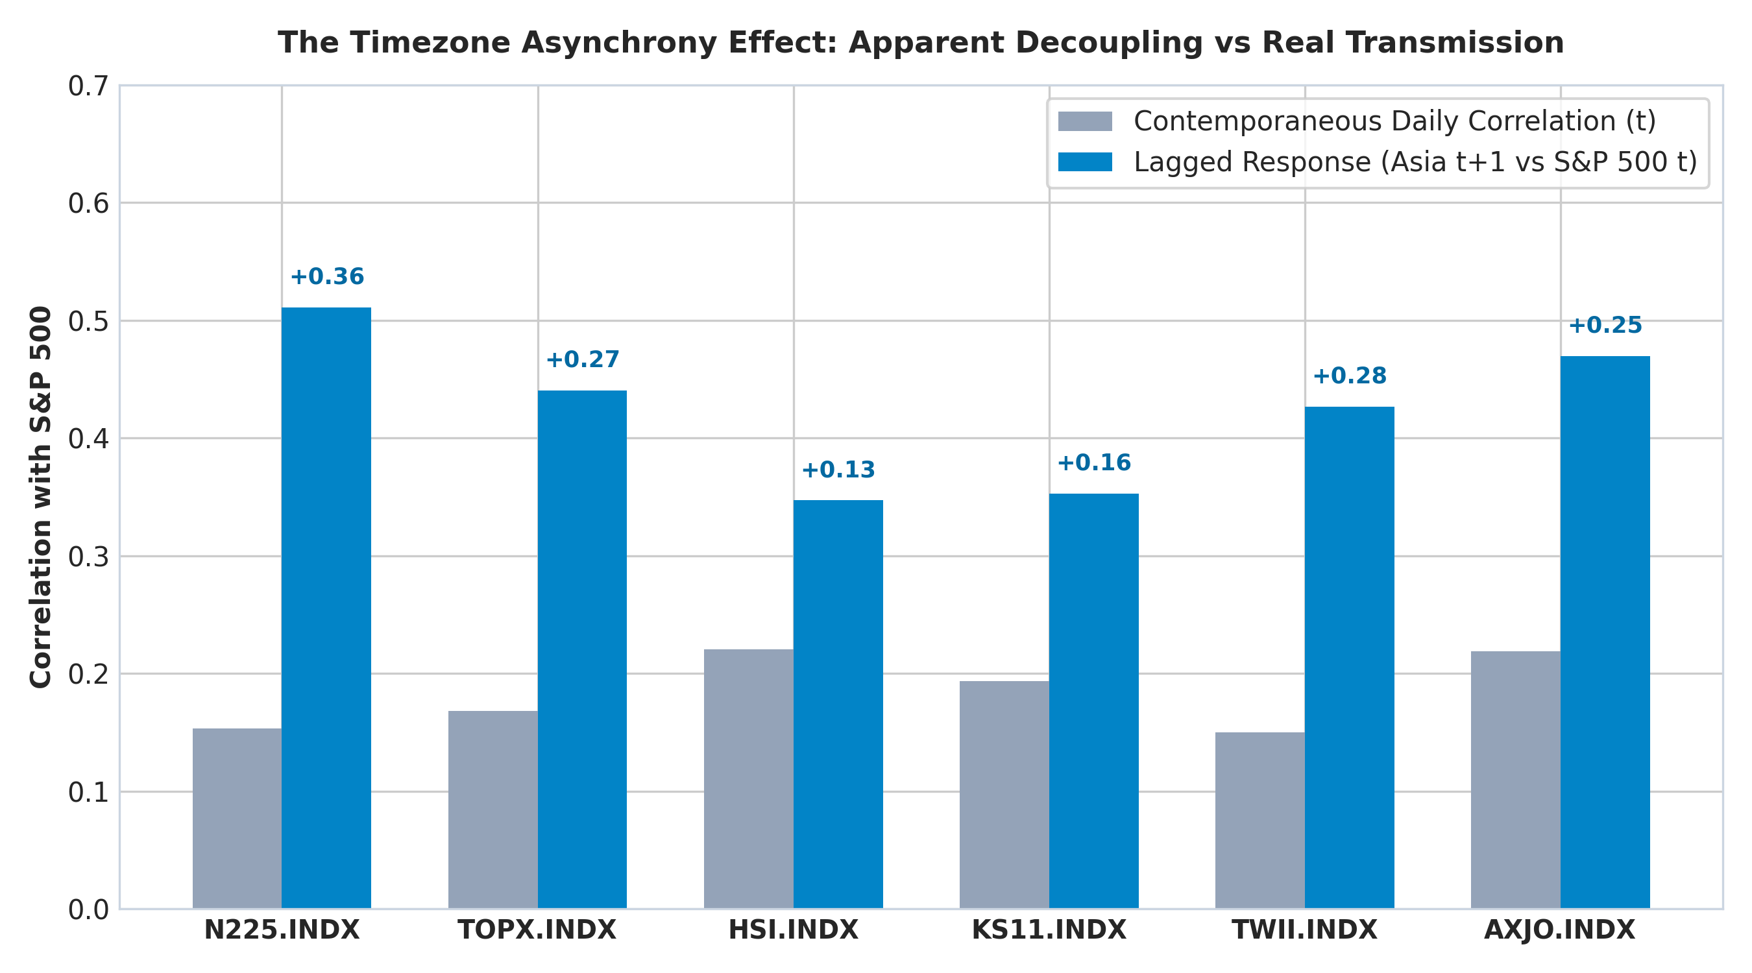
TASK 2 • ASYMMETRIES & FAT TAILS
The Asian Timezone Effect and Structural Outliers
The Asian Decoupling Illusion: Contemporaneous daily data shows near-zero correlation between Asia and the US (Nikkei vs S&P 500 = 0.153). Root cause: Tokyo closes 6 hours before New York opens.
True Transmission at Day t+1: Measuring Asia's next-day response (t+1) to US close (t), correlation triples to 0.511 (+0.358 gain). Australia (AXJO) jumps from 0.219 to 0.470. Overlooking timing severely understates portfolio risk.
Structural Outlier: The VIX: Correlation of -0.734 with S&P 500. Asymmetric leverage effect: +4.82% spike on down days vs -4.31% drop on up days (1.12x fear ratio). Range: 9.14 to 82.69.
Massive Leptokurtosis (Fat Tails): Excess kurtosis from 10 to 18.2 across all indices (normal = 0). Historical 1-day crashes: Prague -16.19% (Lehman 2008), Belgium -15.33% and Spain IBEX -15.15% (COVID March 2020).
Notes:
Diving into market patterns revealed a key insight regarding Asian indices. In traditional daily closing data, Japan or Taiwan appear nearly uncorrelated with Wall Street (0.15 for the Nikkei). However, this is not economic insulation; it is an artifact of asynchronous trading hours: Tokyo closes hours before New York opens.
When we measure the Nikkei's response on day t+1 following the S&P 500 close on day t, correlation triples to 0.511. Any global risk engine using unaligned daily closes will dangerously understate cross-regional portfolio volatility.
Finally, we documented that the VIX serves as a powerful structural outlier with a -0.734 correlation and asymmetric convex reaction to selloffs, while all 30 equity indices display extreme leptokurtosis with single-day drops reaching up to -16% in crisis events.

Slide 7
WHAT TO INVESTIGATE NEXT? • BUSINESS IMPACT IN FLATEXDEGIRO
Next Step: Impact on Margin Loans (Lombard Lending)
Core Business Research Question: How do equity correlation breakdown (Task 2) and FX volatility (Task 1) compound to threaten collateral coverage in FlatexDEGIRO's retail margin lending (Lombard Loans) during market distress?
The Hidden Retail Client Risk: Retail investors frequently hold US tech (USD) alongside European equities (EUR), believing their collateral is diversified. When VIX ≥ 30, cross-correlation exceeds 0.93, causing collateral values to plunge in unison and triggering cascading margin calls.
FX Conversion Risk in Close-Outs: Liquidating USD collateral to cover margin deficits denominated in EUR exposes FlatexDEGIRO treasury to sudden currency gap risk during market illiquidity.
Proposed Methodological Roadmap: Develop a Joint Stress Testing engine (Equity + FX) using Student-t / Clayton Copulas to calibrate Dynamic Collateral Haircuts linked in real time to our Risk Traffic Light.
RETAIL CREDIT EXPOSURE
FlatexDEGIRO Lombard Lending
Core interest-earning asset backed by shares
CONTAGION MECHANISM
Correlation Breakdown > 0.93
Loss of collateral diversification during crashes
PROPOSED RISK MITIGATION
Dynamic Collateral Haircuts
Automated margin adjustments tied to VIX regime
Notes:
To conclude, addressing the question of what I would investigate next: I propose linking the quantitative findings of all three tasks directly into the core revenue engine of FlatexDEGIRO: our retail margin lending book (Lombard Loans).
Leveraged retail investors often hold US tech in dollars alongside European blue-chips in euros, assuming their collateral pool is balanced. Our research proved that when VIX surpasses 30, cross-asset correlations rise above 93%, causing the entire collateral base to collapse simultaneously and triggering widespread margin calls.
When the brokerage must liquidate USD equities to cover EUR debt, treasury immediately absorbs the FX gap risk modeled in Task 1. My technical proposal is to engineer a joint Equity and FX Stress Testing framework using lower-tail copulas, enabling FlatexDEGIRO to dynamically adjust collateral haircuts based on the prevailing volatility regime and optimize treasury hedging. Thank you very much, I look forward to your questions.

