Slide 1
Big Data Technology
Paul Rad, Ph.D.
Associate Professor
Information Systems and Cyber Security, College of Business School
Electrical and Computer Engineering, College of Engineering

Slide 2
Outline
The three Computing Trends
Big Data Market & The age of analytics
Sources of Big Data

Slide 3
The three Computing Trends
The Data Deluge is clear trend from Scientific, Commercial, and Social Applications
Light weight clients from smartphone, tables to sensors
Clouds with cheaper, greener, easier to use IT for (some) applications
APP
APP
SaaS
APP
APP
APP
APP
PaaS
IaaS
APP
Data Deluge
Cloud
Edge / IoT

Slide 4
Big Data Market
Analysts forecast continued growth in the big data market
“The Big Data technology and services market will grow at a 26.4% compound annual growth rate (CAGR) to $41.5 billion through 2018, or about six times the growth rate of the overall information technology market.” IDC.
Global spending on Big Data will grow at a CAGR of 46% between 2015 and 2020. Big Data revenue will reach almost $190 Billion by the end of 2020” Mind Commerce
Big Data will continue to represent a fast-growing multibillion-dollar worldwide opportunity for the next five years. IDC

Slide 5
The Age of Analytics: Competing in a data-driven world
http://www.mckinsey.com/business-functions/mckinsey-analytics/our-insights/the-age-of-analytics-competing-in-a-data-driven-world
ReportMcKinsey Global InstituteDecember 2016

Slide 6
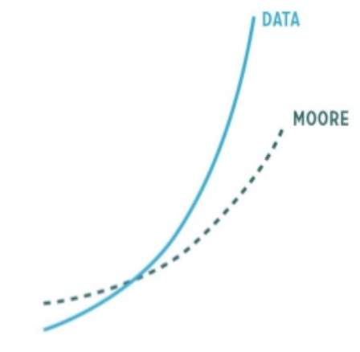
Big Data: Double Edged Sword
Houston, we have a problem!
IDC says Digital Universe will be 35 Zettabytes by 2020.
1 Zettabyte = 1,000,000,000,000,000,000,000 bytes or 1 billion terrabytes
1 Yottabyte = 10²⁴ bytes
Data Volume vs. Moore’s Law
“Data is the new gold”
(Open Data Initiative, European Commission. aim at opening up Public Sector Information)

Slide 7
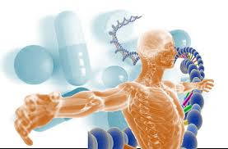
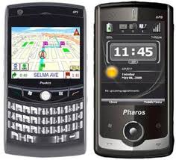
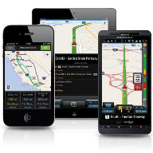
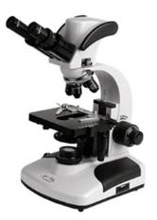
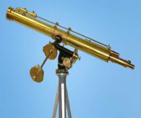
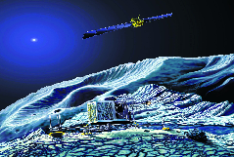
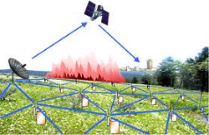
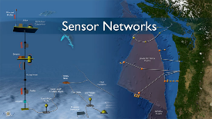
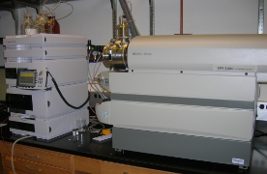
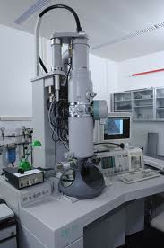
Who is Generating Big Data?
Mobile devices
(tracking all objects all the time)
Social media and networks
(all of us are generating data)
Short Response at Large Scale
Converging:
Big Data, Cloud Compute, Machine Learning
Sensor technology and networks
(measuring all kinds of data)
Scientific instruments
(collecting all sorts of data)

Slide 8
Diverse Data Sources
Big Data Sources
People
(social Media)
Organizational
Data
Sensors
(Machine Data)

Slide 9
Big Data: By the Numbers
~40 10⁹ Web Pages at ~300 kilobytes each = 10 Petabytes
Google processes 24PB of data per day
AT&T transfers 30PB of data per day
90 trillion emails are sent per year
CERN’s Large Hydron Collider (LHC) generates 15 PB a year
Radiology 69 Petabytes per year
Square Kilometer Array Telescope will be 100 Terabits/second
Big Data slogans
“Big Data: The next frontier for innovation, competition, and productivity”
(McKinsey Global Institute)
“Data is the new gold”
(Open Data Initiative, European Commission. aim at opening up Public Sector Information)

Slide 10
Big Data: By the Numbers
Every second, on average, around 6,000 tweets are tweeted on Twitter, which corresponds to over 350,000 tweets sent per minute, 500 million tweets per day and around 200 billion tweets per year. On average, around 6,000 tweets are tweeted on twitter every second.
The total number of people who use YouTube – 1,300,000,000. 300 hours of video are uploaded to YouTube every minute! Almost 5 billion videos are watched on Youtube every single day. In an average month, 8 out of 10 18-49 year-olds watch YouTube.

Slide 11
With Big Data, We’ve Moved into a New Era of Analytics
Key enablers for the appearance and growth of ‘Big-Data’ are:
Increase in storage capabilities
Increase in processing power
Availability of data
Protecting Data (Security)
12+
terabytes
5+
million
of Tweets create daily.
trade events per second.
Volume
Velocity
Variety
Veracity
100’s
Only 1 in 3
of different
types of data.
decision makers trust their information.

Slide 12







Analytics & Automation Software Driving Insights to Action
Distributed Analysis
App Services
Edge
Analyze
Automate
Datacenter
Vendor & Partner Ecosystems
Cloud
Sense…
…Act
Data Warehouses
Access
Engage
Big Data Stores
Virtual
Aggregation
Contextual Interactions
Citizens
Employees
Apps
Devices
Customers

Slide 13
Answer: The Cloud Computing?
According to the official NIST definition, "cloud computing is a model for enabling ubiquitous, convenient, on-demand network access to a shared pool of configurable computing resources (e.g., networks, servers, storage, applications and services) that can be rapidly provisioned and released with minimal management.
Typical requirements and models:
platform (PaaS),
software (SaaS),
infrastructure (IaaS),
Services-based application programming interface (API)
A cloud computing environment can provide one or more of these requirements for a cost
Pay as you go model of business
When using a public cloud the model is similar to renting a property than owning one.
An organization could also maintain a private cloud and/or use both.

Slide 14
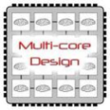
Enabling Technologies
Cloud applications: data-intensive, compute-intensive, storage-intensive
Bandwidth
WS
Services interface
Web-services, SOA, WS standards
VM0
VM1
VMn
Storage Models: S3, BigTable, BlobStore, ...
Virtualization: bare metal, hypervisor. …
Multi-core architectures
64-bit processor

Slide 15
Common Features of Cloud Providers
Development
Environment: IDE, SDK, Plugins
Production
Environment
Simple
storage
Table Store <key, value>
Drives
Accessible through
Web services
Management Console and Monitoring tools
& multi-level security

Slide 16

Windows Azure
Enterprise-level on-demand capacity builder
Fabric of cycles and storage available on-request for a cost
You have to use Azure API to work with the infrastructure offered by Microsoft
Significant features: web role, worker role , blob storage, table and drive-storage

Slide 17

Amazon EC2
Amazon EC2 is one large complex web service.
EC2 provided an API for instantiating computing instances with any of the operating systems supported.
It can facilitate computations through Amazon Machine Images (AMIs) for various other models.
Signature features: S3, Cloud Management Console, MapReduce Cloud, Amazon Machine Image (AMI)
Excellent distribution, load balancing, cloud monitoring tools

Slide 18

Google App Engine
This is more a web interface for a development environment that offers a one stop facility for design, development and deployment Java and Python-based applications in Java, Go and Python.
Google offers the same reliability, availability and scalability at par with Google’s own applications
Interface is software programming based
Comprehensive programming platform irrespective of the size (small or large)
Signature features: templates and appspot, excellent monitoring and management console

