Slide 1
Big Data Technology
Paul Rad, Ph.D.
Associate Professor
Information Systems and Cyber Security, College of Business School
Electrical and Computer Engineering, College of Engineering

Slide 2
Outline
Review: What makes big data valuable?
Characteristics of Big Data
Getting Value out of Big Data
What is Data Science?
The Process of Data Analysis
Scalable Computing (Cluster Computing)

Slide 3
Review: Where Does Big Data Come From?
Big Data Sources
People
(social Media)
Organizational
Data
Sensors
(Machine Data)

Slide 4
Review – What makes big data valuable?
Big Data
Better Models
Higher Precision
Personalized Marketing
Collective Consumer Behavior
Personalized Medicine
Smart City
Etc.

Slide 5
Characteristics of Big Data
Volume refers to vast amounts of data that is generated.
Velocity refers to the speed at which data is being generated and moves from one point to the next
Variety refers to the ever increasing different data formats (i.e Text, Video, Image, Voice, Geospatial)
Veracity refers to unmeasurable uncertainties and truthfulness and trustworthiness of data
Valence refers to the connectedness of big data in the form of graphs
Value

Slide 6
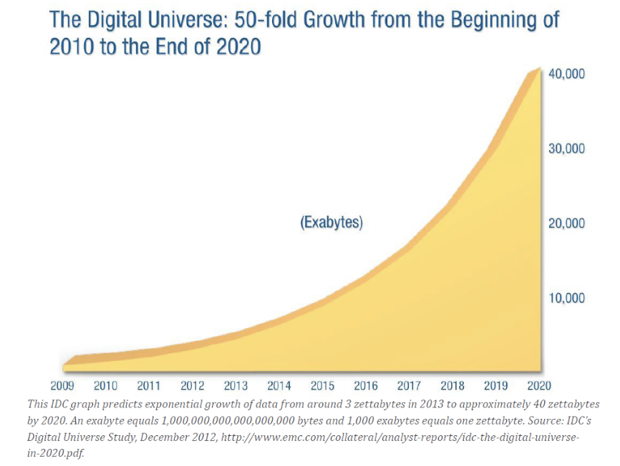
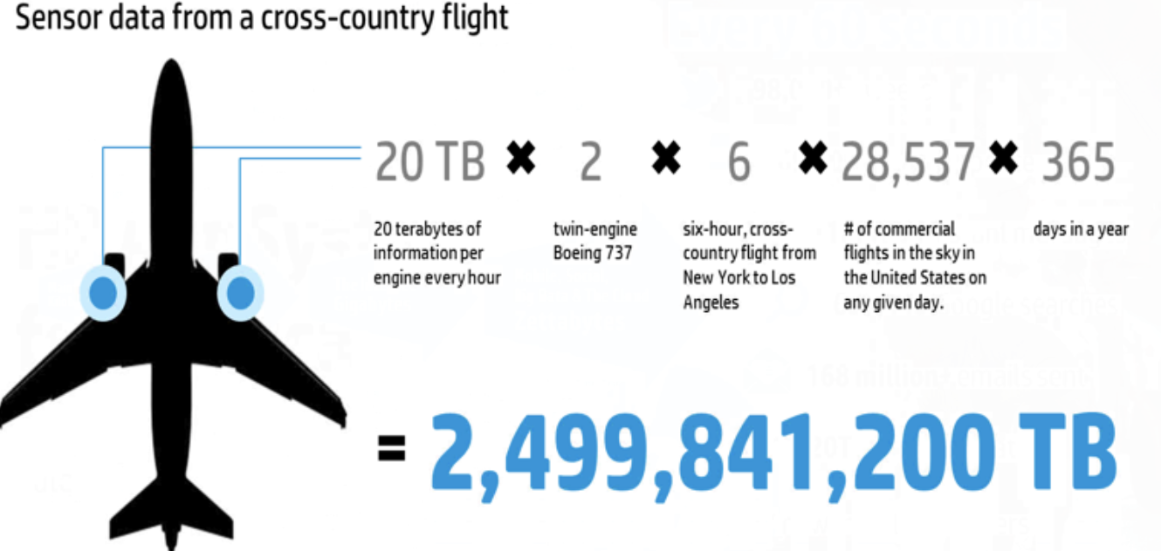
Volume = Size & Scale
Examples
Exponential Data Growth
Every minute ..
204 million emails on Gmail
200,000 Facebook photos
1.3 million video views on YouTube
Business Inside
Challenges
Storage Capacity Leads to
Processing
Networking
Access & Retrieval
Performance
Cost

Slide 7
How much data are we talking about
A DVD ~ 5 GBs
1 TB = 300 hours of good quality video
LHC = 15 PBs a year
IDC says Digital Universe will be 35 Zettabytes by 2020.
1 Zettabyte = 1,000,000,000,000,000,000,000 bytes or 1 billion terabytes
1 Yottabyte = 10²⁴ bytes

Slide 8
Variety = Heterogeneous Data Type → Complexity
Variety Issues
Difficult to create common storage
Management and policy challenges
Harder to process (compare and match data) and correlate
Structure
Semantic
Formats & models
How to interpret and operate on data
Media
Availability
Media in which data get delivered
Real-time ?
Intermittent ?

Slide 9
email: Varity within a Type

Slide 10
Multi-Media Types “Email”
Think of an email collection
Sender, receiver, date...
Attachments
Well-structured
• Body of the email
Text Multi-media
• Who-sends-to-whom
Network
• A current email cannot reference a past email
• Real-time?
Semantics Availability

Slide 11
Velocity
Real-Time Streaming
Batch Processing
Late decisions can lead to missing opportunity

Slide 12
Batch Processing
1) Collect Data
2) Clean Data
3) Process Data
4) Output Results
5) Action

Slide 13
Real-Time Processing
1) Instantly capture streaming data
2) Feel real time data for processing
3) Process Real Time Data
4) Action

Slide 14
Speed of Data Generation vs. Data Processing selections leads to Cost vs. Quality “Real-Time Agile Decision Making”

Slide 15
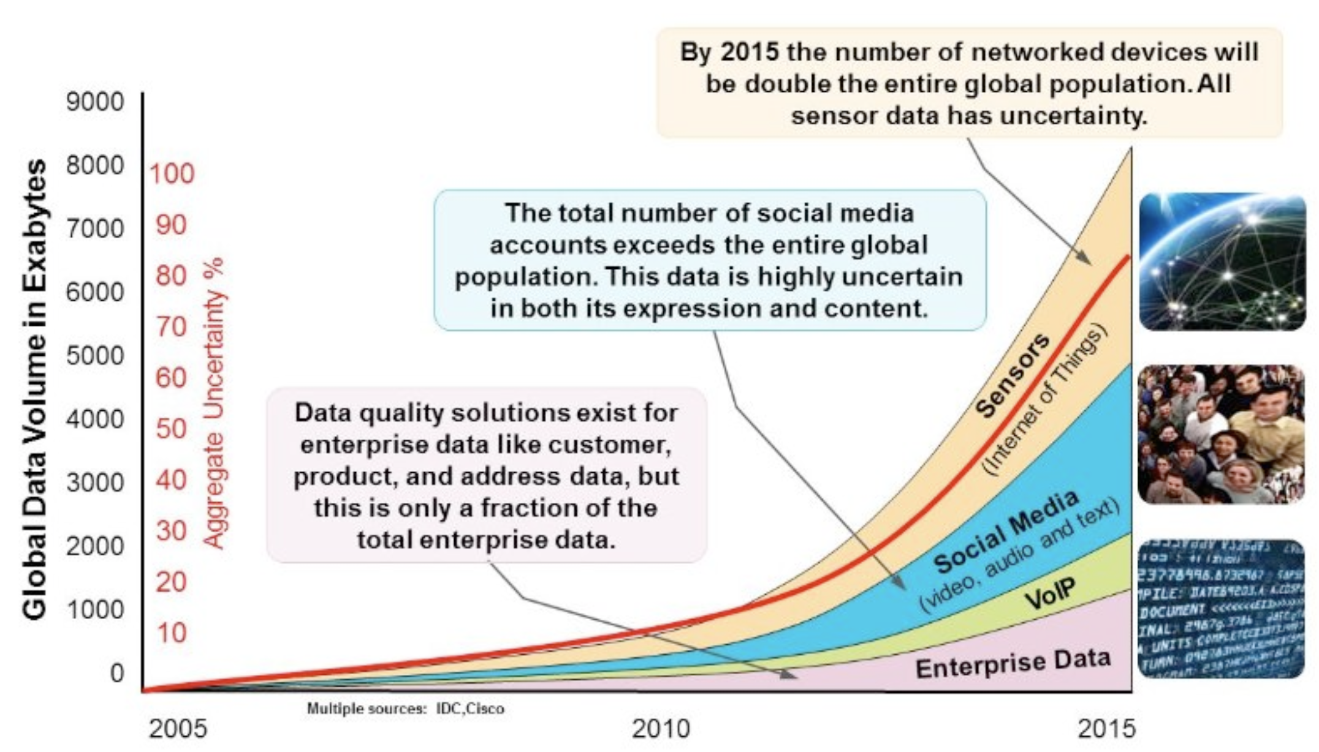
Veracity = Quality (Validity & Volatility)
- Accuracy of data
- Reliability of the data source (Data Provenance)
- Context within Analysis

Slide 16
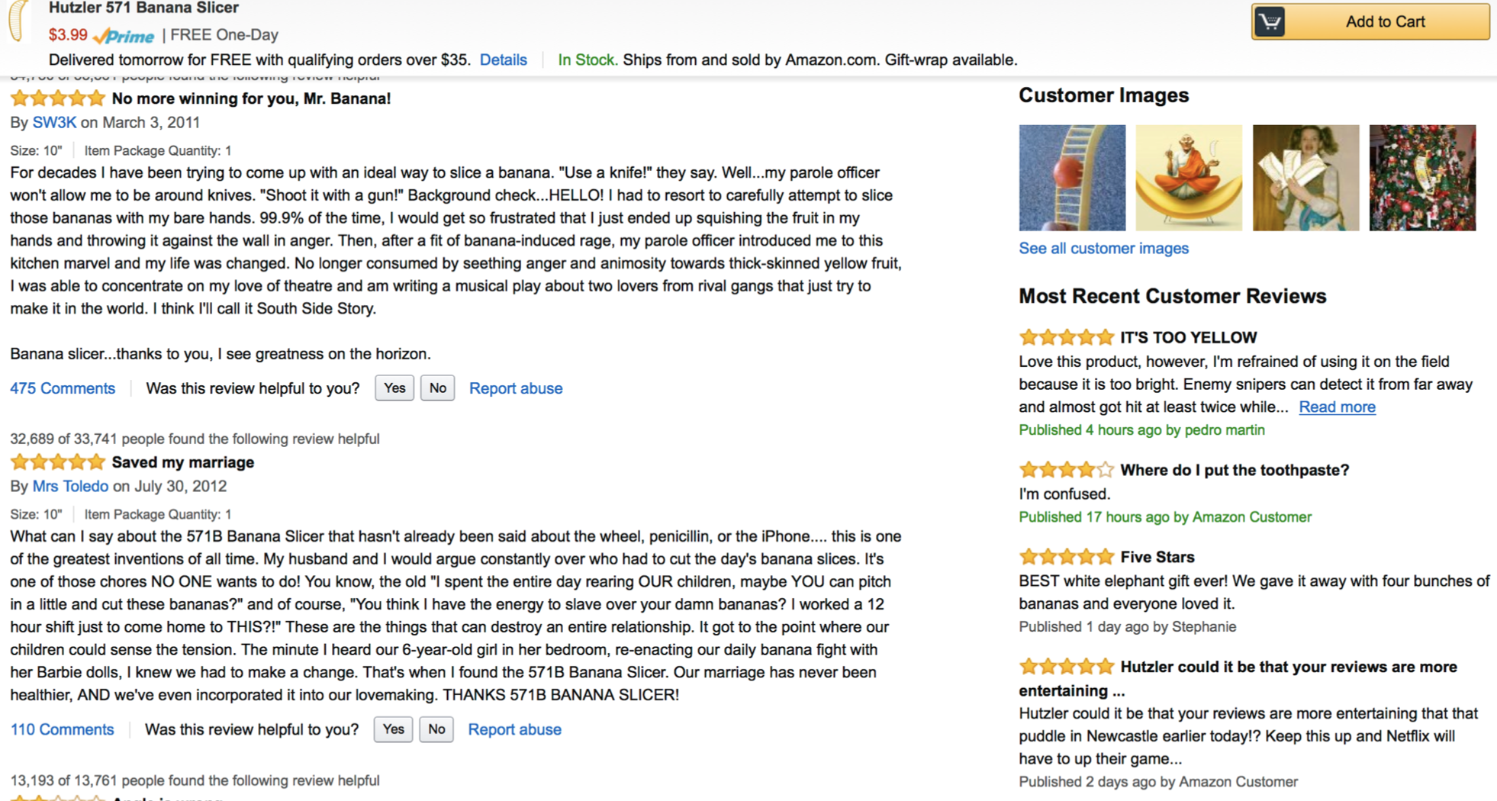

Slide 17
Valence = Measure of Connectivity
Valence increases over time
Presents social behavior and movements
Challenges
More complex data exploration algorithms
Modeling and prediction of valence changes
Group event detection
Emergent behavior

Slide 18
Getting Value from Big Data
Descriptive Analytics
Predictive Analytics
Prescriptive Analytics
Uses data aggregation and data mining to provide insight into the past and answer:
“What has happened?”
Uses statistical models and forecasts techniques to understand the future and answer:
“What could happen?”
Uses optimization and simulation algorithms to advice on possible outcomes and answer:
“What should we do?”

Slide 19
Getting Value from Big Data
How can we make it happen?
Value
What will happen?
Prescriptive Analytics
Why did it happen?
Predictive Analytics
What happened?
Diagnostic Analytics
Big Data
Descriptive Analytics
Difficulty

Slide 20
Getting Value for Big Data
Insight
(Predictive Analytics)
Action
(Prescriptive Analytics)
Big Data
Analysis
(Descriptive Analytics)
Descriptive Analytics:
Insight into the past
Predictive Analytics: Understanding the future
Prescriptive Analytics: Advise on possible outcomes

Slide 21
Data Science – Team Work!
Diverse expertise
Deliver as a team
Big Data Strategy
Data Sharing -No Data Silos
Data Policies i.e. Privacy, Lifetime, regulatory, etc.
Analytics-driven culture
Analytics + Business
Data Science
Data Engineering
Advanced Computing
Visualization
Hacker Mindset
Math
Statistics
Scientific Method
Domain Expertise

Slide 22
Data Product
People
Process
Platform
Product
Problem Definition
Asking the right question
Assessing the Situation
Define Goals
Metrics for Accountability
Expectations, Purpose, Cost , Timeline , Planning of deliverables, Communication, Data Strategy

Slide 23
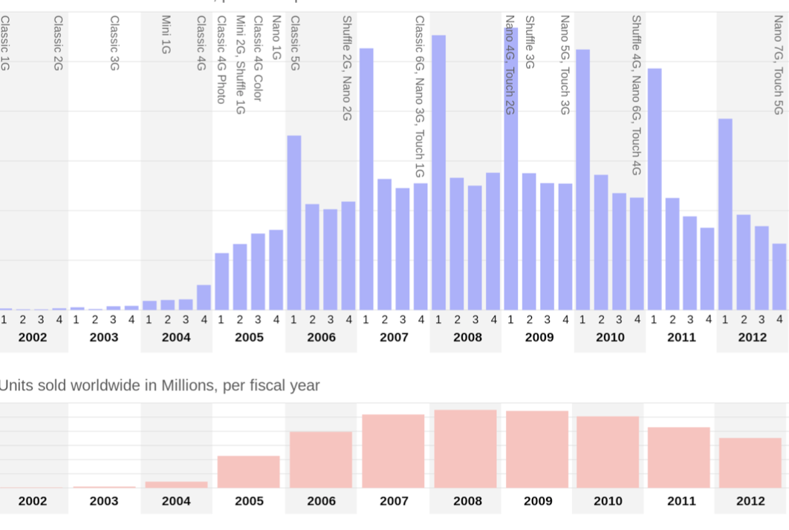

Call Center Logs
New Product Capabilities
Sales Figures

Slide 24
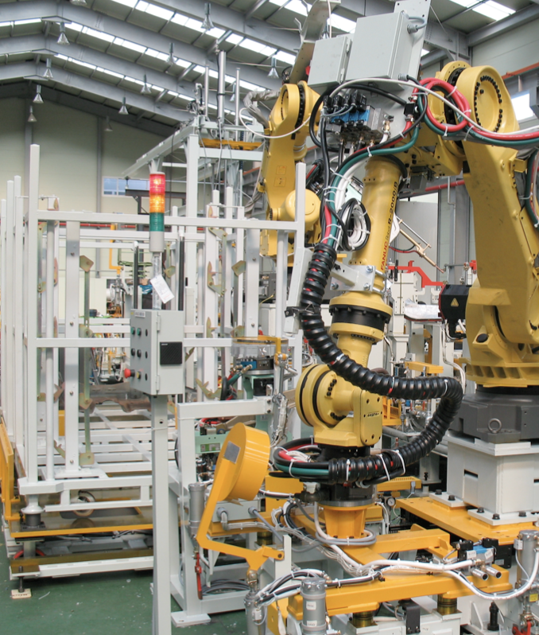
Sensor Data
Predict Equipment Failure
Sensor Data

Slide 25
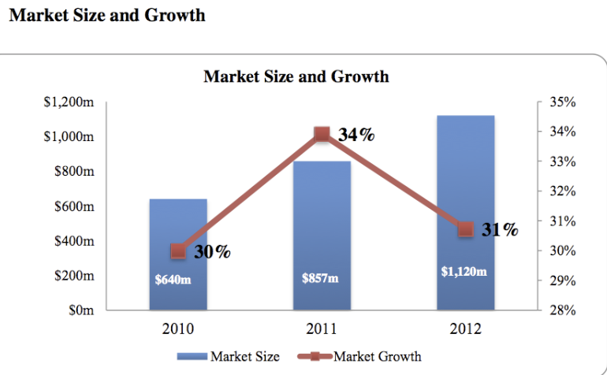

Customer Data
Personalized Marketing
Market Data

Slide 26
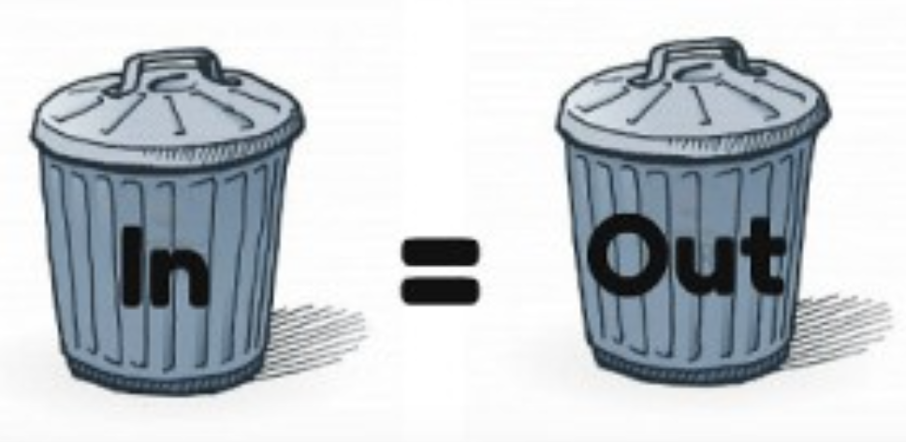
The Process of Data Analytics
Data Engineering
Computational Big Data Science
Acquire
Prepare
Analyze
Report
Act
Identify data sets
Retrieve data
Query data
Select Analytical techniques
Build models
Apply Results
Understand nature of data
Preliminary analysis
Clean
Integrate
Package
Community Results
Visualization

Slide 27
Acquiring Data For Hurricane
Data comes from different sources
NoSQL
SQL
Historical weather
Current weather
Real Time Tweets
Files
WebSocket
REST API

Slide 28
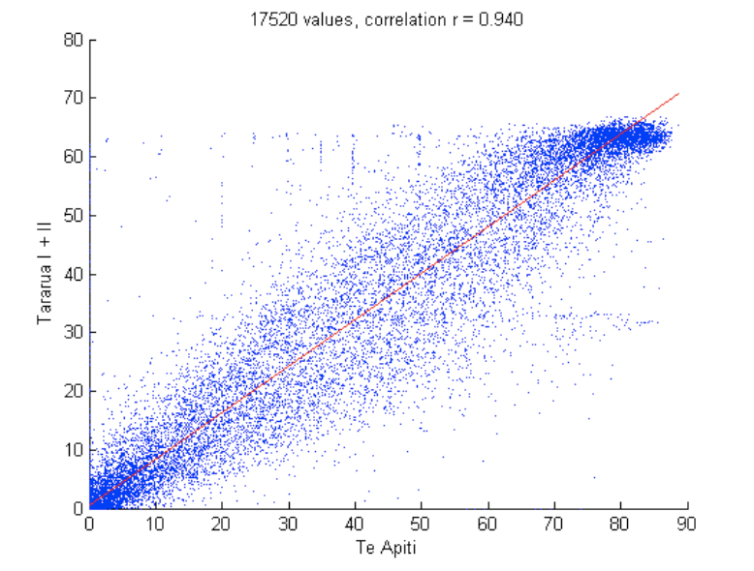
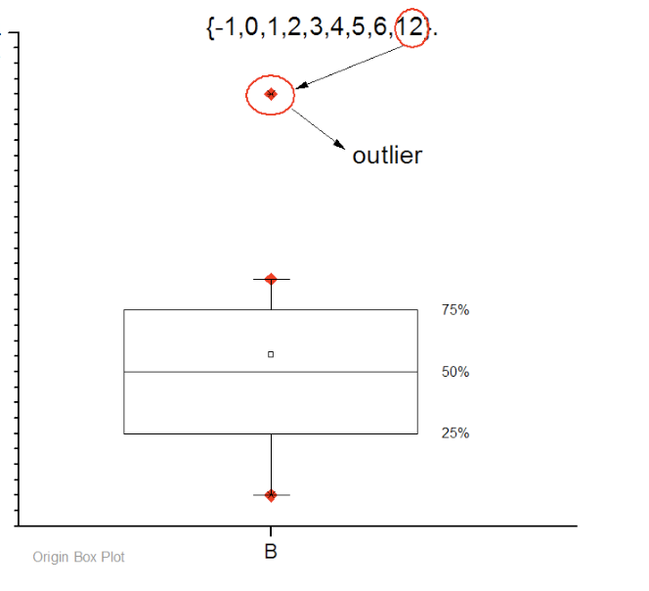
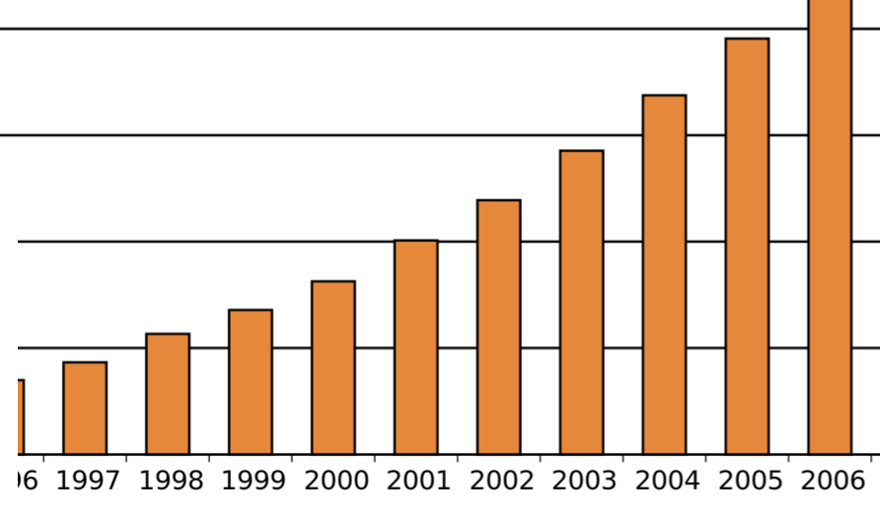
Prepare Data
Data Correlation
Data Trends
Outliers

Slide 29
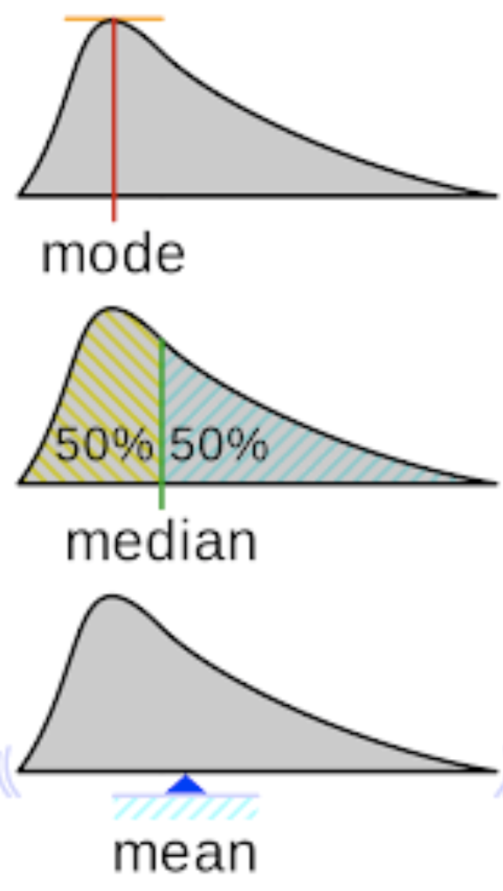
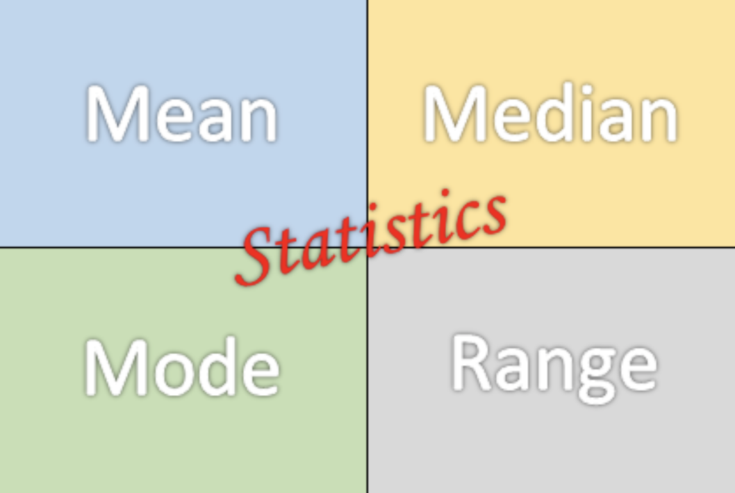
Prepare Data

Slide 30
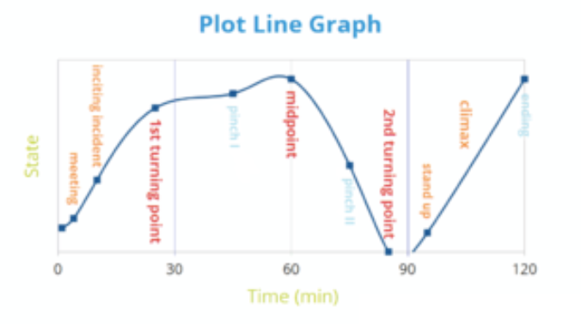
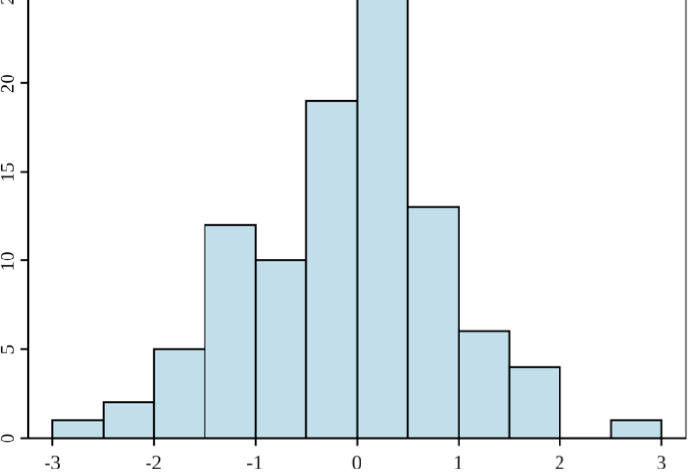
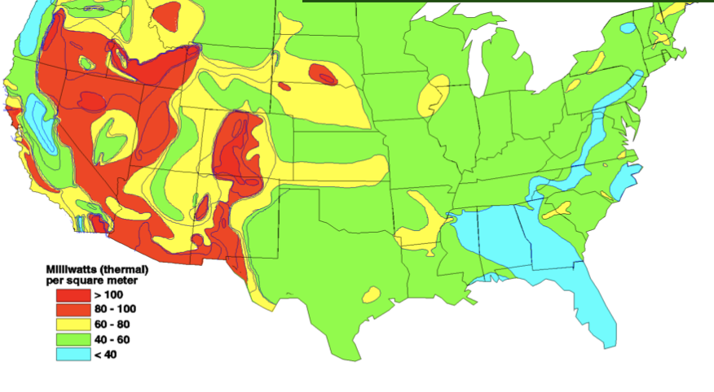
Prepare Data – visualize
Line Graphs
Histogram
Heatmap

Slide 31
Pre-processing Data
Real world data is messy
Inconsistent values
Duplicate records
Missing Values
Invalid Data
Outliers
Data Quality Issues

Slide 32
Data Munging
Munging
Normalization
Transformation
Feature Selection
Data Manipulation
(Grouping)
Dimensionality Reduction

Slide 33
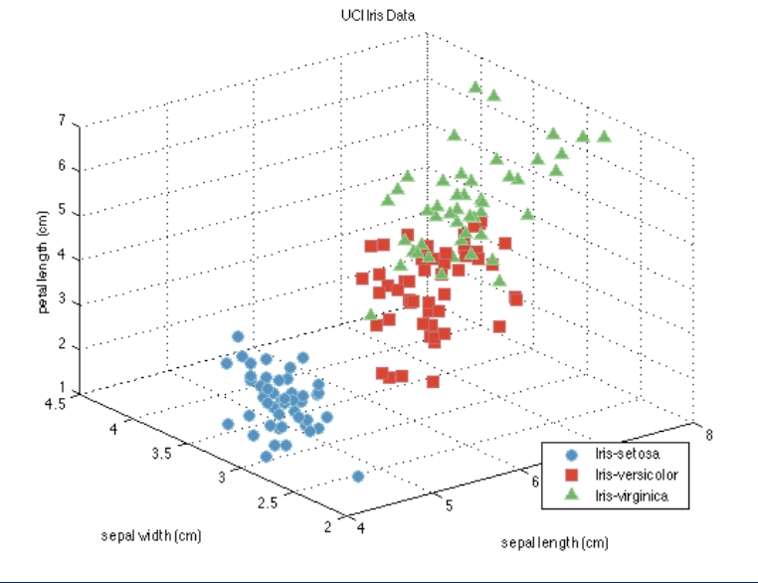
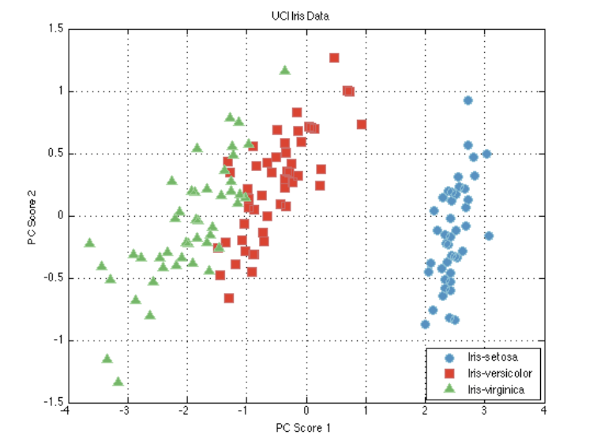
Dimensionality Reduction

Slide 34
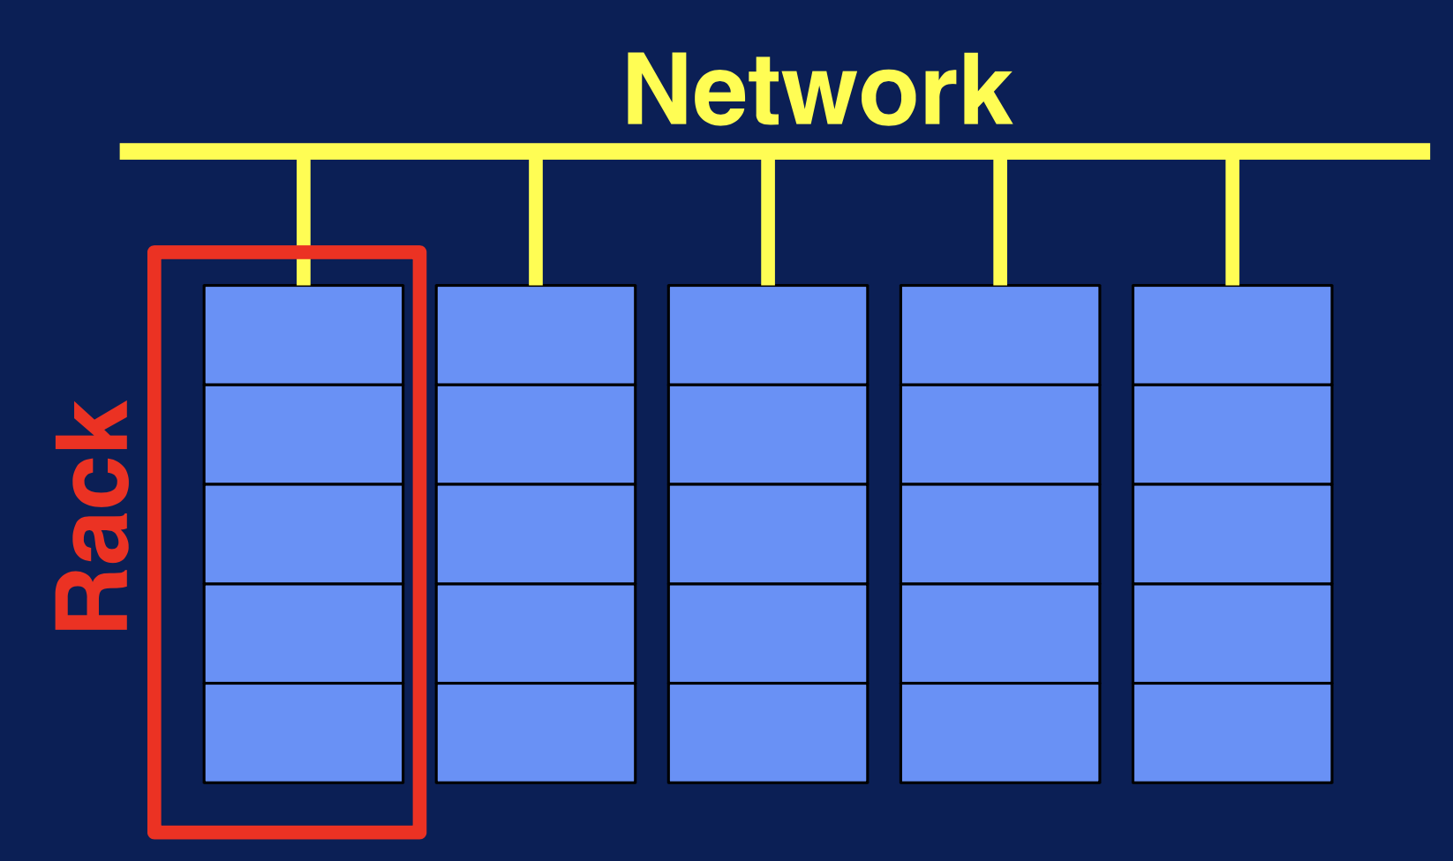
What is a Distributed File System?
Long-term information storage
Access result of a process later
Store large amounts of information
Enable access of multiple processes
As Data grows:
Buy a bigger disk?
Copy data to an external hard drive?

Slide 35
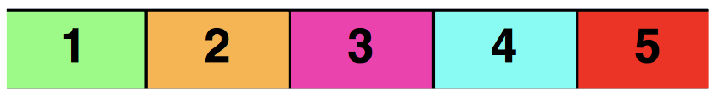
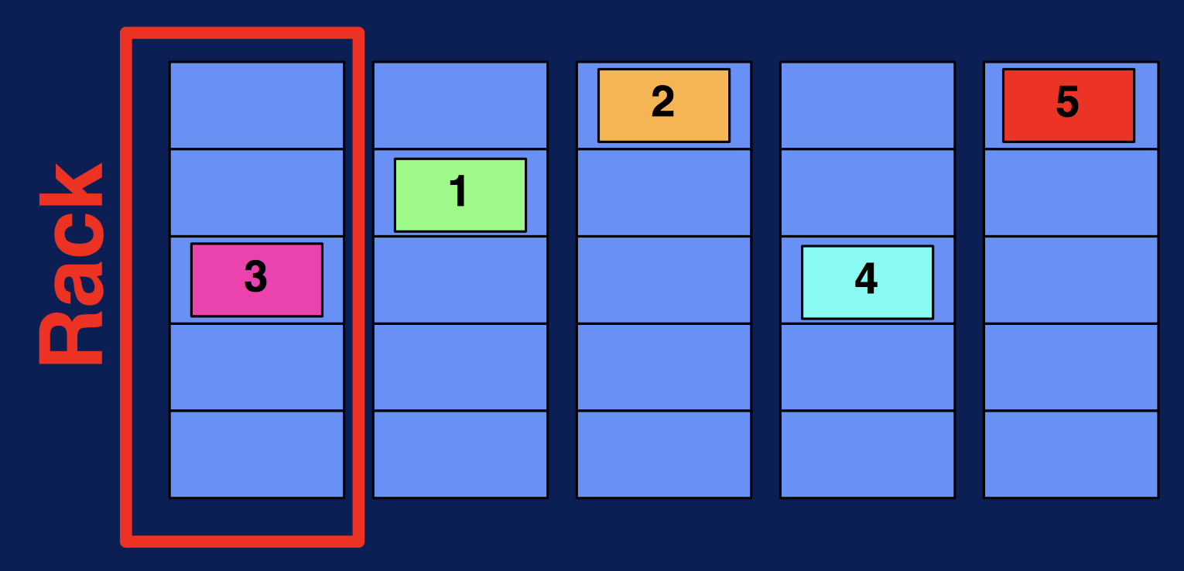
Data Partitioning and Parallelism
Data

Slide 36
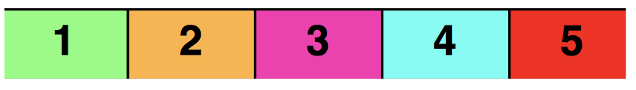
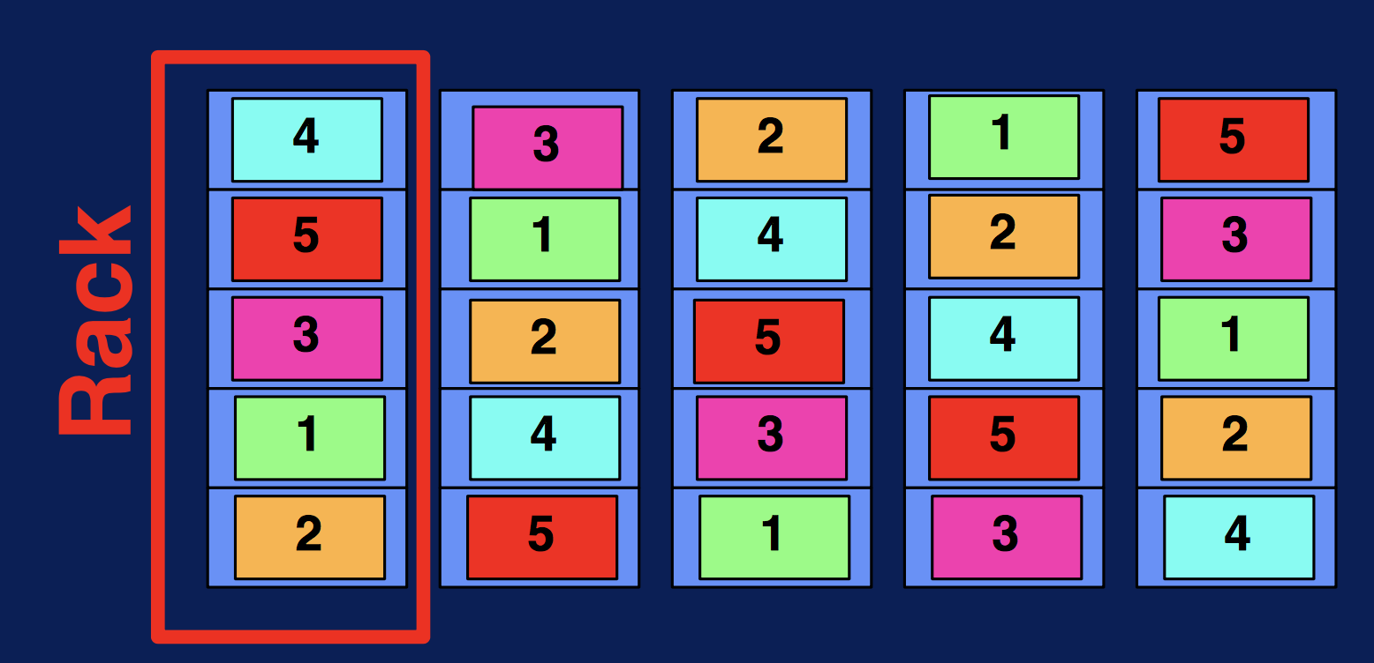
Fault Tolerance – Data Replication
Data

Slide 37
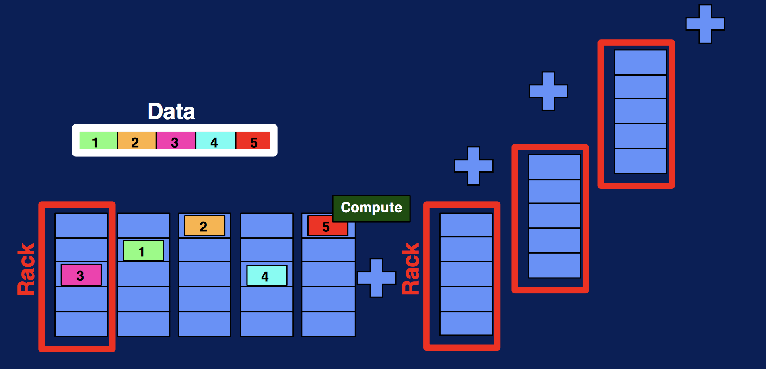
Data Scaling
Data

