Slide 1
Big Data Technology
Paul Rad, Ph.D.
Associate Professor
Information Systems and Cyber Security, College of Business School
Electrical and Computer Engineering, College of Engineering

Slide 2
Outline
Logistics
Summary and Review Previous Sections
Distributed File Systems
Hadoop
Programing Model for Big Data

Slide 3
Question # 1
Amazon has been collecting review data for a particular product. They have realized that almost 90% of the reviews were mostly a 5/5 rating. However, of the 90%, they realized that 50% of them were customers who did not have proof of purchase or customers who did not post serious reviews about the product. Of the following, which is true about the review data collected in this situation?
High Volume
High Valence
High Veracity
Low Valence
Low Veracity
Low Volume

Slide 4
Question #2
As mentioned in the class, what are the challenges to data with a high valence?
Complex data exploration algorithms
Difficult integrate
Reliability of Data

Slide 5
Question #3
What is the veracity of big data?
The connectedness of data
The size of the data
The speed at which data is produced
The abnormality or uncertainties of data

Slide 6
Question #3
What is the veracity of big data?
The connectedness of data
The size of the data
The speed at which data is produced
The abnormality or uncertainties of data

Slide 7
Question #4
Which of the following are the 6 V's in big data?
Valence
Vision
Volume
Variety
Value
Velocity

Slide 8
Question #5
What are the challenges of data with high variety?
The quality of data is low
Hard to perform emergent behavior analysis
Hard in utilizing group event detection
Hard to integrate

Slide 9
Big Data Definition
Big data is a term for data sets that are so large or complex that traditional data processing application software is inadequate to deal with them. Big data challenges include capturing data, data storage, data analysis, search, sharing, transfer visualization, query, updating and information privacy.
--wikipedia.org

Slide 10





Example: Big Data Analytics
Bank Questions:
1) Insurance Product
2) Optimal Price
3) Maximize Profit
Competitors Pricing
Web Activity
Customer Behavior
Mobile Alert with Travel Insurance
$$$
Databases
Social Media
Big Data Attributes:
Volume
Variety
Velocity
Veracity
Valence
Value
Decision Criteria
1) What is important and why is not
2) Learning from experience
3) Adapting to changes
4) Reacting Swiftly
3rd Party Statistics
Transaction

Slide 11

Ox and the load

Slide 12
Ox and the load

Slide 13
Ox and the load

Slide 14
Data Processing Models
Scale Up
Data
Expensive:
Hardware
Software Costs
High risk of failure
Data
Data
Data
Data
Data
Scale
Out
Data
Data
Ease of Management
Data
Data
Benefits:
Commodity Hardware
Free Software Costs
Fault Tolerance
Parallelism
Data
Data
Data
Data

Slide 15
HDD Technology and Advantage of Parallelism
HDD size is improving faster than the transfer rate
Typically in 90’s a drive would be of 1GB HDD and transfer speed would be 4.5 MB/s
Time taken to read the drive = total disk / speed = 1000/4.5 ~ 222 sec. ~ 4 mins
Typical scenarios nowadays is 1TB disk and transfer speed of 100MB/s
Time takes to read the drive = 1,000,000/100 ~ 10,000 Sec. ~ 166 mins = 2.8hrs
Suppose that the 1TB data is distributed over 50 nodes on a cluster with 1/50th of the data on each node then Read time will be 166 mins / 50 which is close to ~ 3.5 min

Slide 16
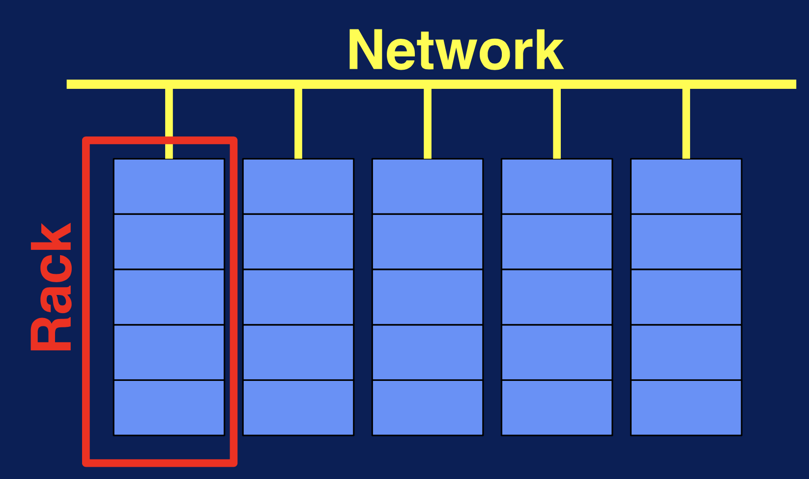
What is a Distributed File System?
Long-term information storage
Access result of a process later
Store large amounts of information
Enable access of multiple processes
As Data grows:
Buy a bigger disk?
Copy data to an external hard drive?

Slide 17
Distribute Cluster File Systems
Data partitioning
Data replication
Data Scalability
Fault Tolerance
High concurrency

Slide 18
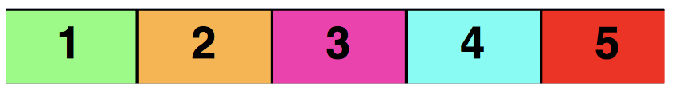
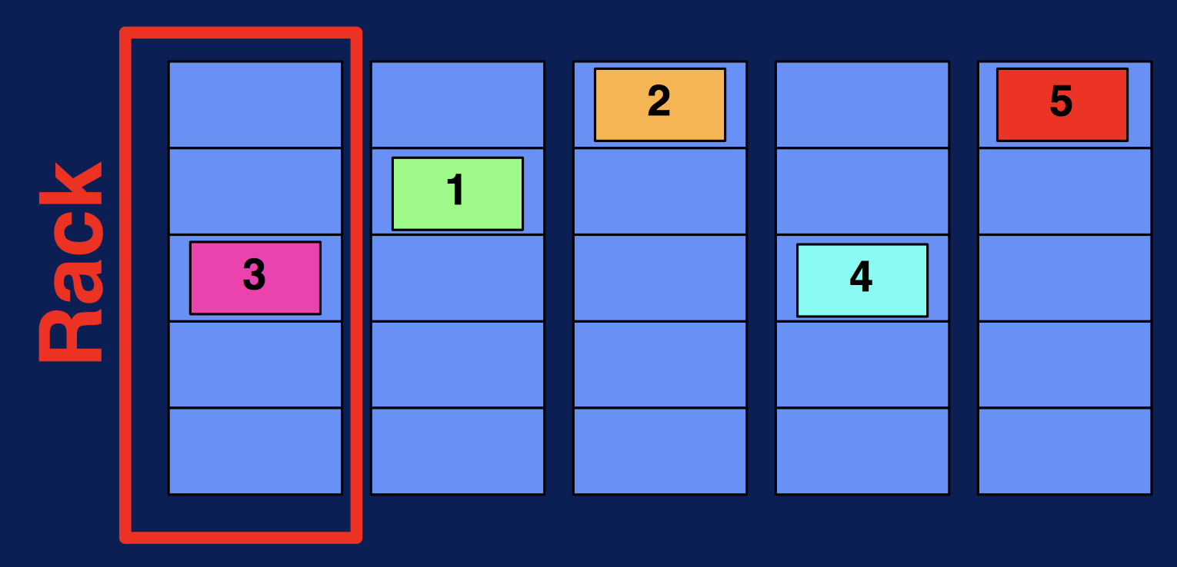
Data Partitioning and Parallelism
Data

Slide 19
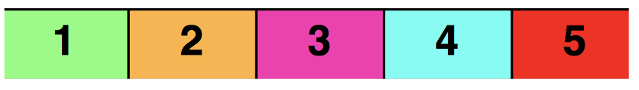
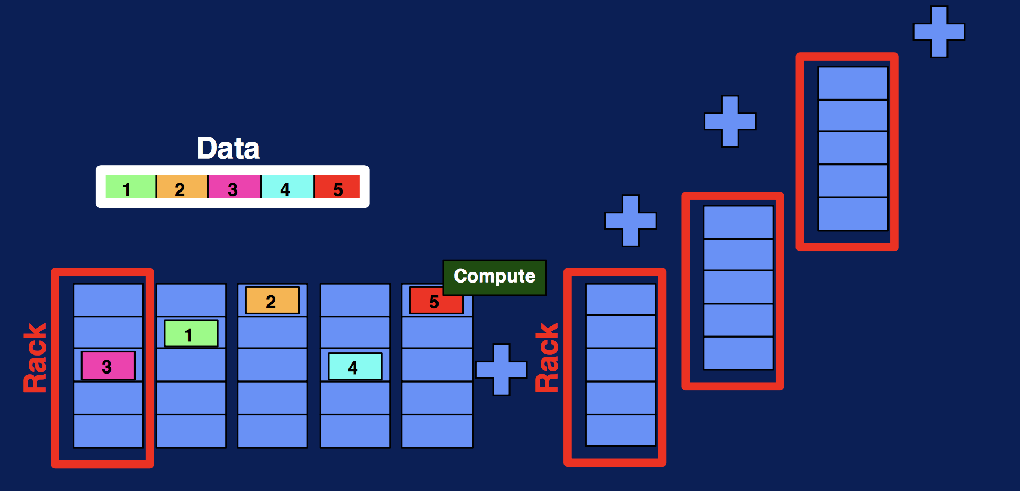
Data Scaling
Data

Slide 20
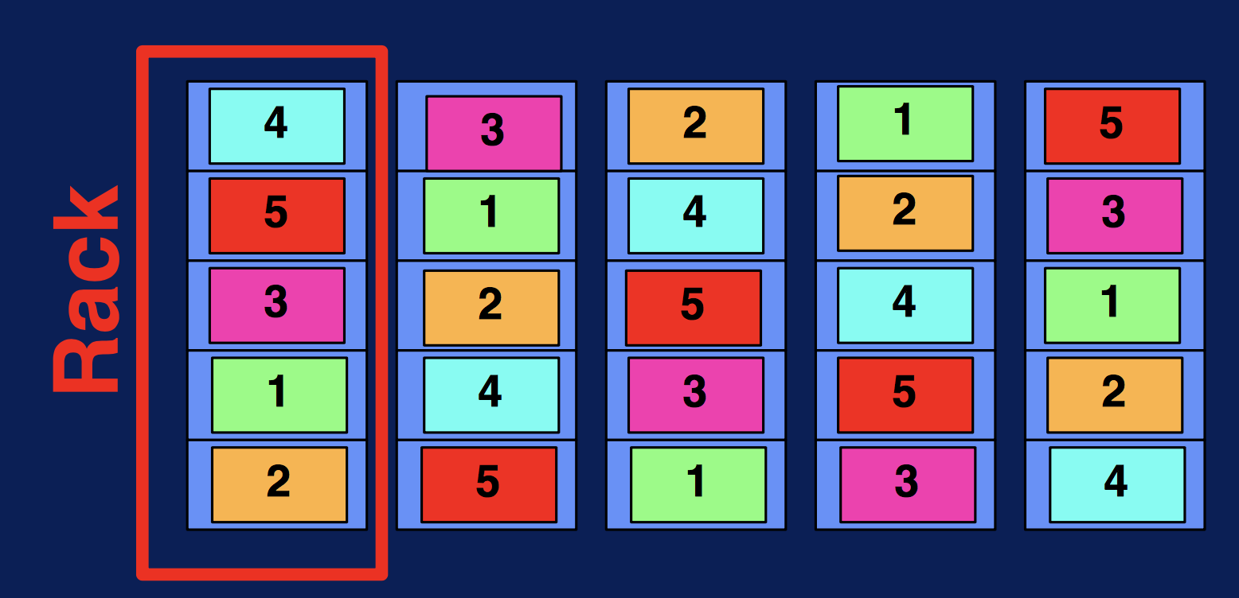
Fault Tolerance – Data Replication
Data

Slide 21
High Concurrency
Data
Read Block 5
Read Block 2
Read Block 3

Slide 22
Software Stack or Layer Software Diagram
D
B
C
A

Slide 23
The Hadoop Ecosystem – Open Source
Data
Data
Data
Data
Data
Data
Data
Data

Slide 24
Main Hadoop Components

Slide 25
Hadoop Distributed File System
Scalable Storage
Fault Tolerance

Slide 26
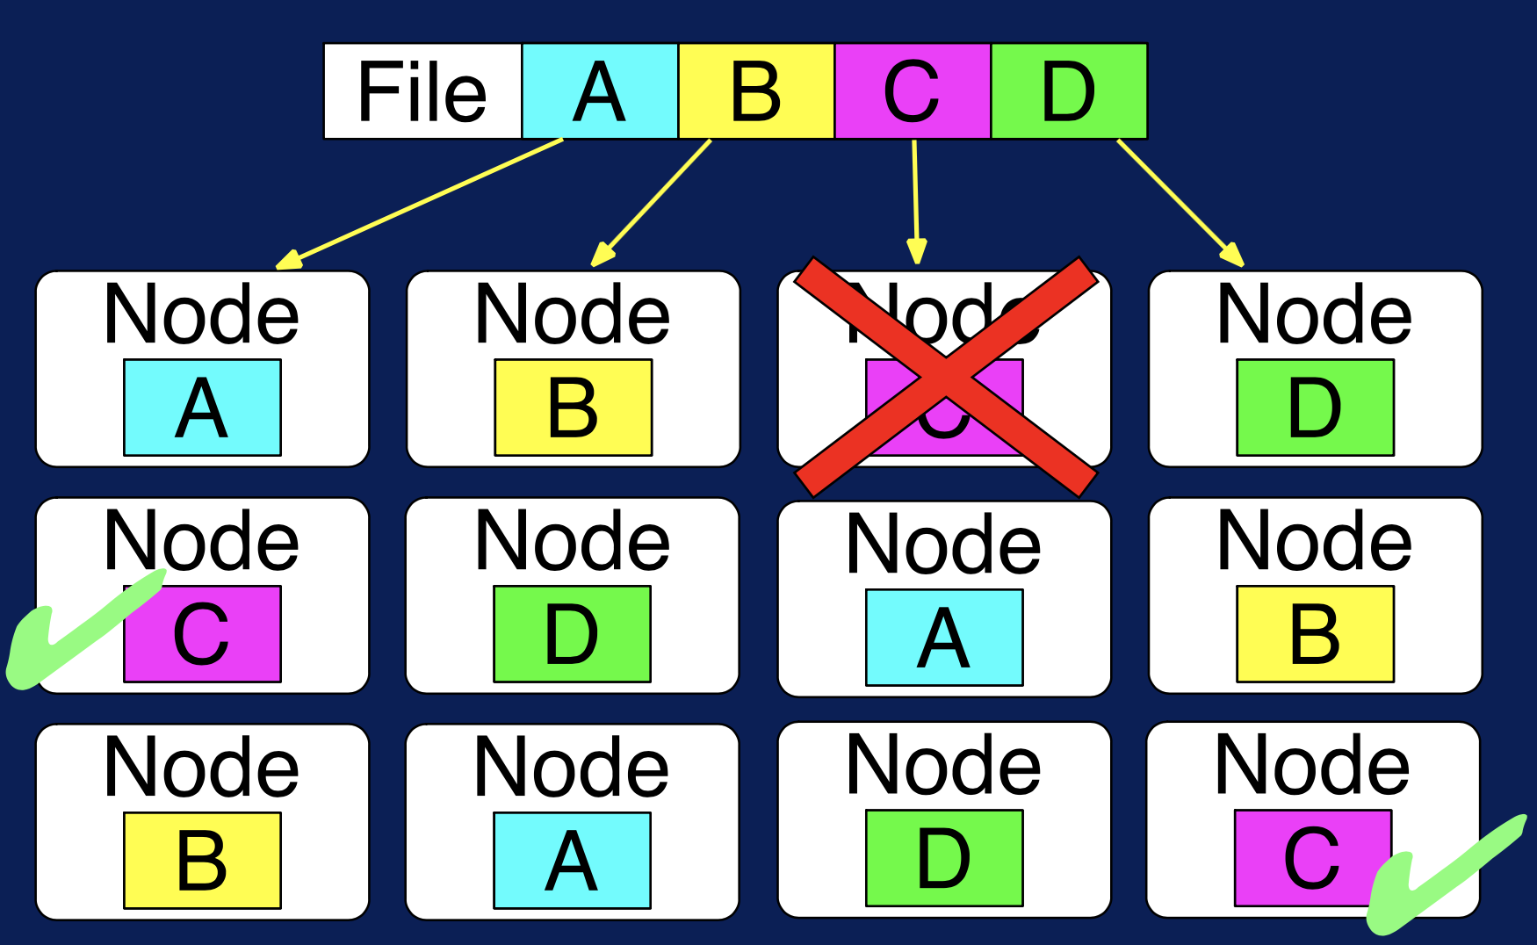
HDFS: A Storage System for Big Data
HDFS = foundation for Hadoop ecosystem by providing Scalability and Reliability
Store massively large data sets as an example it has been deployed for environment with up to 200 Petabytes 4500 servers and 1 billion files and blocks!
HDFS splits files across nodes for parallel access
Replication for fault tolerance
Customized reading to handle variety of file type such Text, GIS, BIO Data Format

Slide 27
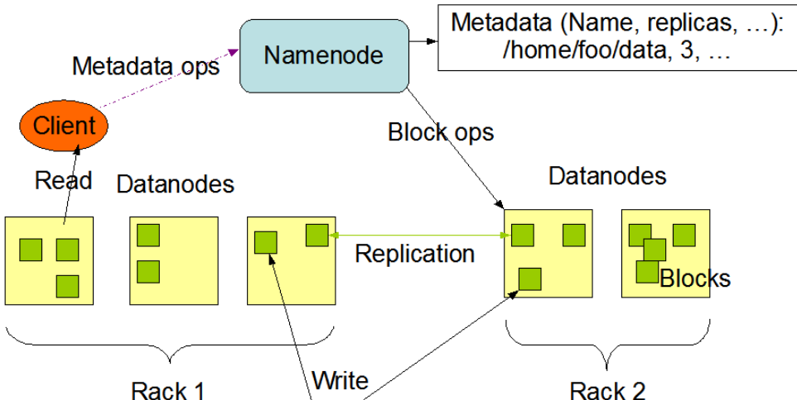
HDFS Structure
Two key components of HDFS
1) NameNode for metadata – Meta data (Usually One per cluster)
Coordinates operations
Keeps track of file name, location in directory, etc.
2) DataNode for block storage (Usually One per server)
DataNode stores file blocks
Listens to NameNode for block creation, deletion, replication

Slide 28
HDFS
Data partitioning
Data replication
Scalability
Fault tolerance
Data locality

Slide 29
YARN – Resource Manager for Hadoop
Flexible Scheduling and Resource Management

Slide 30
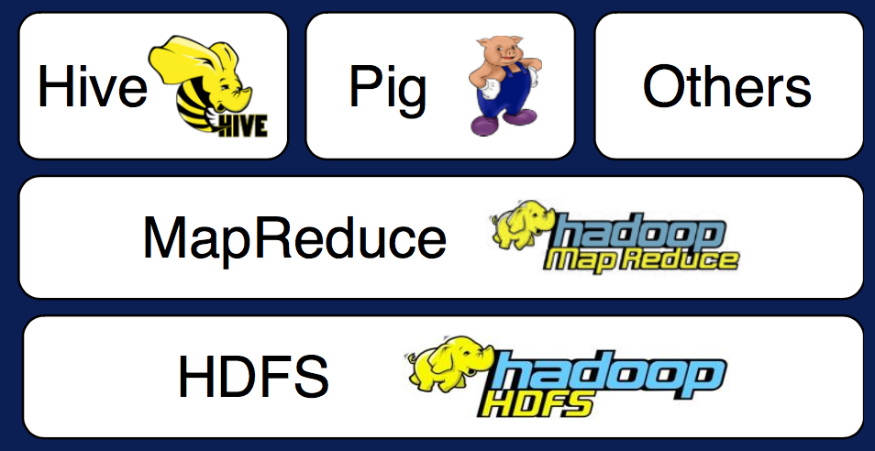
Hadoop 1.0
Share Hadoop across applications
HDFS Cluster Utilization
Higher Resource Utilization → Lower Cost

Slide 31
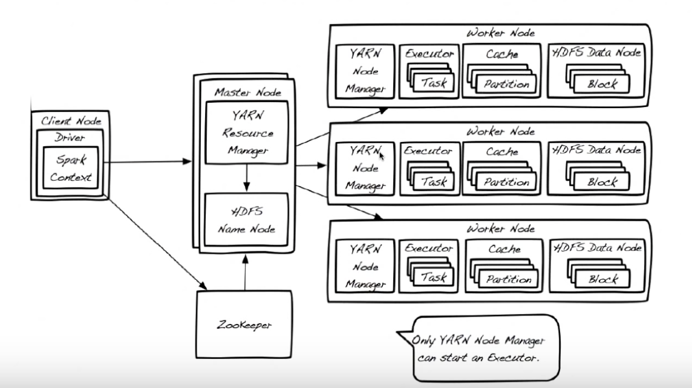
YARN Architecture
Resource Manager + Node Manager = Data Computation Framework
ultimate decision maker

Slide 32
MapReduce - Programming Model
Simplified Programming Model
Map → apply()
Reduce → summarize()
Support large data volumes
Provide fault tolerance
Enable scale out

Slide 33
Parallel Programming
Semaphores
Shared Memory
Locks
Messaging Passing
Threads

Slide 34
MapReduce Programming Model
Based on Functional Programming
1) Map = apply operation to all elements
2) Reduce = summarize operation on elements

Slide 35
WordCount MapReduce Program
File #1
File #2
WordCount
Result File
File #3

Slide 36

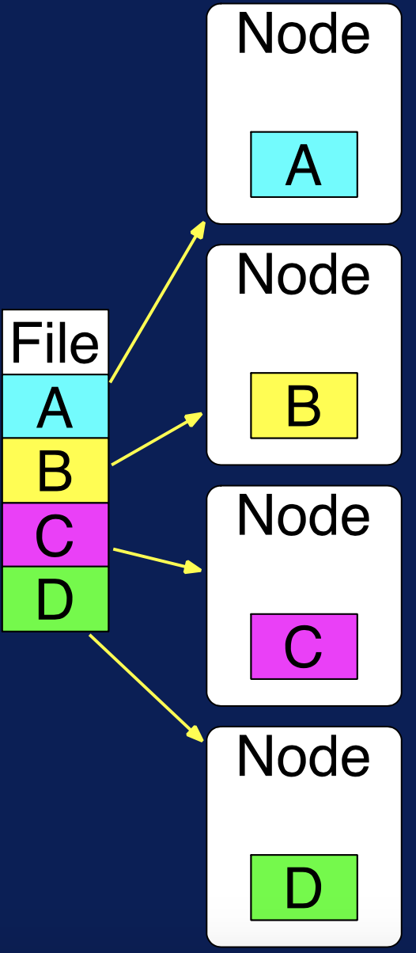
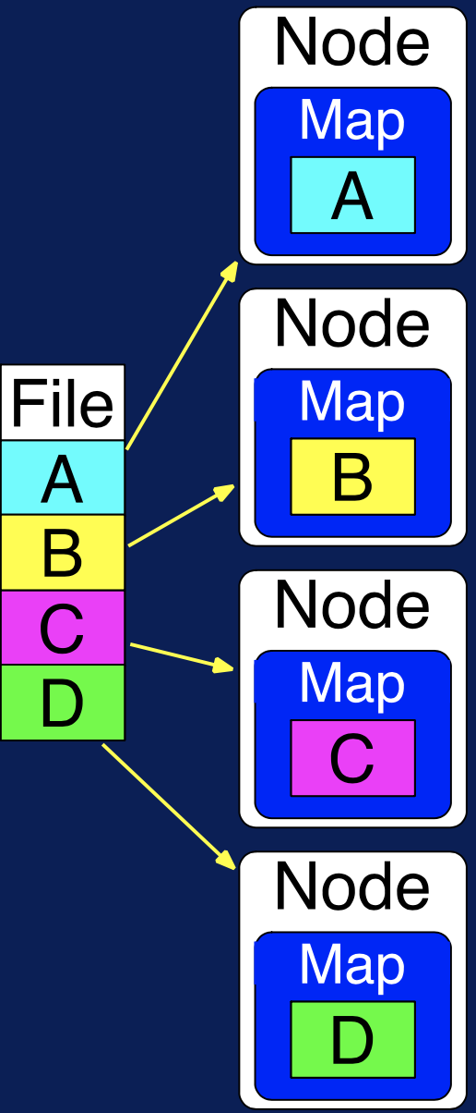



Step By Step
Step 0:
File is stored in HDFS
Step 1:
Map to each node
A wonderful king is Hadoop. Hadoop is the Elephant King.
Hadoop is an elegant fellow. An elephant gentle and mellow.
Hadoop is the Elephant King! A yellow and elegant thing. He never forgets Useful data, or lets An extraneous element cling!
Hadoop never gets mad, Or does anything bad, Because, at his core, he is yellow.

Slide 37
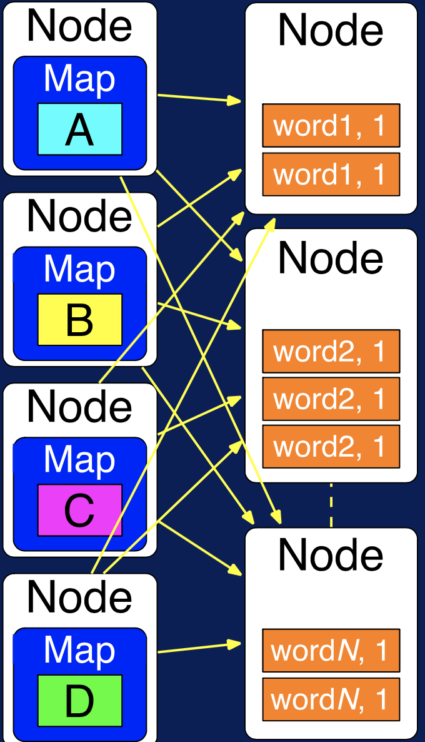
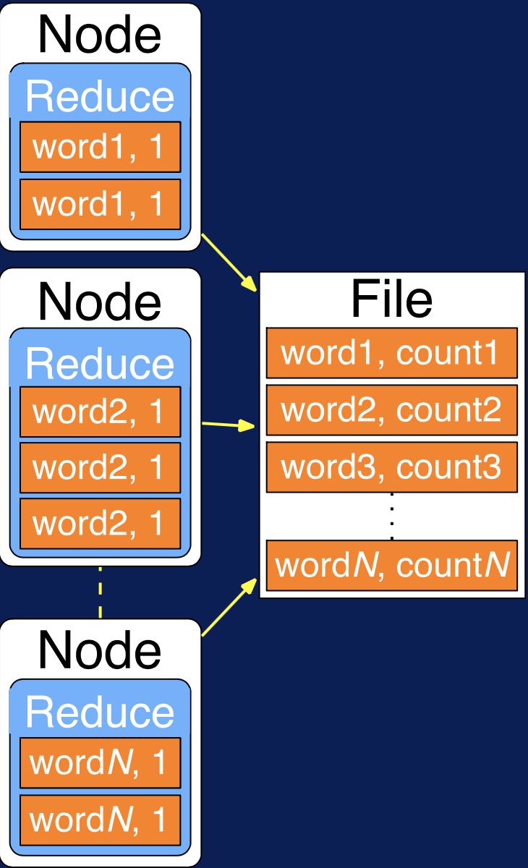
Step By Step
A wonderful king is Hadoop. Hadoop is the Elephant King.
Map generated key-value pairs
Step 2: Sort and Shuffle
Step 3: Reduce
(A, 1)
(wonderful,1)
(king, 1), (king,1)
(is, 1), (is, 1)
(Hadoop, 1), (Hadoop, 1)
(the, 1)
(Elephant, 1)
(King, 1)
Pairs with same key moved to same node
Add values for same keys

Slide 38
MapReduce Process
Map
Soft and Shuffle
Reduce
Applications with independent data-parallel tasks
Parallelization over the input
Parallelization over intermediate data
Parallelization over data groups

Slide 39
MapReduce is not Good
Frequently changing data
Dependent tasks
Interactive analysis

Slide 40
Pig and Hive
Pig = dataflow scripting (created at Yahoo)
Hive = SQL – like queries (created at Facebook)

Slide 41
Giraph
Specialized models for graph processing
Giraph used by Facebook to analyze social graphs

Slide 42
Spark, Storm, Flink
Real-time and in-memory processing
In-memory → 100x faster for some tasks

Slide 43
NoSQL
Key-values
Sparse tables
HBase used for Facebook’s Messaging Platform

Slide 44
Zookeeper for management
Synchronization, High-availability, Configuration
Created by Yahoo to wrangle services named after animals

Slide 45
Hadoop Pre-Built Image & Support
Download separately or part of pre-built image

