Slide 1
Big Data Technology
Paul Rad, Ph.D.
Associate Professor
Information Systems and Cyber Security, College of Business School
Electrical and Computer Engineering, College of Engineering

Slide 2
Outline
Logistics
Summary and Review Previous Sections
Hadoop Ecosystem
MapReduce Programming vs. Hive
Hortonworks Practice

Slide 3
Question # 1
What are the two key components of HDFS and what are they used for?
NameNode for block storage and Data Node for metadata.
FASTA for genome sequence and Rasters for geospatial data.
NameNode for metadata and DataNode for block storage.

Slide 4
Question #2
What is the job of the NameNode?
Coordinate operations and assigns tasks to Data Nodes
Listens from DataNode for block creation, deletion, and replication.
For gene sequencing calculations.

Slide 5
Question #3
What is the order of the three steps to Map Reduce?
Shuffle and Sort -> Map -> Reduce
Map -> Reduce -> Shuffle and Sort
Map -> Shuffle and Sort -> Reduce
Shuffle and Sort -> Reduce -> Map

Slide 6
Question #4
What is the difference between low level interfaces and high level interfaces?
Low level deals with interactivity while high level deals with storage and scheduling
Low level deals with storage and scheduling while high level deals with interactivity

Slide 7
Question #5
Which of the following are problems to look out for when integrating your project with Hadoop?
Advanced Alogrithms
Task Level Parallelism
Data Level Parallelism
Random Data Access

Slide 8
Question #6
What is the purpose of YARN?
Allows various applications to run on the same Hadoop cluster.
Enables large scale data across clusters.
Implementation of Map Reduce.

Slide 9

The Hadoop Ecosystem – Open Source
Data
Data
Data
Data
Data
Data
Data
Data

Slide 10
Pig and Hive
Pig = dataflow scripting (created at Yahoo)
Hive = SQL – like queries (created at Facebook)

Slide 11
Giraph
Specialized models for graph processing
Giraph used by Facebook to analyze social graphs

Slide 12
Spark, Storm, Flink
Real-time and in-memory processing
In-memory → 100x faster for some tasks

Slide 13
NoSQL
Key-values
Sparse tables
HBase used for Facebook’s Messaging Platform

Slide 14
Zookeeper for management
Synchronization, High-availability, Configuration
Created by Yahoo to wrangle services named after animals

Slide 15
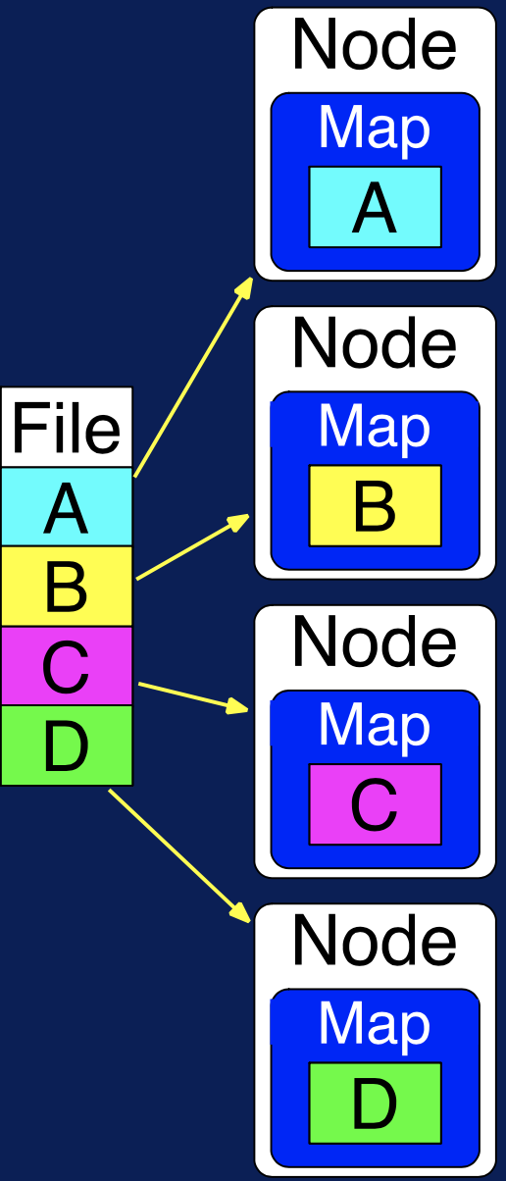
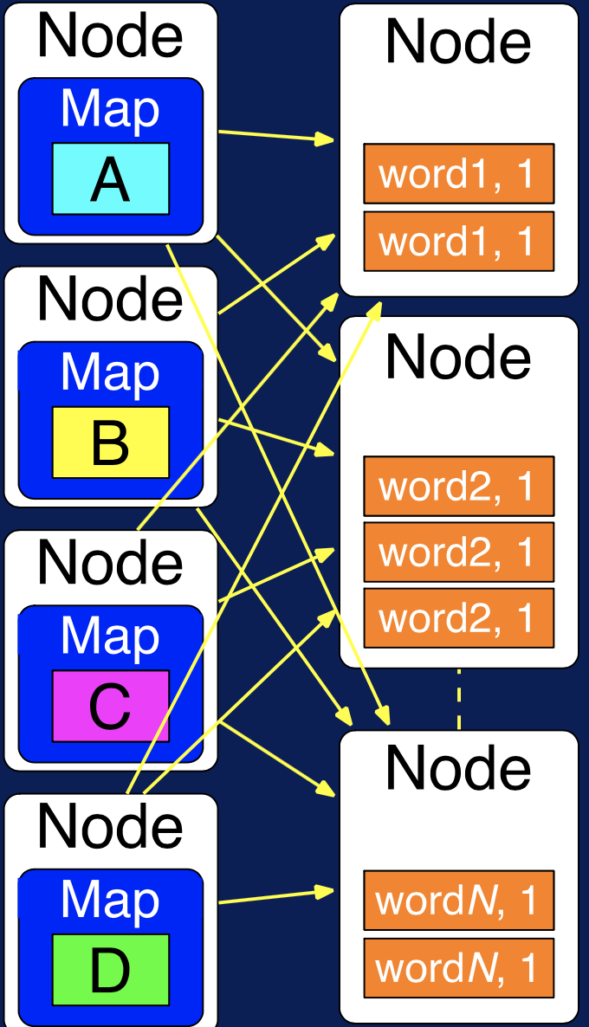
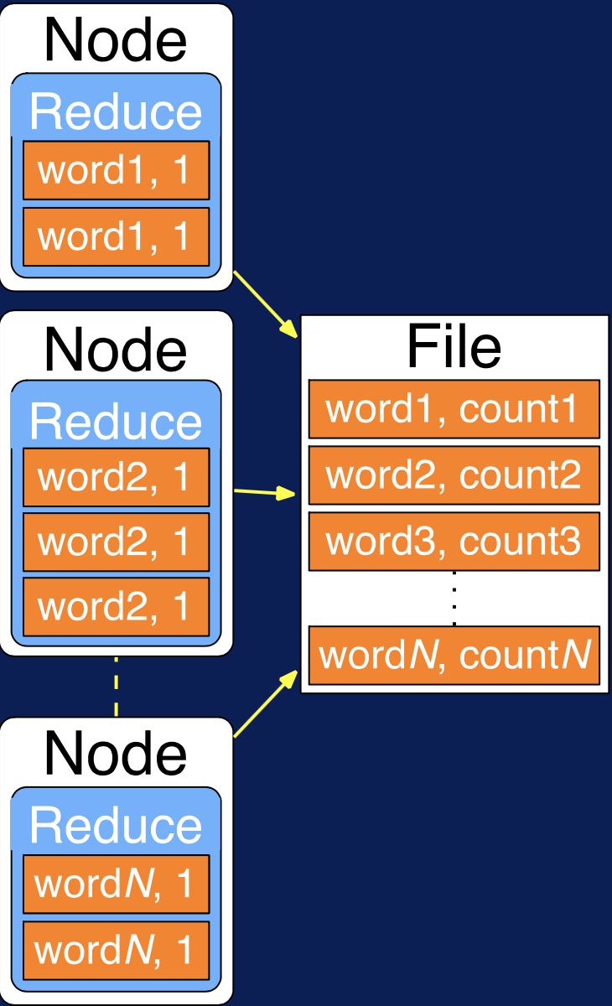
MapReduce Process
Map
Soft and Shuffle
Reduce
Applications with independent data-parallel tasks
Parallelization over the input
Parallelization over intermediate data
Parallelization over data groups

Slide 16
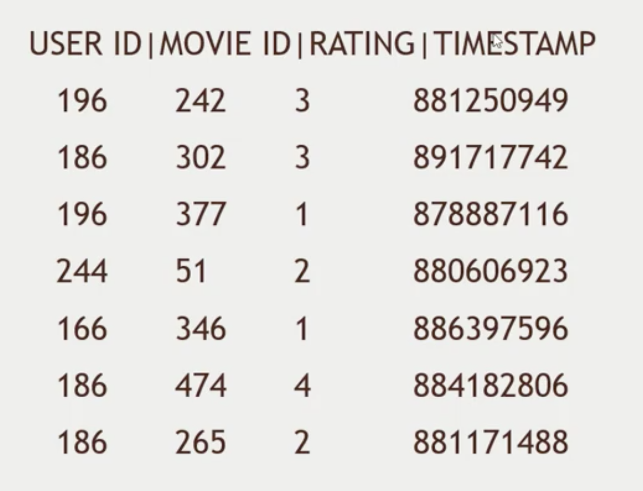
MapReduce

Slide 17
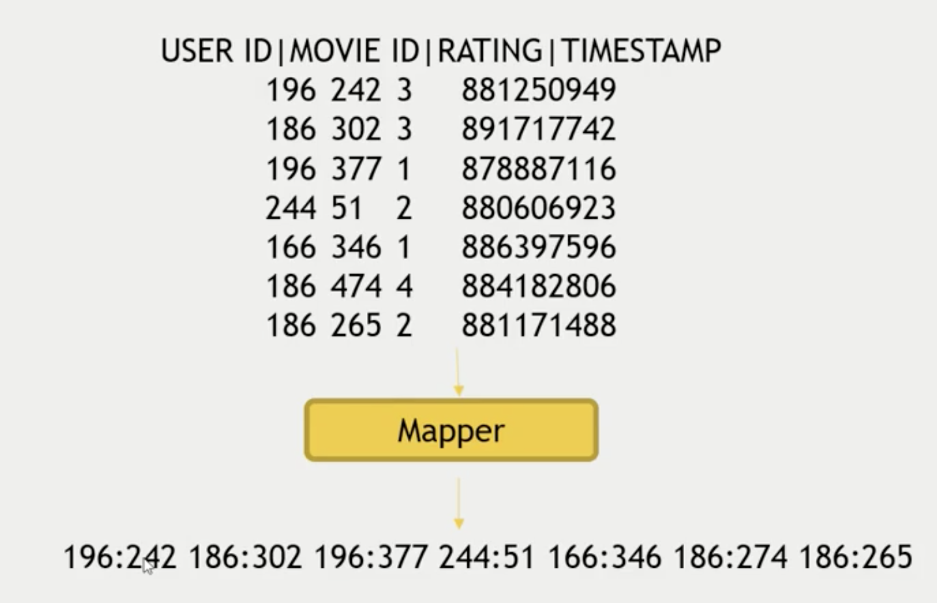
Map users to movies they watched
(Key, Value)

Slide 18
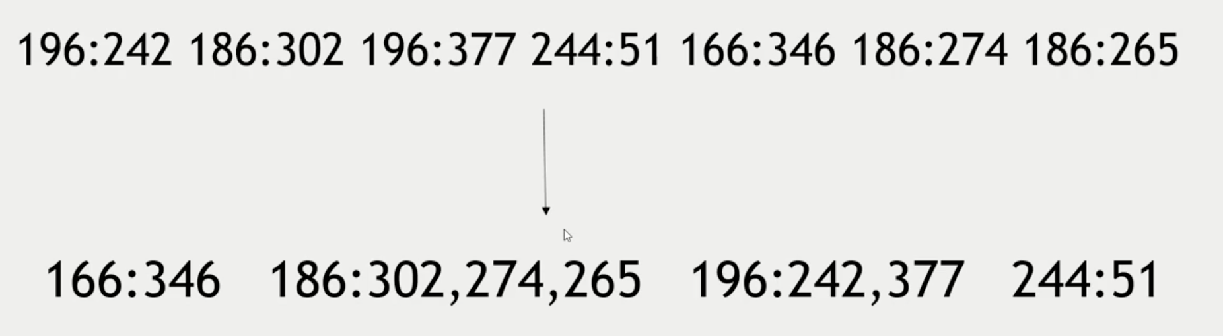
Mapped Data (“Shuffle and Sort”)

Slide 19
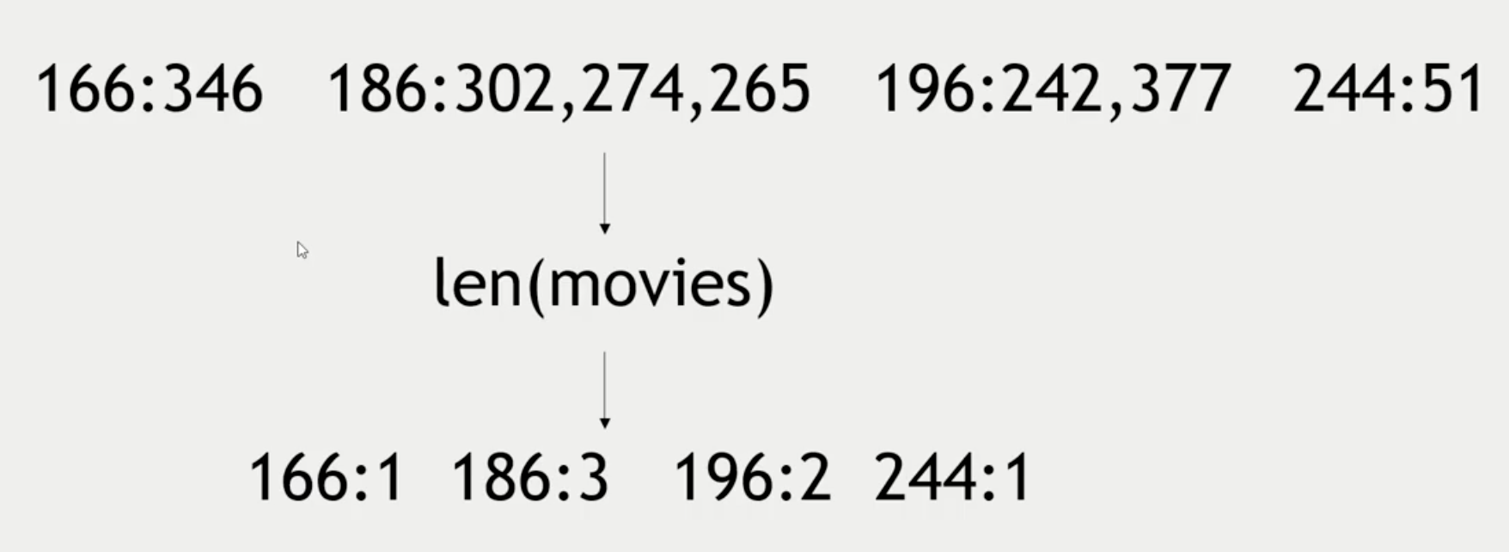
The Reducer Processes Each Key’s Values

Slide 20
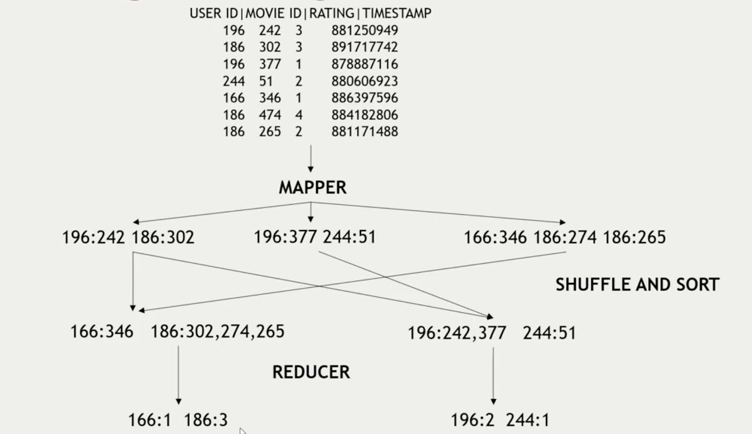
Putting it All Together

Slide 21
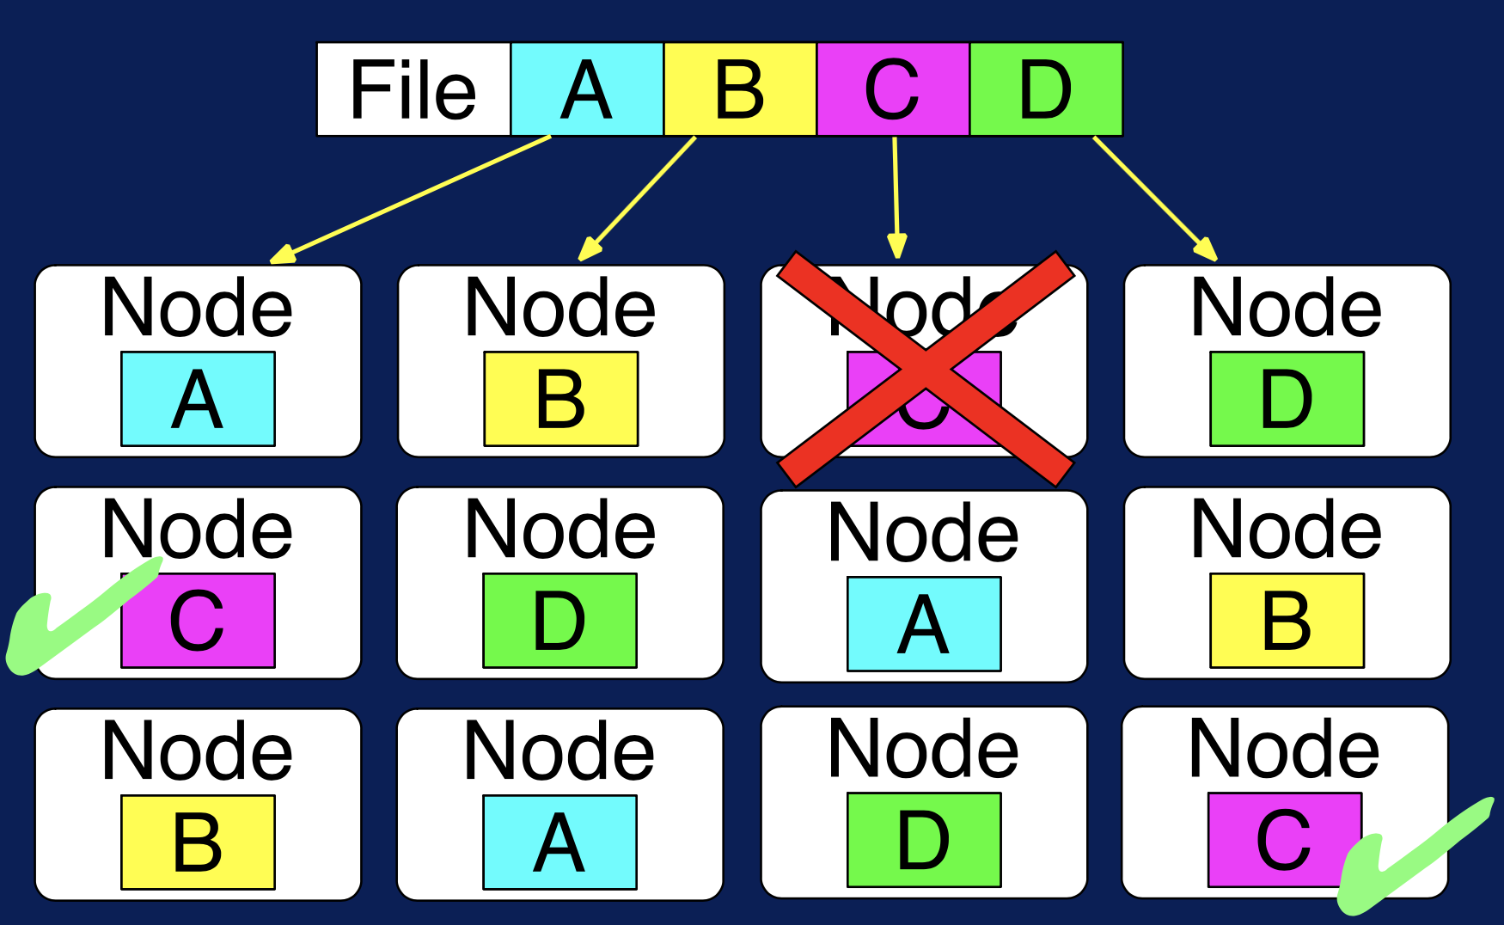
What is happening
NodeManager
Client Node
YARN Resource Manager
MapReduce Application Master
MapTask/
ReduceTask
MapTask/
ReduceTask
MapTask/
ReduceTask

Slide 22
HIVE - RETRIEVING INFORMATION
https://hortonworks.com/blog/hive-cheat-sheet-for-sql-users/
Function | MySQL | Hive
Retrieving Information (General) | SELECT from_columns FROM table WHERE conditions; | SELECT from_columns FROM table WHERE conditions;
Retrieving All Values | SELECT * FROM table; | SELECT * FROM table;
Retrieving Some Values | SELECT * FROM table WHERE rec_name = "value"; | SELECT * FROM table WHERE rec_name = "value";
Retrieving With Multiple Criteria | SELECT * FROM TABLE WHERE rec1 = "value1" AND rec2 ="value2"; | SELECT * FROM TABLE WHERE rec1 = "value1" AND rec2 ="value2";
Sorting | SELECT col1, col2 FROM table ORDER BY col2; | SELECT col1, col2 FROM table ORDER BY col2;
Counting Rows | SELECT COUNT(*) FROM table; | SELECT COUNT(*) FROM table;
Grouping With Counting | SELECT owner, COUNT(*) FROM table GROUP BY owner; | SELECT owner, COUNT(*) FROM table GROUP BY owner;

