Slide 1
Big Data Technology
Paul Rad, Ph.D.
Associate Professor
Information Systems and Cyber Security, College of Business School
Electrical and Computer Engineering, College of Engineering

Slide 2
Outline
Logistics
Summary and Review Previous Sections
Neural Network Model
Forward Propagation (Prediction)
Backpropagation (Learning)
Training vs. Validation Data

Slide 3
3 Types of Learning
Supervised
Unsupervised
Reinforcement
Learning from labeled data
E.g., Spam classification
Discover structure in unlabeled data
E.g., Document clustering
Learning by “doing” with delayed reward
E.g., Chess computer
- Classification
- Regression
- Ranking
- Clustering
- Hidden Markov Models

Slide 4
Supervised Learning
Given examples of a function (X, F(X))
Predict function F(X) for new examples X
Discrete F(X): Classification
Continuous F(X): Regression
F(X) = Probability(X): Probability estimation
Supervised
Classification
Regression
y=12.5
?
?
x=0.8

Slide 5
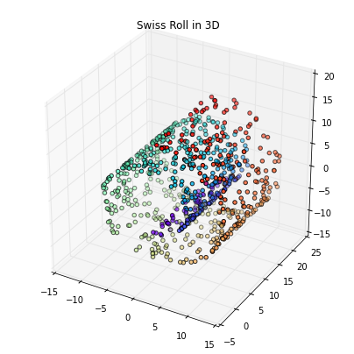
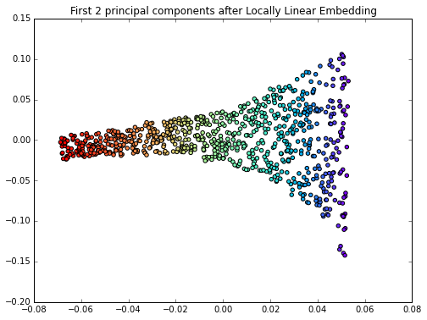
Unsupervised Learning
Unsupervised
Clustering
Compression

Slide 6
Neural Network History
Algorithms that try to mimic the brain
It was very widely used in 80s and early 90s.
Recently very popular again due to State-of-the-art technique for many applications. Human brain: Massively parallel network
The basic computational unit of the brain is a neuron. Approximately 86 billion neurons can be found in the human nervous system and they are connected with approximately 10^14 - 10^15 synapses

Slide 7
What is Neural Network or Deep Learning useful for?
Like all machine learning: making predictions
Deep learning does it with higher accuracy for some problems
For example:
• Self-driving cars • Stock market prediction • Recognizing faces in an image
Under active development and research

Slide 8
The Brain as a Universal Learning Machine
Two viewpoints on the Mind:
1) Evolutionary psychologists propose that the mind is made up of genetically influenced and domain-specific mental algorithms or computational modules, designed to solve specific evolutionary problems of the past
An evolutionary perspective leads one to view the mind as a crowded zoo of evolved, domain-specific programs. Each is functionally specialized for solving a different adaptive problem that arose during hominid evolutionary history, such as face recognition, foraging, mate choice, heart rate regulation, sleep management, or predator vigilance, and each is activated by a different set of cues from the environment.
There is another viewpoint cluster, more popular in computational neuroscience (especially today), that is almost the exact opposite of the evolved modularity hypothesis.
2) Universal learner" hypothesis, aka the "one learning algorithm" hypothesis
The universal learning hypothesis proposes that all significant mental algorithms are learned; nothing is innate except for the learning and reward machinery itself (which is somewhat complicated, involving a number of systems and mechanisms), the initial rough architecture (equivalent to a prior over mindspace), and a small library of simple innate circuits (analogous to the operating system layer in a computer). In this view the mind (software) is distinct from the brain (hardware). The mind is a complex software system built out of a general learning mechanism.
https://youtu.be/r9mvRRwu5Gw

Slide 9
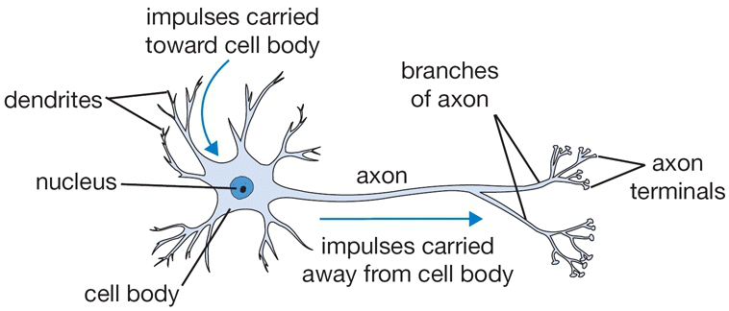
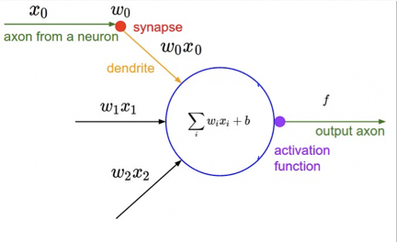
Biological neuron and mathematical model

Slide 10
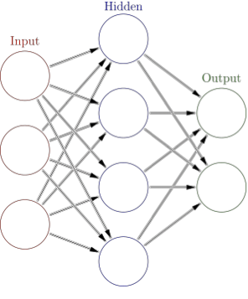
What Is A Neural Network?
The simplest definition of a neural network, more properly referred to as an 'artificial' neural network (ANN), is provided by the inventor of one of the first neurocomputers, Dr. Robert Hecht-Nielsen. He defines a neural network as:
"...a computing system made up of a number of simple, highly interconnected processing elements, which process information by their dynamic state response to external inputs. - In "Neural Network Primer: Part I" by Maureen Caudill, AI Expert, Feb. 1989
Every node in one layer is connected to every node in the next layer.
Signals get transmitted from the input, to the hidden layer, to the output

Slide 11
Deep Learning Architecture
An Artificial Neural Network with one or more hidden layers = Deep Learning
They typically consist of many hundreds of simple processing units which are wired together in a complex communication network.
Each unit or node is a simplified model of a real neuron which fires (sends off a new signal) if it receives a sufficiently strong input signal from the other nodes to which it is connected.
The output is aiming for a target.

Slide 12
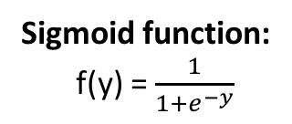

Single Layer Neural Networks with Nonlinear Math Model
bias
F(y)
X0
Activation
function
Sigmoid function:
f(y) = $\frac{1}{1+e^{−y}}$
Input
Strength of Signal
W0 = 1
X1
W1
$$\sum_{i=0}^{n}{xiwi}$$
y
z
=
f(y)
z = Output
W2
0 , 1
X2
Sigmoid takes a real-valued input and squashes it to range between 0 and 1
y
Wn
xn
F(y)
ReLU function:
f(y) = y , y => 0
0 , y < 0
y

Slide 13
Example
X1 | X2 | Output (XOR)
1.0 | 1.0 | 0.0
1.0. 1.0
-0.99 1.05 0.19
-0.43. -0.44 -0.30
=
0.56 0.61 -0.11
Y = 0.0
Y-hat = 0.749
Error = 0.749 – 0 = 0.749
0.56 0.61 -0.11
0.18
1.11 -0.26
=
0.749

Slide 14
Backpropagation Algorithm

Slide 15
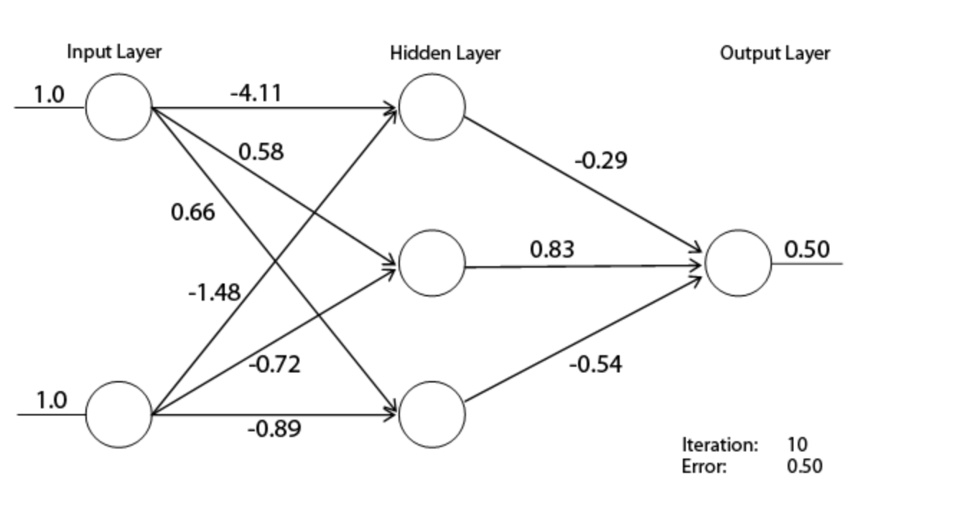
1.0. 1.0
w11 w12 w13
w21 w22 w23
=
y1 y2 y3ç
Y = 0.0
Y-hat = 0.749
Error = 0.50 – 0 = 0.50
y1 y2 y3ç
w1
W2
w3
=
0.50

Slide 16
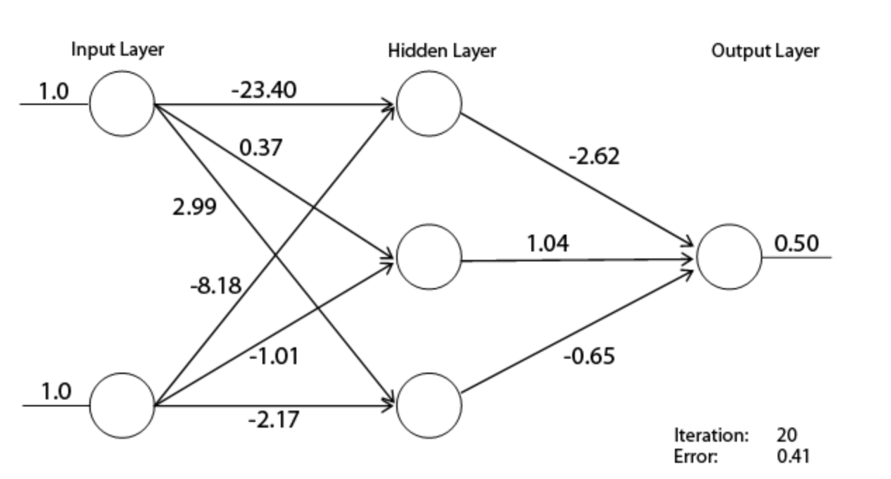

Slide 17
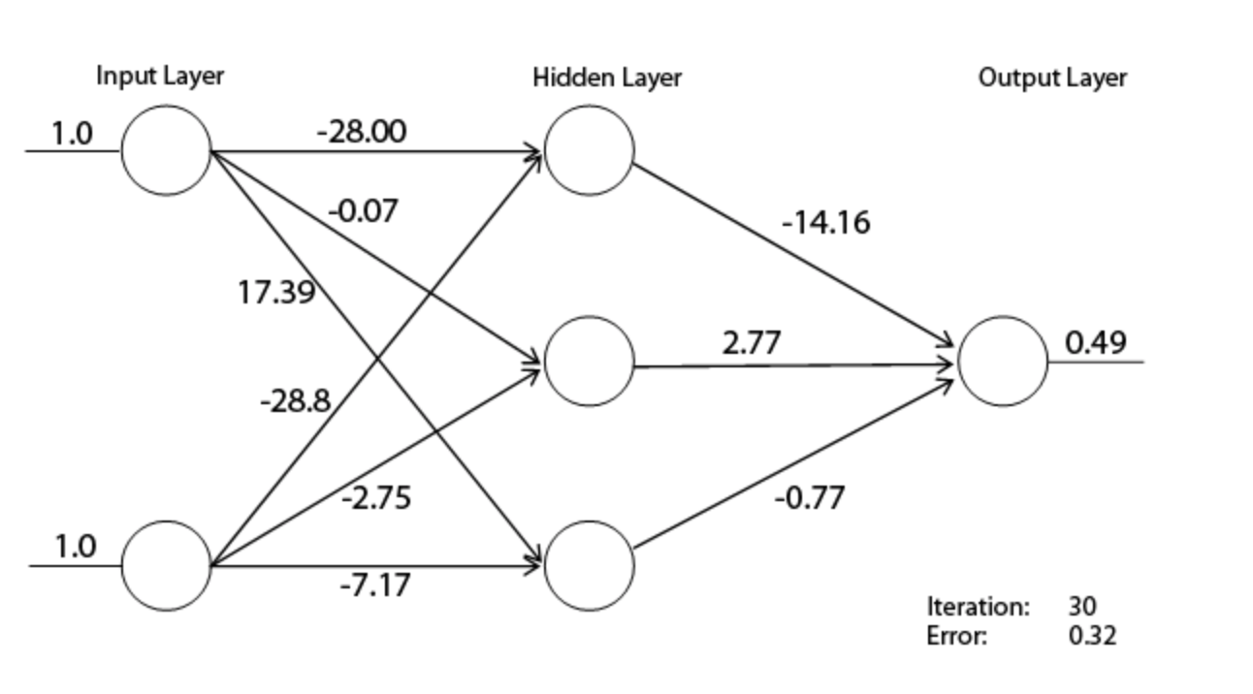

Slide 18
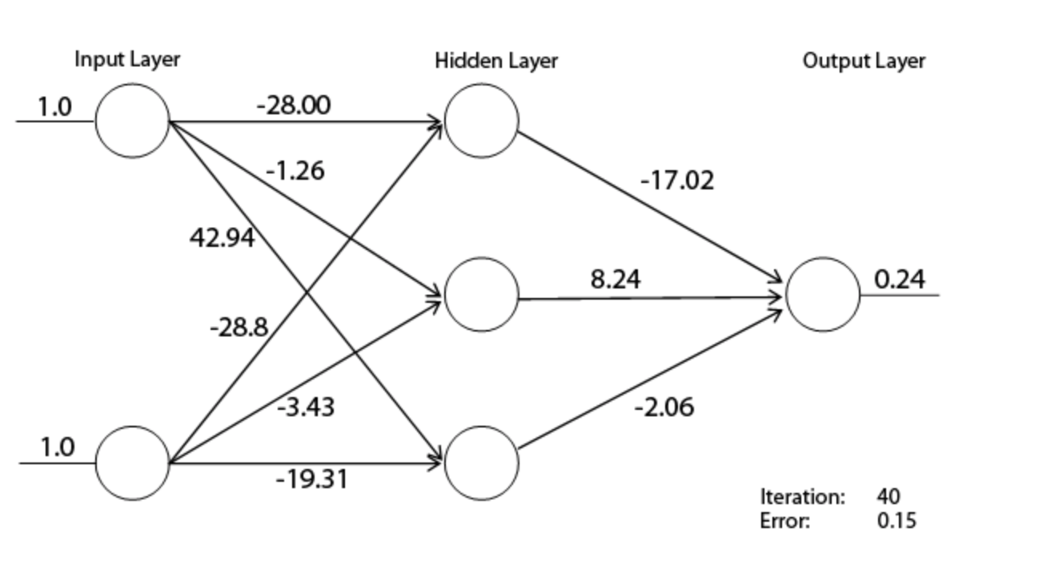

Slide 19
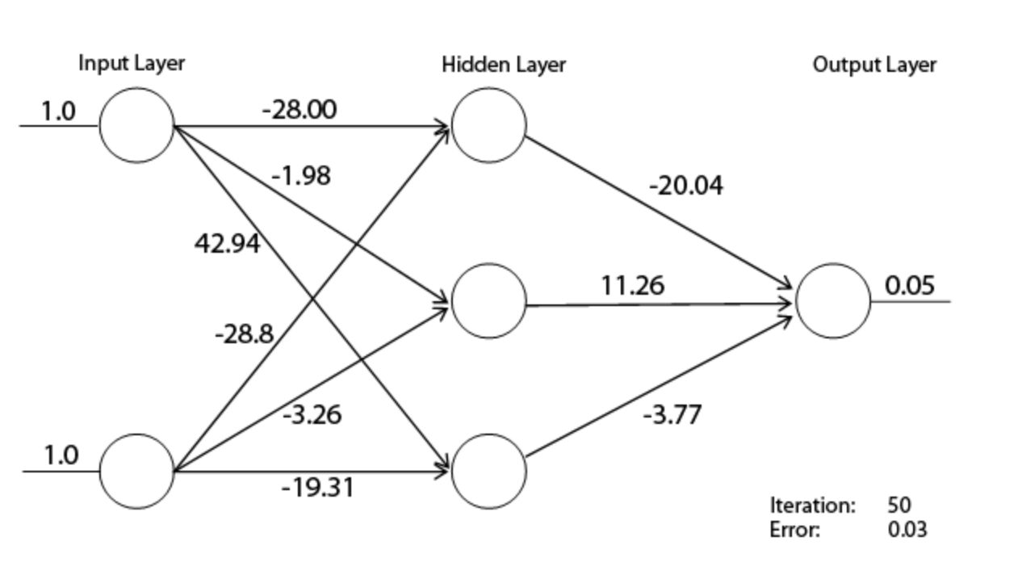

Slide 20
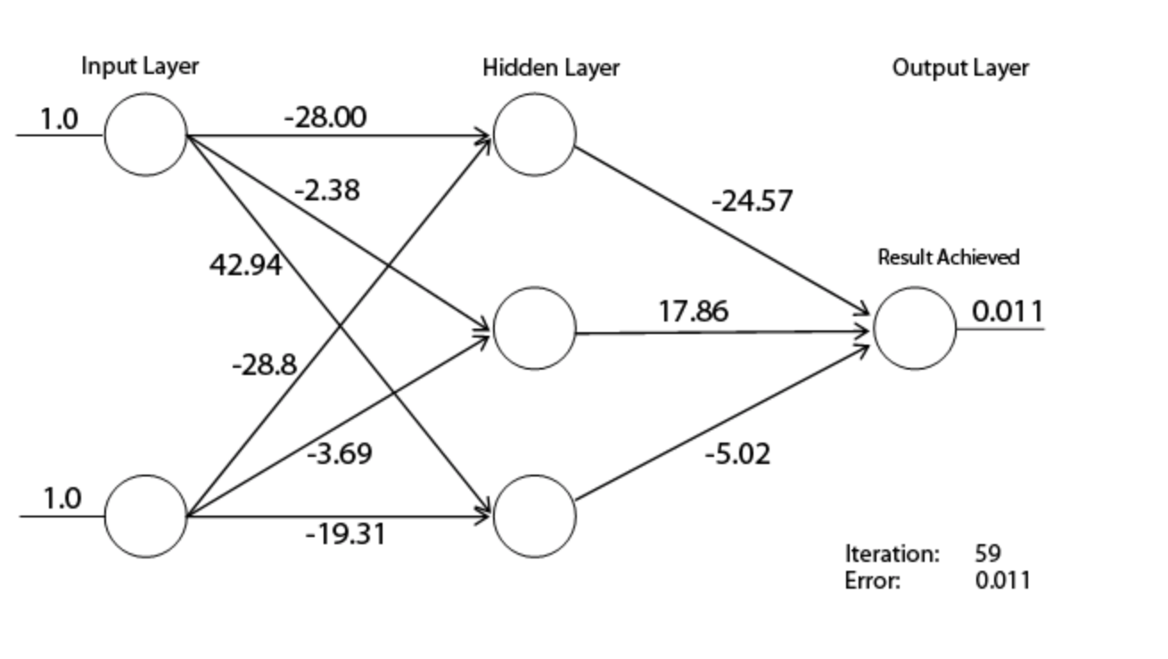

Slide 21
Learning Rate: Steps
Learning Rate should increase with the slope

Slide 22
Example: Multi output units
1
0
0
0
0
0
0
0
0
0
0
1
0
0
0
0
0
0
0
0
h(x) =
0
h(x) =
1
…
0
0
0
0
0
0
0
0
0
1
9
h(x) =

