Slide 1
BART: Denoising Sequence-to-Sequence Pre-training for Natural Language Generation, Translation, and Comprehension by Facebook AI
Presenter : Shiqi Xiao

Slide 2
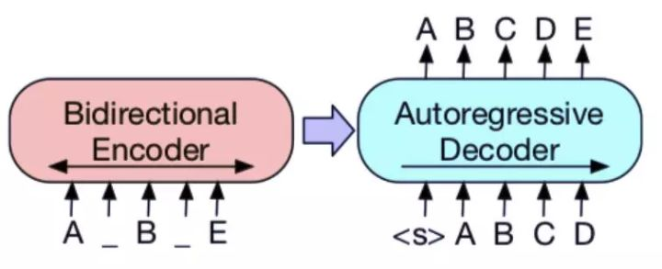
Architecture
BART

Slide 3
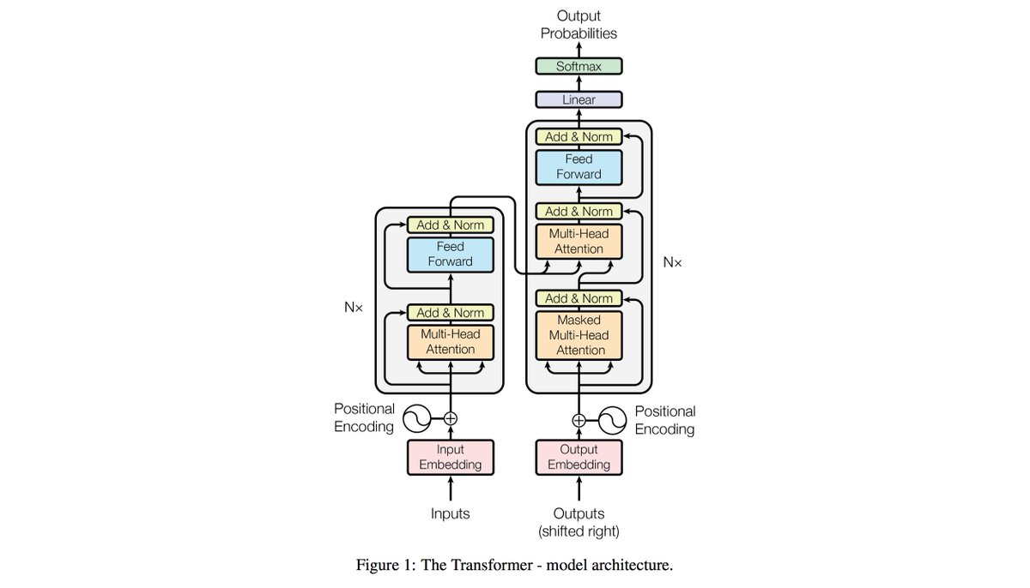
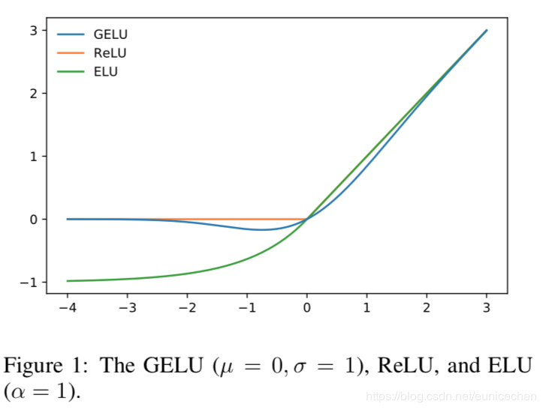

$$GELU\left(x\right)=x∗P\left(X≤x\right) where X\sim N(μ,σ)$$
expectation
input singal
$$σ=0.02 in BART$$

Slide 4
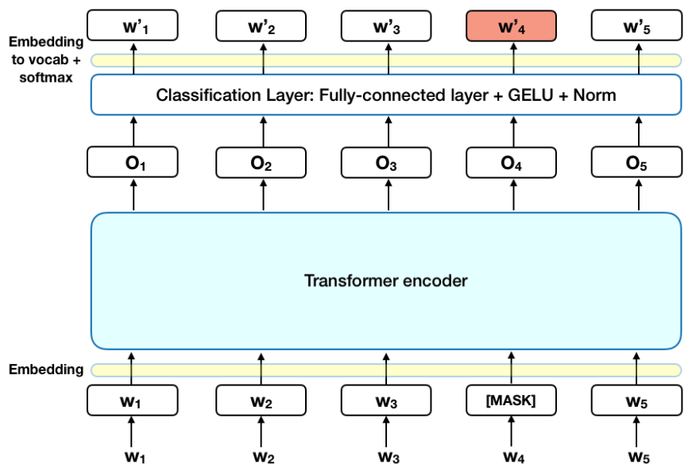
BART
BERT

Slide 5
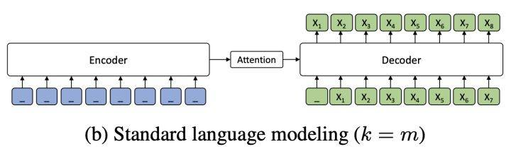
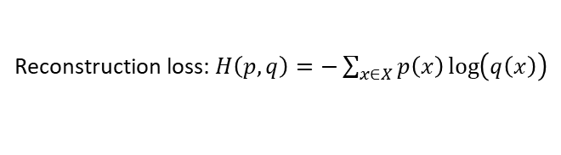
Pre-training
1. document corruption
2. reconstruction
BART
Reconstruction loss: $H\left(p,q\right)=−\sum_{x∈X}{p\left(x\right)\log\left(q\left(x\right)\right)}$

Slide 6
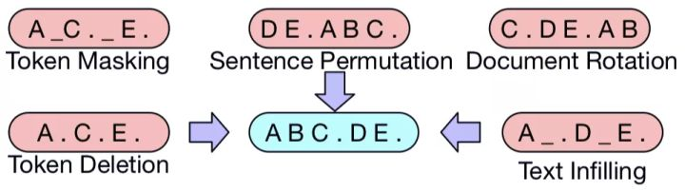
Noising functions

Slide 7
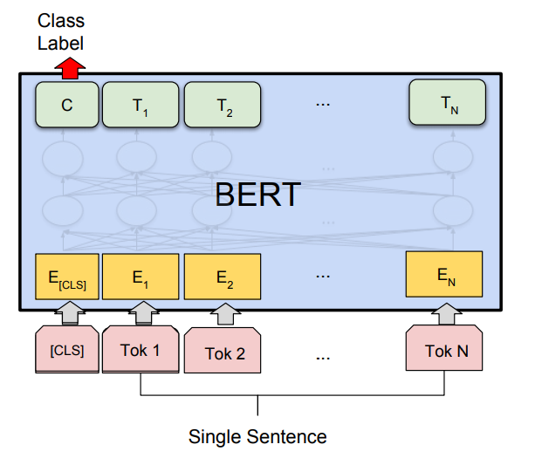
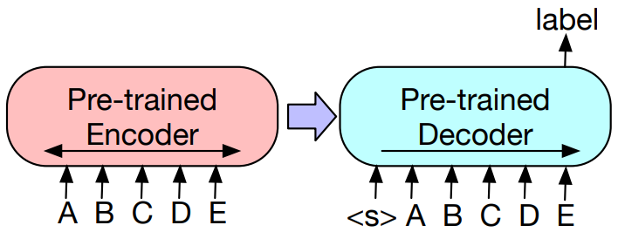
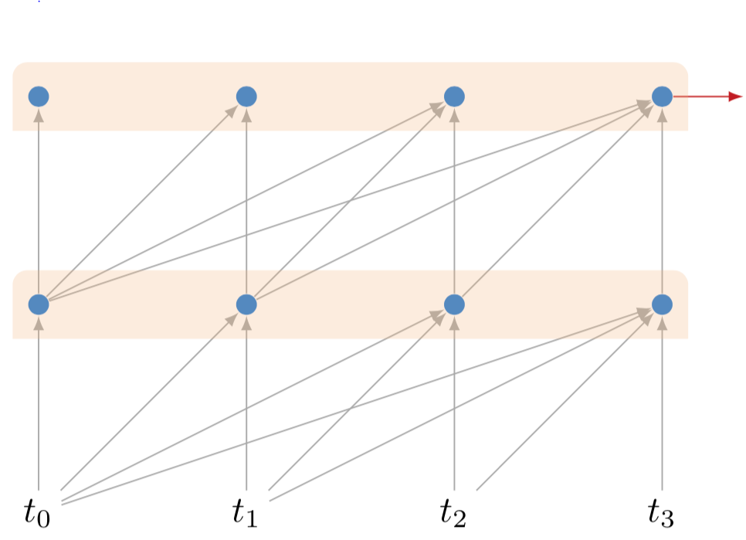
Sequence classification
BART
masked attention

Slide 8
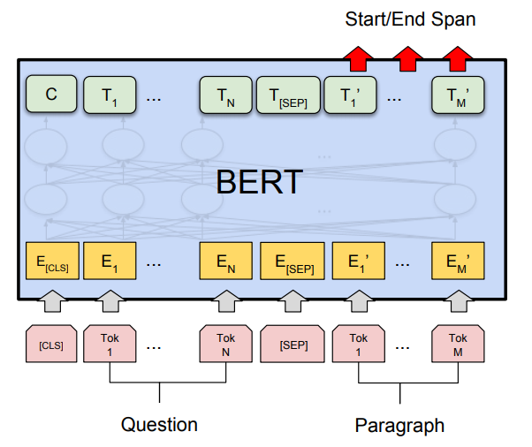
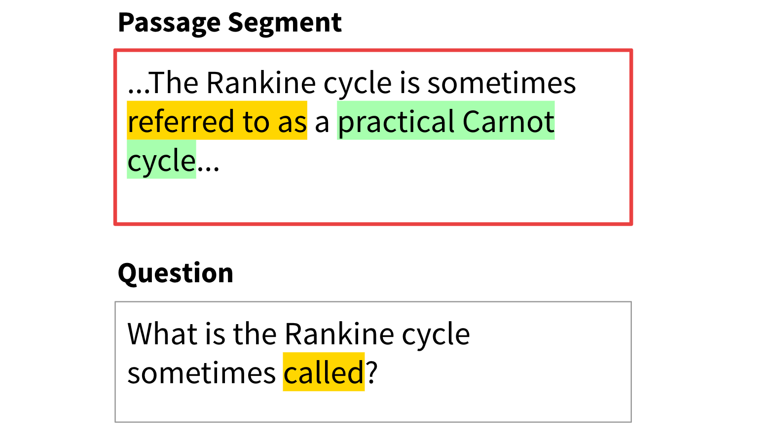
Token classification

Slide 9
Sequence generation
Autoregressive model

Slide 10
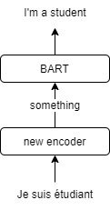
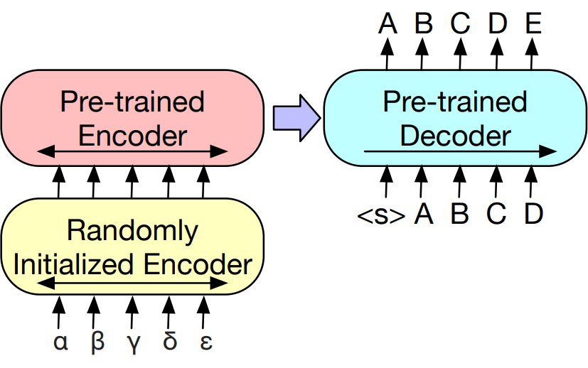
Machine translation

Slide 11
Pre-training objectives
Language Model e.g. GPT
Permuted Language Model e.g. XLNet
Masked Language Model e.g. BERT
Multitask Masked Language Model e.g. UniLM
Masked Seq-to-Seq e.g. MASS

Slide 12
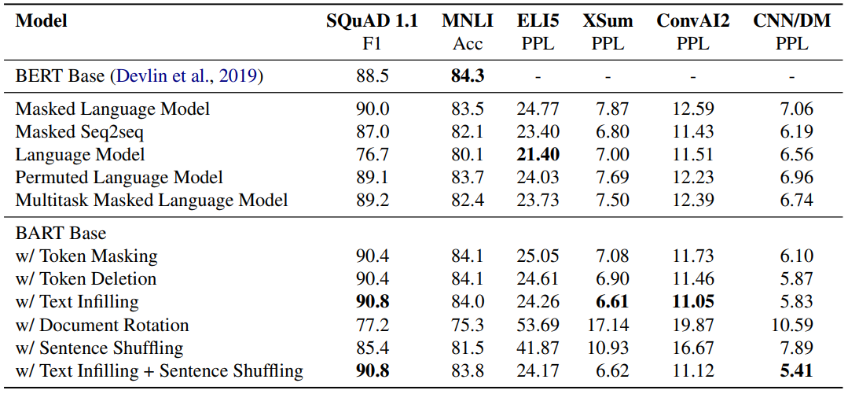
Token-masking > sequence permutation
Left-to-right is important for generation
Bidirectional is important for classification
Pure LM > BART on ELI5

Slide 13
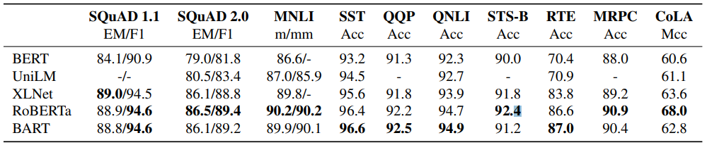
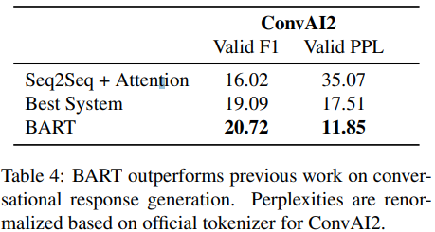
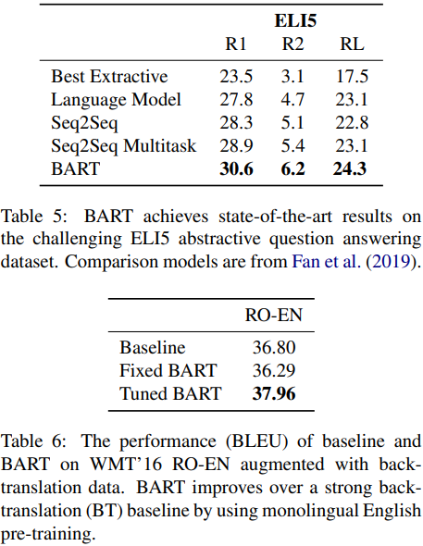
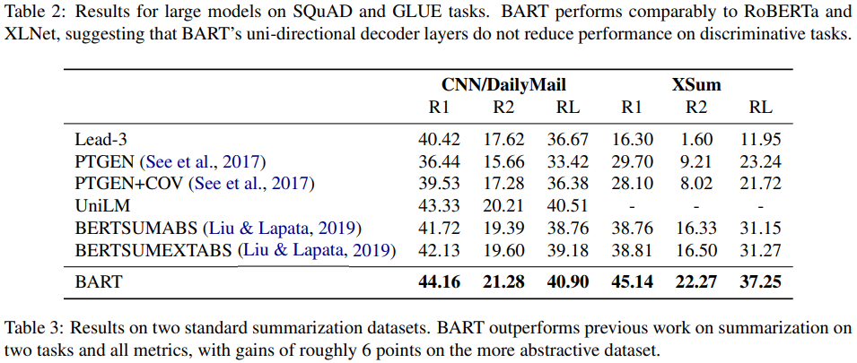
Large-scale experiments
ICLR2020 models:
ELECTRA 88.7/94.2 86.9/89.6 90.5/- 96.0 92.4 94.5 92.1 86.8 90.6 69.3
ALBERT(1M) 89.2/94.8 87.2/89.9 90.4/- 96.8 92.0 95.2 92.7 88.1 90.2 68.7

Slide 14
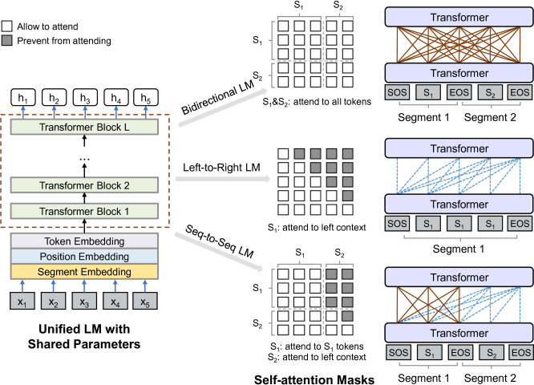
UniLM

Slide 15
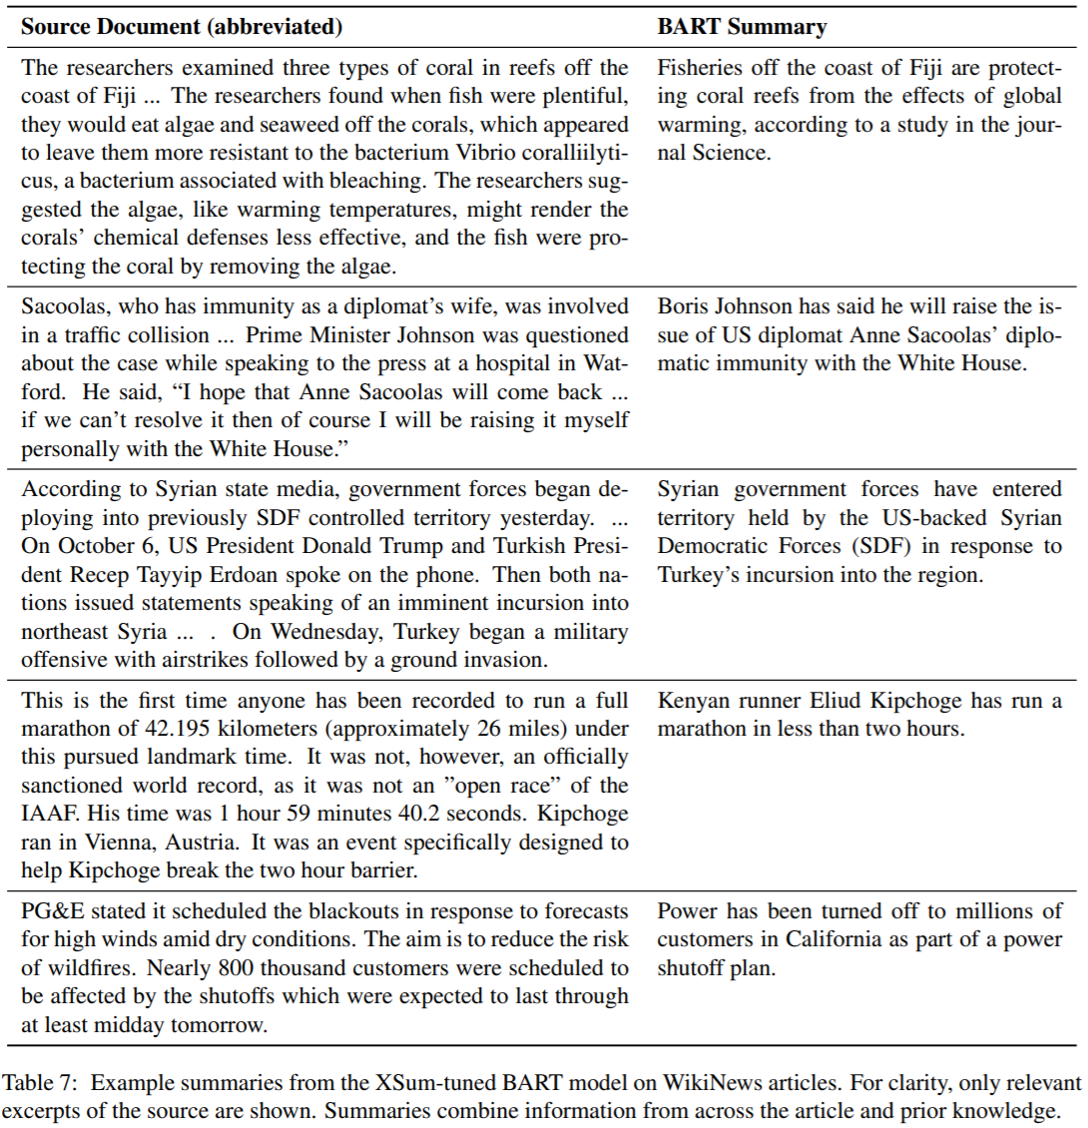

Slide 16
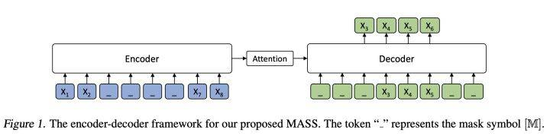
ICLR2020 models:
ELECTRA 88.7/94.2 86.9/89.6 90.5/- 96.0 92.4 94.5 92.1 86.8 90.6 69.3
ALBERT(1M) 89.2/94.8 87.2/89.9 90.4/- 96.8 92.0 95.2 92.7 88.1 90.2 68.7
BART

Slide 17
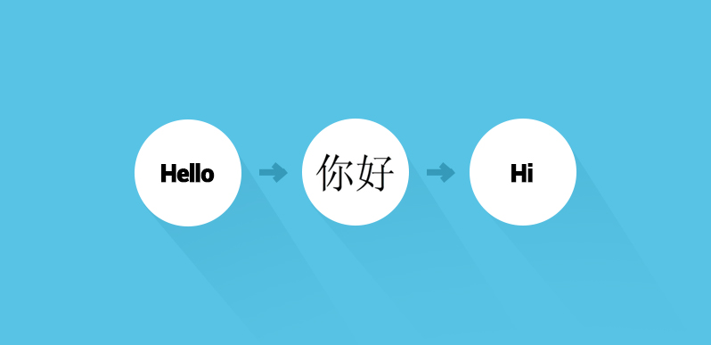
Machine translation
back translation

Slide 18
References
BART, Lewis et al., 2019 https://arxiv.org/abs/1910.13461
BERT, Devlin et al., 2019 https://arxiv.org/abs/1810.04805
Transformer, Vaswani et al., 2017 https://arxiv.org/abs/1706.03762
GeLUs, Hendrycks & Gimpel, 2016 https://arxiv.org/abs/1606.08415
SpanBERT, Joshi et al., 2019 https://arxiv.org/abs/1907.10529
GPT, Radford et al., 2018 https://s3-us-west-2.amazonaws.com/openai-assets/research-covers/language-unsupervised/language_understanding_paper.pdf
RoBERTa, Liu et al., 2019 https://arxiv.org/abs/1907.11692
UniLM, Dong et al., 2019 https://arxiv.org/abs/1905.03197
MASS, Song et al., 2019 https://arxiv.org/abs/1905.02450

