Slide 1
cluster195 DGX Spark vLLM Benchmark Report
Automated LLM + vLLM parameter testing on node13 / GB10 / vLLM v0.22.0 source build
Objective: identify best currently installed LLM and production vLLM settings.
Hardware: cluster195 node13, NVIDIA GB10, ARM64, CUDA 13.0.
Server: vLLM v0.22.1.dev0 from v0.22.0 tag, OpenAI-compatible API.
Benchmark: 3 runs/model, 512 output tokens, direct node13 backend endpoint.
Known platform workaround: use Triton MoE backend on GB10 SM120.
Executive recommendation
Best throughput: Nemotron-30B-MoE-FP8 at 54.67 tok/s
Best vLLM setting: gpu_mem=0.70, seqs=16, max_len=32768, batched=8192, eager=off, chunked_prefill=off

Slide 2
Test Methodology
Dimension | Value
Prompt | "Explain attention mechanisms in transformers."
Output length | max_tokens=512; measured completion tokens/sec
Runs | 3 measured runs per model after warmup request
Model start | Each model served as a separate vLLM restart
Parameter sweep | Qwen3.6-35B-A3B-FP8 varied GPU memory, max seqs, model length, batched tokens, eager, chunked prefill
Endpoint | Direct backend: node13:8000/v1; jsp API key used
Caveat | Single-user throughput; not concurrent/load saturation benchmark

Slide 3
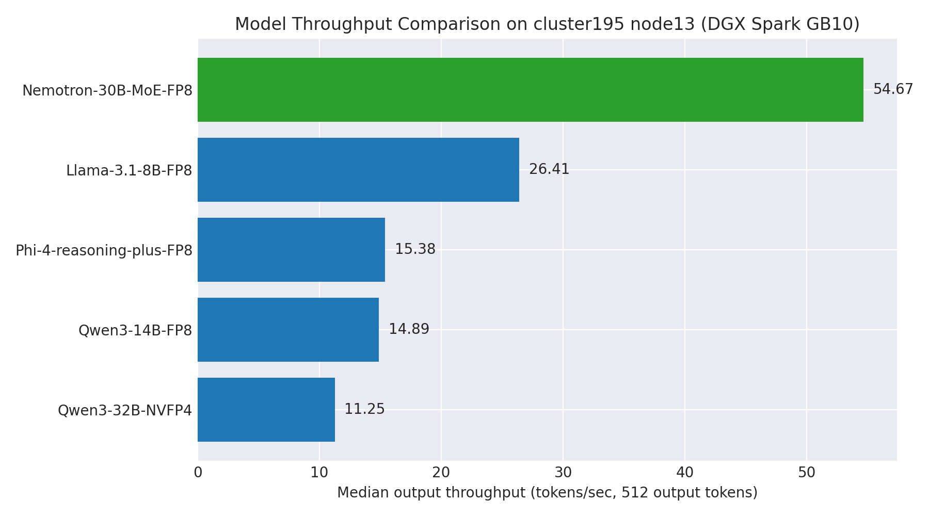
LLM Throughput Comparison
Model | tok/s | avg latency | status
Nemotron-30B-MoE-FP8 | 54.67 | 9.37s | ok
Llama-3.1-8B-FP8 | 26.41 | 19.38s | ok
Phi-4-reasoning-plus-FP8 | 15.38 | 33.29s | ok
Qwen3-14B-FP8 | 14.89 | 34.37s | ok
Qwen3-32B-NVFP4 | 11.25 | 45.49s | ok

Slide 4
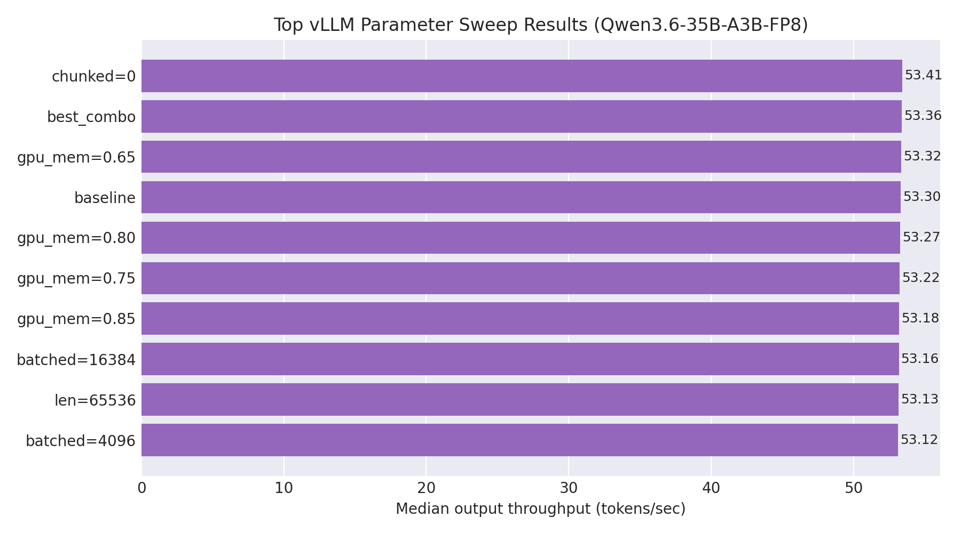
vLLM Parameter Sweep: Key Findings
Best observed config: chunked=0 = 53.41 tok/s.
Chunked prefill OFF slightly improved single-request output throughput (53.41 vs 53.30 tok/s baseline).
GPU memory utilization from 0.65–0.90 had negligible effect for this benchmark; 0.70 is safer for stability.
force-eager reduced throughput materially (~36 tok/s), so keep eager OFF.
max_num_seqs and max_batched_tokens had minimal effect in single-user 512-token generation.

Slide 5
Recommended Production Configuration
Setting | Recommendation | Reason
LLM | Nemotron-30B-MoE-FP8 | Highest measured throughput
gpu_memory_utilization | 0.70 | Stable; no throughput gain at higher values
max_num_seqs | 16 | Baseline is sufficient for current single-user profile
max_model_len | 32768 | Good balance; longer context did not improve token/s
max_num_batched_tokens | 8192 | Stable baseline; higher values not beneficial here
enforce_eager | off | Eager mode was ~32% slower
chunked_prefill | off for single-user throughput | Best observed median token/s
moe_backend | triton | Required workaround for GB10 SM120 MoE kernel support
Operational note: if many users run concurrently, repeat benchmark with concurrent requests before locking max_num_seqs/max_batched_tokens.
Quality note: throughput alone selected Nemotron; final “best LLM” should include task quality, context length, and instruction-following tests.
Current serving can be switched to the winning model or kept on Qwen3.6-35B if quality/context requirements dominate.

Slide 6
Appendix: Raw Results Snapshot
run | gpu | seqs | len | btok | eager | chunked | median tok/s
baseline | 0.70 | 16 | 32768 | 8192 | 0 | 1 | 53.30
gpu_mem=0.65 | 0.65 | 16 | 32768 | 8192 | 0 | 1 | 53.32
gpu_mem=0.75 | 0.75 | 16 | 32768 | 8192 | 0 | 1 | 53.22
gpu_mem=0.80 | 0.80 | 16 | 32768 | 8192 | 0 | 1 | 53.27
gpu_mem=0.85 | 0.85 | 16 | 32768 | 8192 | 0 | 1 | 53.18
gpu_mem=0.90 | 0.90 | 16 | 32768 | 8192 | 0 | 1 | 53.03
seqs=8 | 0.70 | 8 | 32768 | 8192 | 0 | 1 | 52.88
seqs=32 | 0.70 | 32 | 32768 | 8192 | 0 | 1 | 52.79
seqs=64 | 0.70 | 64 | 32768 | 8192 | 0 | 1 | 53.08
len=16384 | 0.70 | 16 | 16384 | 8192 | 0 | 1 | 53.11
len=65536 | 0.70 | 16 | 65536 | 8192 | 0 | 1 | 53.13
batched=4096 | 0.70 | 16 | 32768 | 4096 | 0 | 1 | 53.12
batched=16384 | 0.70 | 16 | 32768 | 16384 | 0 | 1 | 53.16
batched=32768 | 0.70 | 16 | 32768 | 32768 | 0 | 1 | 52.99
eager=1 | 0.70 | 16 | 32768 | 8192 | 1 | 1 | 36.08
chunked=0 | 0.70 | 16 | 32768 | 8192 | 0 | 0 | 53.41
best_combo | 0.80 | 32 | 32768 | 8192 | 0 | 1 | 53.36

