Slide 1

PennApps Ruby Workshop
Justin Kim

Slide 2
What does this do?
3.times do
print 'Hello, world!'
end

Slide 3





Why Ruby?
Optimized for programmer happiness
Used for Ruby on Rails, an extremely popular web framework

Slide 4
Outline
Intro to Ruby
Intro to the Web and MVC
Ruby on Rails

Slide 5
Installing Ruby
Use Ruby Version Manager (RVM) to manage and install Ruby versions
Use this even if you plan on just using one version
We will be using version 2.3.1
When you have trouble remembering what methods do, use Ruby Docs

Slide 6
Printing in Ruby
You can print a value with three different commands print, puts, and p
print outputs the value and returns nil
puts outputs the value with a newline and returns nil
p both outputs and returns the value
I'll be using this in my examples since it also formats output better
I will denote output with #=>
p 'hello world' #=> "hello world”

Slide 7
Running Ruby
Use a REPL (Read-Execute-Print-Loop) with the irb command in terminal
Execute .rb files with the ruby command: ruby file.rb

Slide 8
Methods
Parentheses around arguments can be omitted if unambiguous
Methods have implicit returns
def hi
'hello, there'
end
def hello(name)
puts "hello, #{name}"
end
puts hi #=> "hello, there"
hello('Matz') #=> "hello, Matz"
hello 'DHH' #=> "hello, DHH"

Slide 9
Creating a Class
Use the class and end keywords
A class can be instantiated with the new method
It is convention to write class names in PascalCase
class Student
end
student = Student.new
p student #=> #<Student:0x007ff7989d44b8>

Slide 10
Instance Methods
Methods defined in a class are instance methods by default
class Student
def greet
puts 'hi'
end
end
student = Student.new
student.greet #=> "hi“

Slide 11
Constructors
If a method is named initialize, then it will be executed when the class is instantiated
class Student
def initialize
puts 'hi'
end
end
Student.new #=> "hi"

Slide 12
Inheritance
Classes can inherit from another class with the < operator
Simply place it after the class declaration and name the class
Thus, a class can gain all of its parent class's methods, both public and private
class Bird
end
class Penguin < Bird
end
p Penguin.superclass #=> "Bird"

Slide 13
Installing Gems
Ruby libraries are called gems
The command to install them is gem install gem_name
When installed, the gem is installed in the current Ruby version's gem directory
To use a gem, pass the name of the gem as a string to the require method at the top of the file (e.g. require 'pry’)

Slide 14
The Web

Slide 15
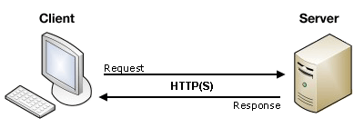
HTTP
Stands for Hypertext Transfer Protocol
A client (e.g. web browser, phone, computer, etc.) sends a request to a server
The server receives this request and sends back a response
This response is usually a web page (i.e. HTML with accompanying files) or data, usually in XML or JSON

Slide 16
HTTP Verbs
The five most common types of HTTP requests are:
GET
POST
PUT/PATCH
DELETE

Slide 17
GET Request
This is usually the default type of request sent
When you enter a URL or click a link, a GET request is sent for the web page
When a web page updates, it probably sent a GET request behind the scenes to get the new data
It should only be used to get something

Slide 18
POST Request
This should be used to send data from the client to the server
While you can technically use GET requests to send data as well, you should absolutely use POST requests if you're sending data
It's much more robust and secure
This is the default type of request sent when submitting a form (e.g. log in)

Slide 19
PUT/PATCH Request
This should be used to update something on the server
Technically, you can use a POST request to update as well, but it is convention to use a PUT or PATCH request
The main difference between a PUT request and a PATCH request:
A PUT request is used to update an entire record
A PATCH request is only used to update part of it

Slide 20
DELETE Request
This should be used to delete something on the server
Technically, you can use a POST request to delete as well, but it is convention to use a DELETE request

Slide 21
MVC
Stands for Model-View-Controller
Every community has different definitions and conventions for MVC
Ignore the conventions of other communities when writing Ruby
Convention over configuration

Slide 22
View
The view is the layer of the application that the user will see
It is typically comprised of .html.erb files
It should have minimal logic in it
It can access instance variables defined in the controller
The corresponding view files should be in a subdirectory of views named for the plural form of the corresponding model

Slide 23
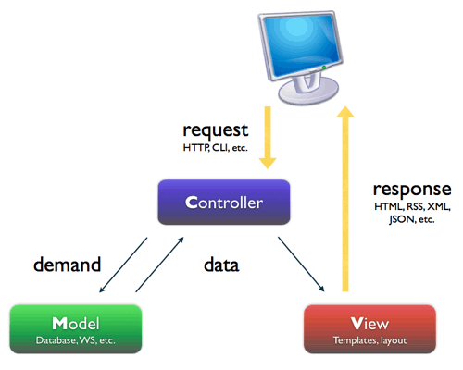

Slide 24
Controller
The controller is the layer of the application that handles HTTP requests
It should pass off as much logic to the model as possible
It can define instance variables for the view to use
This layer of the application should be the most static out of the three
The naming convention is the plural form of the corresponding model with Controller (e.g. UsersController)

Slide 26
Model
The model is the layer of the application with the crux of the logic
It should be the main place where the database is accessed
The naming convention is the singular form of the name

Slide 28
REST
Stands for Representational State Transfer
A set of conventions to expose certain HTTP endpoints
It is convenient for Create, Read, Update, Delete (CRUD) apps
The below example is for a model representing movies
Path | Verb | Usage
/movies | GET | Show a list of movies
/movies/new | GET | Show form to create a new movie
/movies | POST | Create a new movie
/movies/:id | GET | Show a specific movie
/movies/:id/edit | GET | Show a form to update a movie
/movies/:id | PUT/PATCH | Update a movie
/movies/:id | DELETE | Delete a movie

Slide 29
Ruby on Rails

Slide 30
About Ruby on Rails
Also called RoR or most commonly Rails
It is a web framework, similar to Sinatra, but it has far more features and opinions
We will use version 4.2.4
Note, Rails 5 recently came out

Slide 31
Making a Rails App
After you gem install rails, run rails new app_name
Rails will then create a directory of your Rails app with all the basic directories and files
It will also bundle install all the default gems
Check out the Rails documentation

Slide 32
Rails Commands
rails server (or rails s) will start the Rails app
By default, the server uses WEBrick
To use other servers, put the server's gem in the Gemfile (Heroku recommends using puma)
rails console (or rails c) will start the Rails console

Slide 33
Rails Generate
rails generate (or rails g) will generate various files for you
There are several different kinds of generators
The most useful ones (for me at least) are migration, model, and controller
rails g scaffold helped make Rails famous
Generates tests, controllers, views, routes, models, and migrations
It’s too vanilla for actual use though

Slide 34
Rails Generate Syntax
rails g generator_name model_name
For migration, model, and scaffold, you can also specify attributes (the column titles)
rails g generator_name model_name column1:type column2:type
For example, rails g migration Item name:string price:float
For foreign keys, use the references type

Slide 35
Controller
Each route is defined as methods according to its corresponding RESTful route
By default, it will render the corresponding view file
You can render whatever view with the render method
render :show will render the model's show.html.erb page

Slide 36
Routes
The routes are managed in the config/routes.rb file
resources :pluralized_model_name generates all seven RESTful routes
To define custom routes, use http_verb 'route' => 'model_name#method'
get 'users/hello' => 'user#hello' would connect the hello method in UsersController to a GET request to users/hello

Slide 37
Rails Directory
Notice that most of this directory structure should be familiar to you
The main directories not introduced to you yet are: lib, log, test, tmp, and vendor
test contains test files, log contains error logs, and tmp contains temporary files
app/helpers contains modules

Slide 38
Asset Pipeline
Introduced in Rails 2011
It is a way to load resources (i.e. images, javascripts, and stylesheets)
It is comprised of the app/assets, lib, and vendor directories

Slide 39
What Should Go Where
The custom code you write specific to your application should go in app/assets
The custom code you write not specific to your application should go in lib
It's pretty rare to use this
3rd party libraries should go in vendor

Slide 40
Sprockets
Sprockets is an asset packaging system
The stylesheet one can be found at app/assets/stylesheets/application.css
The javascript one can be found at app/assets/javascripts/application.js
They are both loaded in the head tag
Notice how javascript files are loaded with <%= javascript_include_tag %>
stylesheet files are loaded with <%= stylesheet_link_tag %>

Slide 41
Sprocket Application Files
To require a file, append an = to the beginning of the commenting delimiter (e.g. //= for javascript)
require_tree . requires all files in the directory
I try not to use this because it loads the files in alphabetical order
the order usually matters for me
Never write any javascript/css code directly in the application files
require_self will let you do this

