Slide 1
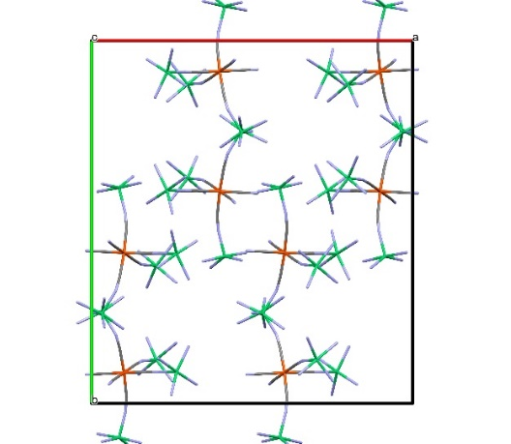
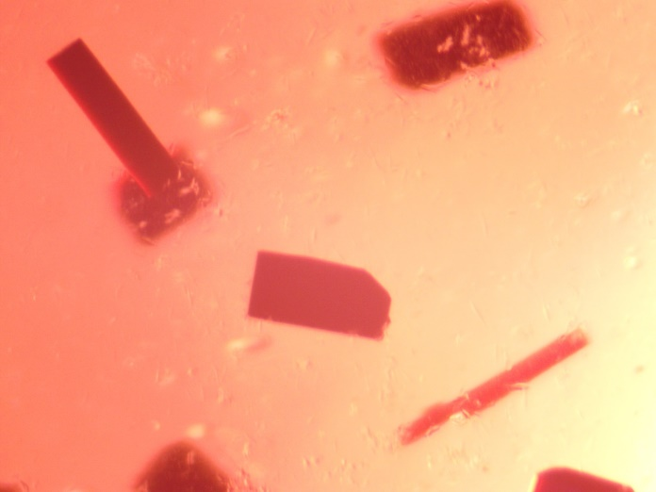

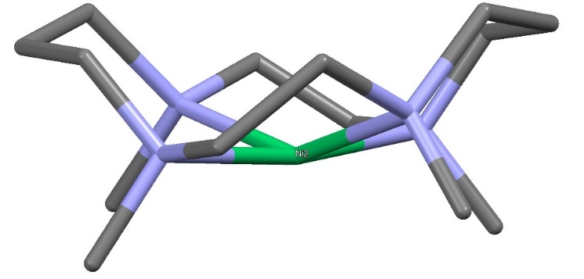
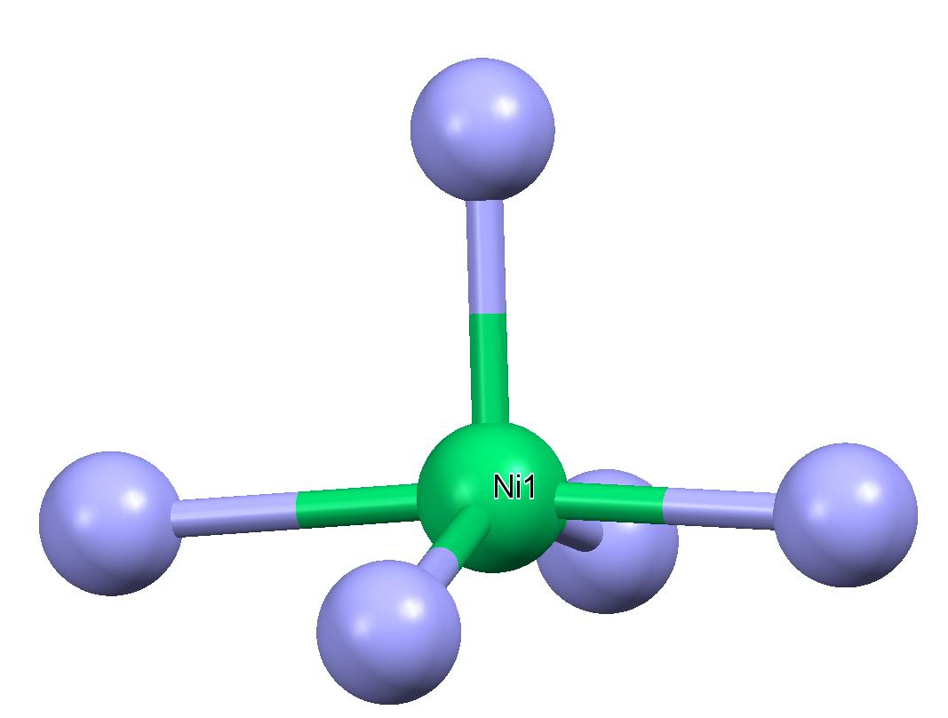
High magnetic anisotropy induced by unusual coordination in a pentanuclear star-like Ni₄Fe molecule
J. Bujakowska, M. Heczko, B. Nowicka
Faculty of Chemistry, Jagiellonian University, Kraków, Poland
Synthesis and structure analysis
The purpose of the studies
Reduced magnetization
The purpose of this work was to synthesize high spin
molecule with high magnetic anisotropy. The [Ni(tmc)]²⁺
(tmc = 1,4,7,11-tetramethyl-1,4,7,11-tetrazacyclotetradecane) and [Fe(CN)₆]³⁻ ions were chosen as building blocks. We expected the formation of a star-like molecule with Ni(II) ions arranged around the central hexacyanoferrate(III), bound by CN‑bridges which are short, and mediate relatively strong magnetic interactions. During the synthesis, the Fe(III) ions have been reduced to Fe(II) and the pentanuclear [Ni^{II}(tmc)]₄[Fe^{II}(CN)₆]⁴⁺ cation was formed. The Continuous Shape Measure calculations show that the coordination geometry for all Ni(II) ions is close to the square pyramid. Magnetic measurements and fitting of the ZFS parameters with the PHI software reveal that the compound shows paramagnetic behavior and high magnetic anisotropy.
The Continuous Shape Measure calculations
Unusual geometry of the cation
Magnetic susceptibility
Atom | vOC-5 | TBPY-5 | SPY-5 | JTBPY-5
Ni1 | 1.31060 | 3.36946 | 1.47126 | 5.36292
Ni2 | 1.44143 | 2.99411 | 1.17059 | 5.29677
Ni3 | 1.37859 | 3.17201 | 1.31811 | 5.02476
Ni4 | 2.15068 | 2.31005 | 2.19399 | 4.08207

