Slide 1

Smart Street Lighting System
An IoT-based intelligent street lighting solution with Adaptive Brightness Control based on Traffic Density and Ambient Light Conditions — improving road safety while reducing unnecessary electricity consumption through centralized monitoring and management.
ARSI UDAY
323129520030

Slide 2


Problem Statement
The Core Issue
What Authorities Need
Street lighting is essential for road safety and public security. Yet conventional streetlights operate at fixed brightness levels — regardless of traffic movement or environmental conditions.
Adaptive Intelligence
Automatically adjust brightness according to traffic density and ambient light levels.
Fixed brightness leads to unnecessary energy consumption around the clock, even when roads are empty.
Energy Efficiency
Reduce electricity waste without compromising road safety or public security.
Intelligent Management
Centralized systems that respond to real-world conditions dynamically.

Slide 3



Proposed Solution
The Smart Street Lighting System leverages IoT technologies, traffic detection, and ambient light sensing to deliver a secure, user-friendly centralized platform for intelligent streetlight management.
Traffic Detection
Ambient Light Sensing
Centralized Platform
Streetlight brightness is dynamically adjusted based on detected traffic movement in real time.
Ambient light conditions are continuously monitored to determine appropriate lighting levels.
A secure and user-friendly platform enables remote monitoring and management of all streetlights.

Slide 4

Project Objectives
1
Automatic Brightness Control
Automatically control streetlight brightness based on real-time conditions.
2
Traffic & Ambient Monitoring
Detect traffic movement, traffic density, and surrounding ambient light conditions.
3
Energy Reduction
Reduce unnecessary electricity consumption through dynamic brightness adjustment.
4
Safety & Security
Improve road safety and public security at all times.
5
Fault Detection & Maintenance
The system supports sustainable smart-city infrastructure by combining intelligent automation with centralized operational oversight.
Monitor operational status, detect and report lighting faults, and reduce maintenance costs.

Slide 5
IoT Sensors and System Components
Six integrated components work together to enable intelligent, adaptive streetlight control across the entire network.
Motion Sensors
Light Intensity Sensors
Detect traffic movement along the road.
Measure surrounding ambient light conditions continuously.
IoT Communication Modules
Streetlight Control System
Transmit sensor and streetlight information to the platform.
Dynamically adjusts brightness based on incoming data.
Cloud-Based Monitoring
Interactive Dashboard
Provides centralized monitoring and management of all streetlights.
Displays streetlight status and operational information.

Slide 6

System Working Process
The adaptive brightness control cycle operates continuously — avoiding unnecessary electricity usage by responding to real-world traffic and light conditions at every step.
Detect Motion
Measure Light
Transmit Data
Analyze & Adjust
Collect Data
At each cycle, the system ensures streetlights operate at precisely the right brightness — no more, no less — eliminating wasteful fixed-level operation and keeping roads safe at all times.

Slide 7
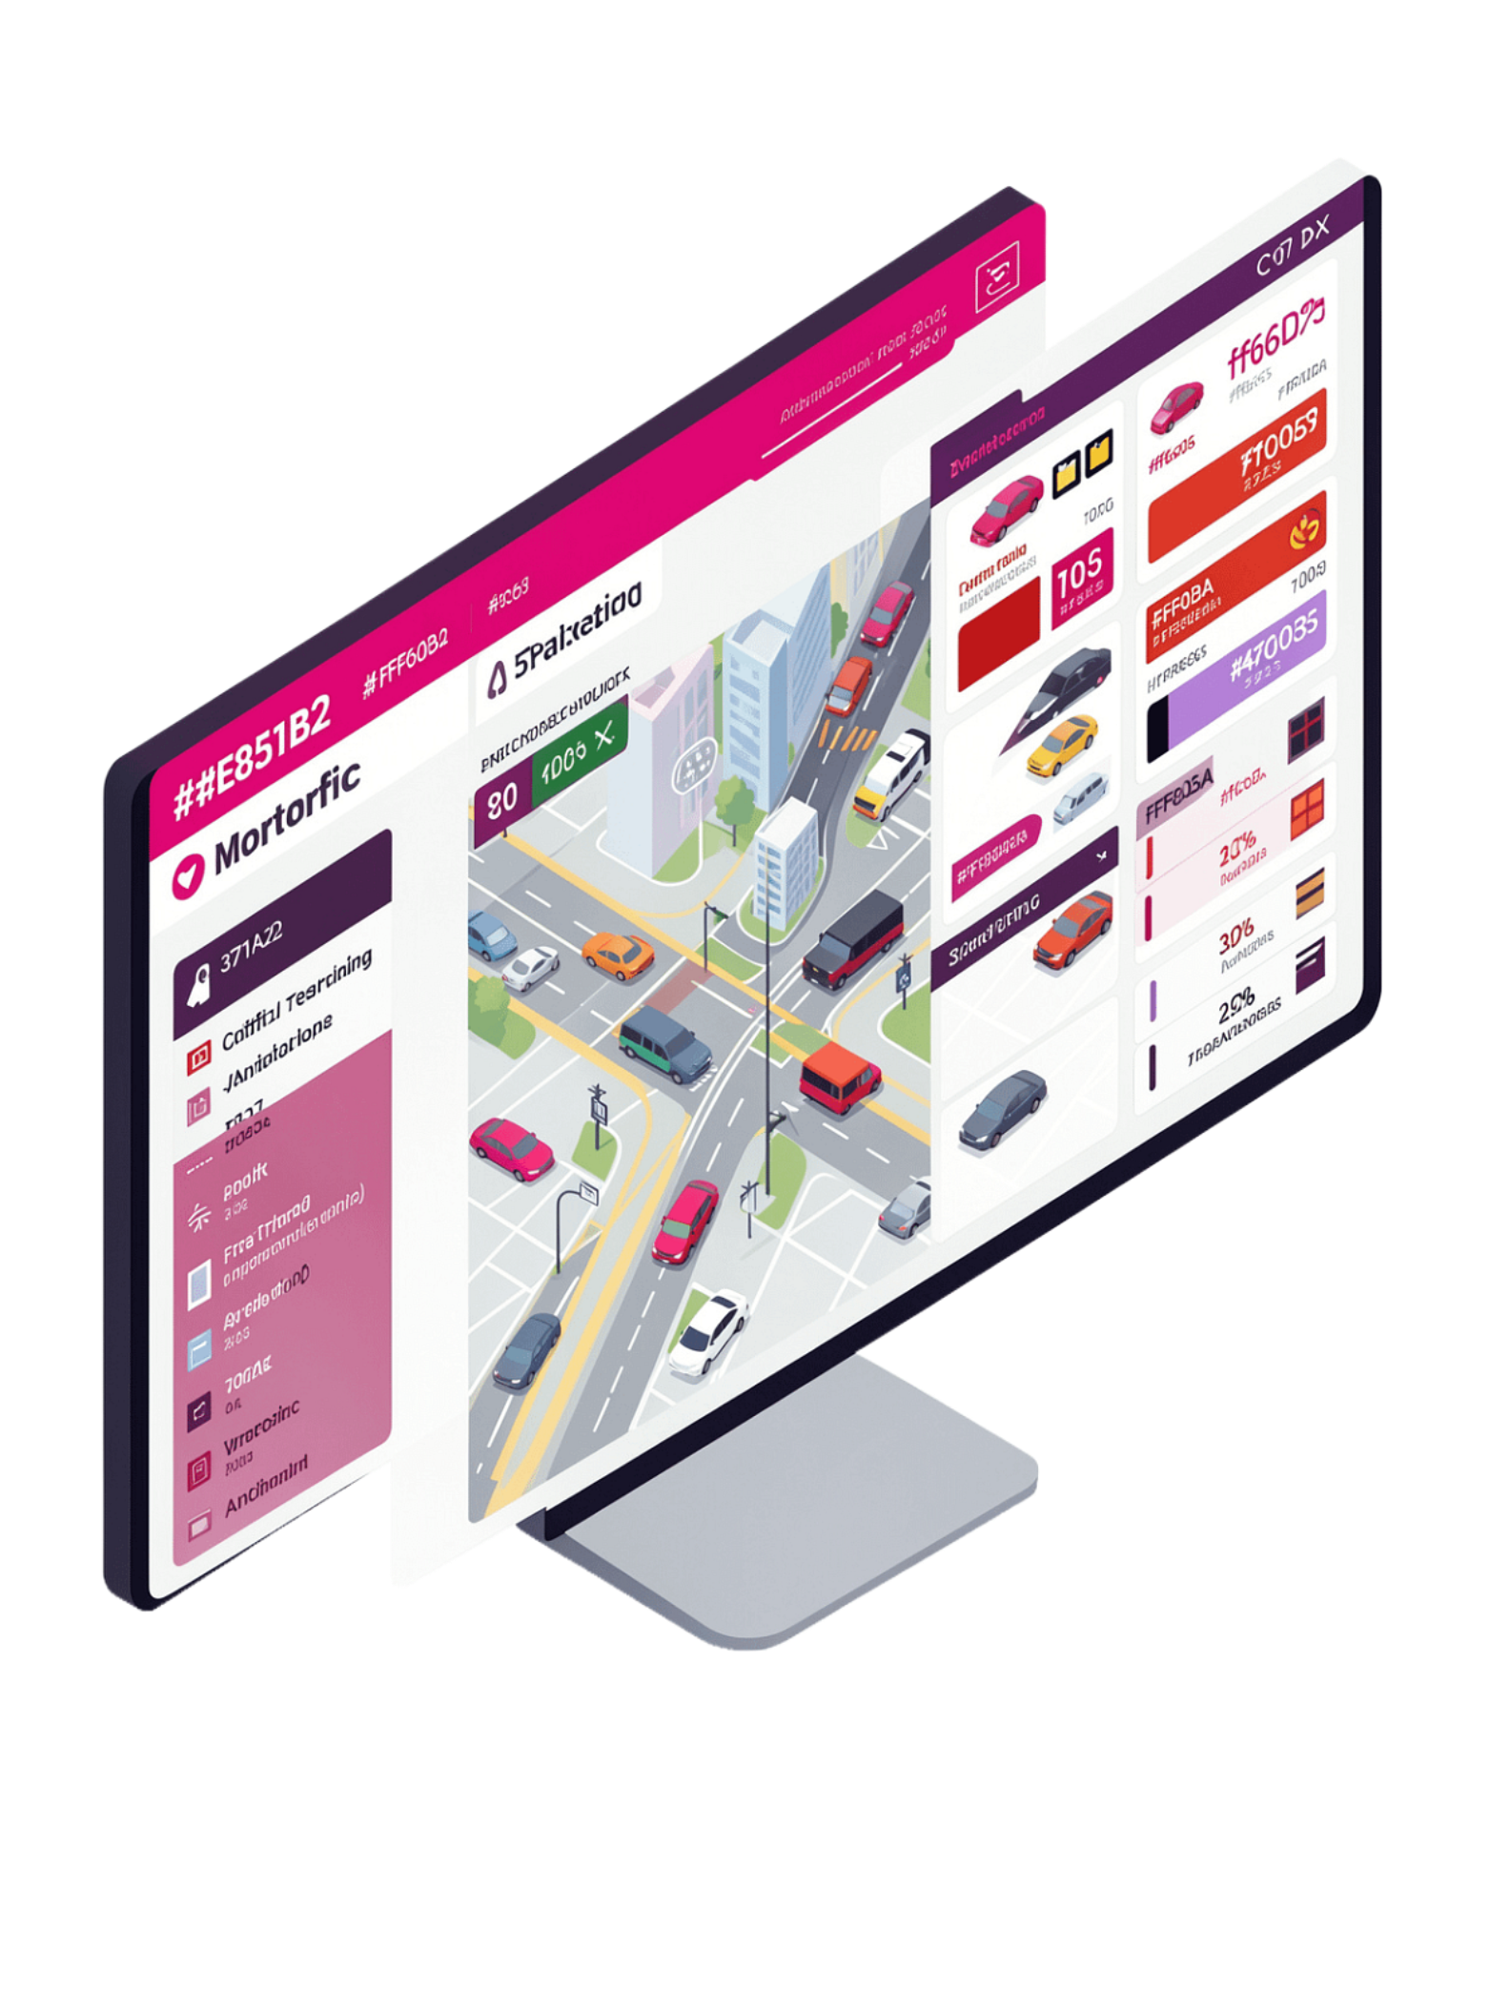
Monitoring Dashboard and Analytics
Information Displayed
What Authorities Can Do
Streetlight Status
Monitor streetlights remotely from a single interface
Track energy usage and identify savings opportunities
Identify and respond to faults immediately
Understand traffic activity patterns over time
Plan and schedule maintenance activities efficiently
Optimize lighting operations across the entire network
Live operational state of every light in the network.
Energy Consumption
Real-time and historical electricity usage data.
Traffic Activity
Current and recent traffic movement patterns.
Fault Alerts & Maintenance Reports
Instant notifications and scheduled maintenance planning.

Slide 8



Adaptive Brightness Control and Benefits
How It Works
Major Benefits
Detect
⚡ Reduces Electricity Consumption
🌱 Improves Energy Efficiency
Traffic detection and ambient light sensors gather real-time conditions.
🚗 Improves Road Safety
🔒 Enhances Public Security
Analyze
The system determines the appropriate brightness level for current conditions.
🔧 Reduces Maintenance Costs
📡 Enables Real-Time Monitoring
Adjust
Streetlight brightness is set dynamically — avoiding unnecessary fixed brightness.
⚙️ Improves Operational Efficiency
🏙️ Supports Sustainable Infrastructure

Slide 9
Applications and Scope
Where the System Is Suitable
System Scope
Smart Cities
The system can centrally monitor and manage multiple streetlights simultaneously, adapting lighting conditions based on traffic movement and ambient light across any deployment environment.
Integrated urban lighting management at scale.
Highways
Adaptive lighting for high-speed traffic corridors.
Residential Areas
Safe, efficient lighting for communities.
Industrial Zones
Reliable lighting for operational and security needs.
Educational Campuses
Smart lighting for student safety and energy savings.
🔐 Secure
📈 Scalable
🖥️ Centralized Monitoring
⚡ Efficient Operations
Protected data transmission and access control.
Designed to grow with expanding infrastructure needs.
Single-platform visibility across all streetlights.
Built to support optimized, sustainable lighting management.

Slide 10

Conclusion
The Smart Street Lighting System provides an intelligent alternative to conventional fixed-brightness streetlights — combining motion sensors, light intensity sensors, IoT communication, and a centralized dashboard to deliver dynamic, condition-responsive lighting.
Detect
Motion and light sensors continuously gather traffic and ambient data.
Adapt
Brightness is dynamically adjusted to match real-world conditions.
Monitor
Dashboards provide status, energy, traffic, fault alerts, and maintenance reports.
Sustain
Reduces electricity usage and costs while supporting smart-city infrastructure.
"Adaptive IoT-based street lighting improves safety, reduces energy consumption, and enables intelligent management of modern urban infrastructure."

