Slide 1


Adventures of Identity Protection
Modernizing Conditional Access Policy framework
16.4.2025 Matti Väliniemi

Slide 2

Introduction and Agenda
Matti Väliniemi Senior Technical Consultant Microsoft 365, Endpoints, Security
Agenda
Conditional Access Policy framework
Goals
Target methods and policies
Design principles and planning
Demo time:
Planning actual policies
Non-Interactive Sign-in Insights and reporting workbook
Creating CatchEmAll policy
Deploying CA Policy framework
Challenges faced & Lessons learned

Slide 3
Reminder
Identity is very popular attack vector
Proactive protection is important

Slide 4
CAP Framework and Personas
CAP Framework = Baseline for designing CAP structure
Persona = Target group of identities
Global
Internal
External
Guest
Admin
Shared Accounts
Service Accounts

Slide 5

Goals
All personas have method for targeting policies
#noexcludes
Each user account belongs to only one target group
Prevent sign-in if an account is not in any of the target groups

Slide 6
Example target methods for personas
Persona | Targeting | Suggested method
Global | All Users | CA Policy for All Users
Internal | Users that use company owned trusted devices | Dynamic Entra ID Group, based on HR data
External | Partners etc that normally use their own or their companys devices (non-trusted) | Dynamic Entra ID Group
Guest | Guest users | CA Policy selection
Admin | Admin users or administrative actions (AAD Join) | CA Policy selection for Admin roles AND Dynamic Entra ID Group of Admins
Shared Accounts | Accounts that are used by multiple persons and therefore difficult or impossible to require MFA | Entra ID Group
Service Accounts | Accounts that are not used by persons (no MFA) and usually not from compliant devices | Entra ID Group

Slide 7
Example policies for personas
Persona | Policy
Global | Sign-in frequency 8h when accessing from non-compliant device
Internal | Require compliant device when using Client / App, MFA with Browser
External | Require MFA
Guest | Require MFA
Admin | Require MFA, Sign-in frequency 8h
Shared Accounts | Require compliant device or known network location
Service Accounts | Require compliant device or known network location

Slide 8
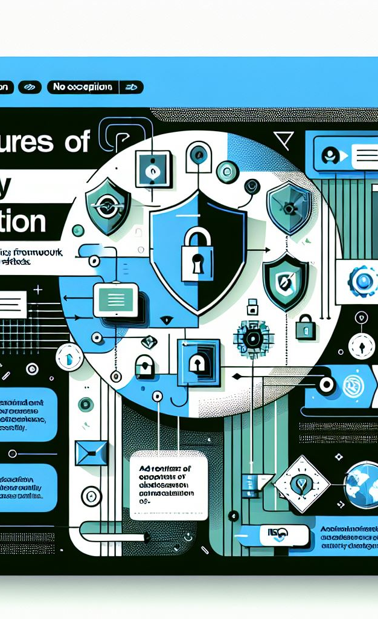
Aim for ”No Exclucions”
Plan CAP targeting to minimize need for exclusions
Internal, External, Guest, Admin, Shared personas should need no exclusions to policies
Service accounts may need to be excluded from their CAP policy when
Signing-in from untrusted network AND
Signing-in with non-compliant device
Monitor excluded accounts extra carefully and do not add accounts to exclude group on light basis.

Slide 9
Importance of Guest MFA
Challenge
When attacker gets hold of user credentials they can fairly easily see what are the guest tenants for that user
They can login as guest without MFA if guest tenant does not require MFA for Guests
Solution
Always require MFA from Guest users.
More info (shout out to Nestori Syynimaa): https://aadinternals.com/post/ests/

Slide 10
Gotta catch em all
Goal
Prevent sign-in from accounts that are not targeted with CA policies
Method
Create Block policy for all users and exclude all your CAP target groups / personas
Result
Rest assured that there are no holes in your CAP Framework

Slide 11

Well planned is half done
Naming standard
Actual CA Policies for different personas and scenarios
CA Policy targeting
Exclusions

Slide 12
Non-interactive Sign-ins
Challenge
Non-interactive sign-ins do not register in Insights and Reporting tool
With new Outlook and Teams client even end user client authentication is now non-interactive type
Solution
Configure custom workbook in Entra or Log analytics to evaluate policy effect in report-only mode for Non-interactive sign-ins before enabling policy
Be alert after enabling policy and have exclusion groups in place so you can add accounts when needed

Slide 13
Demo time
Planning and documenting CA Policies
Creating Insights and Reporting workbook for Non-interactive sign-ins
Creating a CatchEmAll CA Policy

Slide 14
Deploying CA Policy framework
Side-by-side with current policies
All policies are evaluated so no need to prioritize
At first configure policies in Report Only mode
CatchEmAll policy should be configured in the first phase to catch accounts that need to be assigned to some CA policy target group
Deploy policies one persona at a time, pilot if possible
After CatchEmAll has been deployed you can turn off all “old” policies

Slide 15
Challenges faced and Lessons learned
Missing Device ID
Sign-in frequency
Non-Interactive sign-ins
Importance of Guest MFA
Custom application exclude
End Users with Admin roles
Test accounts
Windows Activation
Windows Hello for Business
IPv6

Slide 16
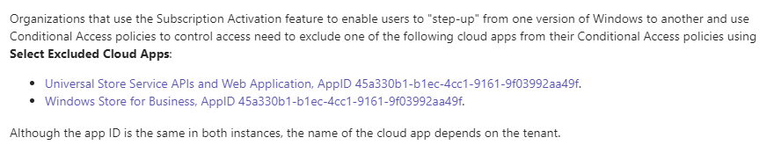
Windows Activation
Challenge
Cloud licensed Windows workstations need to access activation service. This does not support Device Compliance
Solution
Exclude necessary backend applications from CA Policies

Slide 17
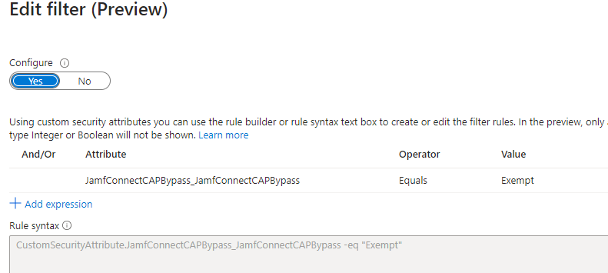
Custom Application Exclude
Challenge
Application (case in point: Jamf Connect) does not support device compliance and needs to be excluded from policy
Application is not available in CA Policy application list
Solution
Create custom security attribute and assign it to application in Entra. Filter CA Policy targeting based on that attribute

Slide 18
Windows Hello for Business
Challenge
Sign-in frequency does not have the desired effect when user has authenticated to device with WHfB
Solution
This is because WHfB is considered as strong (and phishing resistant) authentication and therefore no separate MFA request is not applied.

Slide 19
Sign-in frequency
Challenge
Even SSO sessions and policies without MFA request ask for MFA
Solution
Target Sign-in frequency setting only to Admin users and end users with unknown devices.

Slide 20
IPv6
Challenge
Service account is accessing Entra from trusted network, but uses IPv6 address and therefore is not identified correctly
Solution
If possible change the IPv6 address to IPv4 on the server and check that location is showing correctly in Entra Sign-in logs.

Slide 21
Test Accounts
Challenge
Test accounts hit ”CatchEmAll” policy and are blocked from signing in.
Solution
Create separate persona and target group for Test accounts as well to get them included in CA policies and excluded from CatchEmAll

Slide 22
Missing Device ID
Challenge
Device ID missing from authentication claim -> device identified as ”not compliant”
Some legacy apps might not support Device compliance (case in point: Microsoft ODBC Client)
Solution
Exclude frontend or backend application from policy that requires compliant or hybrid joined device.
Configure MFA requirement in place if possible

Slide 23
End Users with Admin roles
Challenge
Some End Users might have Admin roles assigned and therefore get the Admin CA policy effect in their regular use
Solution
Admin roles should be assigned only to Admin accounts.
Check Admin role assignments before deploying Admin role policy

Slide 24
Q & A
More about the subject from author: Bloggerz.cloud

