Slide 1
HTTP/2 Performance
This slideshow collects data from HTTP/2 performance tests regarding latency. The tested features of HTTP/2 protocol are multiplexing and server push.
This is an assignment for Aalto University course ELEC-E7320 – Internet Protocols

Slide 2
Test framework
The tests are run on a local loopback connection, with a random delay added to simulate a real-life environment (internet connection)
Random delay (30ms + 15ms normal distributed variable) is applied by tc(8)
The exact command is
  tc qdisc (change/add) dev lo root netem delay 30ms 15ms distribution normal
The tests are run 1000 times, both with the given HTTP/2 feature enabled and disabled
The effect to latency is only tested, because these features (push and multiplexing) don’t really try to solve any bandwidth/throughput issues.

Slide 3
Multiplexing
Stream multiplexing was introduced in HTTP/2. This defeats head-of-line blocking, because every request/response uses their own independent HTTP/2 stream.
To test stream multiplexing we created two test cases (1000 iterations) with
  basic HTTP/2 stream multiplexing with 20 concurrent streams
  Replicating HTTP/1.1 in HTTP/2 by creating 20 concurrent streams, but handling their responses in a chain, always waiting for the oldest stream to complete (the library does not allow this, so this case was not implemented)
  Replicating HTTP/1 and using a limited number of connections per time (10 connections). This is actually closest to the real-life situation, as most of the web browsers never implemented the HTTP/1.1 pipelining.
We used the same HTTP/2 library framework (C++14, boost, libnghttp2_asio) in both cases to minimize the internal differences between the two test cases
The simulated delay’s random variable should create some HOL-blocking in the 3rd test case

Slide 4
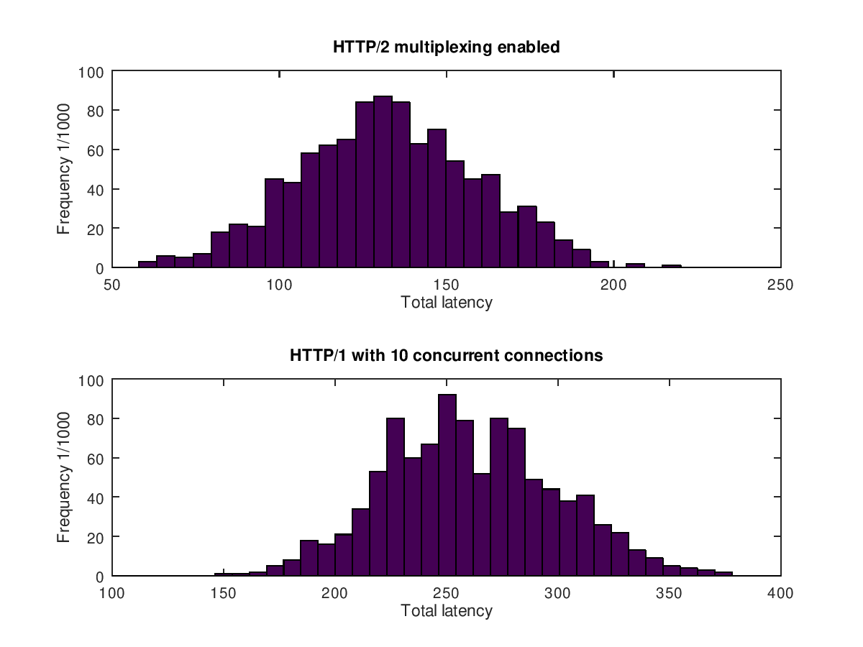
Multiplexing – test results
The results clearly show that HTTP/2 multiplexing is superior when compared to the traditional way of opening many concurrent connections
HTTP/2 results are really impressive, because the opening of the connection already does one RTT, and the resulting mean is about 2 * 2 * 30ms (120ms total)
HTTP/1 is clearly slower, because of the HOL-blocking with the concurrent connections; new requests cannot be made before an old connection has closed
We used maximum of 10 concurrent connections in this example, but many web browsers use even lower amount of them, which would make the performance here even worse
Also a higher latency would affect the HTTP/1 harder
Histograms from 1000-iteration tests. Requests had 30ms (static) +- 15ms (normal distributed random) delay, HTTP/2 uses multiplexing, HTTP/1 uses concurrent connections

Slide 5
Server push
Server push was added in HTTP/2 for faster page loading.
Server “pushes” needed extra data before client requests for it
  A great example is an independent stylesheet file that some HTML file needs.
The push is done through a new push stream initiated by the server
For this case, we created 2 test cases with
  HTTP/2 connection where client loads a html page containing an external stylesheet file, and server pushes this .css file
  HTTP/1.1 style of connection where the client loads the same html page, but requests the .css file itself
  We used the same HTTP/2 library framework (C++14, boost, libnghttp2_asio) in both cases to minimize the internal differences between the two test cases
  In this test, the added delay should show a difference in total page load time, as HTTP/1.1 needs to request the .css file separately.

Slide 6
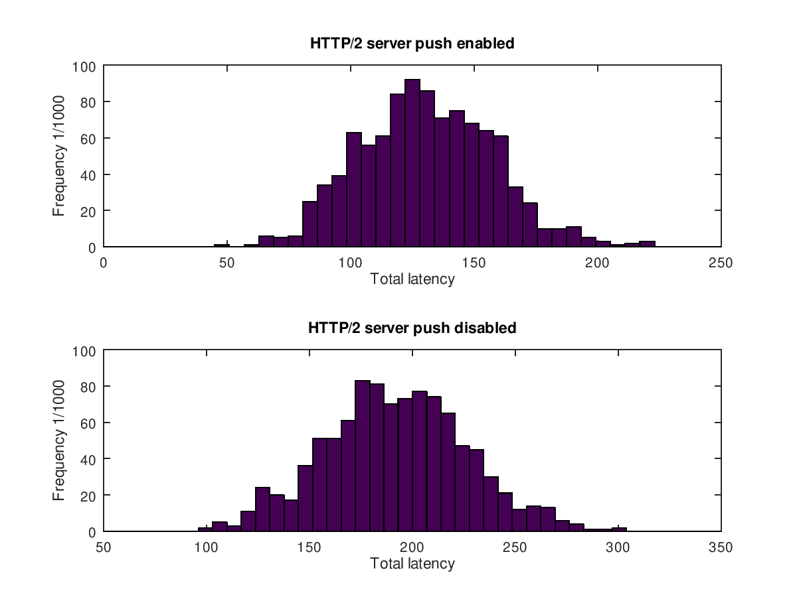
Server push – test results
As we only used one external dependency to measure the overhead caused by manually requesting the file, the difference is really self-evident;
  With server push enabled the mean load time is 2 * RTT (120ms, 2*2*30ms). As long as all the dependencies are pushed, it most likely would not grow much even if the amount of content would grow
  Without server push, the mean load time is about 3 * RTT (180ms). If there were chained dependencies, the load time would most likely be (2+N) * RTT, where N is length of the longest dependency chain
Conclusion: server push really helps with the latency, but on the other hand listing the dependencies will require extra runtime resources from the server
Histograms from 1000-iteration tests. Requests had 30ms (static) +- 15ms (normal distributed random) delay, HTTP/2 pushing enabled in upper plot, disabled in lower with one external .css file loaded.

Slide 7
Source code
Source code for the complete test framework including all test cases and scripts to generate histograms with the collected test data can be found from
https://github.com/jussihi/HTTP2-perf-testing

