Slide 1
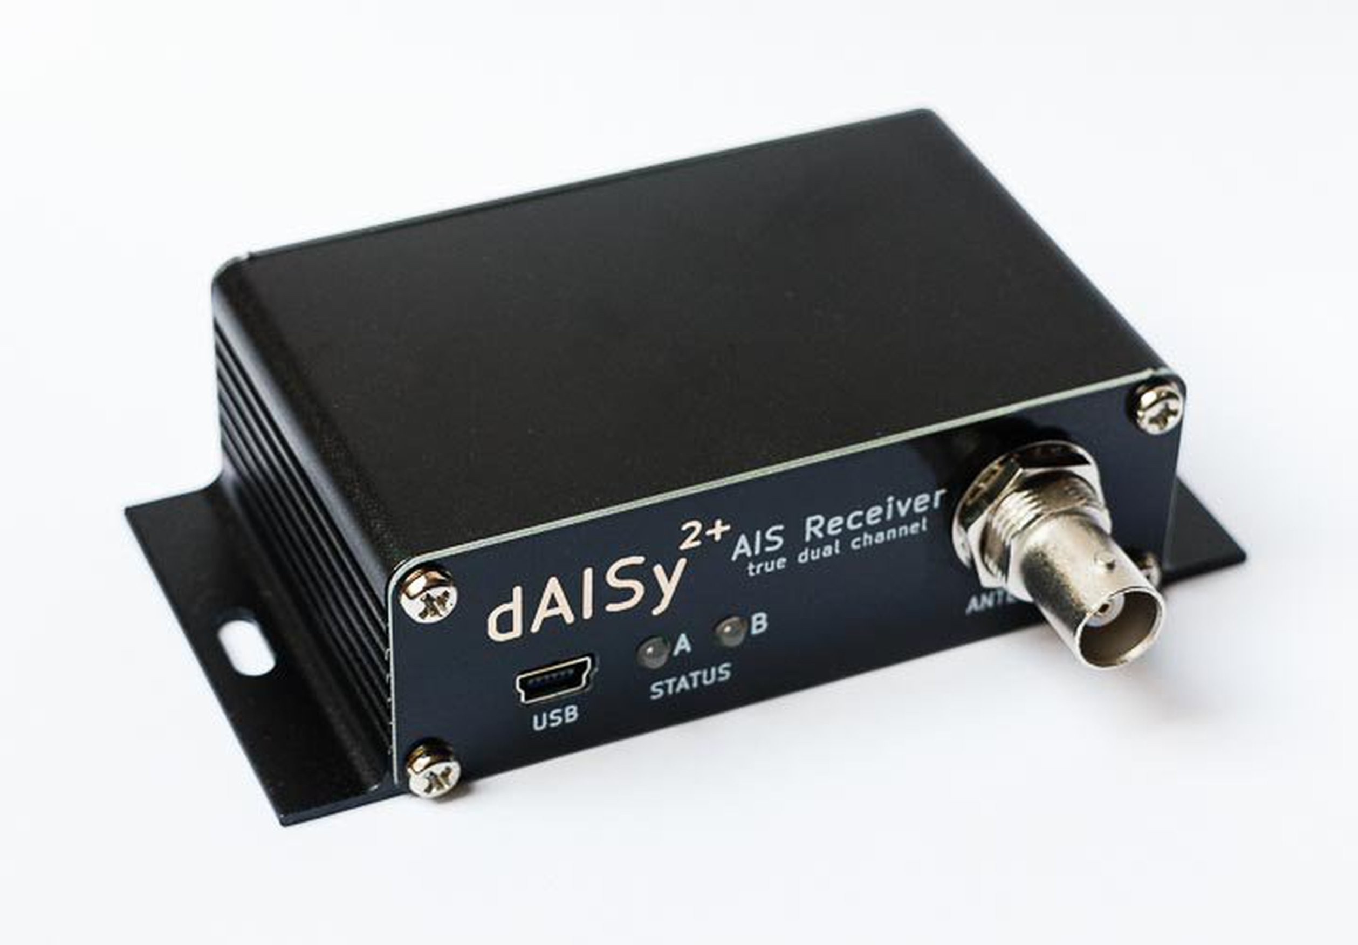
AIS receiver
AIS Dispatcher
AWS (Linux server)
sqlite3
Fast API
AIS Decoder

