Slide 1
Statistical Machine Translator
Jussi Kolehmainen 24.10.2013

Slide 2
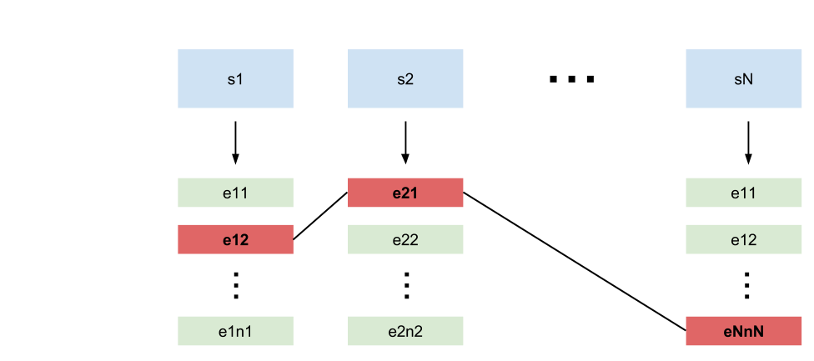
The Problem
Translate a Spanish sentence into English
Translate word by word
Multiple translations for each word

Slide 3
One approach
Build index from a large corpus (e.g. frequencies)
Translate word by word with a dictionary
Calculate statistical features from the index and estimate probabilities for the alternative translations
Rank the alternatives by their probabilities

Slide 4
Corpus → Index
European Parliament Proceedings Parallel Corpus 1996-2011
1,965,734 sentences in both Spanish and English
Redis NoSQL database. Example keys:
en:word:occur → 3452 (frequency)
en:stem:occur → [”occurs”, ”occurence”, ...] (different forms)
en:word:occur:sentences → [523, 1523, 6534, ...] (sentences ids)
en:bigram:has:occurred → 125 (frequency)

Slide 5
Dictionary API
Glosbe API
http://glosbe.com/gapi/translate?from=spa&dest=eng&format=json&phrase=hola
Response has both direct translations and meanings
Direct translations
”hola” → ”hello”
Candidates for translations
Meanings
”killed” → ”... form of kill” → New query with ”kill”

Slide 6

Probability models
Language model P1
$$P\left(e_{2},e_{1}\right)=\frac{\#\left(e_{1},e_{2}\right)}{\#(e_{1})}$$
Translation model P2
$$P\left(e | s\right)=\frac{\&(e,s)}{\#(e)}$$
# = frequency in the same sentence
& = frequency in the parallel sentences

Slide 7
Ranking
Probabilities are smoothed
= some part of the probability to non-existent bigrams and translations
Probability for a translation s → e: P = P1 * P2
Initial probabilities by word frequencies
Probability estimation is iterated N times
Alternatives are ranked by their probabilities

Slide 8
Conclusions
Problems
Dictionary API has a limit for queries per IP address
Dictionary API is relatively slow → Switch to offline dictionary
Finding a good indexing method for tens of millions of entries
Some results
Redis database is fast and east-to-use for indexing sentences
Simple statements produce meaningful translations
Corpus topic affects the results

