Slide 2
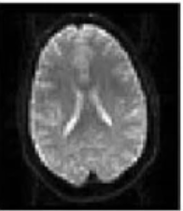

Slide 3
Unprocessed data from Subject 1 ( fMRI time series, T1w anatomical, DTI …)
Processed data from Subject 1 – 3D image where the voxel values have meaning and are comparable between subjects AND voxels
Processed data from subject 1 in the standard space – 3D image – where the voxel locations are comparable between subjects
Single subject fMRI stat map, FA image, gray matter tissue density, etc
Group level statistical map
Unprocessed data from Subject N (fMRI time series, T1w anatomical, DTI …)
Processed data from Subject N – 3D image where the voxel values have meaning and are comparable between subjects AND voxels
Processed data from subject N in the standard space – 3D image – where the voxel locations are comparable between subjects

