Slide 1

Baffling in SHELL-AND-TUBE HEAT EXCHANGERS
P M V Subbarao
Professor
Mechanical Engineering Department
I I T Delhi
A Trade-Off Agent Between Heat Transfer & Flow Loss ……

Slide 2
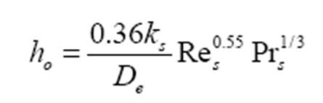
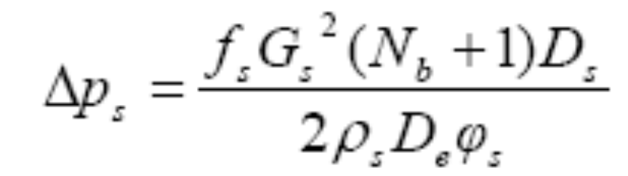
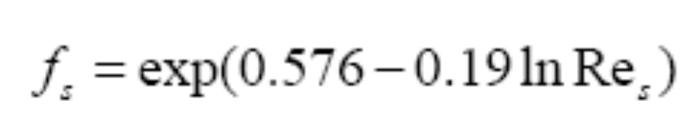
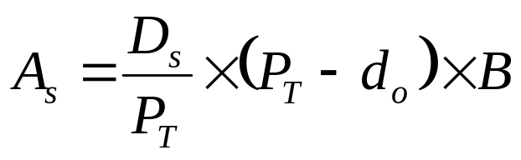
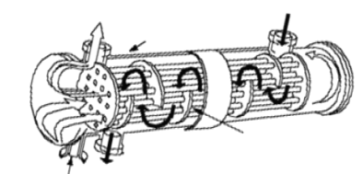
Correlations for Shell side

Slide 3
Kern’s Focus : Cost Vs Benefit

Slide 4
Heat Transfer Vs Flow Loss
Heat transfer and fluid friction losses tend to compete with one another.
The total energy loss can be minimized by adjusting the size of one irreversibility against the other .
These adjustments can be made by properly selecting physical dimensions of the solid parts (Baffles).
It must be understood, however, that the result is at best a thermodynamic optimum.
Constraints such as cost, size, and reliability enter into the determination of truly optimal designs.

Slide 5
Experience of Baffling
One of the most effective methods of enhancing the heat transfer coefficient for shell and tube heat exchangers is the use of a baffle arrangement.
Baffles also serve as support s for the tubes during operation and help in preventing vibration from flow induced eddies.
Although heat transfer is increased through the baffle arrangement, the pressure drop of the shell side fluid is also increased due to the decreased flow area, leakage and bypass effects.

Slide 6
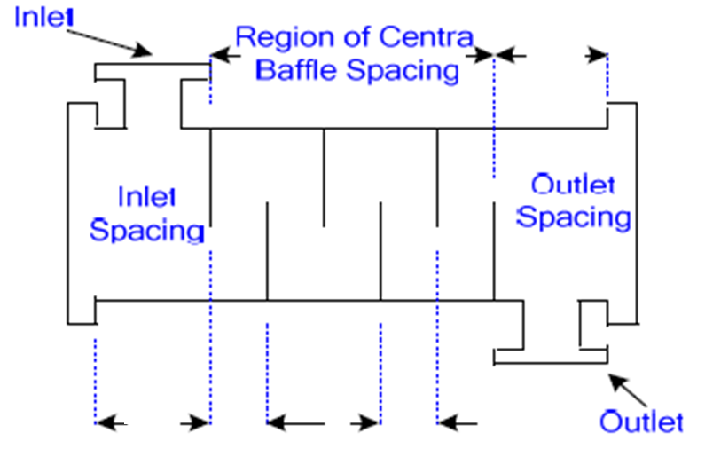
Nomenclature of Baffle Spacing

Slide 7
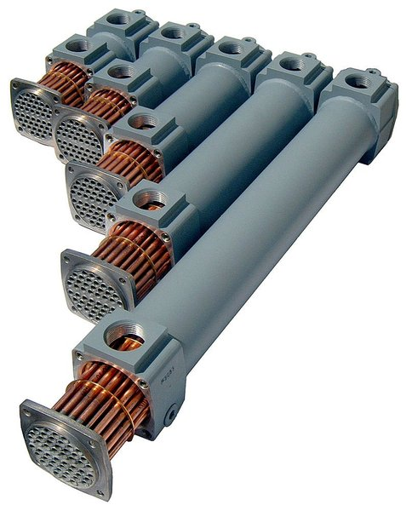
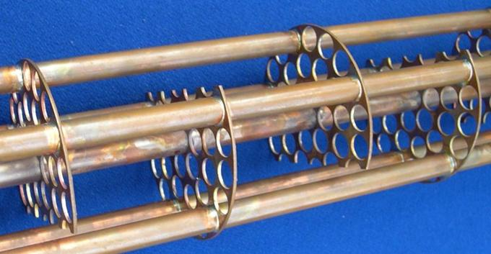
Geometrical Details of Baffles

Slide 8
Baffle Spacing
Baffle spacing is among the most important parameters used in the design of shell and tube heat exchangers.
Closer spacing causes higher heat transfer, but this leads to poor stream distribution and higher pressure drop.
On the other hand, higher baffle spacing reduces the pressure drop, but this will allow more longitudinal flow, which decreases the coefficient of heat transfer.
It is, thus, difficult to realize the advantage of baffle arrangements.

Slide 9
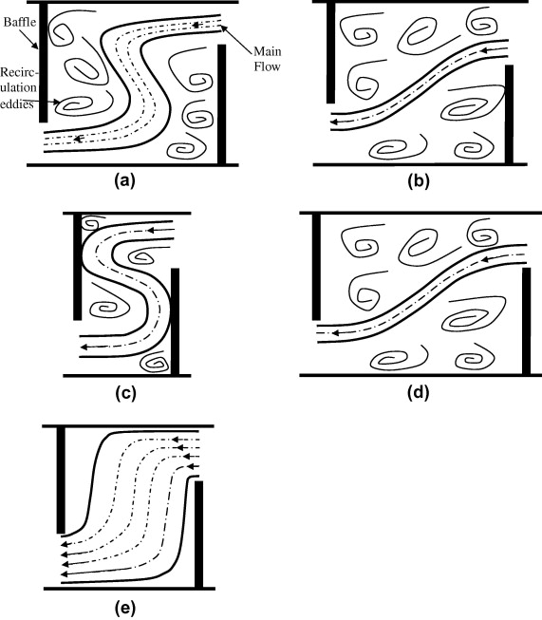
Fluid Dynamics of Baffle Spacing

Slide 10
Baffles Spacing to Baffle Window

Slide 11
B (mm), Central Baffle Spacing:
    The term ‘central’ in central baffle spacing is to state a uniform baffle spacing over the baffled length of the tube bundle because sometimes, the baffle spacing changes due to the inlet and outlet regions.
    The minimum acceptable baffle spacing B_{min} is required for reasons of good flow distribution to get a steady flow pattern of the cross flow and baffle window flow.
    Minimum baffle spacing according to firmly established rules is equal to 20% of the shell diameter D_{s}, but not less than approximately 50 mm.
    The maximum acceptable baffle spacing B_{max} is limited by some requirements.

Slide 12
    One of these requirements is that for getting good flow distribution, which in connection with the baffle window dimensioning, the maximum baffle spacing should not exceed the shell diameter D_{s}.
    So, B_{max} = D_{s}.
    Another requirement for the restriction B_{max} of is the sufficient support for the tubes to prevent sagging and possible tube vibration.
    This dimension is defined as the ‘maximum unsupported span’,L_{B,max}.
    The recommended values of L_{B,max} for plain tubes are a function of the tube diameter and two tube material groups: group A, steel and steel alloys; group B, aluminum and copper alloys.

Slide 13
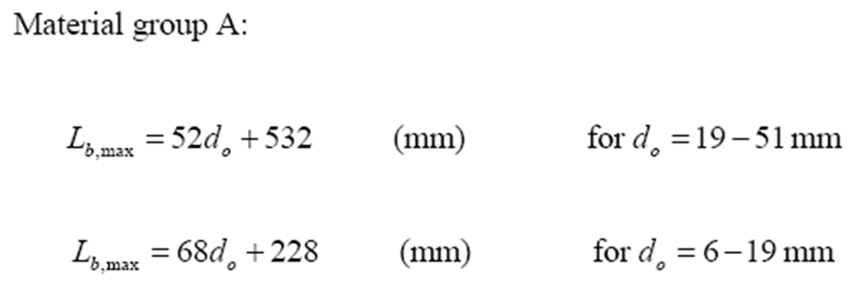
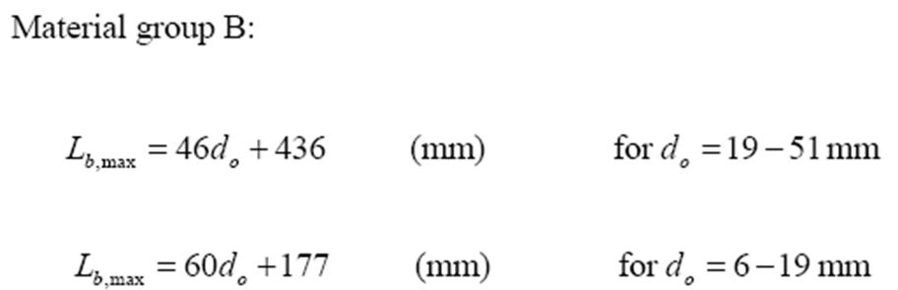

Slide 14
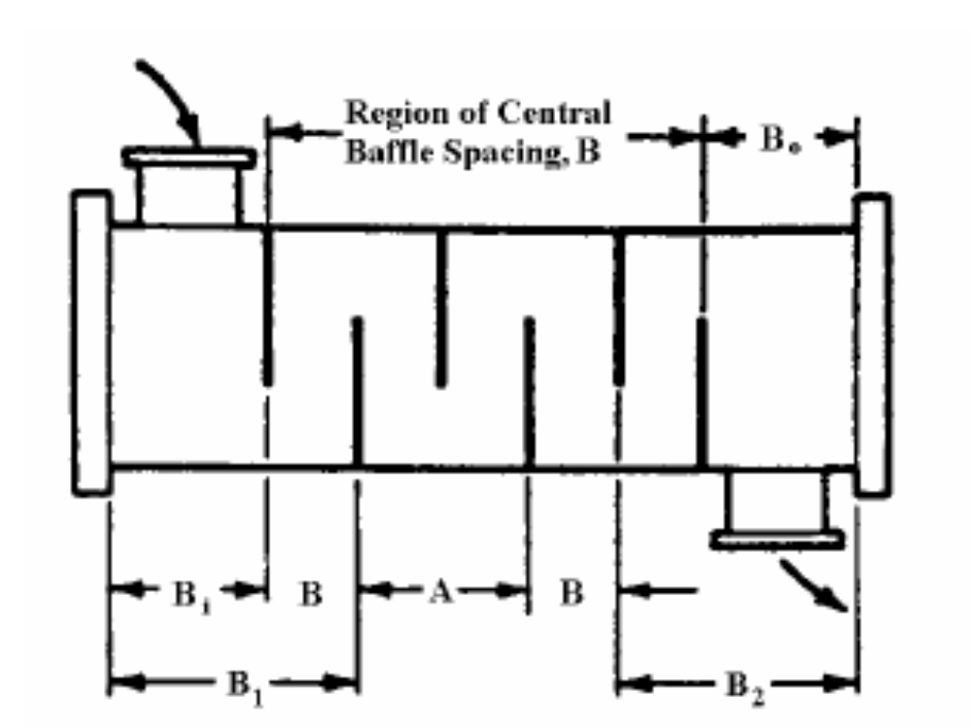
Inlet and outlet baffle spacings

Slide 15
Inlet and outlet baffle spacings
    In the cases where large inlet and outlet nozzles must be used and the baffle spacing adjoining the nozzles must be enlarged.
    The additional data entries of B_{i} and B_{o} are necessary.
    In these cases the longest unsupported tube span is in the baffle window adjoining the enlarged baffle space B₁ and B₂.
    This value must not exceed L_{B,max}.

Slide 16
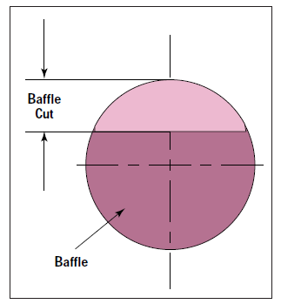
Baffle Cut
Baffle cut is the height of the segment that is cut in each baffle to permit the shell side fluid to flow across the baffle.
This is expressed as a percentage of the shell inside diameter.
Although this, too, is an important parameter for STHE design, its effect is less profound than that of baffle spacing.

