Slide 1


Slide 2
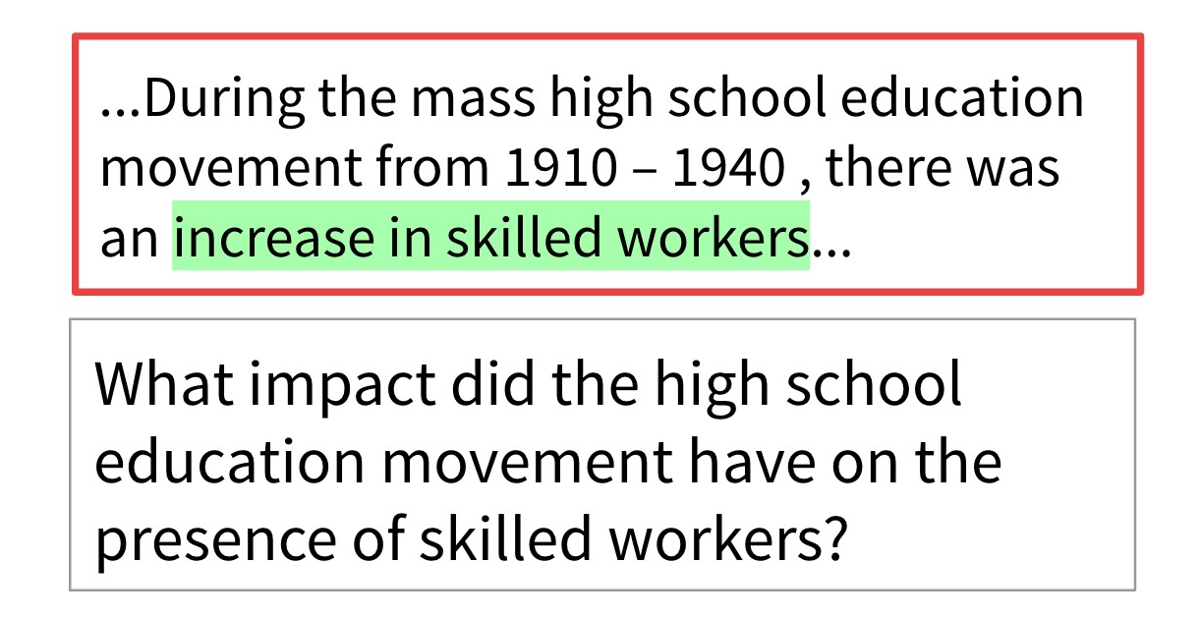
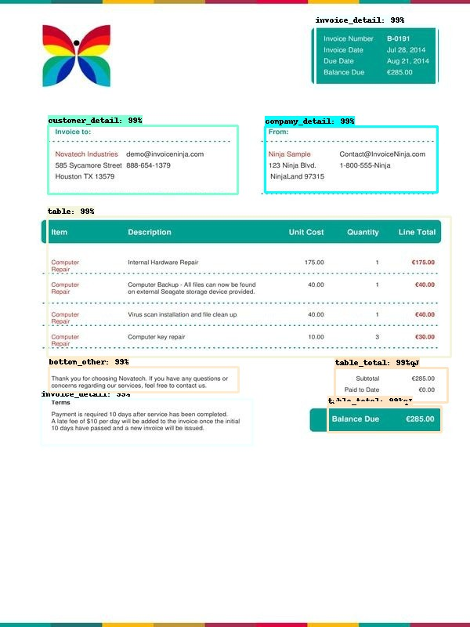
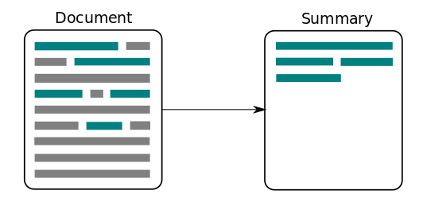
Some high-level NLP usecases. For more, check out https://demo.allennlp.org/
Question & Answering Models:
Invoice Data Extraction:
Text summarization models:

Slide 3
NLP roadmap:
1. Cleaning and pre-processing text
Tokenization, stemming, lemmatization, stopwords, regex etc.
2. Machine understandable text
One hot encoding, Bag of Words, TFiDF etc.
Word2Vec, FastText, Gensim etc.
3. Understanding neural networks
Working of ANN, loss functions, gradient descent, activation functions etc.
4. Popular neural networks for NLP
Creation of word embeddings using neural networks
LSTMs, RNNs, GRUs etc.
Attention mechanisms, encoder-decoder networks, bidirectional networks
5. Transformers

Slide 4
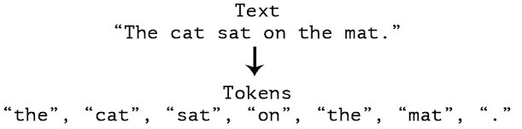
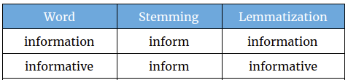
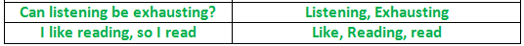
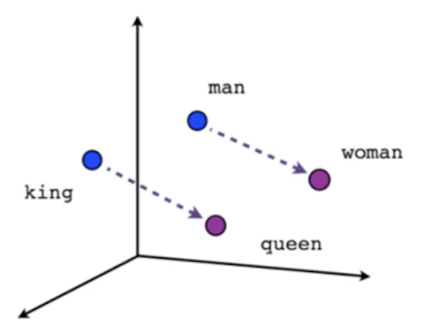
Some low level NLP usecases:
https://explosion.ai/demos/displacy
https://explosion.ai/demos/displacy
https://explosion.ai/demos/displacy-ent
Tokenization
Stemming
Lemmatization
Stop-word removal
POS tagging
Dependency parsing
Vectorization
Named Entity Recognition

Slide 5
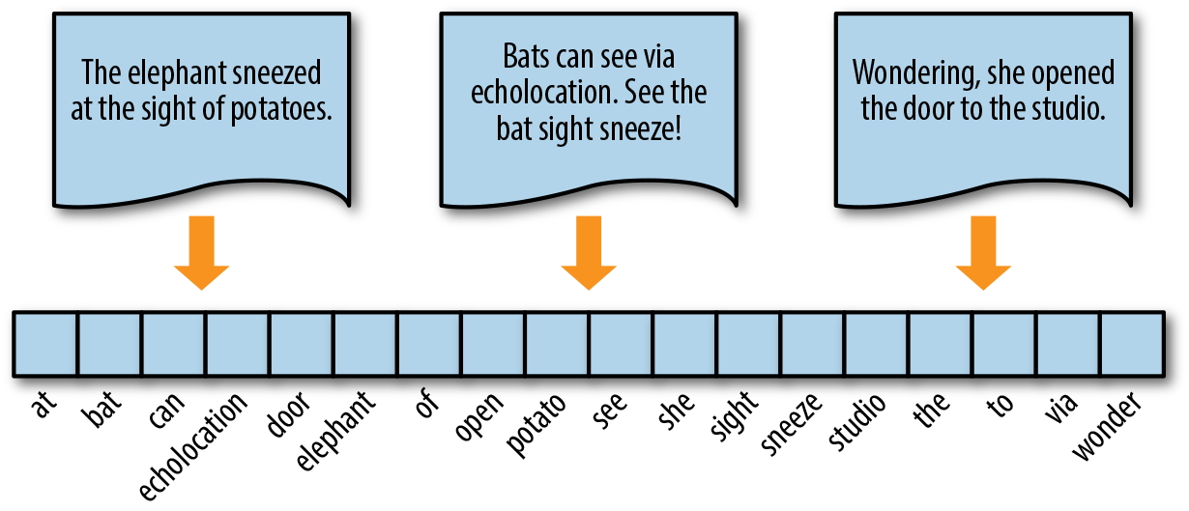
One hot encoding of sentence 1:
1 0 0 0 0 1 1 0 1 0 0 1 1 0 1 0 0 0

Slide 6
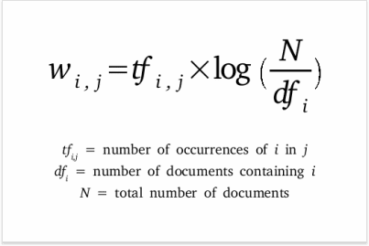
Tf-idf (Term frequency, inverse document frequency)
Each word or token will have a Tf-idf value which is a product of two metrics: How many times a word appears in a document, and the inverse document frequency of the word across a set of documents.
The term frequency of a word in a document: There are several ways of calculating this frequency, with the simplest being a raw count of instances a word appears in a document. Then, there are ways to adjust the frequency, by length of a document, or by the raw frequency of the most frequent word in a document.
The inverse document frequency of the word across a set of documents. This means, how common or rare a word is in the entire document set. The closer it is to 0, the more common a word is. This metric can be calculated by taking the total number of documents, dividing it by the number of documents that contain a word, and calculating the logarithm.
If the word is very common and appears in many documents, this number will approach 0. Otherwise, it will approach higher values.

Slide 7
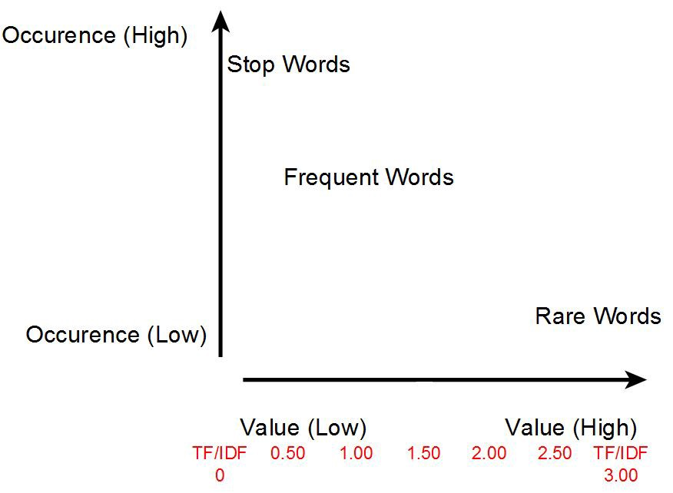
Intuition of tf-idf

Slide 8
Flowchart of an average NLP usecase using ML or DL
1. Analysis and pre-processing of texts
Tokenization, stemming, lemmatization, stopwords, regex etc.
2. Text to numbers (vectorization) (generation of embeddings)
One hot encoding, Bag of Words, TFiDF etc.
Word2Vec, FastText, Gensim etc.
3. Using the ML or DL model to train a task
4. Parameter tuning of the model
5. Check performance metrics

Slide 9
Major NLP usecases:
Topic modelling eg: We have a bunch of restaurant reviews and need to identify the major topics or areas of interest.
Text clustering (unsupervised) eg: We have mixed text containing paragraphs related to chemistry, astronomy, mystery novel and food reviews. We need to sort them into clusters or groups.
Text classification (supervised) eg: Classify mails into spam or non-spam (ham) eg: Categorize if individual tweets deal with Indian tourism or not.
Similarity comparison eg: We have a sample sentence and need the top 20 similar sentences from a book
Grammatical corrections or grammar analysis

