Slide 1
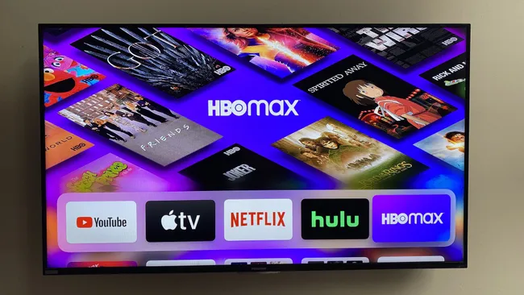
Movie Recommendation System
Personalized Viewing for a Next-Gen Streaming Platform
MovieLens Dataset • SVD • TF-IDF • Hybrid Routing • Streamlit

Slide 2
Business Problem
Why does personalization matter?
The Challenge
The Cost of Churn
Our Solution
A new streaming platform needs to compete with Netflix & Disney+. Without personalization, users churn within the first few sessions.
Acquiring a new subscriber costs 5–7× more than retaining one. Poor recommendations = lost revenue and brand damage.
A multi-stage recommendation engine that adapts to every user — from first login to long-term resident.
Goal: Increase user retention by delivering the right movie to the right user at the right time.
Dataset: MovieLens — 100,000+ ratings across 9,000+ movies
Methodology: CRISP-DM (Business Understanding → Deployment)
Deployment: Interactive Streamlit dashboard

Slide 3
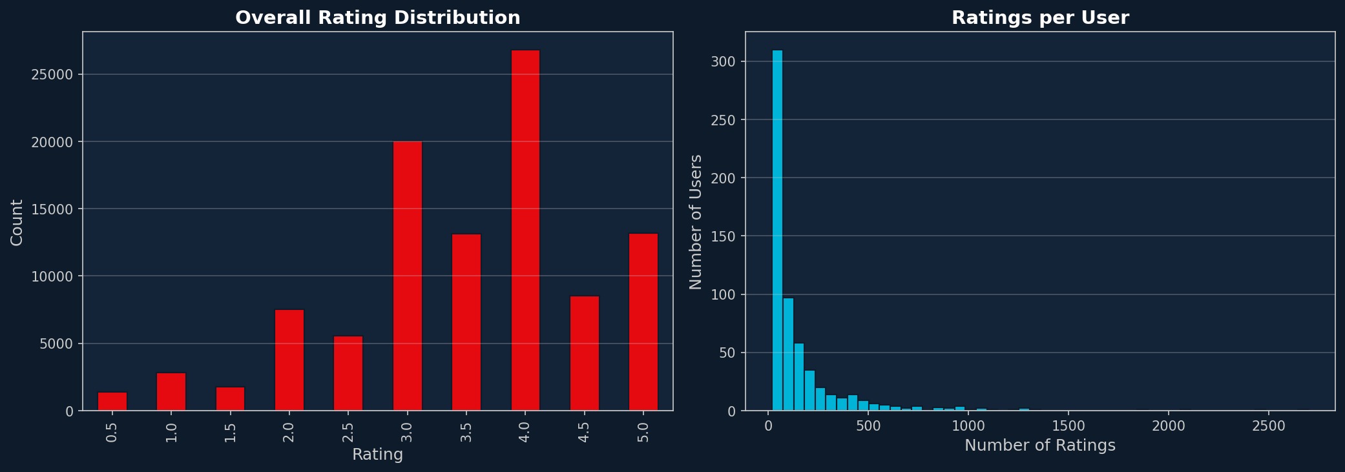
Dataset & Exploratory Data Analysis
MovieLens 100K
100,000+
9,000+
600+
18
User Ratings
Unique Movies
Active Users
Genre Categories
Key EDA Findings
Rating distribution is left-skewed — users tend to rate movies they enjoyed (avg ≈ 3.5)
Drama, Comedy, and Thriller dominate the catalog; niche genres are underrepresented
Power users (top 5%) account for ~30% of all ratings — classic long-tail distribution
~40% of users have fewer than 10 ratings, confirming a significant cold-start challenge
User tags (e.g. 'atmospheric', 'twist ending') provide rich semantic signals for TF-IDF

Slide 4
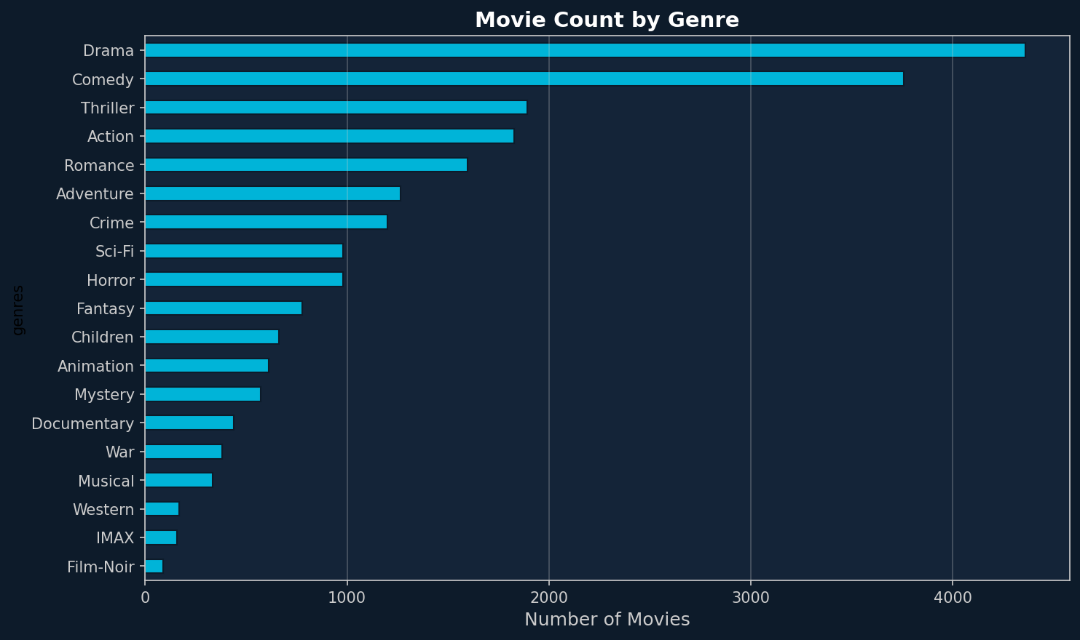
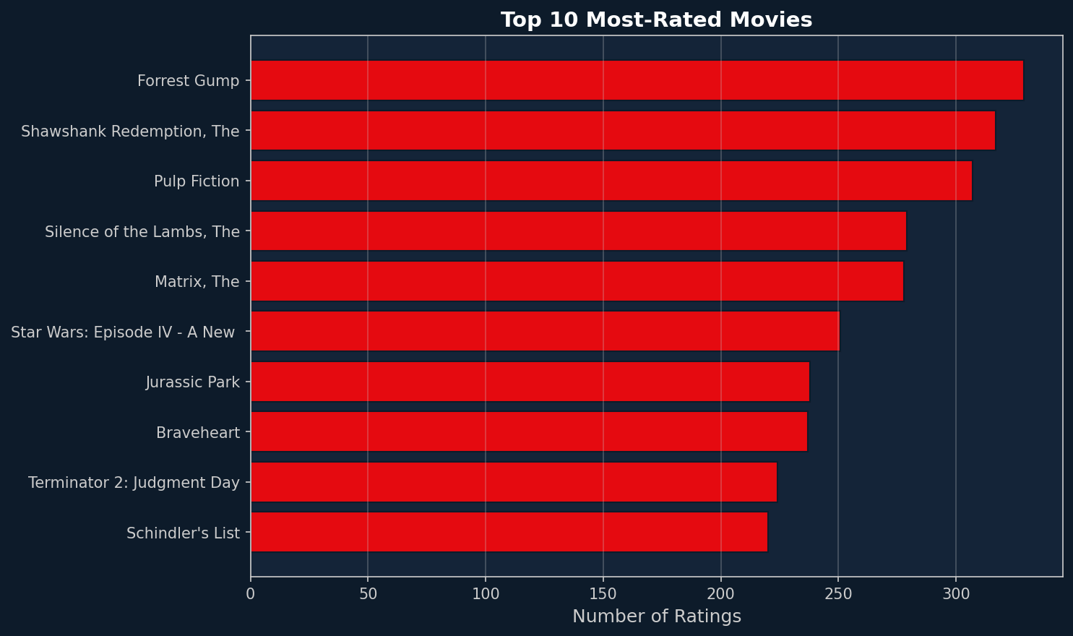
EDA — Visual Insights
Genre distribution & most-rated movies

Slide 5
System Architecture — The Router
One engine, three strategies
User Login → Count Ratings → Router → Select Strategy → Return Recommendations
New / Near-Cold (0–10 ratings)
Early User (10–50 ratings)
Resident User (50+ ratings)
Popularity-Based + Content-Based (TF-IDF)
Hybrid Model (SVD + TF-IDF, α-weighted)
Collaborative Filtering (Optimized SVD)
Ensures new users see relevant content immediately
Balances exploration with personalization
Full latent-factor personalization
α = 0.7 (SVD weight) in Hybrid mode — tuned to favour collaborative signal while preserving content diversity

Slide 6
Algorithms Deep-Dive
How each model works
SVD (Collaborative Filtering)
TF-IDF (Content-Based)
• Decomposes the user-item matrix into latent factors • Captures hidden taste patterns (e.g. 'likes slow-burn dramas') • Trained with SGD; regularised to prevent overfitting • Best RMSE: 0.861
• Builds a feature vector from genres + user tags per movie • Cosine similarity between user profile and all movies • User profile = weighted average of rated-movie vectors • Ideal for cold-start & niche discovery
Hybrid (α-Weighted Blend)
KNN (User-Based CF)
• Final score = α × SVD_norm + (1−α) × Content_norm • α = 0.7 (SVD dominates, content adds diversity) • Explanation engine: labels each rec with a human reason • Smooth transition from cold-start to full CF
• Finds k nearest neighbours by rating similarity • Aggregates neighbour ratings for unseen movies • RMSE: 0.898 — solid but slower than SVD • Useful for community-based recommendations

Slide 7
Evaluation Results
RMSE (lower = better) • NDCG@10 (higher = better)
Model
RMSE
NDCG@10
Best For
SVD (Collaborative)
0.861
0.953
Active / Resident users
KNN (User-Based CF)
0.898
0.948
Community-driven recs
Hybrid (SVD + TF-IDF)
—
0.554
Early users (10–50 ratings)
Content-Based (TF-IDF)
—
0.527
New users / cold-start
SVD achieves the best RMSE (0.861) and NDCG@10 (0.953) — selected as the primary engine for resident users.

Slide 8
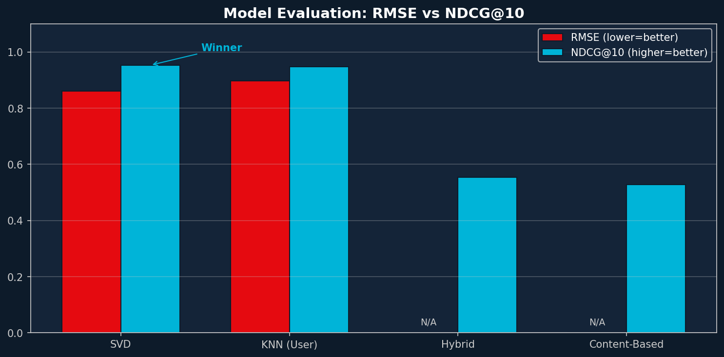

Slide 9
Sample Recommendations
SVD top-5 predictions for selected users
User 1
User 100
User 300
The Shawshank Redemption (1994)
Lawrence of Arabia (1962)
There Will Be Blood (2007)
★ 5.0
Crime
★ 4.66
Adventure
★ 4.61
Drama
In the Name of the Father (1993)
There Will Be Blood (2007)
The Shawshank Redemption (1994)
★ 5.0
Drama
★ 4.62
Drama
★ 4.55
Crime
Dr. Strangelove (1964)
The Shawshank Redemption (1994)
Three Billboards Outside Ebbing (2017)
★ 5.0
Comedy
★ 4.61
Crime
★ 4.54
Crime
Rear Window (1954)
The Philadelphia Story (1940)
Citizen Kane (1941)
★ 5.0
Mystery
★ 4.58
Comedy
★ 4.53
Drama
Casablanca (1942)
Dr. Strangelove (1964)
Ghost in the Shell (1995)
★ 5.0
Drama
★ 4.57
Comedy
★ 4.52
Animation

Slide 10
Streamlit Dashboard
Interactive deployment
User ID Input
Recommendation Slider
Enter any user ID to instantly retrieve personalised recommendations.
Choose between 5 and 20 recommendations per session.
Onboarding Flow
Automatic Routing
New users rate 10 popular movies to bootstrap their content profile.
The router silently selects the best algorithm based on rating history.
Feedback Buttons
Dual-Column Layout
Users mark each recommendation as Interested or Not Interested.
Cold-start users see Popular Picks alongside Content-Based picks side by side.
Run locally: streamlit run app.py | Dependencies: streamlit, pandas, numpy, scikit-learn, scikit-surprise

Slide 11
Conclusions & Next Steps
What we built and where to go next
Key Achievements
Future Improvements
• SVD delivers NDCG@10 = 0.953 — near-perfect ranking quality
• Deep Learning: Neural Collaborative Filtering (NCF) or two-tower model
• Cold-start fully mitigated via popularity + TF-IDF onboarding
• Real-time retraining pipeline with streaming user events
• Hybrid model bridges the gap for early-stage users
• A/B testing framework to measure retention lift in production
• Router logic adapts seamlessly across all user lifecycle stages
• Incorporate implicit feedback (watch time, re-watches, skips)
• End-to-end deployment via Streamlit with real-time feedback loop
• Expand content features: cast, director, synopsis embeddings
• CRISP-DM methodology ensures reproducible, business-aligned results
• Cloud deployment on AWS (SageMaker + Lambda + API Gateway)

Slide 12
Thank You
Group 1 — Movie Recommendation System — Phase 4
Questions?
0.861
0.953
100K+
4
RMSE
NDCG@10
Ratings
Models

