Slide 1
Predicting H1N1 Vaccination Uptake
Justin Mawira

Slide 2
Overview of The Task
We want to understand who gets vaccinated and why
Why it matters:
To improve public health campaigns
To prepare for future pandemics
To target resources effectively

Slide 3
The Data
Source: 26,000+ respondents from the 2009 National H1N1 Flu Survey
What was looked at:
Opinions: Is the vaccine safe? Am I at risk?
Behaviours: Do they wear masks? Wash hands?
Demographics: Age, income, race, and employment.

Slide 4
Data Handling
EDA
Visualization
Cleaning
Imbalance fixing
Modeling
Model evaluation

Slide 5
Visualizations
1. Vaccination Rate by Opinion on Vaccine Effectiveness
2. Vaccination Rate by Opinion on H1N1 Risk
3. Vaccination Rate by Doctor’s Recommendation
4. Vaccination Rate: Doctor’s Rec x Opinion on H1N1 Risk
5. Vaccination Rate: Income x Risk (w/,w/o Rec)

Slide 6
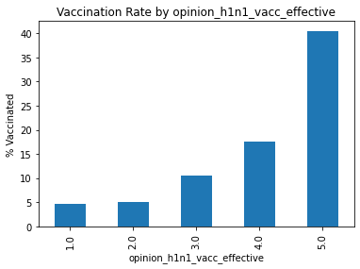
Visual 1

Slide 7
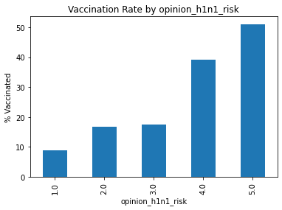
Visual 2

Slide 8
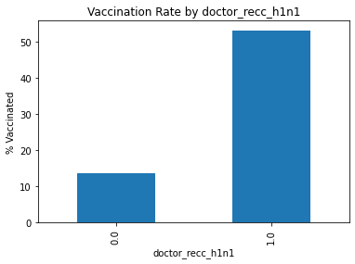
Visual 3

Slide 9
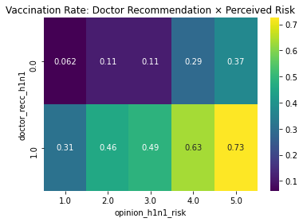
Visual 4

Slide 10
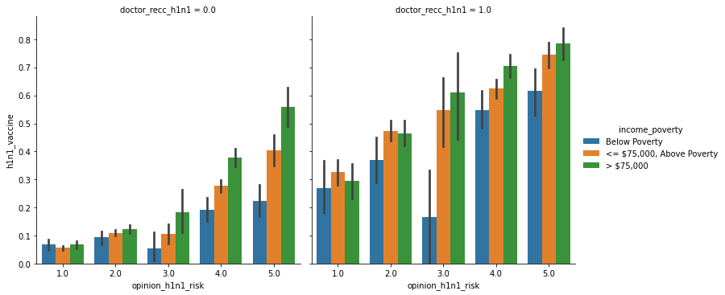
Visual 5

Slide 11
Findings: The “Doctor Factor”
A doctor’s recommendation is the single strongest predictor of vaccination
Individuals who received a recommendation were significantly more likely to vaccinate, even if they originally thought their personal risk was low
Even people who feel at risk don’t always vaccinate — unless advised by a doctor (at level 5 perceived risk, 37% rate without doctor’s rec vs. 73% with doctor’s rec)

Slide 12
Findings: Mindset Matters
Effectiveness: People who believe the vaccine works are nearly 8x more likely to get it than skeptics (40% vs 5%)
Risk: If people don’t feel they are in danger of getting sick, they don't get the shot. (rate of 10% at risk level 1 vs. 50% at risk level 5)

Slide 13
Findings: Socio-economic Barriers
High-income individuals who feel "at risk" vaccinate at higher rates than low-income individuals who feel the same level of risk (esp. when the latter do not have a doctor’s rec)
Black respondents and the 45–54 age group also showed slightly lower vaccination likelihoods in this dataset
Hence, It’s not just about "wanting" the vaccine; it’s about access and systemic trust.

Slide 14
Other factors
Certain employment environment had significant correlation with vaccination status
30% of individuals who reported wearing masks tended to be vaccinated, while 20% of those who didn’t were vaccinated
22% of individuals who reported hand-washing tended to be vaccinated, while 14% of those who didn’t were vaccinated

Slide 15
The Model
Two model types were tested and the winner was Logistic Regression
The model achieved an ROC-AUC of 0.83
In English; on a scale of 0.5 (guessing) to 1.0 (perfect), 0.83 means the model is very strong at distinguishing between those who will and won't get vaccinated

Slide 16
Recommendations
Use doctors to promote vaccines
Run campaigns specifically targeting how the vaccine works to build trust in vaccine effectiveness
Outline the likelihood (and severity) of infection during campaigns
Target lower-uptake demographic groups (e.g., Black communities and lower-income households) to bridge the trust gap and address systemic barriers

Slide 17
Potential Impact
Higher vaccination rates
Better targeted campaigns
More efficient resource use

Slide 18
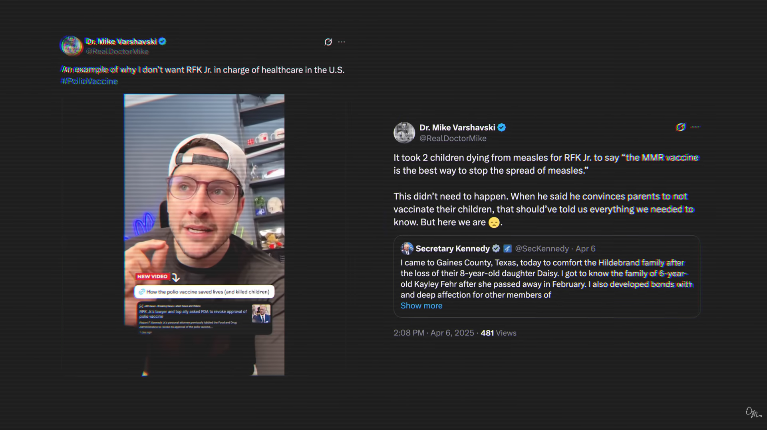
Don’t be like RFK Jr — Questions?

