Slide 1




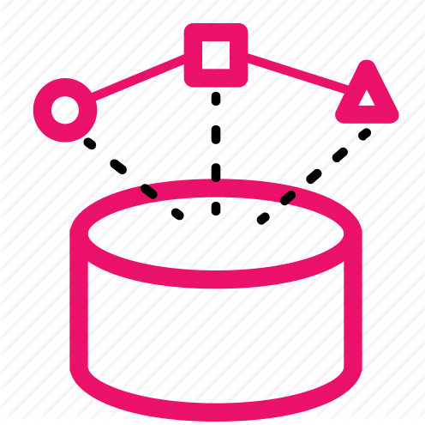




Data Collection
Sentiment Analysis
Visualization
Market Data
Pre-Processing
Topic Detection
Trend Detection

Slide 2
 | October |  |  |  | November |  |  |  | December |  |  |  | January |  |  |  | February
 | 1 | 2 | 3 | 4 | 1 | 2 | 3 | 4 | 1 | 2 | 3 | 4 | 1 | 2 | 3 | 4 | 1 | 2 | 3 | 4
Data Collection
Preprocessing Module Development
Machine Learning Modelling
Results analysis
Visualization
Reporting

