Slide 1
Uprising of the Jokers

Slide 2
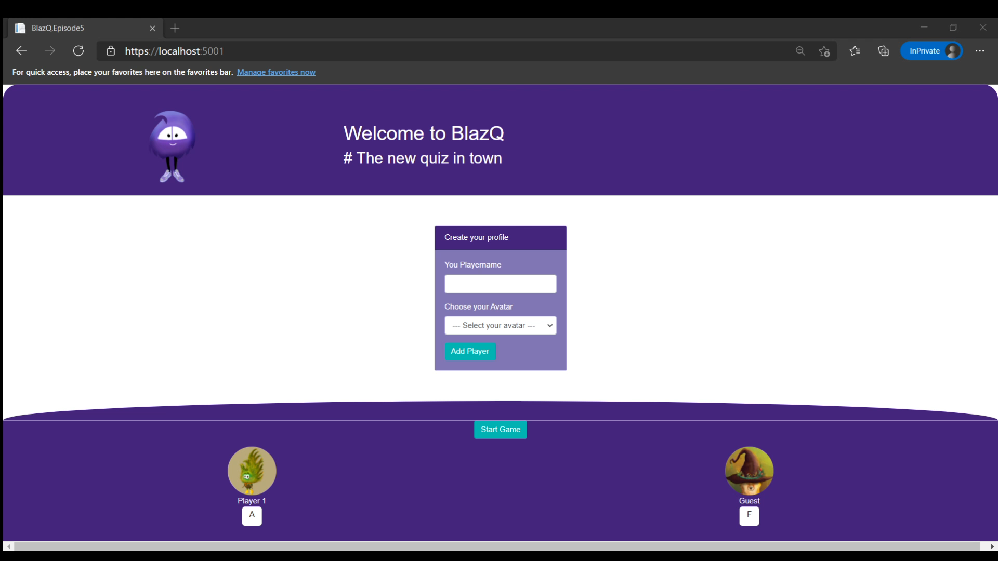
Episode’s goals: Playing BlazQ with Friends

Slide 3
Episode’s Content
Report on the last episode
Jump into coding

Slide 4
Learning Values
There are no dumb questions
No one is free of error
It’s about learning
Respect

Slide 5
Report on the last episode
Statistics, Feedback and Implications

Slide 6
Statistics
Live viewer: 1
Recorded stream viewer:
Twitch: 11 (-22)
YouTube: 0 (-10)
Feedback form received: 0
Discussions: 0
Part I: Report on the last episode

Slide 7
Statistics over time
Part I: Report on the last episode

Slide 8
Views per episode
Part I: Report on the last episode

Slide 9
Total view count over time
Part I: Report on the last episode

Slide 10
Feedback && What’s new?
So far no feedback received
Part I: Report on the last episode

Slide 11
Report summery
It is still a lot of fun doing it and we have same new followers
Still better than expected
Part I: Report on the last episode

Slide 12
Points and Jokers
Changing the Game mechanics to spice it up a bit

Slide 13
Debrief
Wrapping up the episode

Slide 14
Summary
Another session and more features
With each iteration we changing the code (also existing one) frequently
“Good code” is created overtime
Part II: Debrief

Slide 15
Summary
It’s okay (maybe even preferred) to go tiny steps
Easier to spot mistakes and correct them
Coding is fun
Part II: Debrief

Slide 16
The session plan – I
Go live
Finishing touches and deploy the application, so that everyone in the world can use it
Part II: Debrief

Slide 17
The session plan – II
Be seated in the lobby
First step in the multiplayer domain
BlazQ goes Multiplayer
Adding the mechanics for the multiplayer option
The hall of knowledge
Persisting a high score and more
This is my lobby
Introducing authentication and privacy into BlazQ
[Outro] Ain’t no sunshine when it's gone
The careers as a software developer
Part II: Debrief

Slide 18
Next Episode
Go live
Finishing touches
Deploy the app to the cloud
Episode at Thu, 25 Feb, 8 PM PST
Link: https://twitch.tv/justthebenno
Part II: Debrief

Slide 19
Questionnaire
Help me to improve the learning experience
A quick form, taking less than 5 minutes to complete
The results (and impacts) will be shown next episode
http://bit.ly/3ucZFNG
Part II: Debrief

Slide 20
Thanks for listening
I appreciate your time
If you enjoyed it, spread the word and see you on the next episode
If not, feel free to tell me why
Part II: Debrief

