Slide 1
Building the shell

Slide 2
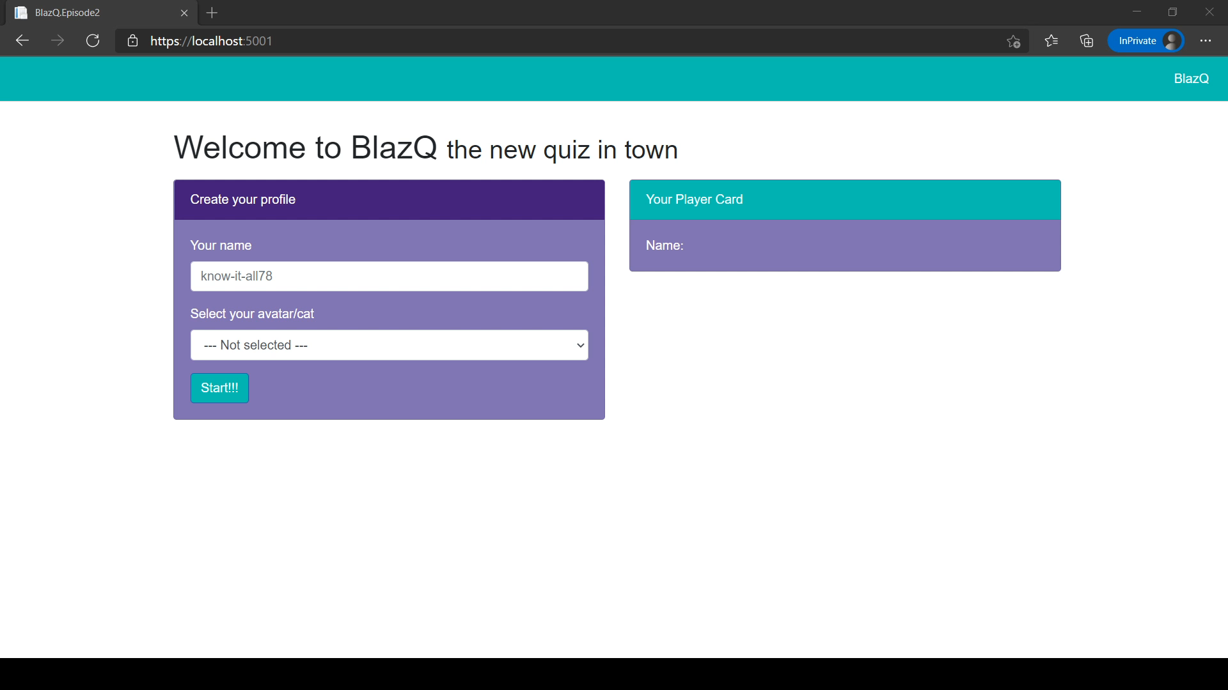
Episode’s goals: Playing a round of BlazQ

Slide 3
Episode’s Content
Report on the last episode
How to create a Blazor application
Inspecting the skeleton of a Blazor application
Building the quiz

Slide 4
Learning Values
There are no dumb questions
No one is free of error
It’s about learning
Respect

Slide 5
Report on the last episode
Statistics, Feedback and Implications

Slide 6
Statistics
Live viewer: 1
Recorded stream viewer:
Twitch: 24
YouTube: 9
Feedback form received: 0
Discussions: 0
Part I: Report on the last episode

Slide 7
Statistics other
Github
Stars: 3
Follower: 2
Part I: Report on the last episode

Slide 8
Feedback
So far no feedback received
Changes based on introspection
Part I: Report on the last episode

Slide 9
What’s new?
A teaser before an episode
10 minutes before start a countdown with a quiz
Bandwidth and connection check
Observing of the chat
Part I: Report on the last episode

Slide 10
Report summery
It takes time to build a community
It might be a slow start but that doesn’t project the end
I keep the faith and stay motivated and hoping for the best
Part I: Report on the last episode

Slide 11
How to create a Blazor application
dotnet new is your friend

Slide 12
Inspecting the skeleton of an Blazor application
Program, Host, Imports, Layouts and Components

Slide 13
Building the quiz
Let’s start building the quiz

Slide 14
Debrief
Wrapping up the episode

Slide 15
Summary
We built the very first version of the quiz. Yeah!
We know how we can individualize (other questions, avatars etc.) the quiz
We created our first class and implemented their logic
Part V: Debrief

Slide 16
Summary
We have seen many of the moving parts of a Blazor application
We used input from a user and executed an action when a button was clicked
We implemented multiple pages and navigated between
Part V: Debrief

Slide 17
The session plan – I
Prettifying BlazQ
Implementing the design
Couch Coop
Adding multiple players that can play locally
Uprising of the Jokers
Add more elements to the game
Go live
Finishing touches and deploy the application, so that everyone in the world can use it
Part V: Debrief

Slide 18
The session plan – II
Be seated in the lobby
First step in the multiplayer domain
BlazQ goes Multiplayer
Adding the mechanics for the multiplayer option
The hall of knowledge
Persisting a high score and more
This is my lobby
Introducing authentication and privacy into BlazQ
[Outro] Ain’t no sunshine when it's gone
The careers as a software developer
Part V: Debrief

Slide 19
Next Episode
Prettifying BlazQ
Deeper understanding of HTML, CSS and Bootstrap
Component lifecycle
Episode at Thu, 04 Feb, 8 PM PST
Link: https://twitch.tv/justthebenno
Part V: Debrief

Slide 20
Questionnaire
Help me to improve the learning experience
A quick form, taking less than 5 minutes to complete
The results (and impacts) will be shown next episode
https://forms.gle/7fTNmCXLbyUoPt9Z7
Part V: Debrief

Slide 21
Thanks for listening
I appreciate your time
If you enjoyed it, spread the word and see you on the next episode
If not, feel free to tell me why
Part V: Debrief

