Slide 1
Dressing up

Slide 2
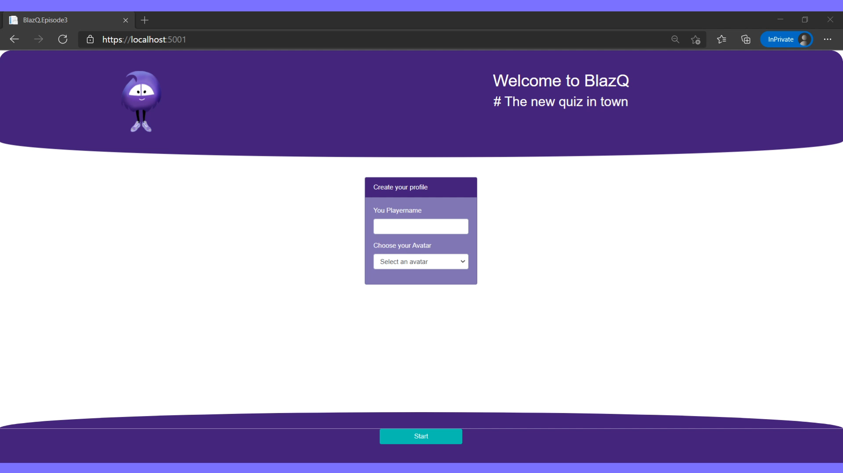
Episode’s goals: Playing a round of BlazQ

Slide 3
Episode’s Content
Report on the last episode
Jump into coding

Slide 4
Learning Values
There are no dumb questions
No one is free of error
It’s about learning
Respect

Slide 5
Report on the last episode
Statistics, Feedback and Implications

Slide 6
Statistics
Live viewer: 1
Recorded stream viewer:
Twitch: 33 (+9)
YouTube: 10 (+1)
Feedback form received: 0
Discussions: 0
Part I: Report on the last episode

Slide 7
Statistics over time
Part I: Report on the last episode

Slide 8
Views per episode
Part I: Report on the last episode

Slide 9
Total view count over time
Part I: Report on the last episode

Slide 10
Feedback && What’s new?
So far no feedback received
No changes
Part I: Report on the last episode

Slide 11
Report summery
It takes time to build a community
But we have increased viewers
Part I: Report on the last episode

Slide 12
Making it pretty
Bootstrap and Responsive Web Design

Slide 13
Debrief
Wrapping up the episode

Slide 14
Summary
BlazQ looks good!
We know what responsive web design is
Components are great
Better reusability
Less code more output
Part II: Debrief

Slide 15
Summary
Responsive web design can be tricky
A good design and useability is a lot of work
Not necessarily the skillset of a software dev
Part II: Debrief

Slide 16
The session plan – I
Couch Coop
Adding multiple players that can play locally
Uprising of the Jokers
Add more elements to the game
Go live
Finishing touches and deploy the application, so that everyone in the world can use it
Part II: Debrief

Slide 17
The session plan – II
Be seated in the lobby
First step in the multiplayer domain
BlazQ goes Multiplayer
Adding the mechanics for the multiplayer option
The hall of knowledge
Persisting a high score and more
This is my lobby
Introducing authentication and privacy into BlazQ
[Outro] Ain’t no sunshine when it's gone
The careers as a software developer
Part II: Debrief

Slide 18
Next Episode
Couch Coop
Acting based on keyboard events
More player, more logic?
Episode at Thu, 11 Feb, 8 PM PST
Link: https://twitch.tv/justthebenno
Part II: Debrief

Slide 19
Questionnaire
Help me to improve the learning experience
A quick form, taking less than 5 minutes to complete
The results (and impacts) will be shown next episode
http://bit.ly/3rl9t63
Part II: Debrief

Slide 20
Thanks for listening
I appreciate your time
If you enjoyed it, spread the word and see you on the next episode
If not, feel free to tell me why
Part II: Debrief

