Slide 1
Move it!

Slide 2
Episode’s Content
Introduction
Preparation
Let Blazorly move
Debrief

Slide 3
Introduction
What is BlazQ and how does it help to learn software development?

Slide 4
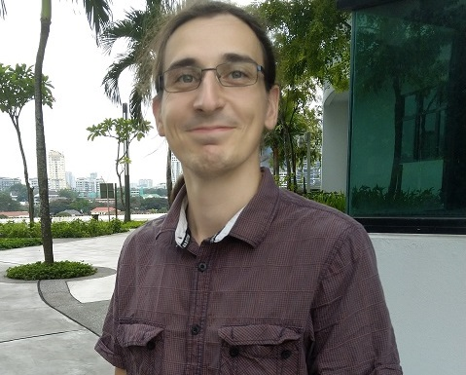
About me
Ben(jamin)
30 years old
Studied Electric Engeneering in Germany
Worked as Freelancer in different domains including
Software development
Teaching and coaching
Author and speaker
Part I: Introduction

Slide 5
Why BlazQ?
I love to develop software
I want that others can feel as empowered and “mighty” as I do
BlazQ is my contribution to a smooth start on the path towards becoming a software developer
Part I: Introduction

Slide 6
What is BlazQ?
Blazor is web technology from the .NET stack
.NET is a huge library to build any type of application
Q because we are building a quiz
Starting local, to coach coop, to a online multiplayer version
I’ve planned 12 episodes so far
We are working slowly but steady towards understanding basic concepts of software development
Part I: Introduction

Slide 7
Learning Values
There are no dump questions
I’m not free of error
It’s about learning
Respect
Part I: Introduction

Slide 8
Why BlazQ?
I love to develop software
I want that others can feel as empowered and “mighty” as I do
BlazQ is my contribution to a smooth start on the path towards becoming a software developer
Part I: Introduction

Slide 9
Learning Mode
I strongly recommend to focus on understanding during listening
Practice by yourself a time convenient for you
Part I: Introduction

Slide 10
Learning Mode - GitHub
The material for each episode is provided on Github
Code
Illustration
Slides
etc
Part I: Introduction

Slide 11
Learning Mode - GitHub
[Heading to the repo and showing basic functions]
Part I: Introduction

Slide 12
Learning Mode - Questions
Starting with the next episode, at the beginning there will be a block where you can ask questions
Besides, you can start discussion on Github
Part I: Introduction

Slide 13
Learning Mode - Questions
[Show how to start a discussions on Github]
Part I: Introduction

Slide 14
Episode’s goals
Setting up the development environment
Move Blazorly around the screen
Part I: Introduction

Slide 15
Preparation
Setting up the development environment

Slide 16
Setting up the environment
3 Things are needed
.NET 5 SDK
Git
VS Code
Runs on Windows, MacOS and Linux
Part II: Preparation

Slide 17
Setting up the environment
In the Github repo, there is a document with a step by step guide for Windows
Links for setup for MacOS and Linux are provided
Part II: Preparation

Slide 18
Setting up the environment
[Show case: Installing on Windows]
Part II: Preparation

Slide 19
Visual Studio Code Plugins
The following plugins for vscode are recommended

Slide 20
Blazorly
How to program a simple animation

Slide 21
Getting the source code
Go the the Github Repo and copy the repo URL
Go into a directory of your choice and open a terminal
type: git clone <Paste URL>
Part III: Blazorly

Slide 22
Open Visual Studio code
Start VS code
Open the directory “episode1/BlazQ.Episode1/BlazQ.Episode1”
Start the debugging process
Part III: Blazorly

Slide 23
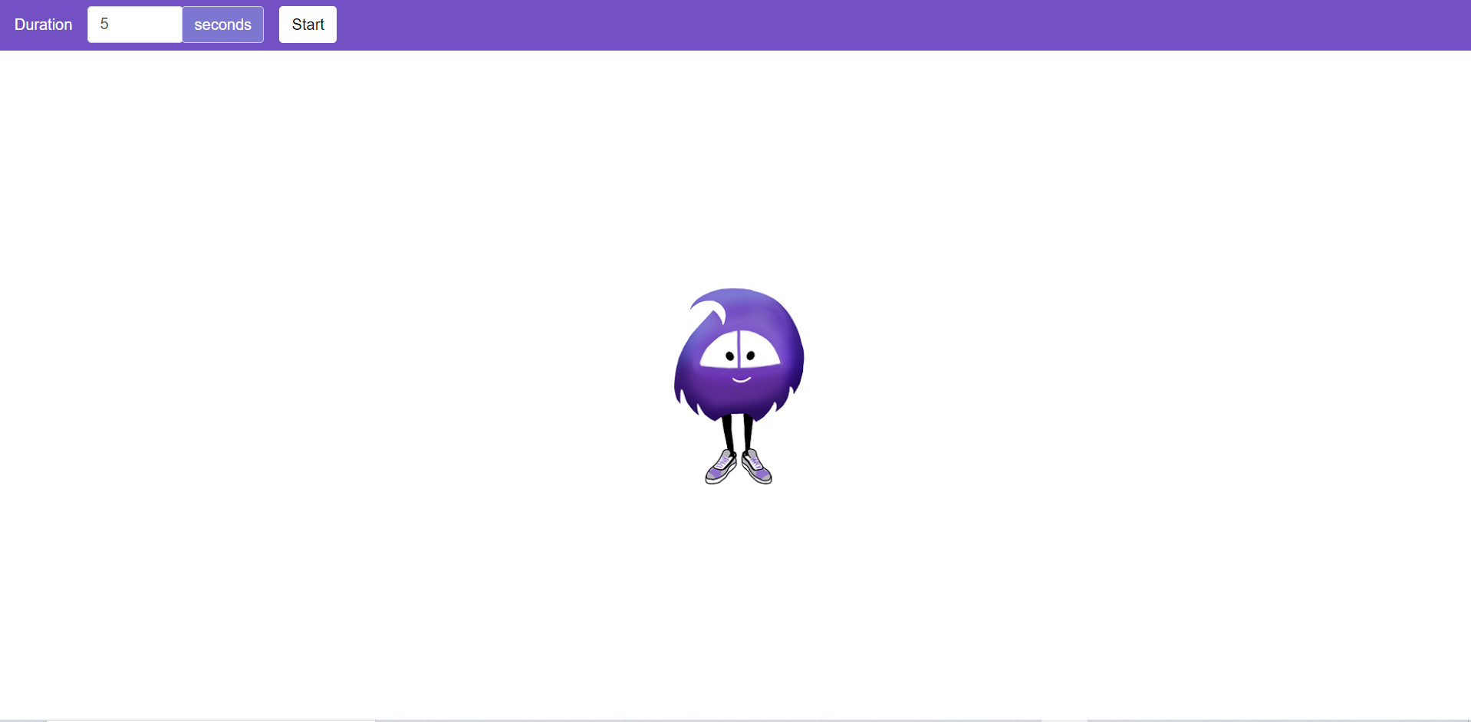
Starting point: Say hello to Blazorly
Part III: Blazorly

Slide 24
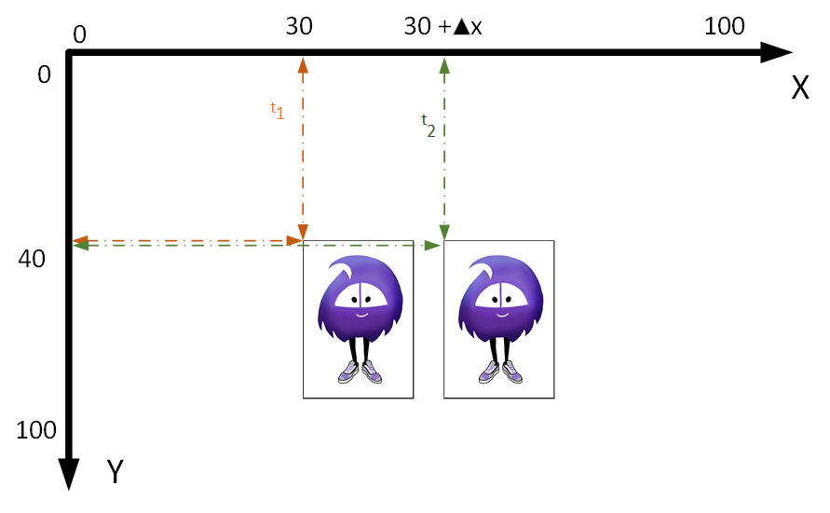
The first task: Move from left to right
Part III: Blazorly

Slide 25
Stop multiple animations
How to stop multiple animations?
Part III: Blazorly

Slide 26
The third task: Move from up to down
Part III: Blazorly

Slide 27
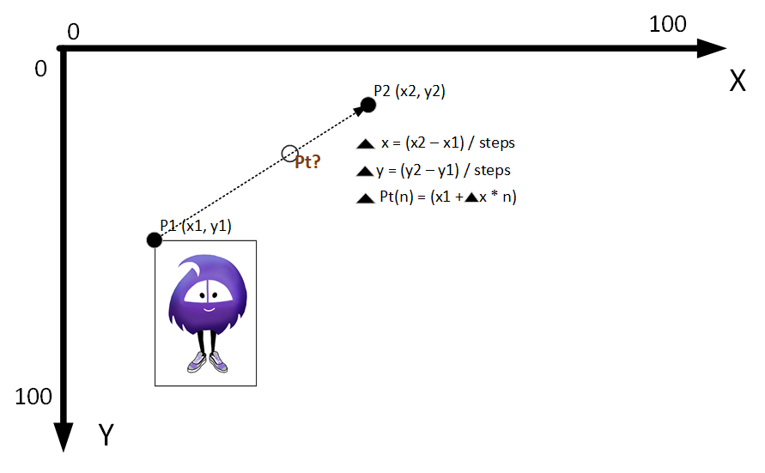
Can we generalize it? Going for paths!
Part III: Blazorly

Slide 28
Debrief
Wrapping up the episode

Slide 29
Summery
Setting up the environment
Animated the quizmaster
Introduction to variables, methods and control structures
Understand that each program consists of control structures and data
The concept of generalization to solve more than one specific problem
Part IV: Debrief

Slide 30
Summery
The episode was a quick and very brief walkthrough
The understanding will come along the path
This episode was about to accomplish (the movement of Blazorly) to feel good for the next session
Part IV: Debrief

Slide 31
Next Episode
Building the „shell“ of BlazQ
Quiz
Single player
Look okay but not great
Episode at <insert time here>
Link:
Part IV: Debrief

Slide 32
Questionnaire
Help me to improve the learning experience
A quick form, taking less than 5 minutes to complete
The results (and impacts) will be shown next episode
Part IV: Debrief

Slide 33
Thanks for listing
I appreciate your time
If you enjoyed it, spread the word and see you on the next episode
If not, feel free to tell me why
Part IV: Debrief

