Slide 1
Couch Coop

Slide 2
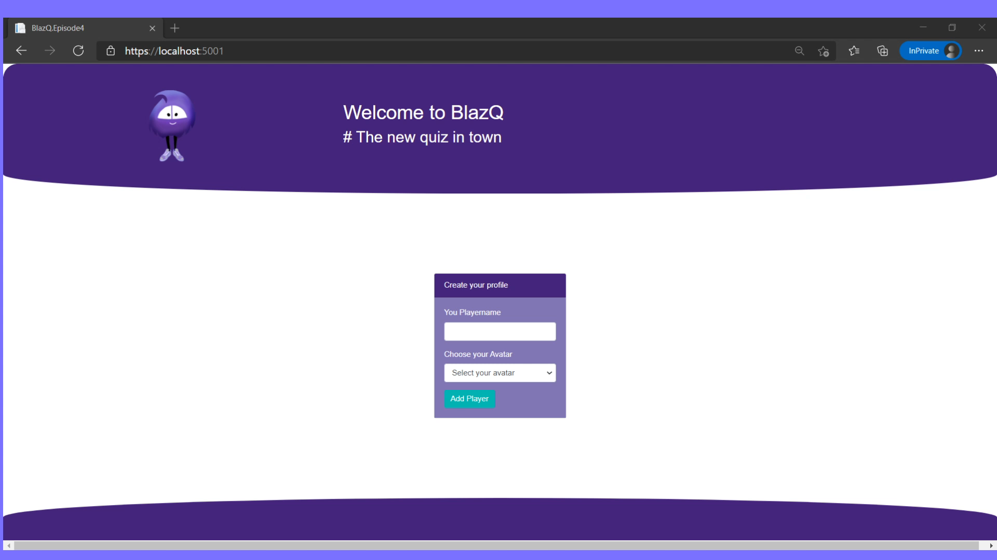
Episode’s goals: Playing BlazQ with Friends

Slide 3
Episode’s Content
Report on the last episode
Jump into coding

Slide 4
Learning Values
There are no dumb questions
No one is free of error
It’s about learning
Respect

Slide 5
Report on the last episode
Statistics, Feedback and Implications

Slide 6
Statistics
Live viewer: 1
Recorded stream viewer:
  Twitch: 11 (-22)
  YouTube: 0 (-10)
Feedback form received: 0
Discussions: 0
Part I: Report on the last episode

Slide 7
Statistics over time
Part I: Report on the last episode

Slide 8
Views per episode
Part I: Report on the last episode

Slide 9
Total view count over time
Part I: Report on the last episode

Slide 10
Feedback && What’s new?
So far no feedback received
More/different advertisement?
No changes so far
Part I: Report on the last episode

Slide 11
Report summery
Setbacks are part of the experience
Maybe the format is not appropriate?
Part I: Report on the last episode

Slide 12
Let’s play together
Adding multiple players and the couch coop mode

Slide 13
Debrief
Wrapping up the episode

Slide 14
Summary
We can play with others!
It’s good to have a foundation, that we can tweak
Small steps are the way to success
Part II: Debrief

Slide 15
Summary
With coding we can implement rules
It’s good to not only think about the happy path, but also what ways players will find to interact
Coding is fun
Part II: Debrief

Slide 16
The session plan – I
Uprising of the Jokers
  Add more elements to the game
Go live
  Finishing touches and deploy the application, so that everyone in the world can use it
Part II: Debrief

Slide 17
The session plan – II
Be seated in the lobby
  First step in the multiplayer domain
BlazQ goes Multiplayer
  Adding the mechanics for the multiplayer option
The hall of knowledge
  Persisting a high score and more
This is my lobby
  Introducing authentication and privacy into BlazQ
[Outro] Ain’t no sunshine when it's gone
  The careers as a software developer
Part II: Debrief

Slide 18
Next Episode
Uprising of the Jokers
  Adding more elements to the game
  Rewrite of the point system
Episode at Thu, 18 Feb, 8 PM PST
Link: https://twitch.tv/justthebenno
Part II: Debrief

Slide 19
Questionnaire
Help me to improve the learning experience
A quick form, taking less than 5 minutes to complete
The results (and impacts) will be shown next episode
http://bit.ly/3aWmahh
Part II: Debrief

Slide 20
Thanks for listening
I appreciate your time
If you enjoyed it, spread the word and see you on the next episode
If not, feel free to tell me why
Part II: Debrief

