Slide 1
Move it!

Slide 2
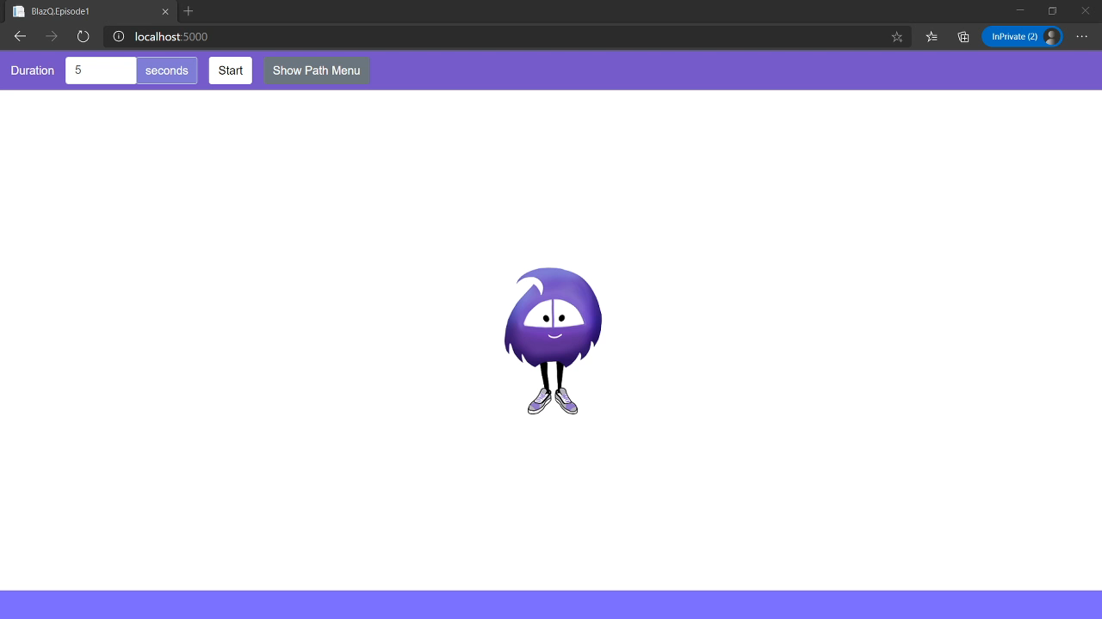
Episode’s goals: Move Blazorly around the screen

Slide 3
Episode’s Content
Introduction
Preparation
Let’s move Blazorly
Debrief

Slide 4
Introduction
What is BlazQ and how does it help to learn software development?

Slide 5
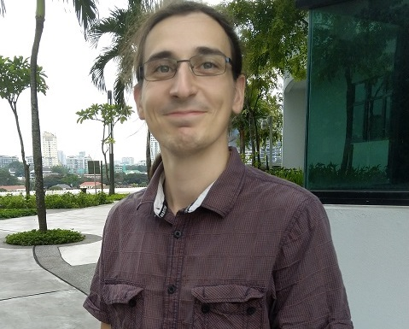
About me
Ben(jamin)
30 years old
Studied Electric Engineering in Germany
Worked as a freelancer in different domains including
Software development
Teaching and coaching
Author and speaker
Part I: Introduction

Slide 6
Who will benefit?
Is Software Engeneering your thing?
I want to develop software!
BlazQ will help you to evaluate the question whether a career as a Software Engineer is something that you’ll enjoy
You can see, if the this way of thinking is something you want to do to earn a living
Do you like to be challenged? Surpassing your limits to reach new highs of understanding?
You have already made the decision to get into tech and software development
You don’t know where to start or feel overwhelmed by all the possibilities
Looking for a challenging but still easy to follow introduction
Part I: Introduction

Slide 7
Why BlazQ?
I love to develop software
I want that others can feel as empowered and “mighty” as I do
BlazQ is my contribution to a smooth start on the path towards becoming a software developer
Part I: Introduction

Slide 8
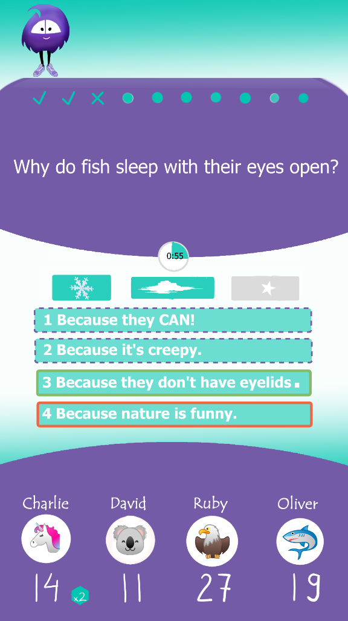
What is BlazQ?
Blazor is web technology within the .NET stack
.NET is a huge library to build any type of application
Q because we are building a quiz
Starting local player, to couch coop, to a online multiplayer version
Part I: Introduction

Slide 9
About the game
BlazQ should be a fun quiz
Taking itself not too seriously
You (as a developer) create the questions
We will add “Jokers” to spice it up
You don’t know Jack (YDKJ) is kind of the archetype (https://www.youtube.com/watch?v=PrGMnVTnmcU&t=246s)
Part I: Introduction

Slide 10
What is BlazQ?
We will start from scratch (in the next episode)
I’ve planned 12 episodes so far
We are working slowly but steady towards understanding basic concepts of software development
Part I: Introduction

Slide 11
What techniques will be covered?
Web development (HTML and CSS)
C# and object orientated programming (OOP)
Client server und HTTP REST API
Persistent data (Database, Storage)
Bidirectional communication (WebSocket)
Part I: Introduction

Slide 12
Learning Values
There are no dumb questions
No one is free of error
It’s about learning
Respect
Part I: Introduction

Slide 13
Learning Mode
I strongly recommend to focus on understanding during listening
Practice by yourself at a time convenient for you
Part I: Introduction

Slide 14
Learning Mode - GitHub
The material for each episode is provided on Github
Code
Illustration
Slides
And more
https://github.com/just-the-benno/BlazQ
Part I: Introduction

Slide 15
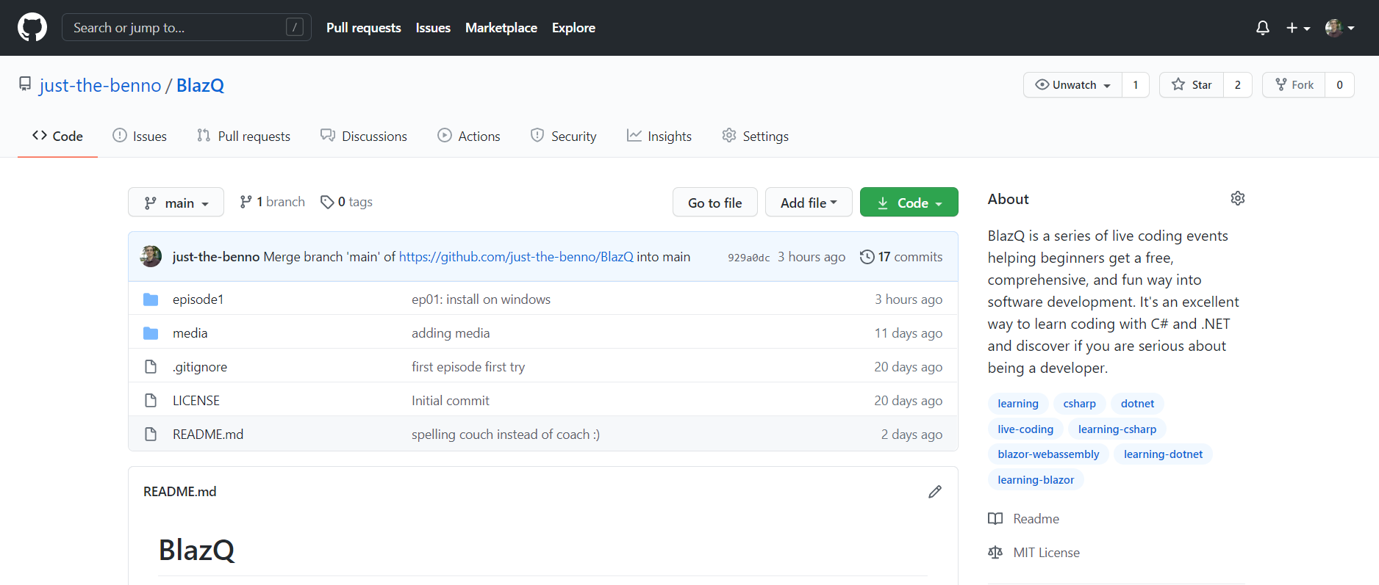
Learning Mode - GitHub
Part I: Introduction

Slide 16
Learning Mode - Questions
Starting with the next episode, at the beginning there will be a block where you can ask questions
Besides, you can start discussion on Github
Part I: Introduction

Slide 17
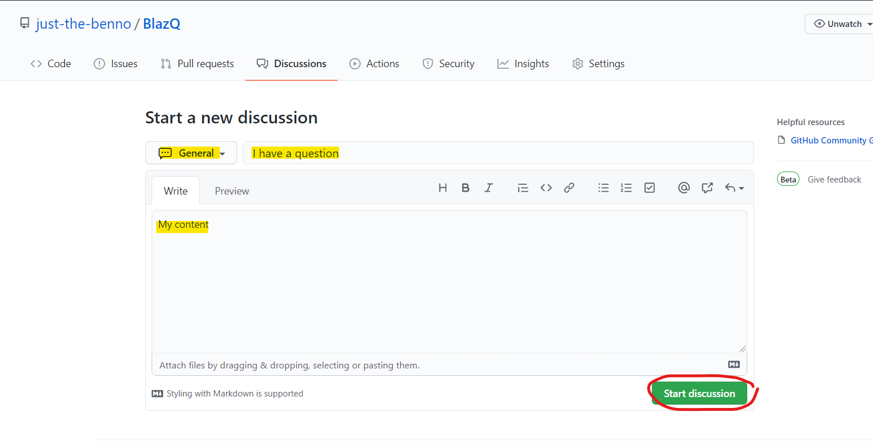
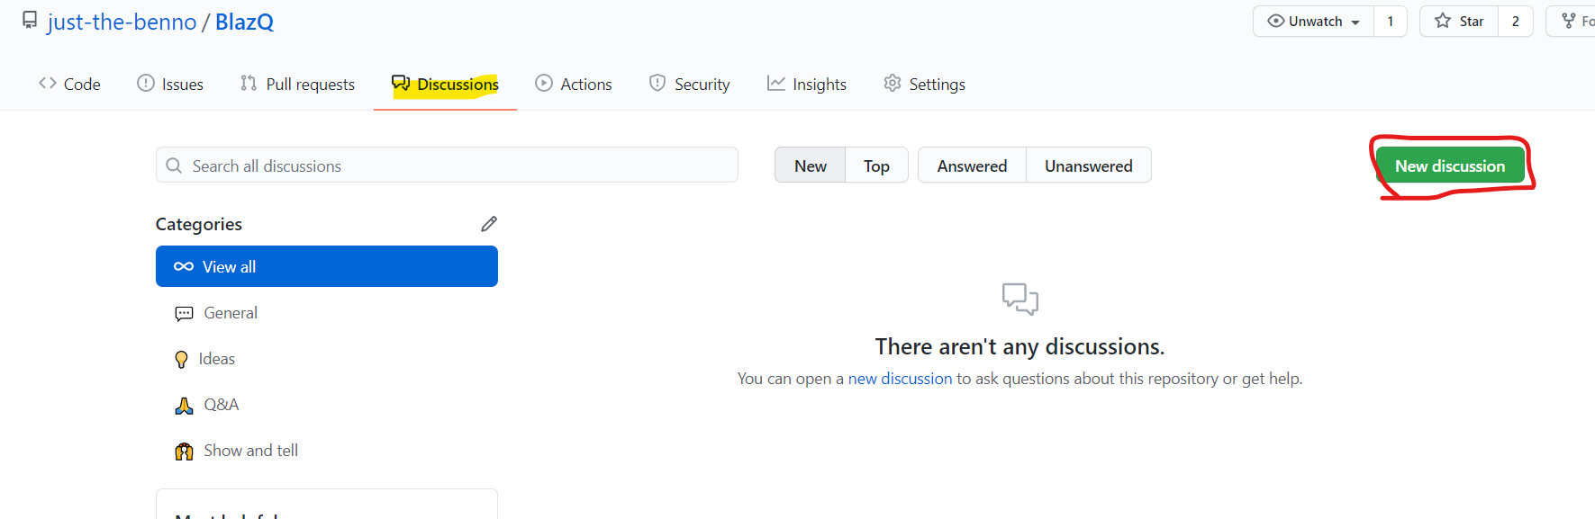
Learning Mode - Questions
Part I: Introduction

Slide 18
Episode’s goals
Setting up the development environment
Move Blazorly around the screen
Part I: Introduction

Slide 19
Preparation
Setting up the development environment

Slide 20
Setting up the environment
3 Things are needed
.NET 5 SDK
Git
VS Code
Runs on Windows, MacOS and Linux
Part II: Preparation

Slide 21
Setting up the environment
In the Github repo, there is a document with a step by step guide for Windows
Links for setup for MacOS and Linux are provided
Part II: Preparation

Slide 22
Setting up the environment
See https://github.com/just-the-benno/BlazQ/blob/main/episode1/setup-windows.md
Part II: Preparation

Slide 23
Visual Studio Code Plugins
Only one plugin for vscode is needed
C# (https://marketplace.visualstudio.com/items?itemName=ms-dotnettools.csharp)

Slide 24
Blazorly
How to instruct a simple animation

Slide 25
Getting the source code
Go the the Github Repo and copy the repo URL
Go into a directory of your choice and open a terminal
type: git clone https://github.com/just-the-benno/BlazQ.git
Part III: Blazorly

Slide 26
Open Visual Studio code
Start VS code
Open the directory “episode1/BlazQ.Episode1/BlazQ.Episode1”
Start the debugging process
Part III: Blazorly

Slide 27
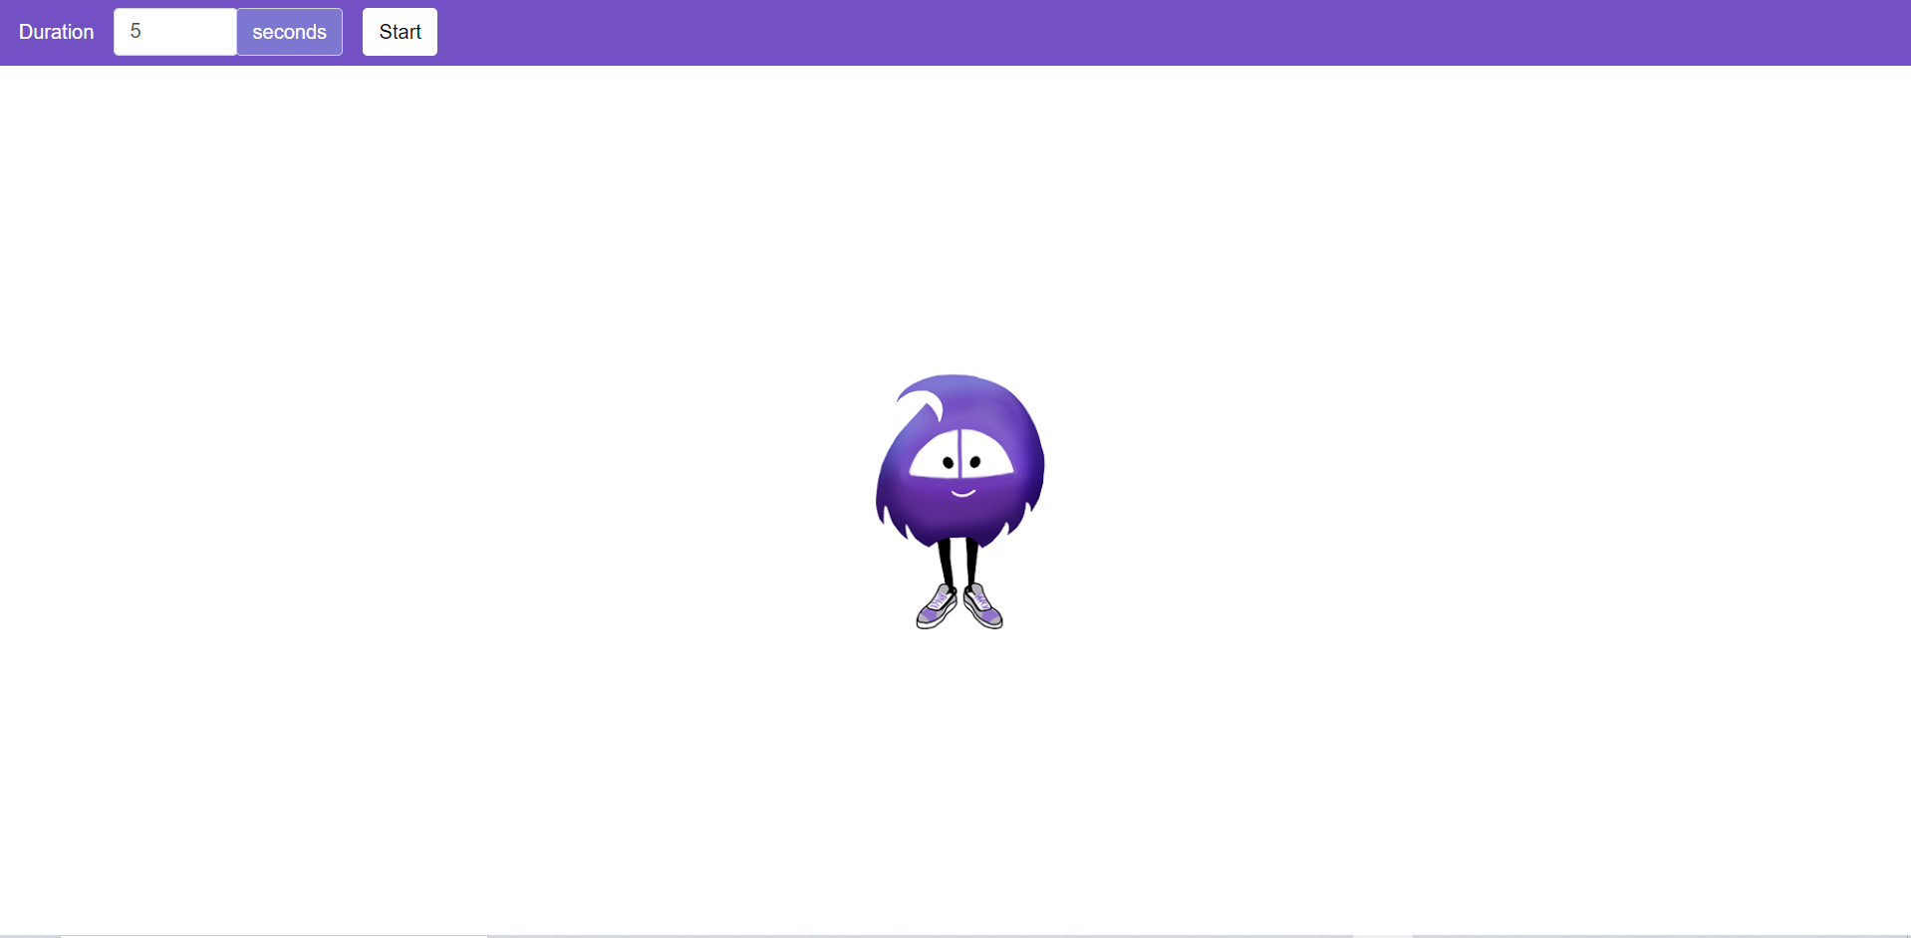
Starting point: Say hello to Blazorly
Part III: Blazorly

Slide 28
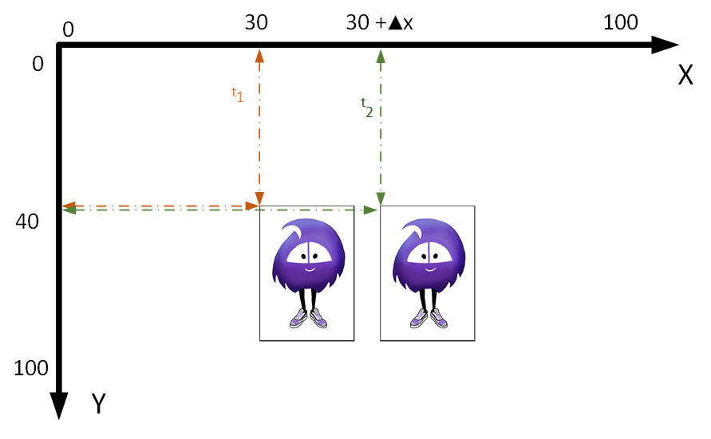
The first task: Move from left to right
Part III: Blazorly

Slide 29
Stop multiple animations
How to stop multiple animations?
Part III: Blazorly

Slide 30
The third task: Move from up to down
Part III: Blazorly

Slide 31
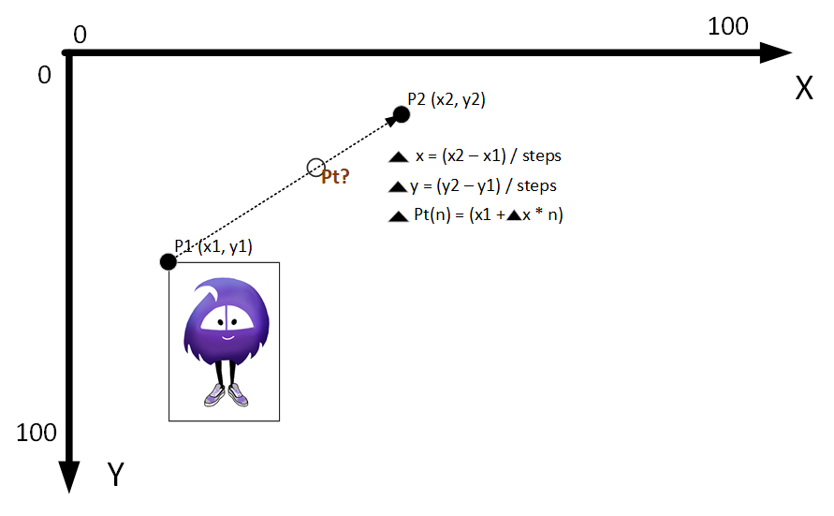
Can we generalize it? Going for paths!
Part III: Blazorly

Slide 32
Debrief
Wrapping up the episode

Slide 33
Summary
Setting up the environment
Animated the quizmaster
Introduction to variables, methods and control structures
Understand that each program consists of control structures and data
The concept of generalization to solve more than one specific problem
Part IV: Debrief

Slide 34
Summary
The episode was a quick and very brief walkthrough
The understanding will come along the path
This episode was about to accomplish (the movement of Blazorly) to feel good for the next session
Part IV: Debrief

Slide 35
The session plan – I
Building the shell of BlazQ:
Start your first project and build the foundation for BlazQ single player mode
Prettifying BlazQ
Implementing the design
Coach Coop
Adding multiple players that can play locally
Uprising of the Jokers
Add more elements to the game
Go live
Finishing touches and deploy the appliaction, so that everyone in the world can use it
Part IV: Debrief

Slide 36
The session plan – II
Be seated in the lobby
First step in the multiplayer domain
BlazQ goes Multiplayer
Adding the mechanics for the multiplayer option
The hall of knowledge
Persisting a high score and more
This is my lobby
Introducing authentication and privacy into BlazQ
[Outro] Ain’t no sunshine when it's gone
The careers as a software developer
Part IV: Debrief

Slide 37
Next Episode
Building the „shell“ of BlazQ
Quiz
Single player
Look okay but not great
Episode at Thu, 28 Jan, 8 pm PST
Link: https://twitch.tv/justthebenno
Part IV: Debrief

Slide 38
Questionnaire
Help me to improve the learning experience
A quick form, taking less than 5 minutes to complete
The results (and impacts) will be shown next episode
https://forms.gle/HKFBKnQDT6KyFjRS9
Part IV: Debrief

Slide 39
Thanks for listing
I appreciate your time
If you enjoyed it, spread the word and see you on the next episode
If not, feel free to tell me why
Part IV: Debrief

