Slide 1
Impact of Lifestyle on Lipid Profiles: A Rural-Urban Analysis
Submitted in the partial fulfillment for the award of the degree of
BACHELOR OF ENGINEERING
IN
COMPUTER SCIENCE ENGINEERING specialization in Internet Of Things
Submitted by:
NAMAN RAI (22BIT70058) VISHAL KUMAR(22BIT70052)
Under the Supervision of: Er. Tejinderpal Singh (E16552)
Department of AIT-CSE
DISCOVER . LEARN . EMPOWER

Slide 2
Outline
Introduction to the Project
Problem Formulation
Objectives of the Work
Dataset and Tools
Methodology
Literature Review
Key Results: The Rural Paradox
Conclusion
Future Scope
References

Slide 3
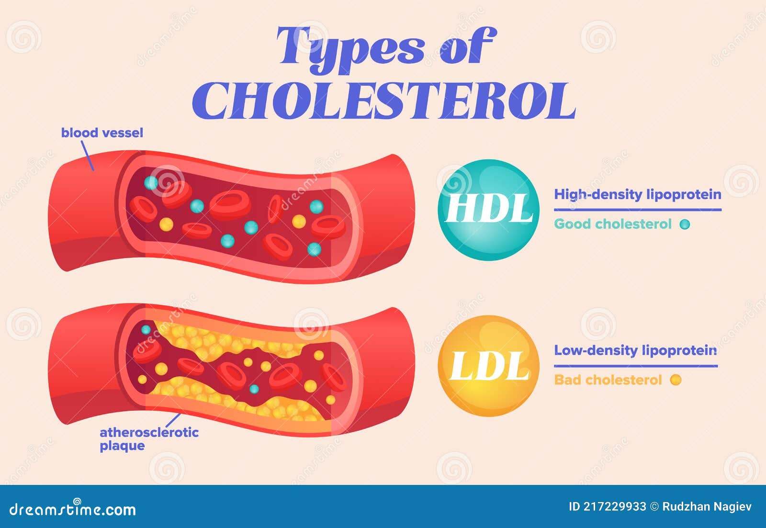
Introduction to the Project
What is this research?
This project investigates the impact of lifestyle and environment on lipid profiles by analyzing the LDL/HDL ratio to compare cardiovascular risk in rural and urban populations in North India
The Global & National Crisis:
Cardiovascular diseases (CVDs) are the dominant cause of mortality worldwide, accounting for nearly 19 million deaths annually.
In India, this epidemic represents a "health-development paradox": modernization has increased life expectancy but also amplified metabolic vulnerability.
Why the LDL/HDL Ratio?
Traditional tests look at single lipid fractions (like just LDL).
The LDL/HDL ratio is a more powerful, holistic index. It reflects the dynamic equilibrium between pro-atherogenic (LDL) and anti-atherogenic (HDL) forces.
It is a low-cost, robust, and reproducible biomarker, making it ideal for mass screening in resource-limited settings.

Slide 4


Problem Formulation
The Unseen Epidemic:
Dyslipidemia (imbalanced lipids) progresses quietly. By the time of a heart attack or stroke, the pathology is often irreversible.
In India, over 4.77 million cardiovascular deaths occur annually, and 52% of those happen before age 70.
The “Rural Paradox”:
Traditional Assumption: Urbanization and "city life" are the primary drivers of heart disease.
Emerging Reality: This study exposes a counterintuitive trend. Rural populations, traditionally healthier, are now showing higher atherogenic risk.
Why is this happening?:
Rural Modernization: Mechanization of agriculture (tractors vs. manual labor), new sedentary behaviors, and traditional diets being replaced by refined carbohydrates and low-cost saturated fats.
Infrastructure Gap: Modernity arrived in villages without the urban safety nets of routine healthcare, diagnostic screening, and health awareness programs.

Slide 5
Objectives of the Work
Quantify: To statistically quantify and compare the mean LDL/HDL ratios between representative rural and urban populations in North India.
Validate: To validate the LDL/HDL ratio as a low-cost, robust, and reproducible biomarker for large-scale cardiovascular risk screening.
Analyze: To investigate the lifestyle, dietary, and socioeconomic drivers (the "Rural Paradox") behind the observed differences in lipid profiles.
Recommend: To provide compelling, evidence-based recommendations for integrating LDL/HDL ratio screening into national public health programs, such as the NPCDCS.

Slide 6
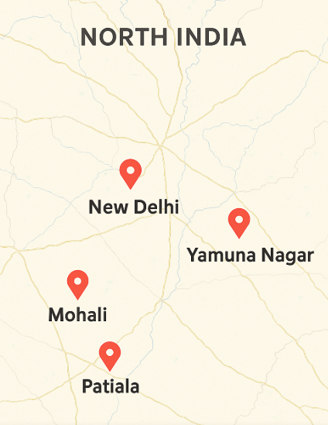
Dataset and Tools
Dataset
Design: A retrospective cross-sectional study.
Sample Size: 4,015 anonymized lipid profile records collected from diagnostic labs.
Cohorts:
Urban (n=2,146): New Delhi and Mohali.
Rural/ Semi-urban (n=1,869): Patiala and Yamuna Nagar.
Demographics: Participants aged 20–70 years.
Analytical Tools
Core Statistical Analysis: R Studio (v4.2.1).
Secondary Validation: Python 3.10 (Pandas, Matplotlib).
Visualization: MS Excel, Tableau, and Power BI for creating policy dashboards.

Slide 7
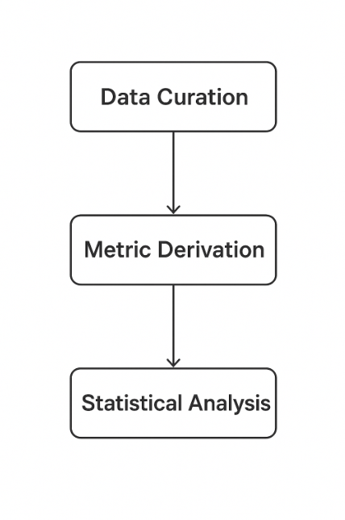
Methodology
1. Data Curation & Preprocessing:
Data was cleaned to remove duplicates, normalize measurement units, and handle outliers.
Anomalous records (<1%) were removed to create a high-confidence dataset.
2. Metric Derivation:
Primary Metric: LDL/HDL Ratio (LDL-C / HDL-C).
Validation Metrics:
Atherogenic Index of Plasma (AIP = log[TG/HDL-C]).
Castelli’s Risk Index-I (CRI-I = TC/HDL-C).
3. Statistical Analysis:
Software: R Studio v4.2.1.
Tests Used:
Descriptive statistics (mean, median, SD).
Normality assessed via Shapiro-Wilk test
Comparative significance evaluated using a two-proportion Z-test (α = 0.05).
Age-stratified analyses (<40, 40–60, >60 years) were performed.

Slide 8
Literature Review
Evolution of Lipid Science
1948 (Framingham Heart Study): The foundation of preventive cardiology. Established the first statistical link between high serum cholesterol and coronary heart disease (CHD).
2004 (INTERHEART Study): A 52-country study that quantified global risk. Found that abnormal lipids accounted for 49% of heart attack risk and that South Asia had the youngest mean age for a first heart attack.
2018 (PURE Study): Revealed that rural populations in low/middle-income nations had higher cardiovascular mortality due to healthcare inequity, shattering simplistic rural-urban dichotomies.
Identified Research Gaps
Gap 1: The vast majority of global lipid studies are urban-centric, leaving rural populations underrepresented.
Gap 2: The LDL/HDL ratio is rarely used as a primary, standalone metric for public health screening, despite its simplicity and power.
This Project's Contribution
Directly addresses both gaps by focusing on North India's rural population and validating the LDL/HDL ratio as a tool for public health equity.

Slide 9
Key Results (The Rural Paradox)
The findings revealed striking, counterintuitive contrasts with high statistical significance (p <0.001).
Urban Cohort (n = 2,146)
Mean LDL/HDL Ratio: 2.73 ± 0.58
Population at High-Risk (>3.5): 5.5%
Context: Benefited from better healthcare access, routine screening, and greater awareness promoting lifestyle modification.
Rural Cohort (n = 1,869)
Mean LDL/HDL Ratio: 3.52 ± 0.69
Population at High-Risk (>3.5): 25%
Context: Mechanization of agriculture, sedentary behavior, and shift to refined diets have eroded the traditional cardiometabolic advantage.
Key Takeaway
Rural adults in this study were approximately 4.5 times more likely to have a high-risk LDL/HDL ratio compared to urban adults.

Slide 10
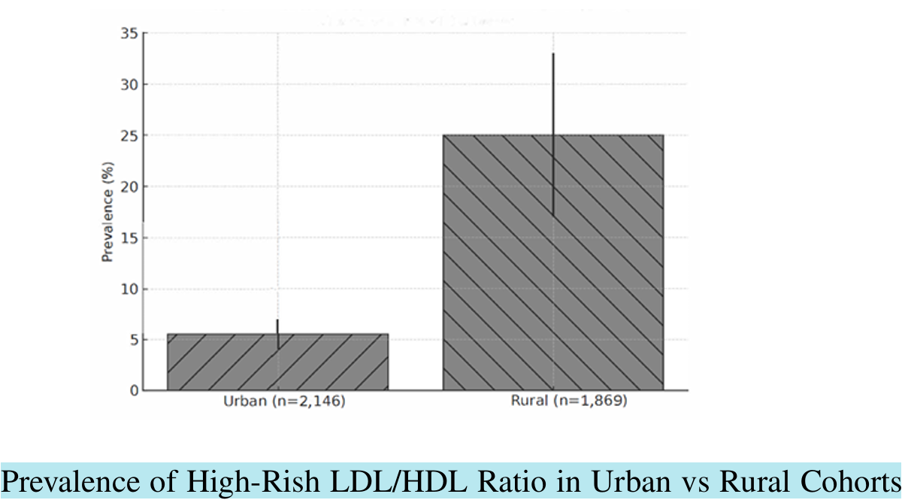
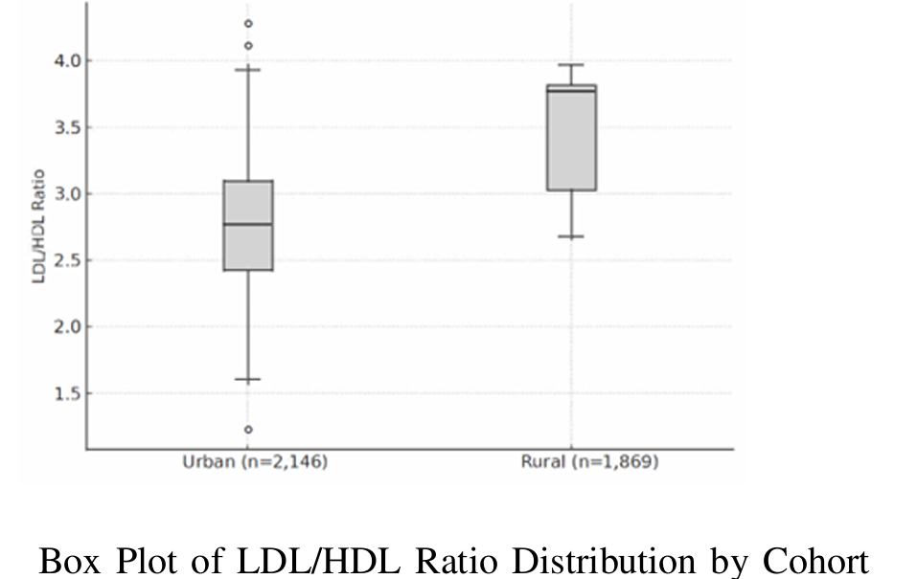
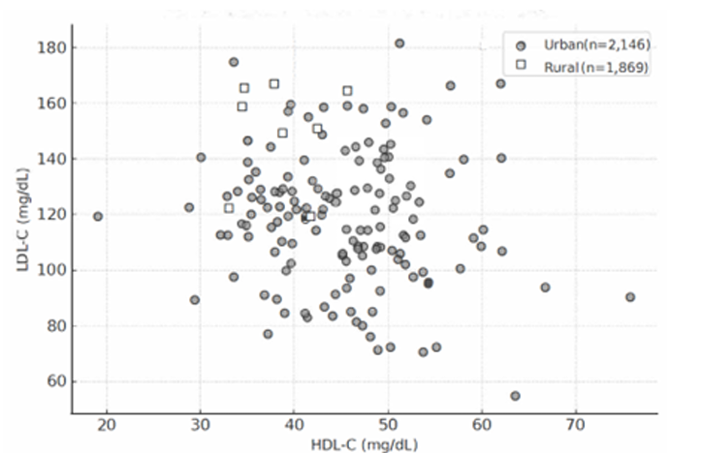
Key Results (The Rural Paradox)

Slide 11
Conclusion
Scientific Conclusion: This study provides compelling evidence for the "Rural Paradox". India’s rural heart is no longer immune to the metabolic consequences of modernization, exhibiting significantly higher atherogenic risk than urban counterparts.
Analytical Achievement: The LDL/HDL ratio is validated as a low-cost, robust, and reproducible biomarker, perfectly suited for cardiovascular risk stratification in resource-limited rural health systems.
Policy Implication: The ratio is a biological indicator of social transition. It should be integrated into the National Program for Prevention and Control of Cancer, Diabetes, Cardiovascular Diseases, and Stroke (NPCDCS) to substantially enhance early detection.
Core Message: True national progress lies not just in economic development, but in sustaining the physiological harmony between tradition and transformation.

Slide 12


Future Scope
Longitudinal Study Expansion: Re-sample the same 4,015-participant cohort over 5 years to track the dynamic changes in lipid behavior and the impact of lifestyle modifications.
Technological Integration (AIoT): Couple biochemical data with wearable and IoT devices to automate tracking of physical activity, sleep cycles, and heart rate, creating a cyber-physical health ecosystem.
Advanced AI & Predictive Modeling: Implement Machine Learning (Random Forest, XGBoost) and Neural Networks to build a self-learning national risk index that can provide predictive alerts to individuals and public health officials.
Policy Translation: Develop and deploy the analytical dashboard for integration with the Ayushman Bharat Digital Mission (ABDM), turning the research prototype into a national-scale operational tool.

Slide 13
References
[1] World Health Organization, Global Health Estimates 2023: Deaths by Cause, Age, Sex, by Country and by Region, Geneva, 2024.
[2] ICMR–INDIAB Study, “Prevalence of dyslipidemia in Indian states,” Indian J. Endocrinol. Metab., vol. 28, pp. 200–210, 2024.
[3] S. Yusuf et al., “Modifiable risk factors, cardiovascular disease, and mortality in 52 countries (INTERHEART),” The Lancet, vol. 364(9438), pp. 937–952, 2014.
[4] S. Yusuf et al., “Prospective Urban and Rural Epidemiological (PURE) study,” Lancet, vol. 391, pp. 1783–1795, 2018.
[5] S. L. Gupta et al., “LDL/HDL ratio as a superior marker for coronary risk stratification in South Asians,” J. Lipid Res., vol. 64, no. 1, pp. 78–89, 2023.
[6] T. Pandey, “Emerging patterns of dyslipidemia in rural North India: An epidemiological transition,” Indian Heart J., vol. 75, pp. 301–309, 2024.

