Slide 1

The Practical Efficiency of Regular Expression Membership Algorithms
Honours Thesis Defence – April 26, 2022
By: Justin Gray
Supervised by: Dr. Konstantinidis

Slide 2
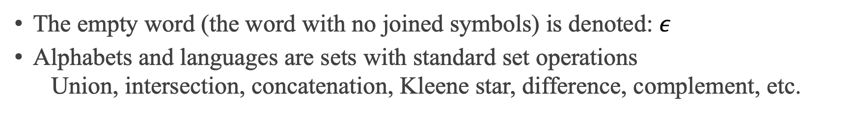
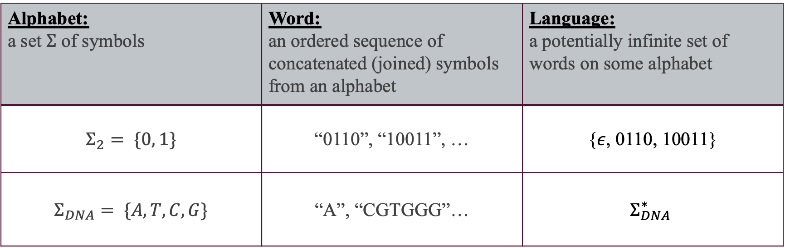
Formal Languages
Alphabet: a set $Σ$ of symbols | Word: an ordered sequence of concatenated (joined) symbols from an alphabet | Language: a potentially infinite set of words on some alphabet
$$Σ_{2}= \{0, 1\}$$ | “0110”, “10011”, … | {$ε$, 0110, 10011}
$$Σ_{DNA}= \{A, T, C, G\}$$ | “A”, “CGTGGG”… | $$Σ_{DNA}^{∗}$$
The empty word (the word with no joined symbols) is denoted: $ε$
Alphabets and languages are sets with standard set operations
Union, intersection, concatenation, Kleene star, difference, complement, etc.

Slide 3
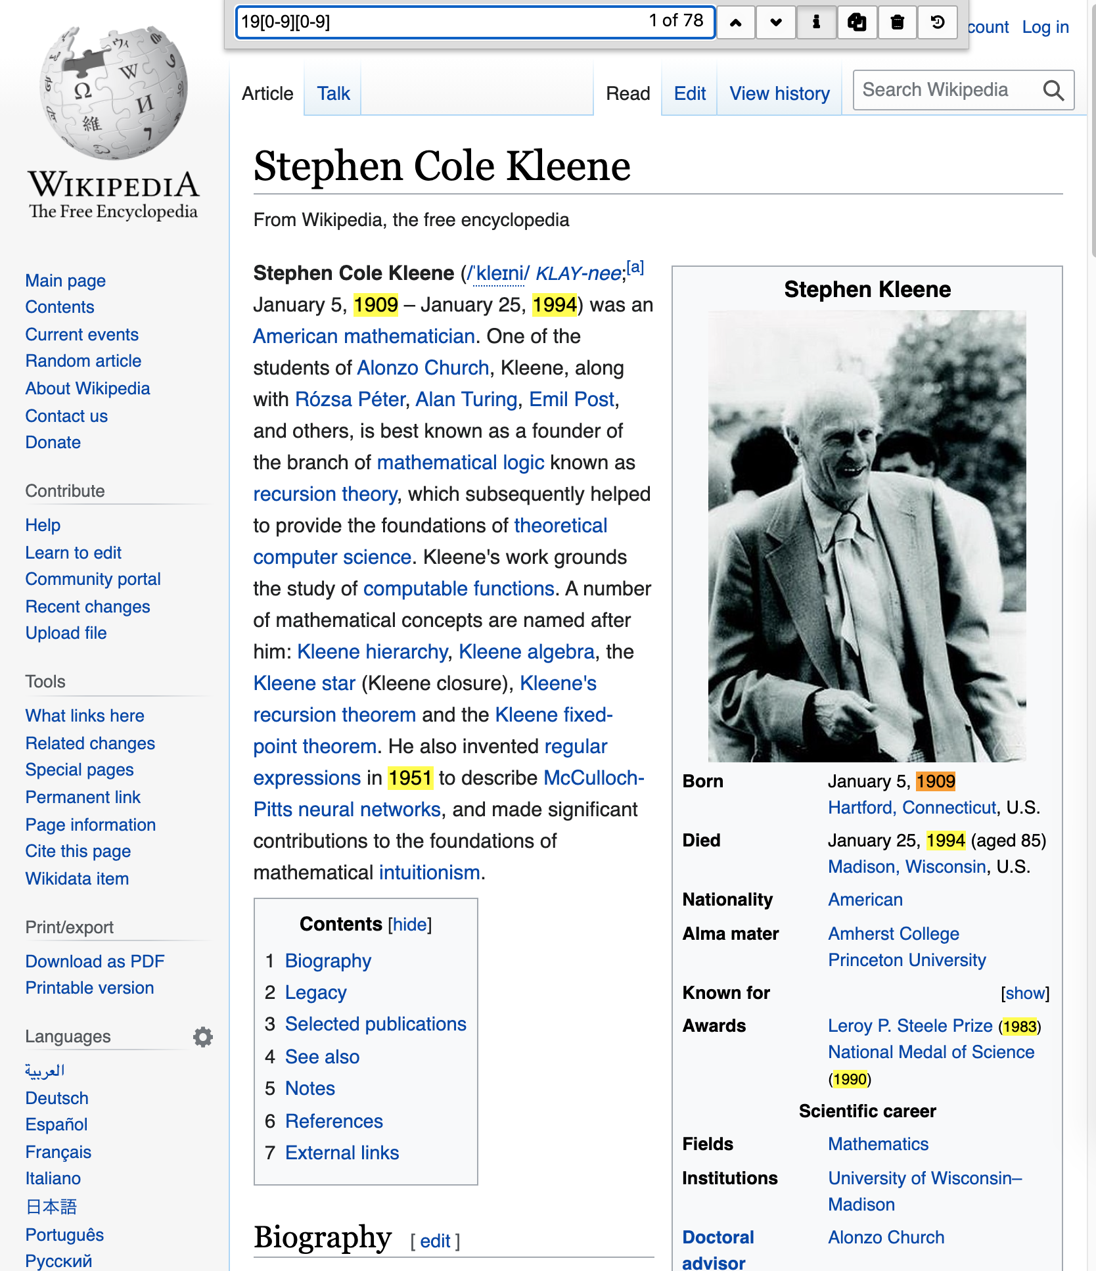
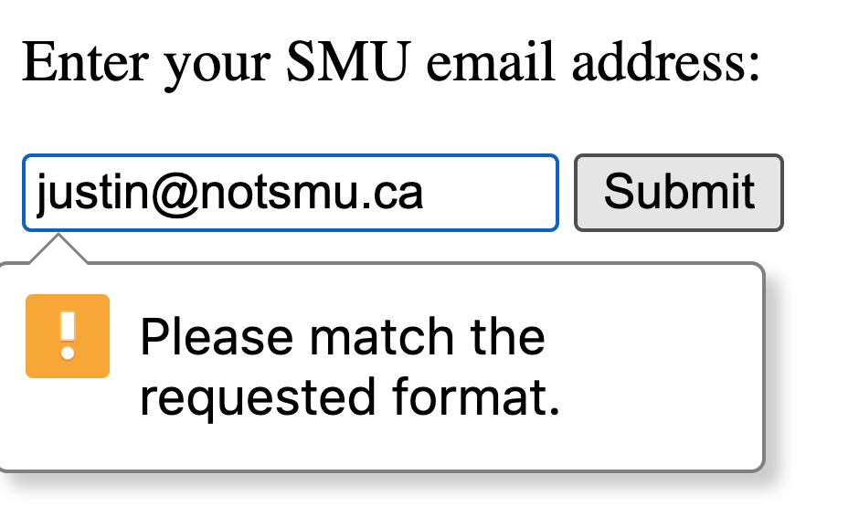
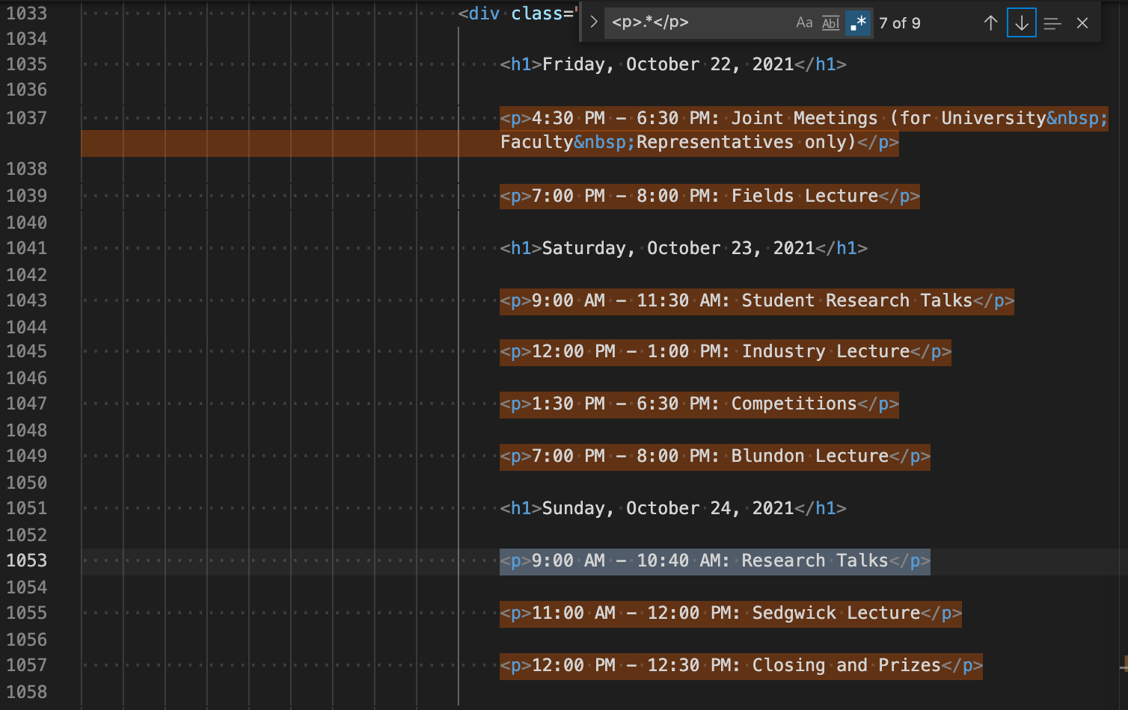
Motivation – Formal Languages
Searching Validating Extracting
DNA searching
Online quiz fill-in-the-blank correctness
Filtering shell output (grep)
AND… Anywhere things are encoded as text.

Slide 4
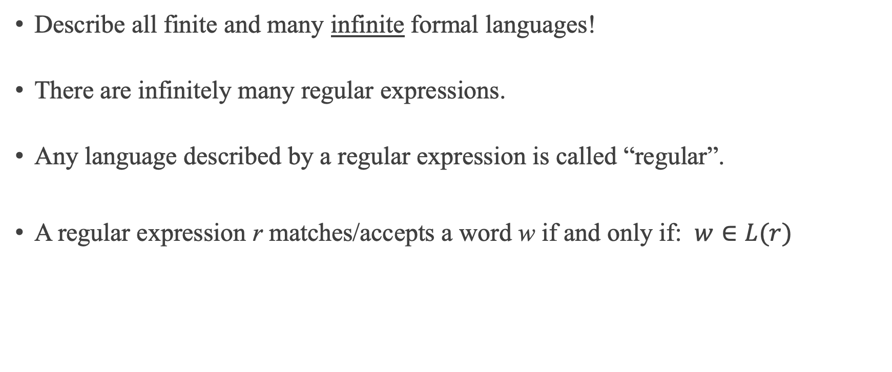
Regular Expressions
Describe all finite and many infinite formal languages!
There are infinitely many regular expressions.
Any language described by a regular expression is called “regular”.
A regular expression r matches/accepts a word w if and only if: $w∈L(r)$

Slide 5
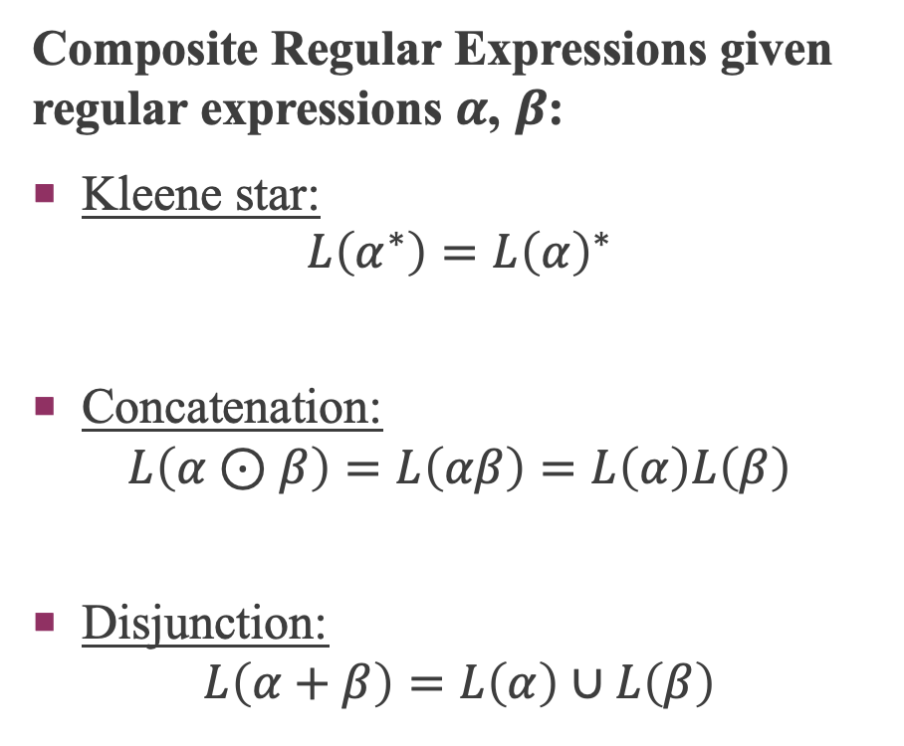
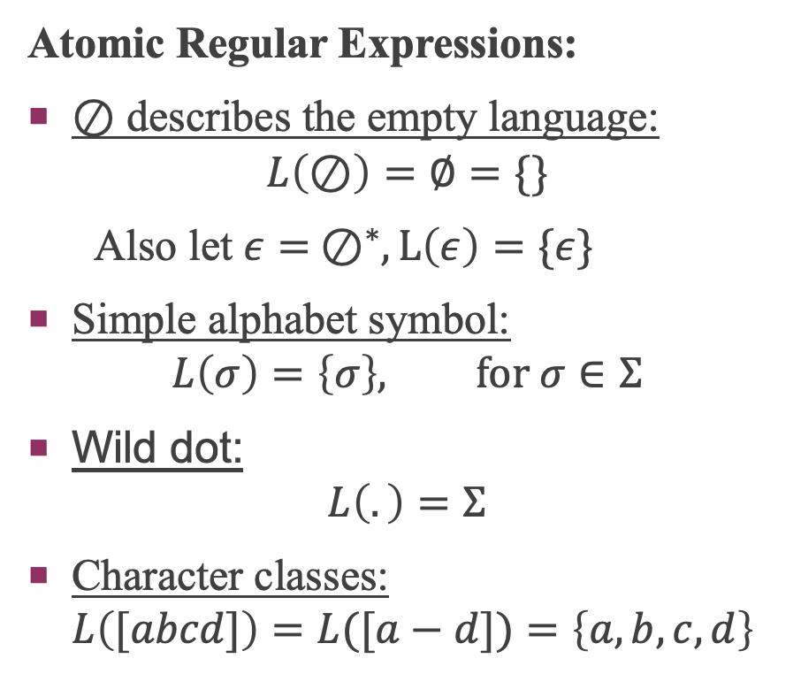
Regular Expressions – Definition
Atomic Regular Expressions:
⊘ describes the empty language: $L\left(⊘\right)=∅=\{\}$
Also let $ε= ⊘^{∗}, L\left(ε\right)=\{ε\}$
Simple alphabet symbol: $L\left(σ\right)=\left\{σ\right\}, for σ∈Σ$
Wild dot: $L\left(.\right)=Σ$
Character classes: $L\left([abcd]\right)=L([a−d])=\left\{a,b,c,d\right\}$
Composite Regular Expressions given regular expressions $α$, $β$:
Kleene star: $L\left(α^{∗}\right)=L{\left(α\right)}^{∗}$
Concatenation: $L\left(α⊙β\right)=L\left(αβ\right)=L\left(α\right)L\left(β\right)$
Disjunction: $L\left(α+β\right)=L\left(α\right)∪L\left(β\right)$

Slide 6
Regular Expression Trees
Regular expressions often rely on implicit precedence rules: star > concat > disj a+ab*
Fully parenthesize the expression (a + (a (b*)))
Draw the tree
+
a
⊙
a
*
b
Many regular expression algorithms depend on the regular expression tree.
The size of a regular expression is the number of nodes in the tree.

Slide 7

Regular Expression Membership Problem
Recall: A regular expression r matches/accepts a word w if and only if: $w∈L(r)$
Given a regular expression r and a word w, is $w∈L(r)$?
Partial Derivatives
Backtracking
Finite Automata

Slide 8
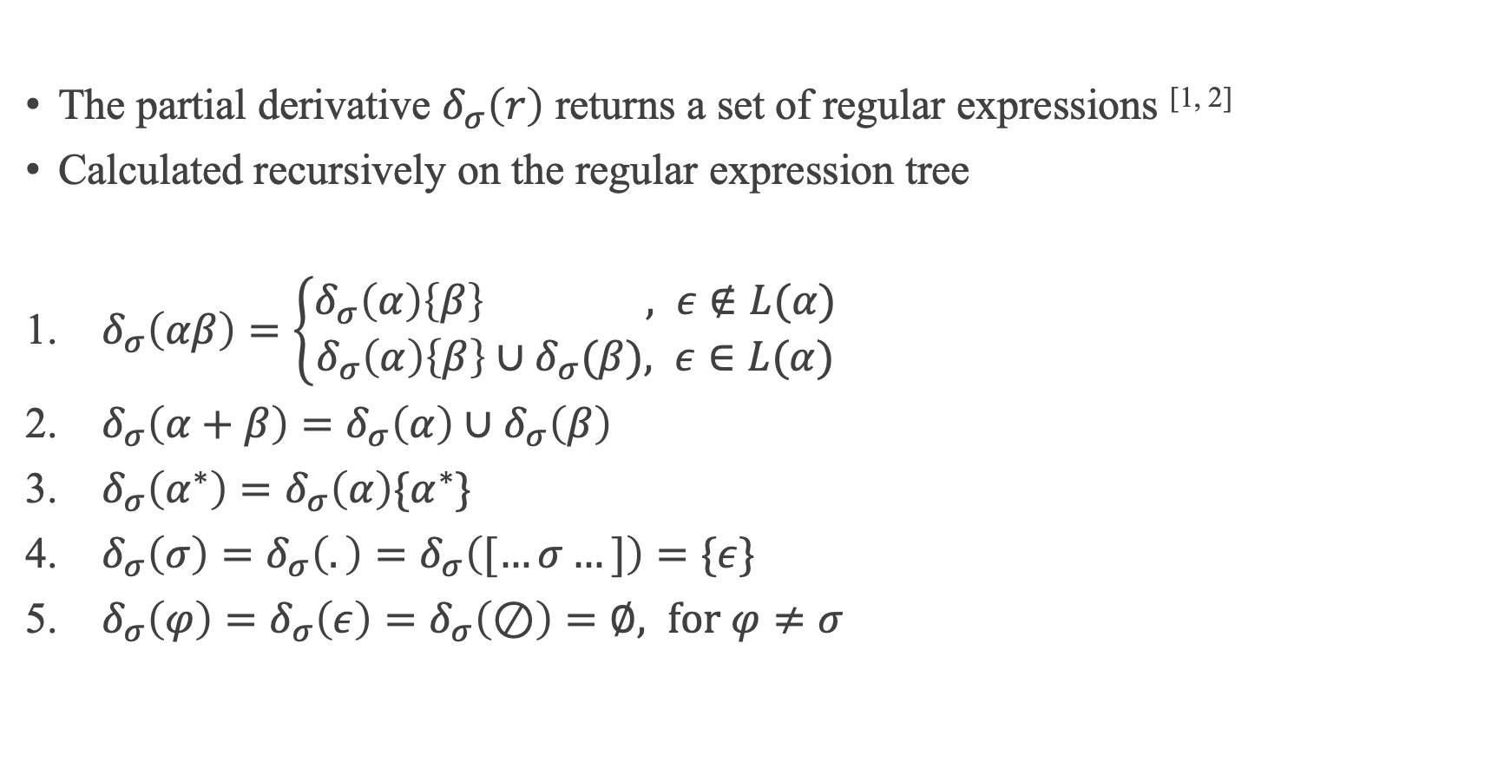
1. Partial Derivative Membership
The partial derivative $δ_{σ}\left(r\right)$ returns a set of regular expressions ^{[1, 2]}
Calculated recursively on the regular expression tree
$δ_{σ}\left(αβ\right)=\left\{\begin{aligned}δ_{σ}\left(α\right)\left\{β\right\} , ε∉L(α) \\ δ_{σ}\left(α\right)\left\{β\right\}∪δ_{σ}(β), ε∈L(α)\end{aligned}\right.$
$δ_{σ}\left(α+β\right)=δ_{σ}\left(α\right)∪δ_{σ}\left(β\right)$
$δ_{σ}\left(α^{∗}\right)=δ_{σ}\left(α\right)\{α^{∗}\}$
$δ_{σ}\left(σ\right)=δ_{σ}\left(.\right)=δ_{σ}\left([…σ…]\right)=\{ε\}$
$δ_{σ}\left(φ\right)=δ_{σ}\left(ε\right)=δ_{σ}\left(⊘\right)=∅, for φ≠σ$

Slide 9
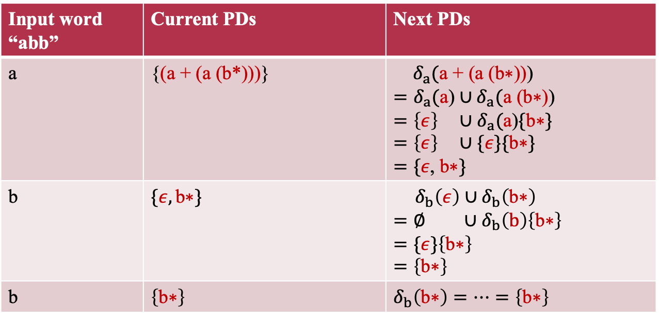
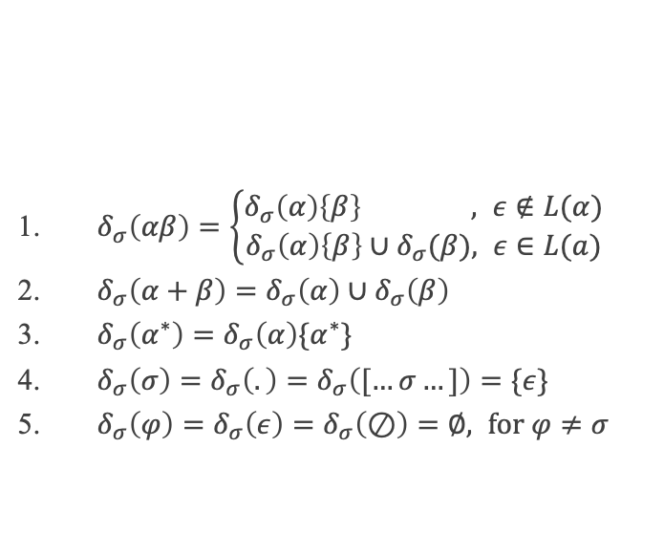
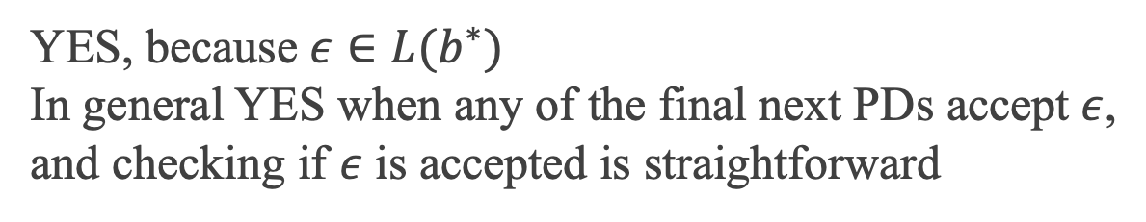
1. Partial Derivative Membership
Input word “abb” | Current PDs | Next PDs
a | {(a + (a (b*)))} | $δ_{a}(\text{a}\text{ + }\text{(}\text{a}\text{ (}\text{b}\text{∗))}\text{)}$ $=δ_{a}(\text{a}\text{)}∪δ_{a}(\text{a}\text{ (}\text{b}\text{∗))}$ $={\left\{ε\right\} ∪δ}_{a}(\text{a}\text{)}\{\text{b}\text{∗}\}$ $=\left\{ε\right\} ∪\{ε\}\{\text{b}\text{∗}\}$ $=\{ε\text{,} \text{b}\text{∗}\}$
b | $\{ε,\text{b}\text{∗}\}$ | $δ_{b}\left(ε\right)∪δ_{b}\left(\text{b}\text{∗}\right)$ $=∅ ∪δ_{b}\left(b\right)\left\{\text{b}\text{∗}\right\}$ $=\{ε\}\left\{\text{b}\text{∗}\right\}$ $=\left\{\text{b}\text{∗}\right\}$
b | $\left\{\text{b}\text{∗}\right\}$ | $δ_{b}\left(\text{b}\text{∗}\right)=…=\left\{\text{b}\text{∗}\right\}$
(a + (a (b*)))
+
a
⊙
a
*
b
$δ_{σ}\left(αβ\right)=\left\{\begin{aligned}δ_{σ}\left(α\right)\left\{β\right\} , ε∉L(α) \\ δ_{σ}\left(α\right)\left\{β\right\}∪δ_{σ}(β), ε∈L(a)\end{aligned}\right.$
$δ_{σ}\left(α+β\right)=δ_{σ}\left(α\right)∪δ_{σ}\left(β\right)$
$δ_{σ}\left(α^{∗}\right)=δ_{σ}\left(α\right)\{α^{∗}\}$
$δ_{σ}\left(σ\right)=δ_{σ}\left(.\right)=δ_{σ}\left([…σ…]\right)=\{ε\}$
$δ_{σ}\left(φ\right)=δ_{σ}\left(ε\right)=δ_{σ}\left(⊘\right)=∅, for φ≠σ$
YES, because $ε∈L(b^{∗})$
In general YES when any of the final next PDs accept $ε$, and checking if $ε$ is accepted is straightforward

Slide 10

2. Backtracking Membership ^{[3]}
- Applied on the regular expression tree by tracking “unmatched” substrings.
- Applied on an NFA by moving backwards through previous configurations. But the NFA must be first be constructed
Method used by most real-world regular expression libraries to decide membership. This algorithm supports non-regular operations such as backreferences
It’s usually very fast!! Consider the simplicity over partial derivatives

Slide 11
2. Backtracking Membership
Is “abb” accepted by (a + (a (b*)))?
abb Cannot continue, no b’s expected. Backtrack and re-match “a”
abb
abb
abb Return YES, as all symbols in the word have been matched and at the end position of the regular expression

Slide 12
2. Backtracking Membership
Let r = (a + a)*
aab ∈ L(r)?
aab
aab X
aab X
aab
aab X
aab X
Answer: NO
aaab ∈ L(r)?
aaab
aaab
aaab X
aaab X
aaab
aaab X
aaab X
aaab
aaab
aaab X
aaab X
aaab
aaab X
aaab X
Answer: NO
aaaab ∈ L(r)?
aaaab
aaaab
aaaab
aaaab X
aaaab X
aaaab
aaaab X
aaaab X
aaaab
aaaab
aaaab X
aaaab X
aaaab
aaaab X
aaaab X
Answer: NO
aaaab
aaaab
aaaab
aaaab X
aaaab X
aaaab
aaaab X
aaaab X
aaaab
aaaab
aaaab X
aaaab X
aaaab
aaaab X
aaaab X

Slide 13
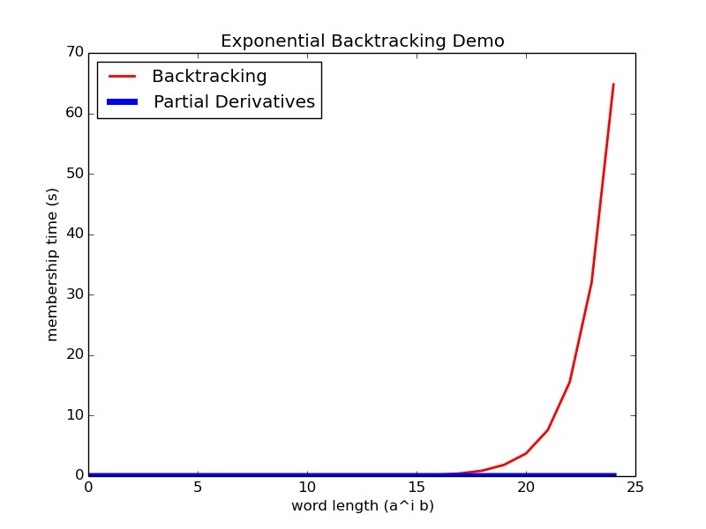
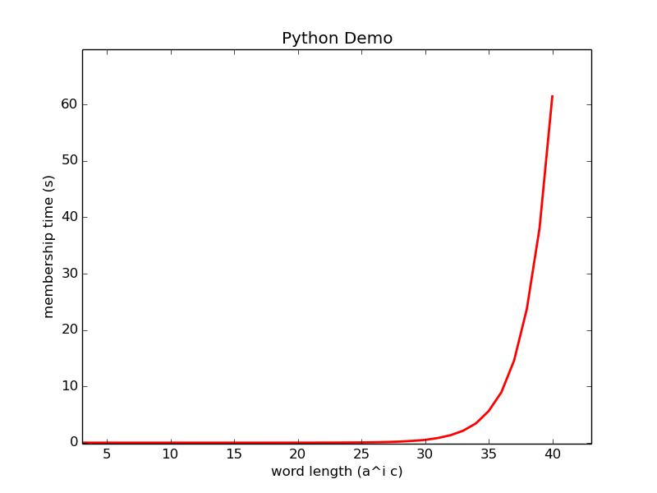
2. Backtracking Membership
Figure 1: $a^{i}b∈L\left({\left(a+a\right)}^{∗}\right)$ membership time (our implementation)
Figure 2: $a^{i}c∈L\left({\left(a+aa\right)}^{∗}b\right)$ membership time in Python’s re ^{[4]}

Slide 14
3. Finite Automaton Membership
State machines that can answer membership, but first the automaton needs to be constructed from the regular expression
Configuration pair: ({current states}, word suffix)
Construct the NFA (non-deterministic finite automaton) for a regular expression
Test if the input word is accepted
Start at the initial state (in arrow)
Take transitions (edges) to other states according to the input word
Once the input word is entirely consumed, accept if and only if at some final state (double circled)

Slide 15
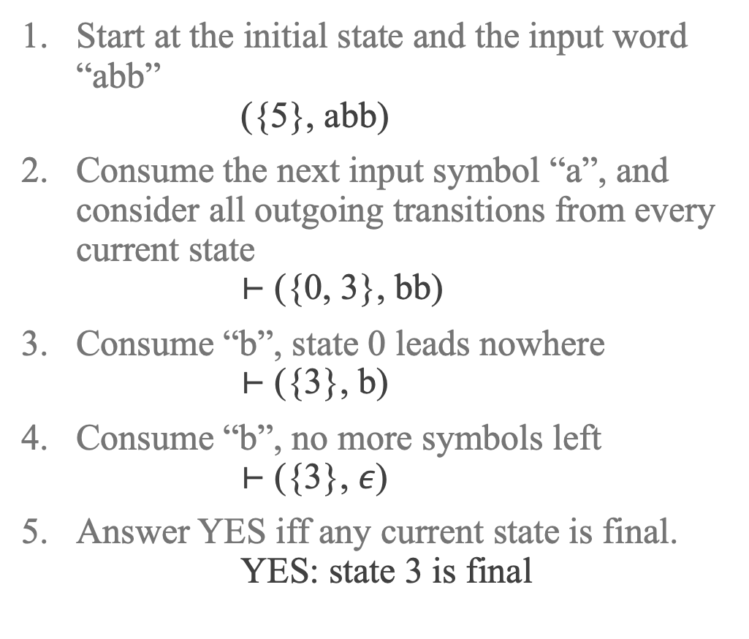
3. Finite Automaton Membership
Start at the initial state and the input word “abb” ({5}, abb)
Consume the next input symbol “a”, and consider all outgoing transitions from every current state ⊢ ({0, 3}, bb)
Consume “b”, state 0 leads nowhere ⊢ ({3}, b)
Consume “b”, no more symbols left ⊢ ({3}, $ε$)
Answer YES iff any current state is final. YES: state 3 is final
Is “abb” accepted by this NFA?

Slide 16
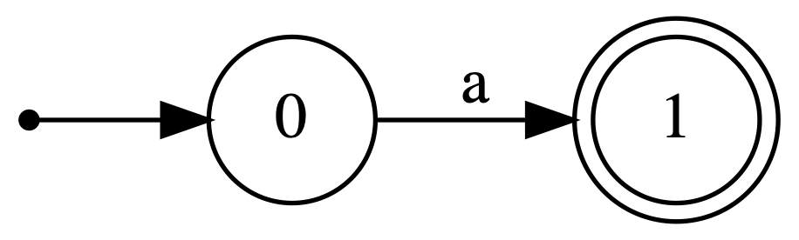
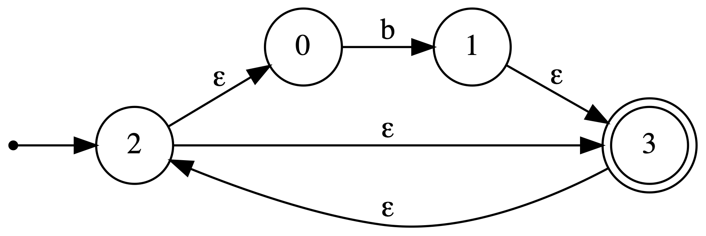
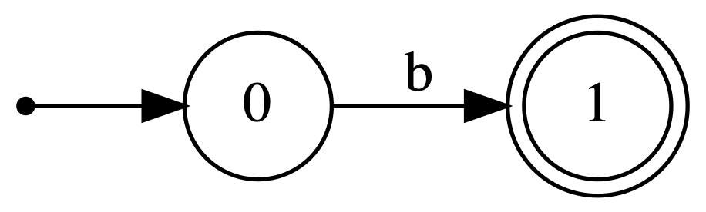
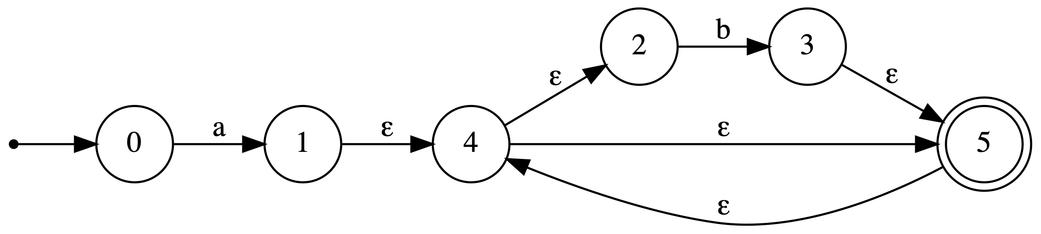
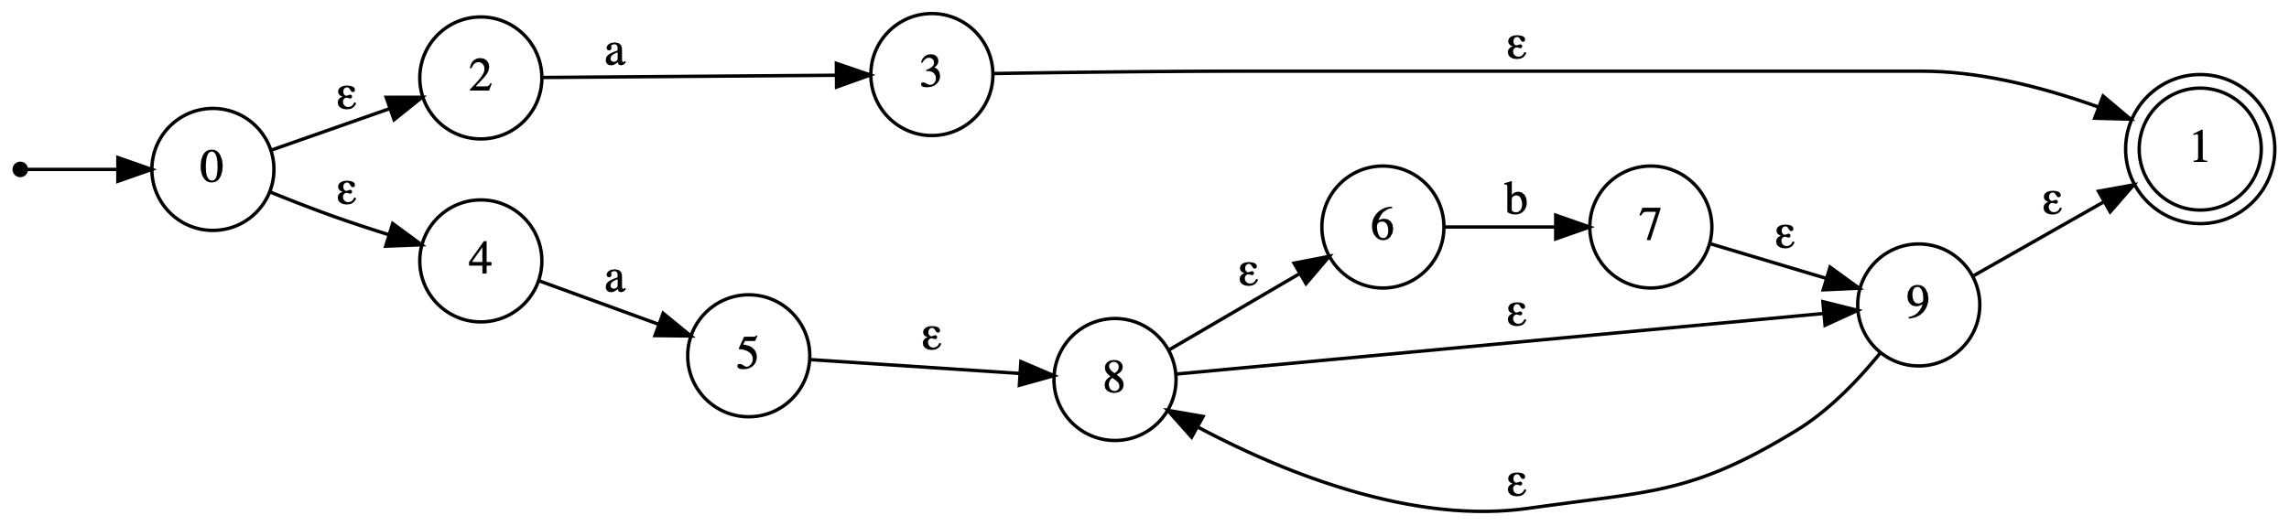
NFA Thompson Construction
+
a
⊙
a
*
b

Slide 17
Methodology
Partial matching:
In practice, regular expressions accept a word if any substring of that word is accepted. Programmers use anchors to avoid this behaviour. But theoretical algorithms must accept the entire input, so anchors need to be removed appropriately:
Unanchored expression (a + (a (b*))) can become ((.* (a + (a (b*)))) .*)
https://grep.app ^{[5]}
12,023 distinct expressions (complete, regular, and error-free)
Practical expressions from GitHub
Randomly generated expressions on a small alphabet of size 10
Collect samples of regular expressions

Slide 18
Methodology
Generate a test set of input words:
Up to 10,000 accepting and 10,000 rejecting words
Consistently generated using language enumeration techniques
Measure construction time:
Regular expression string → regular expression tree
Plus, if NFA-type algorithm: regular expression tree → NFA (Also record the size of the NFA as number of states + number of transitions)
Measure membership time as a mean average over all generated input words for that regular expression

Slide 19
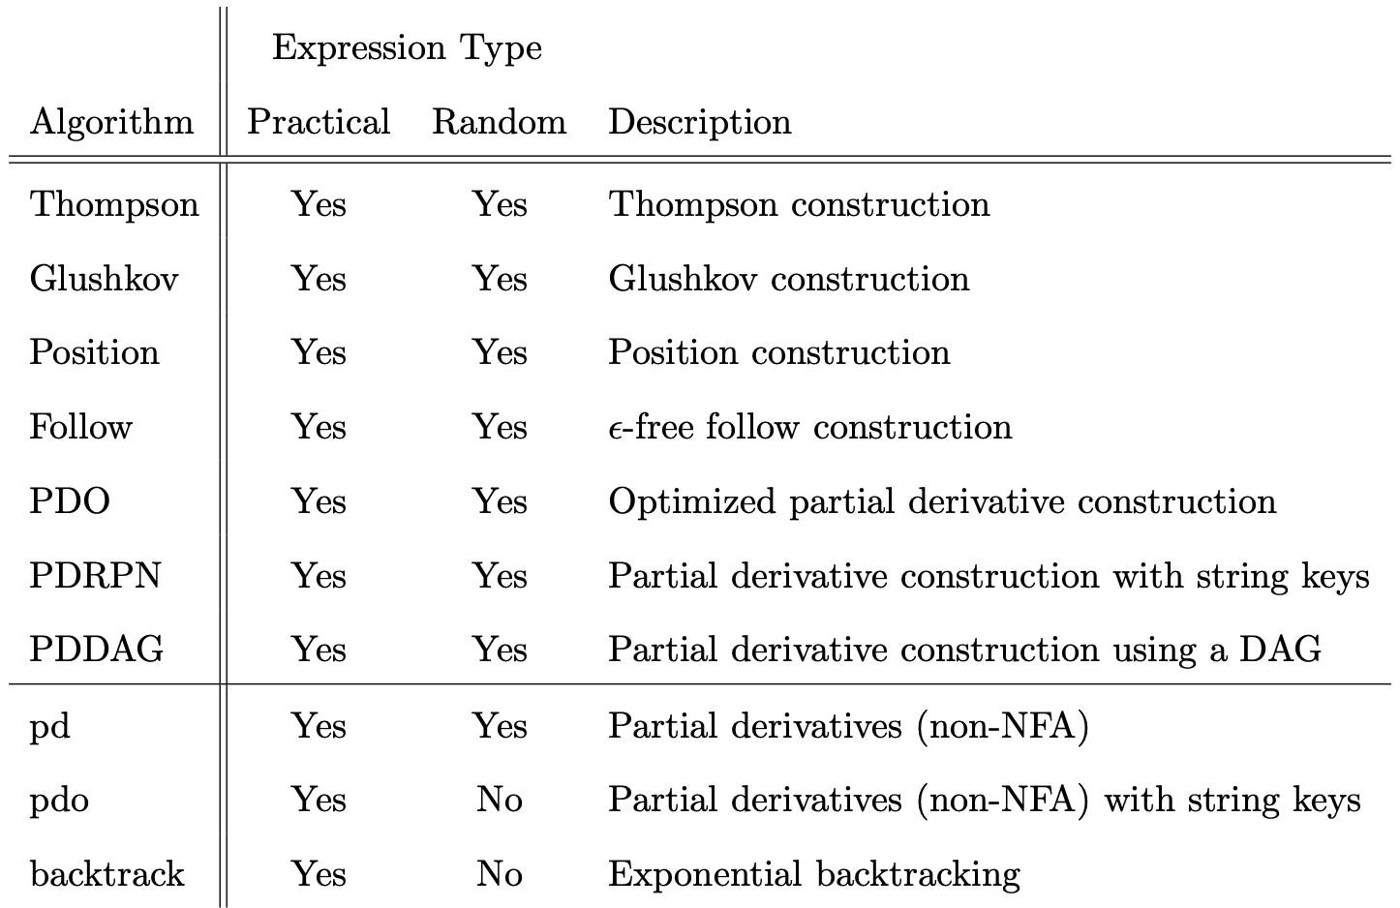
Summary of Tested Algorithms

Slide 20
Considered Scenarios
 | Practical Sample | Random Sample
One construction + one word membership | How much pre-processing is appropriate for each scenario? More pre-processing might lead to a faster structure, like an NFA with fewer states.
One construction + 100,000-word membership
import re
if not re.match("a|ab*", someInput):
raise Exception()
SELECT *
FROM my_table
WHERE col ~ ‘a|ab*’;

Slide 21
Practical Sample: One word
Construction is approximately four times more expensive than deciding word membership.
Backtracking is fast: no NFA construction cost, and programmers may be avoiding vulnerable expressions.
Cheap constructions are also very good: follow, position, and Glushkov.

Slide 22
Practical Sample: 100,000 words
Construction time becomes negligible.
Backtracking is still fast, except for some vulnerable expressions.
NFA with empty transitions (Thompson) delays matching and is therefore slower.
Partial derivatives spend a lot of time re-computing the same things.
Partial derivative NFAs are slightly the fastest, as they are generally the smallest.

Slide 23
Practical Sample: NFA Sizes by Construction Method

Slide 24
Random Sample: One word
Partial derivatives are very fast!
Randomly generated regular expressions have a lot of nested stars. Leading to very large input test words. Thus, constructions are generally faster than membership tests.
95% confidence that these results are correct within a 5% margin of error

Slide 25
Random Sample: 100,000 words
There is almost no difference between one word and 100,000-word membership graphs because constructions are faster than membership for huge test words.
Except that the very slow PDO construction is negligible compared to the long membership time of 100,000 words.
95% confidence that these results are correct within a 5% margin of error

Slide 26
Conclusions Backtracking
Programmers often use regular expressions as a black box, and do not always consider their vulnerability. This is dangerous since the decision time is exponentially bound
Unless non-regular features are really important, the backtracking algorithm should be avoided
Is “abb” accepted by (a + (a (b*)))?
abb Backtrack
abb
abb
abb Return YES

Slide 27
Conclusions NFA Algorithms
The follow NFA is fast to construct
And almost as efficient/small as the partial derivative NFA

Slide 28
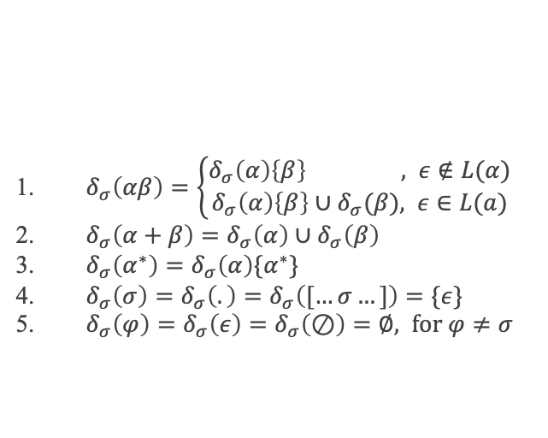
Conclusions Partial Derivatives
Improvements can be made in this area: comparing regular expression trees when adding elements to the “current” set is expensive. Can this cost be avoided by using a similar algorithm as the PDDAG construction, but with only completing some of the work?
Without this PDDAG-inspired algorithm, non-NFA partial derivatives are too slow
$δ_{σ}\left(αβ\right)=\left\{\begin{aligned}δ_{σ}\left(α\right)\left\{β\right\} , ε∉L(α) \\ δ_{σ}\left(α\right)\left\{β\right\}∪δ_{σ}(β), ε∈L(a)\end{aligned}\right.$
$δ_{σ}\left(α+β\right)=δ_{σ}\left(α\right)∪δ_{σ}\left(β\right)$
$δ_{σ}\left(α^{∗}\right)=δ_{σ}\left(α\right)\{α^{∗}\}$
$δ_{σ}\left(σ\right)=δ_{σ}\left(.\right)=δ_{σ}\left([…σ…]\right)=\{ε\}$
$δ_{σ}\left(φ\right)=δ_{σ}\left(ε\right)=δ_{σ}\left(⊘\right)=∅, for φ≠σ$

Slide 29
Thank You Dr. Konstantinidis
FOR SUPERVISING THIS RESEARCH PROJECT, AND INSPIRING MY INTEREST IN ACADEMIA

Slide 30
References
Valentin Antimirov. “Partial derivatives of regular expressions and finite automaton construc- tions”. In: Theoretical Computer Science 155.2 (1996), pp. 291–319. DOI: 10.1016/0304- 3975(95)00182-4.
B. G. Mirkin. “An Algorithm for Constructing a base in a Language of Regular Expressions”. In: Eng. Cybernetics 5 (1966), pp. 51–57.
Martin Berglund, Frank Drewes, and Brink Van Der Merwe. “Analyzing Catastrophic Back- tracking Behavior in Practical Regular Expression Matching”. In: Electronic Proceedings in Theoretical Computer Science 151 (May 2014), pp. 109–123. DOI: 10.4204/EPTCS.151.7.
Robert Sedgewick, Kevin Wayne. Algorithms,4th ed. Available: https://algs4.cs.princeton.edu/54regexp/
grep.app. https://grep.app. Search across a half million git repos.
To read about language enumeration techniques and all the NFA construction algorithms, refer to the submitted thesis paper.
This paper (along with all source code) is available at https://github.com/just1ngray/SMUHon-Practical-RE-Membership-Algs

