Slide 1
The Practical Efficiency of Regular Expression Membership Algorithms
Justin Gray
(Supervised by Dr. Konstantinidis)

Slide 2
Formal Languages
Alphabet set Σ of symbols {0, 1} or {a, b, c, d, …, z} or …
Word string made from these symbols 0101011, jbc, … ε for the empty word “”
Language set of words {ε, 0, 1, 00, 01, 10, 11, …}
“Regular” languages can be described by regular expressions
Notes:
This is really important.
Keep alphabet, word, and language straight
REMEMBER! Words are just a sequence of symbols, not necessarily a real-life English word

Slide 3
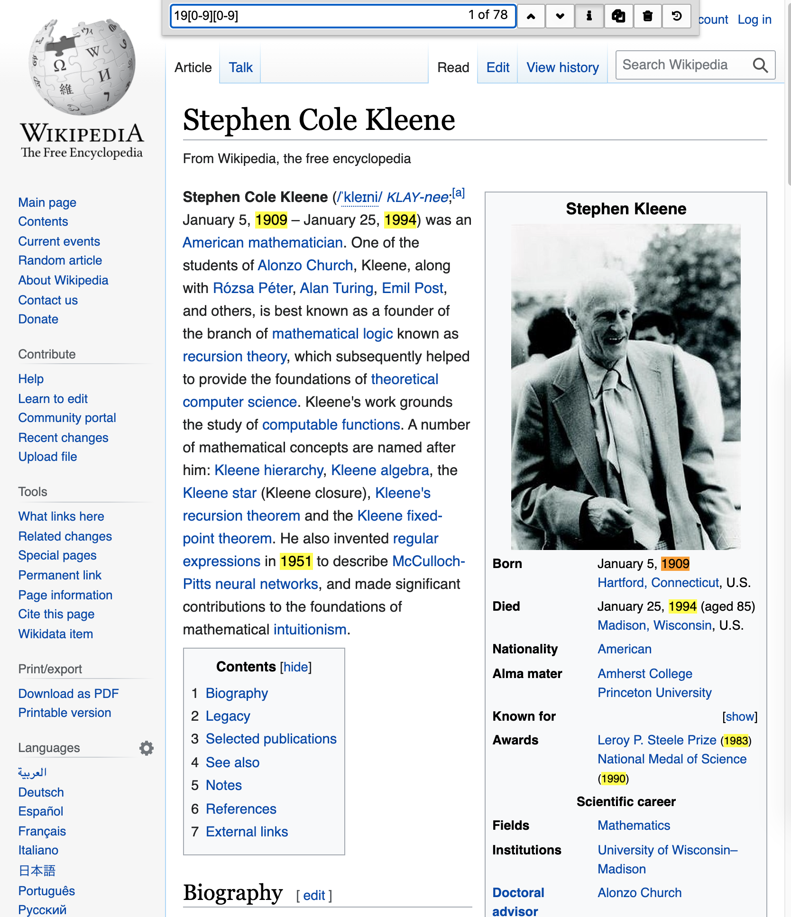
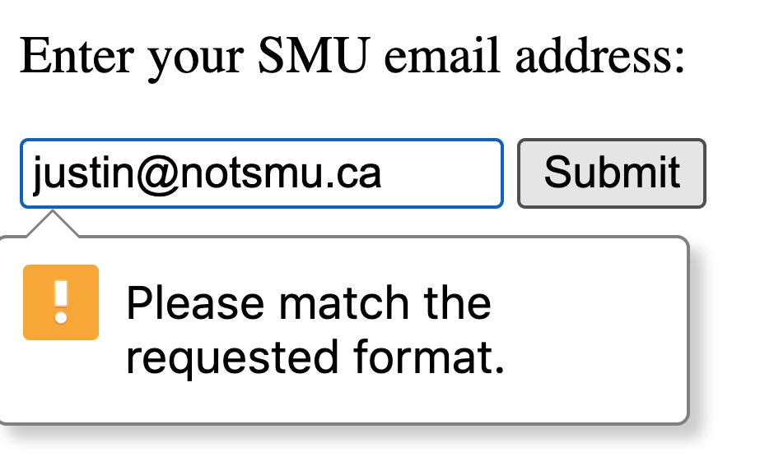
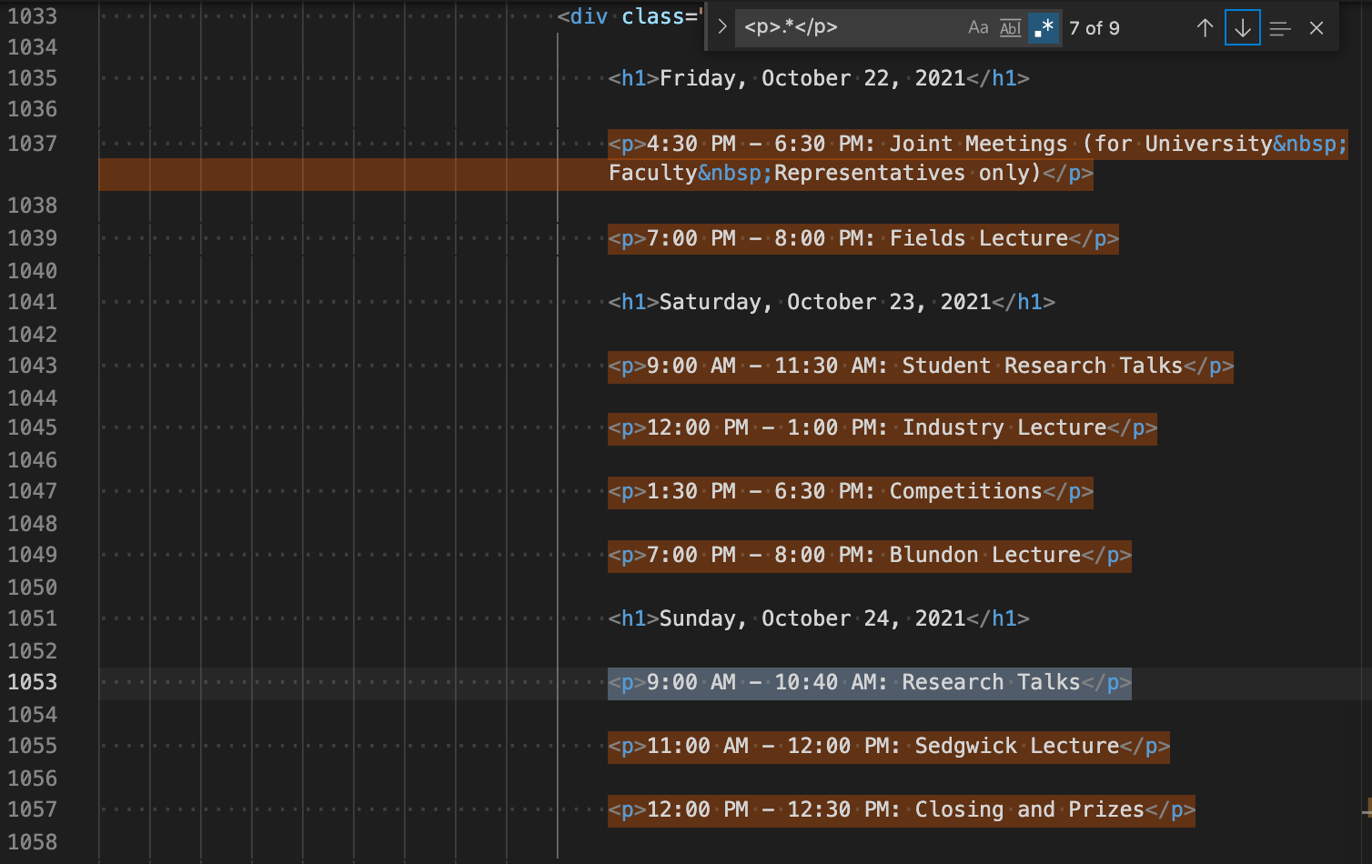
Applications of Regular Expressions
Searching Validating Extracting
DNA searching
Online quiz fill-in-the-blank correctness
Filtering shell output (grep)
AND… Anywhere things are encoded as text.

Slide 4
Mathematical Regular Expressions
Concatenation L(ab) = {ab} “a” followed by a “b”
Disjunction L(a + b) = {a, b} “a” or “b”
Star L(a*) = {ε, a, aa, aaa, …} 0 or more “a”s
Notes:
Three main mathematical operations

Slide 5
Some Compatible UNIX Extensions
Wild dot matches any single symbol L(a.a) = {aσa : for any σ∈Σ} {aaa, a a, aba, a0a} ⊂ L(a.a)
Character Classes L([abc0-9]) = {a, b, c, 0, 1, 2, 3, …, 9} L([^a]) = {σ∈Σ\{a}}
Optional L(a?) = {ε, a}
Notes:
These extensions are compatible because they are just “sugar” on top of mathematical operations

Slide 6
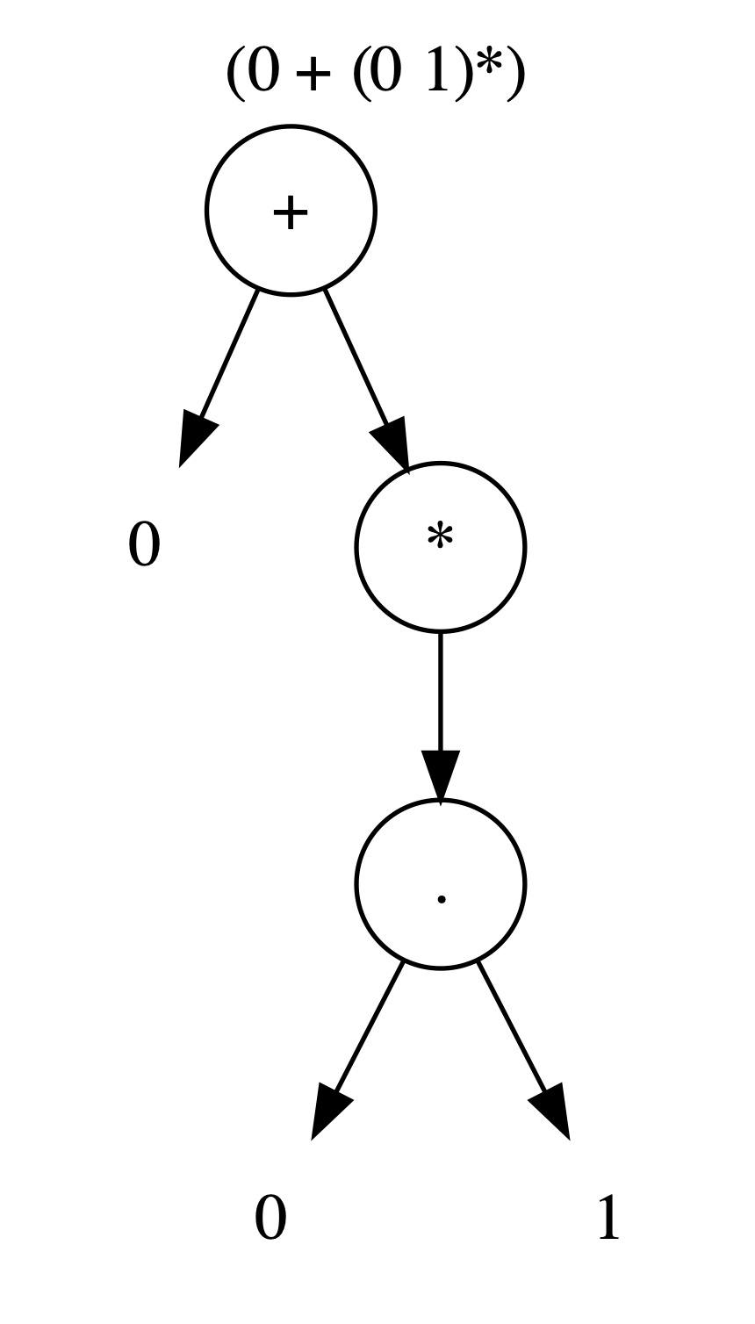
Regular Expression Trees
Consider the expression (0 + (0 1)*)
Disjunction: (0 + (0 1)*)
“0” is a symbol
Star: (0 1)*
Concatenation: (0 1)
“0” is a symbol
“1” is a symbol

Slide 7
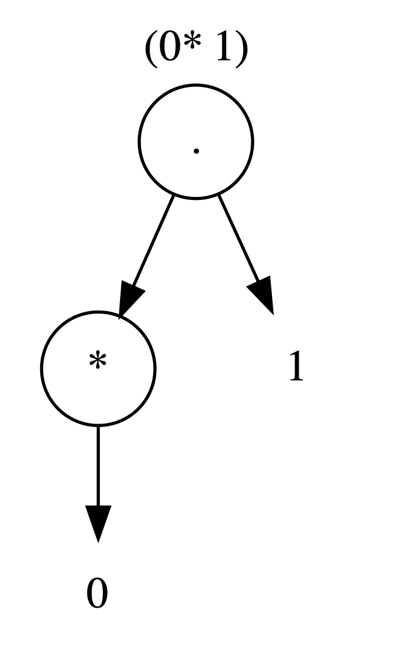
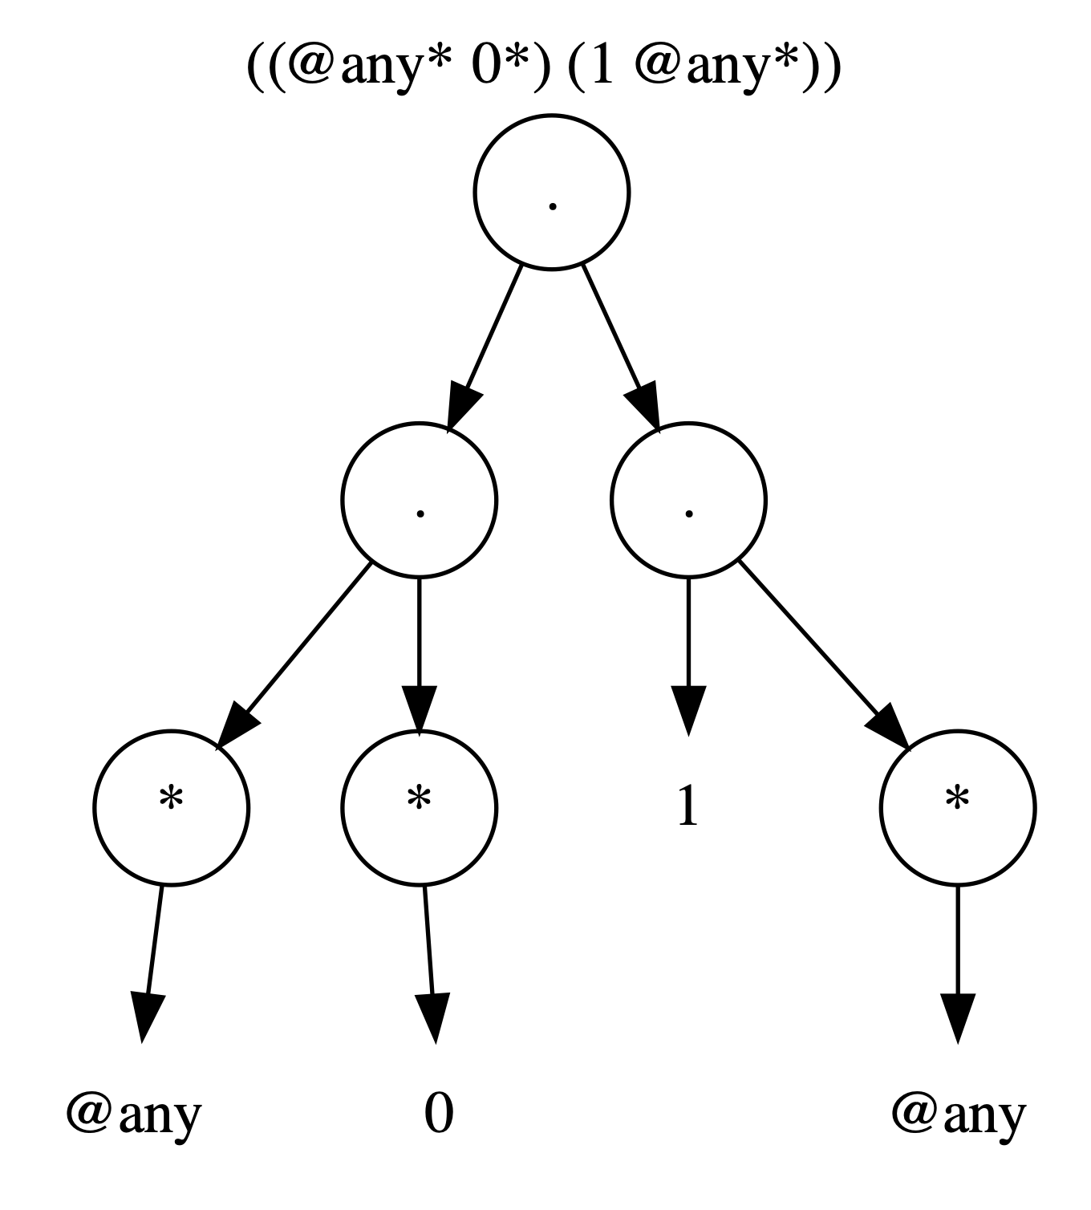
Partial Matching
UNIX regular expressions generally match words if any substring of that word is accepted. (I.e., α will accept xwy if w∈L(α))
Mathematical regular expressions require full matches
We can make our regular expressions partially match by adding “.*” appropriately (this generally means at the beginning and end of leaves)
Notes:
Must consider anchors – they complicate matters a great deal.

Slide 8
The Membership Problem
Given a word w and a regular expression α, w∈L(α)?
3 Approaches:
(Partial) Derivatives
Backtracking
Automata
If you were designing a regular expression library today, which algorithm should you follow?

Slide 9
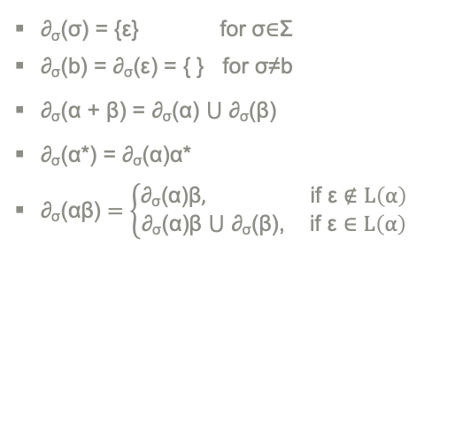
The Membership Problem: Partial Derivatives
∂_{σ}(σ) = {ε} for σ∈Σ
∂_{σ}(b) = ∂_{σ}(ε) = { } for σ≠b
∂_{σ}(α + β) = ∂_{σ}(α) ⋃ ∂_{σ}(β)
∂_{σ}(α*) = ∂_{σ}(α)α*
$\text{∂}\text{σ}\text{(}\text{αβ}\text{)}=\left\{\begin{aligned}\text{∂}\text{σ}\text{(}\text{α}\text{)}\text{β}, \text{if} \text{ε}∉L\left(α\right) \\ &\text{∂}\text{σ}\text{(}\text{α}\text{)}\text{β}\text{ ⋃ }\text{∂}\text{σ}\text{(}\text{β}\text{), }\text{if} \text{ε}∈L\left(α\right)\end{aligned}\right.$
0101 ∈ L(0+(01)*)?
Letters of 0101 | Current PDs | Next PDs
0 | {0+(01)*} | ∂₀(0+(01)*) = ∂₀(0) ⋃ ∂₀((01)*) = {ε} ⋃ ∂₀(01)(01)* = {ε} ⋃ {1}(01)* = {ε, 1(01)*}
1 | {ε, 1(01)*} | ∂₁(ε) = { } ∂₁(1(01)*) = {(01)*}
0 | { } ⋃ {(01)*} = {(01)*} | ∂₀((01)*) = ∂₀(01)(01)* = {1}(01)* = {1(01)*}
1 | {1(01)*} | ∂₁(1(01)*) = {(01)*}
 | {(01)*}
0101∈L(0+(01)*) ⟺ ε∈L((01)*)
⟺ Yes

Slide 10
The Membership Problem: Backtracking
Implemented in almost every programming language
Supports non-regular language operations (i.e., backreferences)
Can work without constructing an automaton
Usually very fast:
0101 can be processed through L(0+(01)*) in “5 steps”
0101 ∈ L(0+(01)*)
0101 X
0101
0101
0101
0101 ✔️

Slide 11
The Membership Problem: Backtracking
Let α = (a + a)*
aab ∈ L(α)
aab
aab X
aab X
aab
aab X
aab X
Answer: No
aaab ∈ L(α)
aaab
aaab
aaab X
aaab X
aaab
aaab X
aaab X
aaab
aaab
aaab X
aaab X
aaab
aaab X
aaab X
Answer: No
aaaab ∈ L(α)
aaaab
aaaab
aaaab
aaaab X
aaaab X
aaaab
aaaab X
aaaab X
aaaab
aaaab
aaaab X
aaaab X
aaaab
aaaab X
aaaab X
Answer: No
aaaab
aaaab
aaaab
aaaab X
aaaab X
aaaab
aaaab X
aaaab X
aaaab
aaaab
aaaab X
aaaab X
aaaab
aaaab X
aaaab X

Slide 12
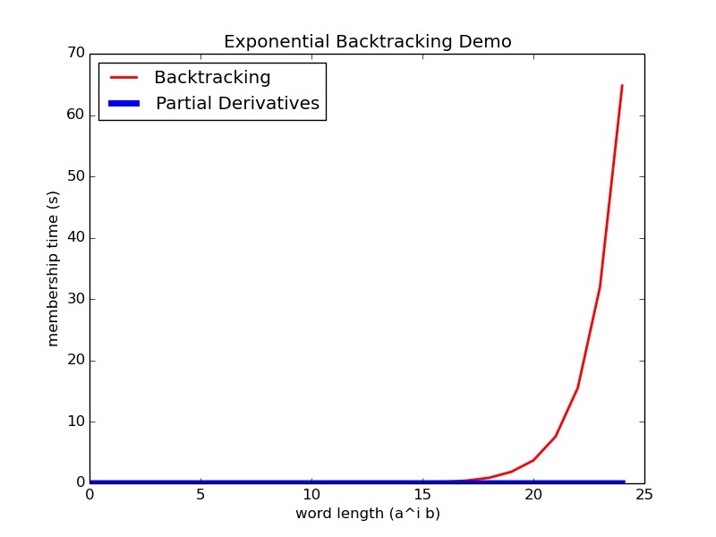
Figure 1: My implementation using the expression (a + a)*

Slide 13
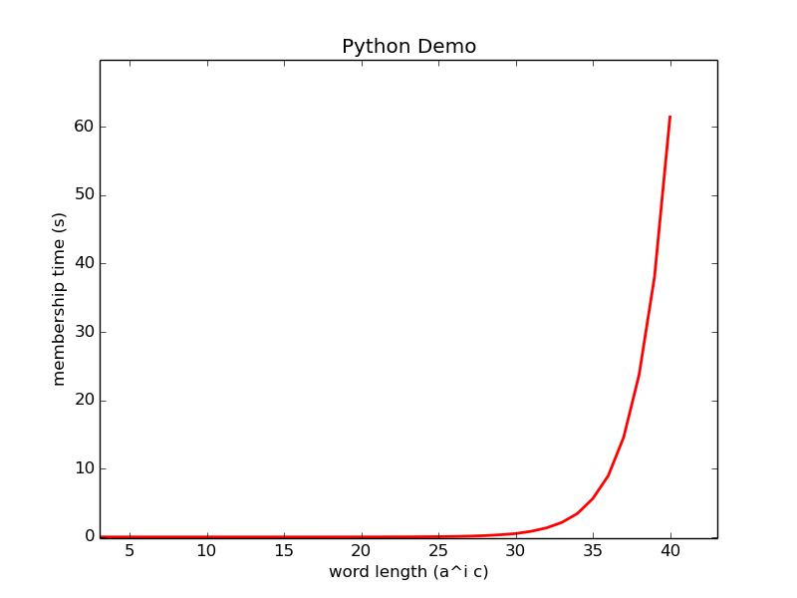
Figure 2: Python’s re module and the expression ((a + aa)* b) ^{[1]}

Slide 14
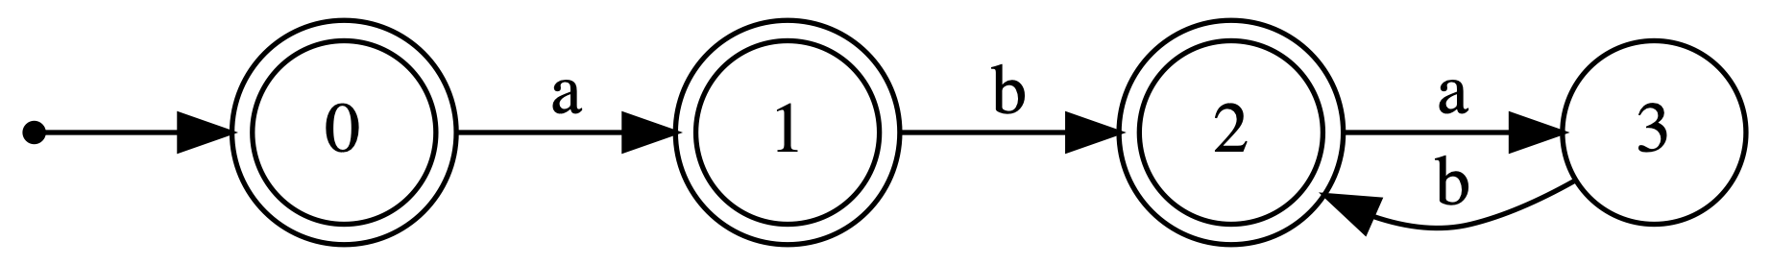
The Membership Problem: Automata
Automata are state machines
Input: word
Output: YES if the entire word can be processed leading to any final state, NO otherwise
Final states are double circled
Symbols of the input word are consumed at each transition
({0}, abab)
⊢ ({1}, bab)
⊢ ({2}, ab)
⊢ ({3}, b)
⊢ ({2}, ε)
2 is final - accept

Slide 15
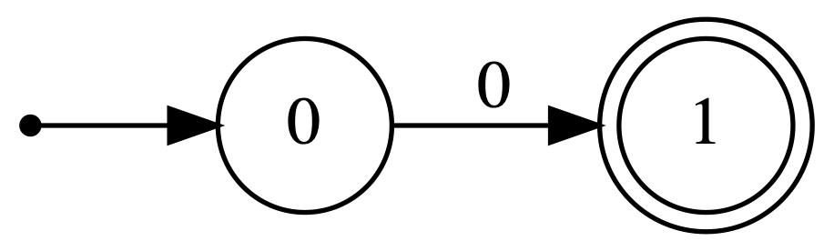
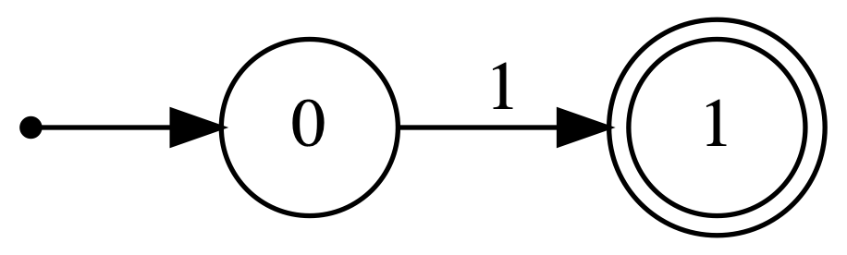
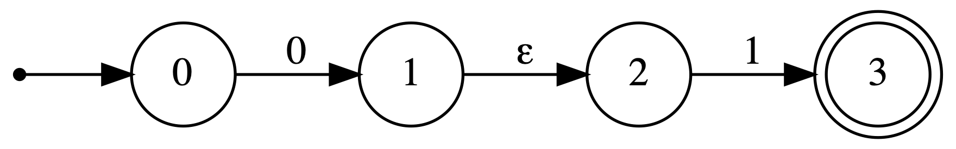
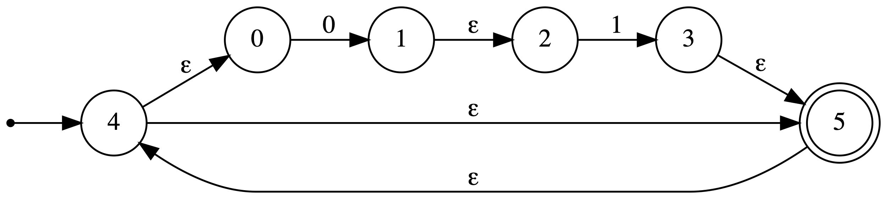
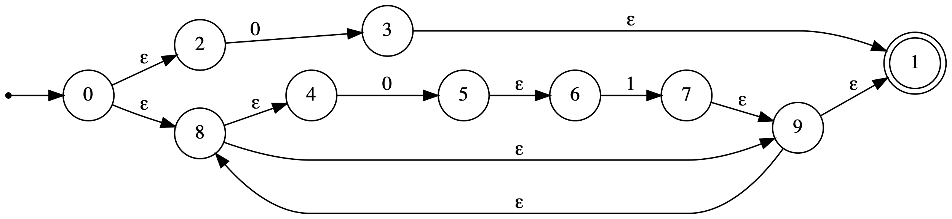
The Membership Problem: Automata

Slide 16
Collecting Practical Regular Expressions
https://grep.app indexes GitHub source code
Extracted 31,887 lines of code containing partial regular expressions from public GitHub repositories
12,023 of these lines have regular expressions satisfying:
Completeness
No errors
No backreferences, lookaheads, boundary assertions
Distinct when formatted as equivalent unambiguous mathematical expressions

Slide 17
Test Words
Accepting Words
Pairwise-inspired generation ^{[2]}
Enumeration
Words are inserted into source code to simulate partial matching
Rejecting Words
Distorting accepted words (adding, swapping, and removing characters)
Comparing against a static list of word inputs
The average expression is tested against 1,980 accepting words and
4,468 rejecting words.
Only 726/12,023 regular expressions have been fully tested. Each
regular expression is tested multiple times to ensure accuracy.

Slide 18
Results
Regular expressions are grouped by string length
This is how they are most commonly defined
The time measurement consists of:
Time to construct the appropriate object (parsing from a string into the tree, plus any automaton construction time)
Plus the time to evaluate the average test word

Slide 19
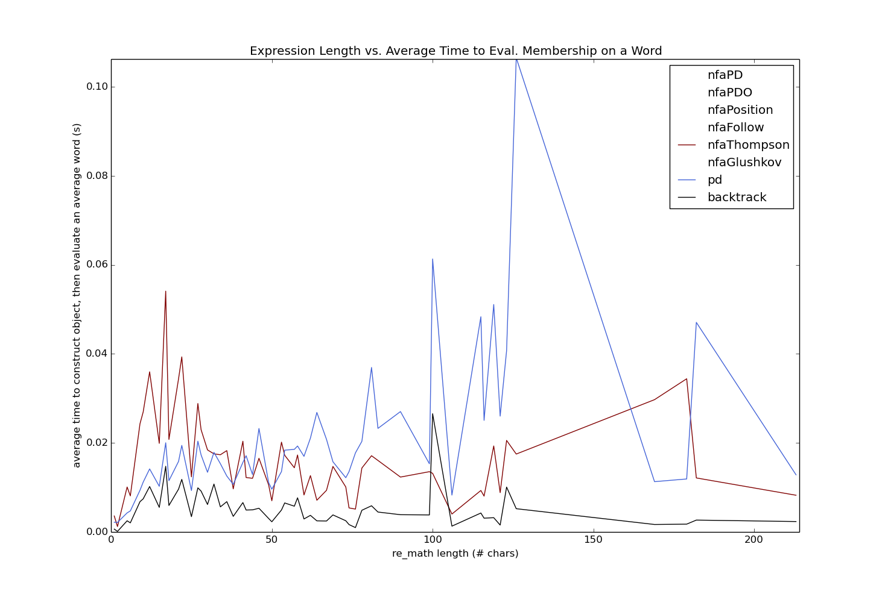
Figure 3: partial derivatives, vs. Thompson, vs. backtrack
Notes:
We have the highest resolution in expressions under length ~100.

Slide 20
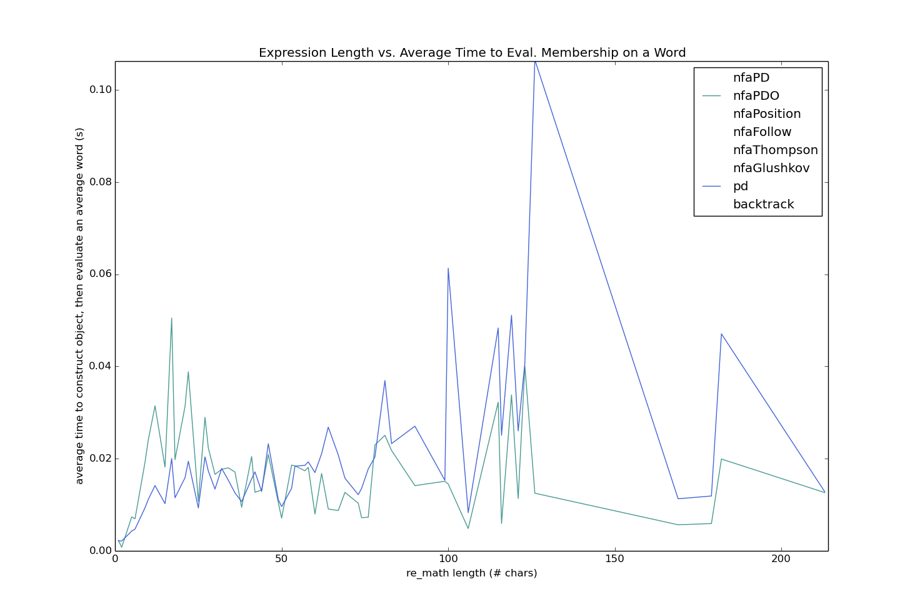
|pd(α)|≤|α|_{Σ}
Figure 4: partial derivatives vs. partial derivative automaton
Notes:
For expressions longer than ~50, it’s more efficient to compute ALL partial derivatives with respect to ALL symbols in the alphabet and create the respective automaton.
This is because the total number of partial derivatives of α will be ≤ the alphabet length of the given expression.
WOW!!
Note: as soon as you have to compute multiple words on a RE, you should build the NFA no matter what.

Slide 21
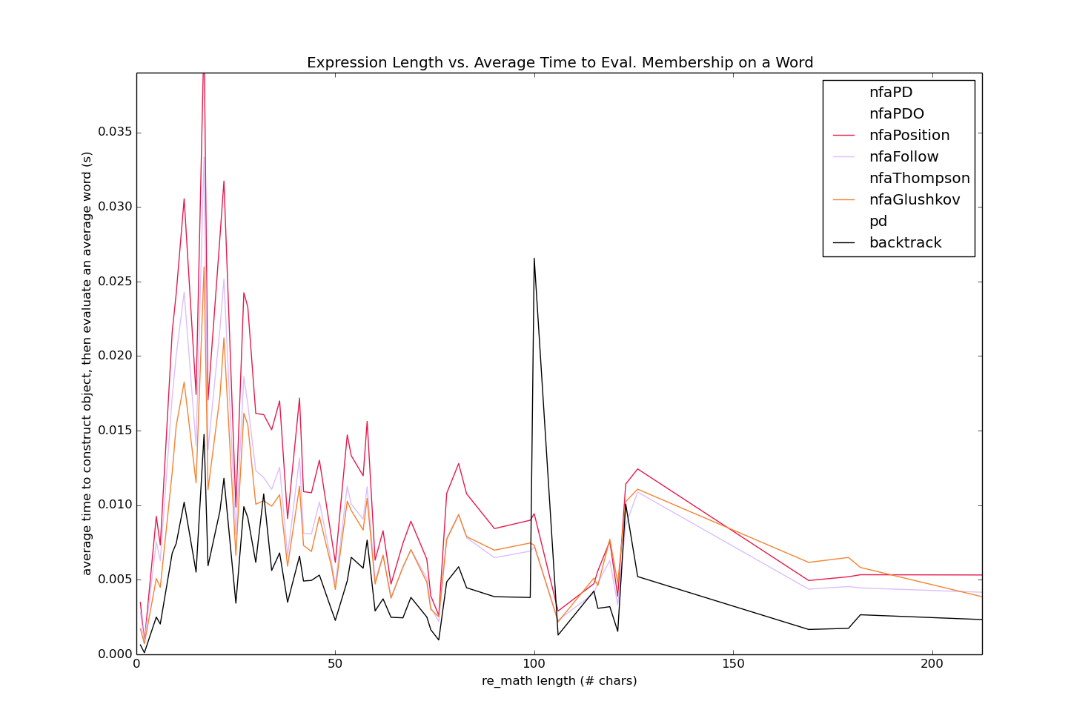
Figure 5: fastest algorithms compared

Slide 22
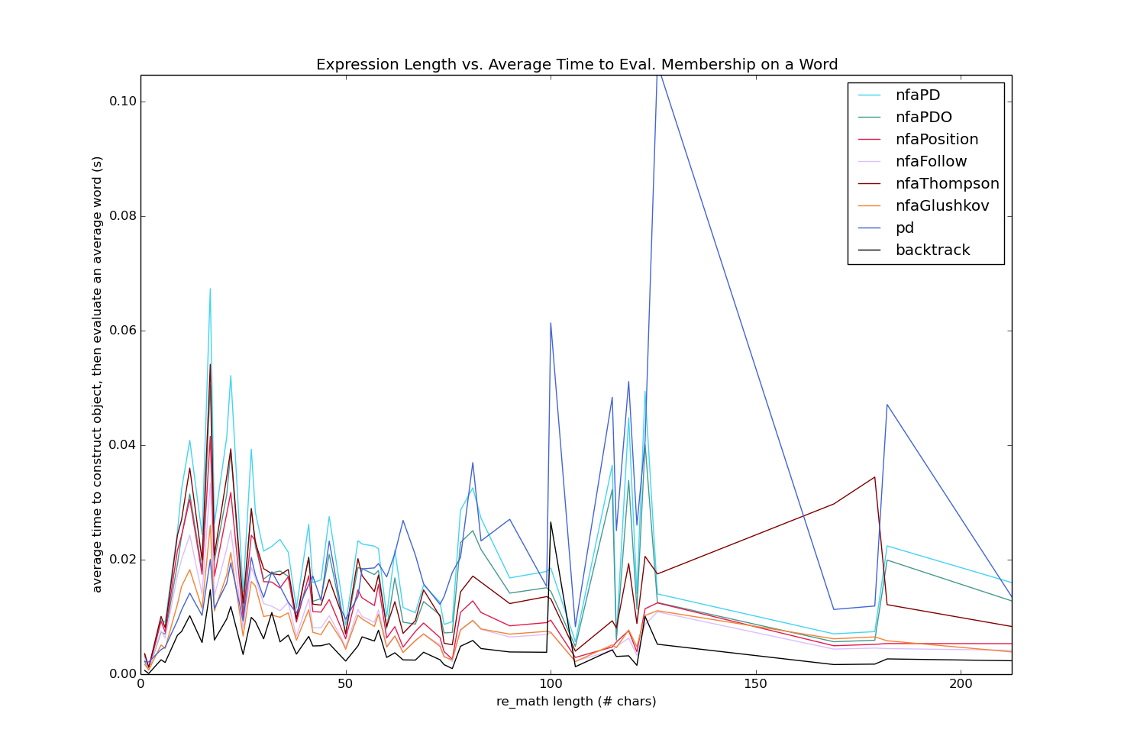
Figure 5: all algorithms

Slide 23
Further Work
We hope to test these algorithms on randomly generated regular expressions (this has been done, but not with these UNIX extensions)
Partial derivative optimizations when evaluating equality of large regular expression trees

Slide 24
Thank you!
To Dr. Konstantinidis for supervising this research and making his expertise available
For your attention
Questions?
The source code of this project is made publicly available at https://github.com/just1ngray/SMUHon-Practical-RE-Membership-Algs

Slide 25
Reference List
R. Sedgewick, K. Wayne, Algorithms, 4th ed. Available: https://algs4.cs.princeton.edu/54regexp/
L. Zheng, S. Ma, Y. Wang, and G. Lin, “String Generation for Testing Regular Expressions,” The Computer Journal, vol. 63, no. 1, Jan., pp. 41-65, 2020.

