Slide 1
Phalanx Duel — Make the Rules Legible

Slide 2
Phalanx Duel
Make the rules legible
A small game as a laboratory for boundaries, feedback, and trust
Software Craftsmanship McHenry County · 30 minutes

Slide 3
The question behind the game
Can a tactical card game make its rules:
playable;
deterministic;
explainable;
replayable; and
honest about what it has not proved?

Slide 4
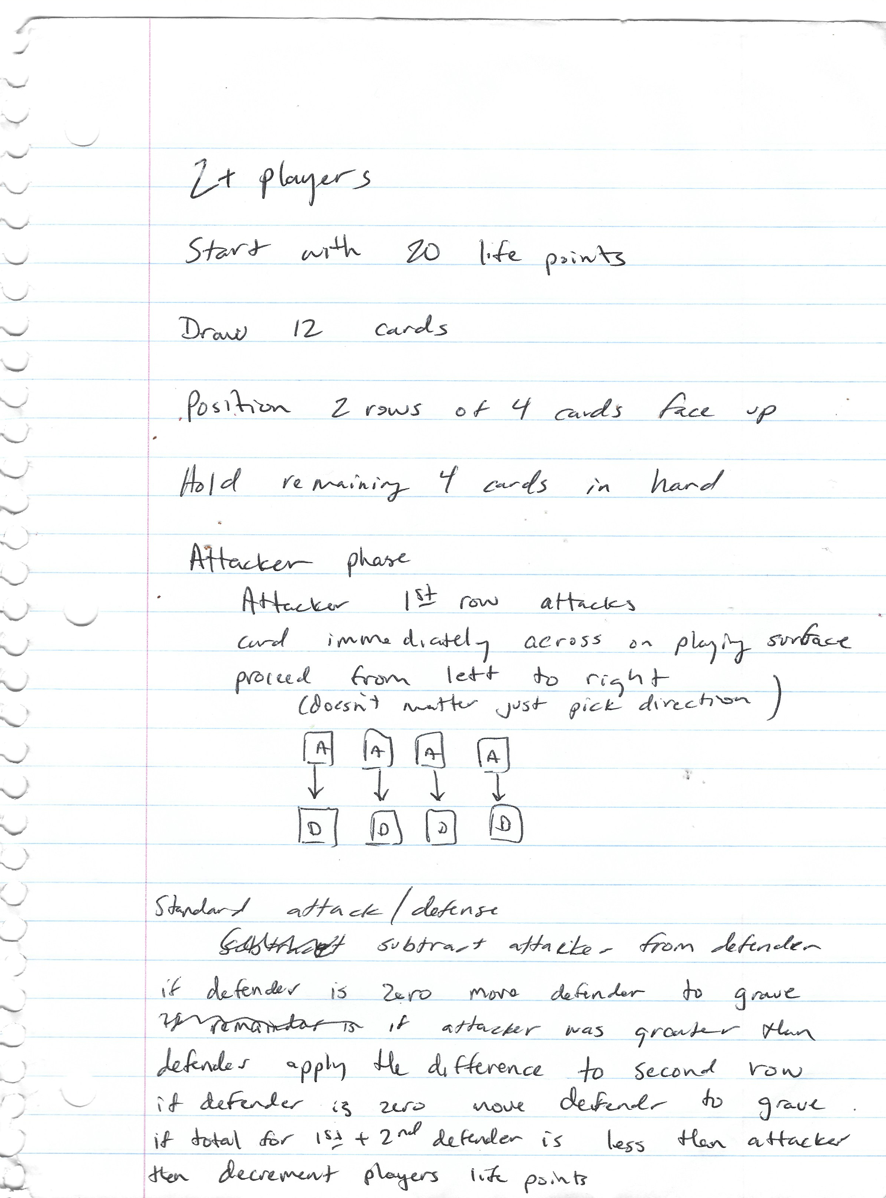
The project started at a table
A standard 52-card deck
A notebook of formation and damage sketches
Friendly tabletop matches
A design goal: tactical pressure without collectible-card complexity
July 2022 · Camp Tesomas
bg right:42%

Slide 5
The medium changed; the core question did not
notebook → tabletop play → Ruby model → TypeScript engine ↓ web · Go CLI · bots · agents · replay · telemetry
The digital system is the latest testable expression of the formation-first design—not a separate game with unrelated rules.

Slide 6
The battlefield fits on a small grid
Opponent LP back: [ ][ ][ ][ ] front: [ ][ ][ ][ ] ← attack lanes front: [ ][ ][ ][ ] ← attack lanes back: [ ][ ][ ][ ] Player LP
Cards occupy columns and ranks.
The front card meets the attack first.
A destroyed card exposes the next card in the column.
Remaining damage can reach Life Points.

Slide 7
Suits change the boundary being crossed
Suit | Tactical role in the current rules
♦ Diamonds | Card-to-card defense boundary
♥ Hearts | Card-to-player death-shield boundary
♣ Clubs | First eligible overflow after destruction
♠ Spades | Life Point damage at the player boundary
The effect depends on resolution state. Slogans like “hearts heal” are wrong.

Slide 8
One attack is a causal story
validated action ↓ combat calculation ↓ shield / destruction / collapse ↓ overflow / Life Point damage ↓ post-state + events + arithmetic witness
The player sees one result. The system retains the chain that produced it.

Slide 9
Put authority in one transition boundary
state + valid action + configured rules │ ▼ TypeScript rules engine ┌───────┼────────┐ ▼ ▼ ▼ state events hashes └───────┼────────┘ ▼ server projections → web / Go / agent clients
Clients still have behavior. They do not become competing rule engines.

Slide 10
Determinism is a contract, not a slogan
Given the same configured inputs and valid action sequence, the engine should produce the same result.
Explicit state and actions
Canonical card identity
State and action evidence for replay
Versioned rules semantics
Determinism does not, by itself, prove fairness or production availability.

Slide 11
The same match can explain itself
The current system carries engine-authored evidence into:
previews;
narration and combat effects;
semantic events;
replay checks; and
the terminal match report.
Play the verified full-game capture

Slide 12
Testing is a ladder of confidence
Shared schemas and contract tests
Pure engine and property checks
Isolated server/Postgres integration tests
Replay, event-log, rules, and combat-reference checks
Headless and browser playthroughs
Production health and assurance checks
Each rung answers a different question.

Slide 13
Shared contracts do not erase integration work
Caller | What it shares | What it must still prove
Browser | projected state and actions | interaction and visual behavior
Go CLI | generated/synchronized models | reconnect and terminal behavior
MCP agents | gameplay tool contracts | profile safety and action flow
Replay tools | state/action evidence | equivalence and visibility rules

Slide 14
Observability is not availability
OpenTelemetry is the collector-first instrumentation path.
Local telemetry can correlate match, session, reconnect, and QA activity.
Production health and telemetry reachability are separate signals.
The current production audit reported otel_active: false.
That gap belongs in the talk because trustworthy systems report degradation.

Slide 15
What is deliberately unfinished
Production OTel restoration and truthful readiness signals
Fly.io billing remediation before the next promotion
Browser automation edge cases
MCTS configuration race
Dependency/security maintenance
Native-client parity and monetization experiments
An honest roadmap is part of the engineering artifact.

Slide 16
The lesson is bigger than the game
Put authority in one deterministic engine.
Treat clients as replaceable projections.
Record enough evidence to explain a result.
Make verification claims narrower than the evidence.
Form the line. Find the breach. Explain the result.

