Slide 1
Rassah
رصّة
Type an order number. Get the cheapest safe carton, numbered packing instructions and a 3D layout, from messy product pages.
AI packing assistant for Saudi e-commerce
Project 1: AI Product Development and Monitoring · Tuwaiq Academy × Startupbootcamp × Meta · 22 Oct 2026
Team: M1 AI & Data · M2 Engine & UI · M3 Platform & Monitoring
Notes:
Speaker M1 (0:00–0:10). Rassah, رصّة: the packer types an order number and gets the cheapest safe carton, instructions and a 3D layout.

Slide 2
Packers pick cartons by eye
1
2
3
Oversized cartons cost money
Fragile items break, liquids leak
The data doesn't exist
Couriers bill the larger of actual and volumetric weight (L × W × H / 5000). A light order in a big box pays for air.
A new packer puts a book on a perfume bottle, or lays an oil bottle flat. Breakage means returns.
Cartonization tools assume clean dimensions in a warehouse system. Small Saudi merchants only have free-text product pages in Arabic and English.
Problem size is a hypothesis: we did not contact merchants, and all data is synthetic.
Notes:
Speaker M1 (0:10–0:30). Three problems: volumetric weight, breakage, and missing product data. Say honestly that problem size is a hypothesis.

Slide 3
Before and after Rassah
Before
After
Packer guesses the carton
Product sizes unknown or buried in text
New packers learn by breaking things
No record of what went wrong
Packer types an order number
Gemini reads each product page once (cached)
Cheapest valid carton + numbered Arabic steps + 3D view
Packer confirms or corrects; every correction is measured
Notes:
Speaker M1 (0:30–0:45). Before: guesswork. After: order number in, carton, instructions and 3D layout out, with the packer still in control.

Slide 4
How it works
1
LLM
2
Search
3
Geometry
Gemini understands
Engine computes
Validator proves
Product text → outer dimensions, weight, fragile / liquid / sensitive flags, source of each value, evidence quote
3D packing search: corner grid × rotations × 9 strategies + 40 seeded restarts, per carton
Independent code: no overlap, ≥ 70% base support, nothing on fragile, liquids upright, weight limit
The LLM understands, the engine computes, the validator proves.
Output: the cheapest valid carton by estimated carton + shipping cost. If nothing fits, Rassah says so.
Notes:
Speaker M1 (0:45–1:00). Three steps. Gemini only reads text. The engine searches positions. A validator that shares no code with the engine checks every layout before the packer sees it.

Slide 5
AI extraction with honesty rules
Every value carries its source
Rules the system enforces
page
Stated on the product page, with the evidence quote
Never invent a value or a layout
JSON schema + Zod check on every Gemini response
Product text is passed as data, not instructions
One extraction per product, cached; packer corrections are never overwritten
Gemini failure → visible “extraction failed”, logged, alerted
inferred
Estimated from clues (50 ml, 400 pages). Gets a 15% safety margin and an “estimated” badge
unknown
No basis. The order stops: “needs measurement”
The 15% margin will be checked against the measured inferred-size error (extraction eval, two runs: holdout 16.1%, all 12.9%).
Notes:
Speaker M1 (Q&A backup, or 10 s in the pitch). Source tags page / inferred / unknown. Inferred values get a safety margin; unknown stops the order. Extraction (30 synthetic products, 10 holdout, gemini-3.5-flash-lite): 100% parse, dims within 1 cm 100%, honesty on no-info products 100%, estimated-size error 12.9% in the latest run (14.3% in the first; holdout 16.1% vs 18.2%, only 4 products; LLM run-to-run variation; one fragile false positive in run 2), so the 15% margin stands.

Slide 6
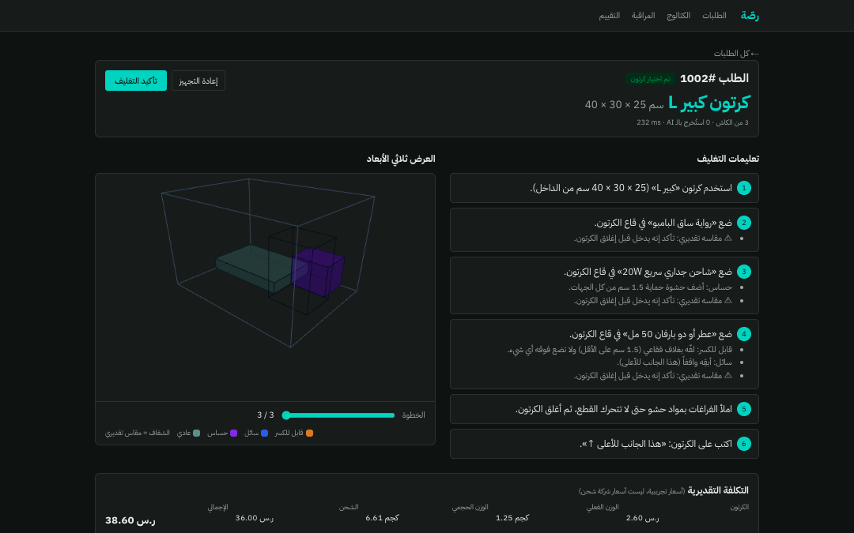
Live demo
1001
Single book → smallest suitable carton
1002
Perfume with no dimensions: inferred, padded, upright, on top. Numbered steps + 3D slider
Edit
Packer corrects a value → recorded as a correction (metric M1)
1020
≈ 20.5 kg: every carton too small or too weak. Rassah says so
/monitoring
Correction rate, Gemini failures, p95 latency; click a run for its trace
Backup if the live demo fails: recorded video docs/report/demo.mp4 and backup screenshots in docs/report/screens/.
Notes:
Speaker M2 (1:00–1:50). Follow docs/demo-script.md. If anything fails, switch to the backup video within 10 seconds. Outage story (simulated Gemini outage → M6 critical alert) is kept for Q&A.

Slide 7
Packing evaluation: 60 seeded fixtures
40 / 40
0 / 20
20 / 20
20 / 28
engine layouts pass the independent validator
false “packed” claims on impossible cases
known-feasible recall on zero-slack exact fills (up from 3 / 20, then 15 / 20)
naive-baseline layouts break a safety rule
Extraction (30 products, holdout 10): 100% parse, dims ±1 cm 100%, honesty 100%, estimated-dim error 13%. No cost savings claimed: 0 SAR vs baseline on the 8 fixtures where both are valid. Source: eval/results/packing-2026-10-21-engine-0.2.json
Notes:
Speaker M2 (1:50–2:20). Validity 100%, zero false claims, recall 20 of 20 on the hardest exact-fill cases, and the naive baseline breaks a rule in 20 of 28 layouts. We do not claim savings. Extraction: 100% parse, dims within 1 cm 100%, honesty 100%, estimated-dim error 12.9% (first run 14.3%; holdout 16.1% vs 18.2%, run-to-run variation).

Slide 8
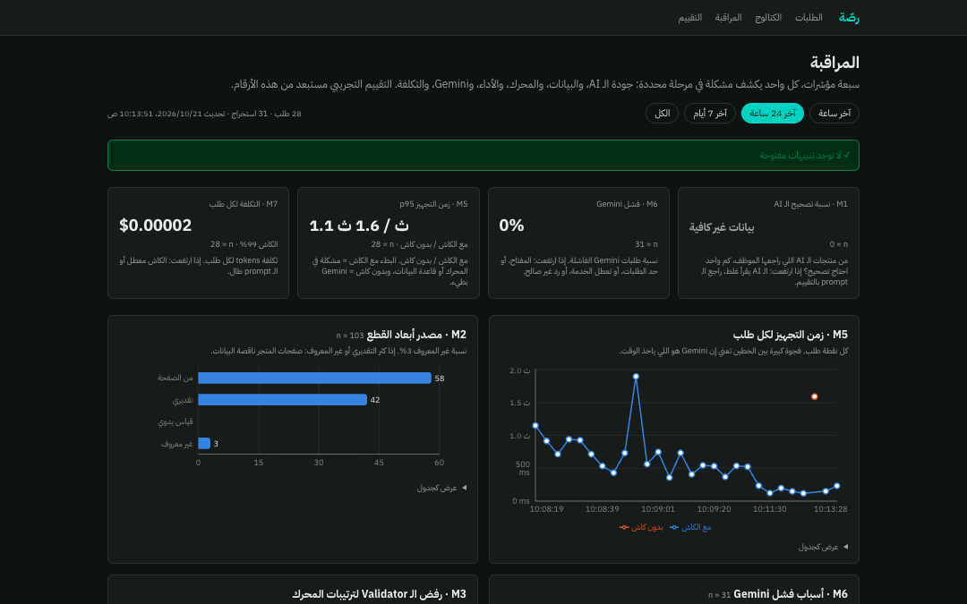
Monitoring: seven metrics, one trace per run
M1
AI correction rate
M2
Data-source mix
M3
Validator rejections (must be 0)
M4
No-carton rate
M5
p50 / p95 latency, cached vs uncached
M6
Gemini failure rate
M7
Cost per order + cache hits
Investigation: the eval showed recall 3 / 20 → traced fixture feasible-05 (every score preferred flat items) → added “tight” scores → 15 / 20, validity still 100%, regression test added.
Notes:
Speaker M3 (2:20–2:40). Each metric is tied to a failure it reveals; red = critical alert rules. One-line investigation story. In Q&A: the simulated Gemini outage raises the M6 critical alert.

Slide 9
Limits, and what we ask for next
What it does not do yet
The ask: a pilot with one merchant
Synthetic data (30 products, written by the team)
Rigid box-shaped products only, one carton per order
Illustrative costs, always labeled “estimated”
Heuristic search: not globally optimal (finds 20 / 20 exact fills, but time-bounded)
No crush-strength or void-fill modeling; no live Salla / Zid link
100 real orders: the packer and Rassah side by side
Measured: carton spend, courier invoices, damage, packing time
Then: Salla / Zid integration, multi-carton orders, scale-weight feedback
Notes:
Speaker M3 (2:40–2:55). State limits plainly. The ask: one merchant, 100 real orders, so the savings claim can be measured instead of assumed.

Slide 10
Team and who presents what
M1
M2
M3
AI & Data
Engine & UI
Platform & Monitoring
Gemini extraction, synthetic dataset, extraction eval
Packing engine, validator, result page, 3D view
Next.js, Supabase, events, dashboard, alerts, CI
Slides 1–5 · 0:00–1:00
Slides 6–7 · 1:00–2:20 (live demo)
Slides 8–11 · 2:20–3:00
Every member can explain every part: each one walks through code another member wrote.
Notes:
Shown briefly or skipped in the 3 minutes; it documents the speaker split (all three speak). Q&A: any member answers any question.

Slide 11
Thank you
شكراً
Repository
github.com/justAbdulaziz10/Rassah
Live app
https://rassah.vercel.app
Questions welcome. Appendix: architecture, development flow, monitoring flow, metrics, tools.
Notes:
Speaker M3 (2:55–3:00). Thank the judges; repo and live URL on screen. Live URL is final: https://rassah.vercel.app.

Slide 12
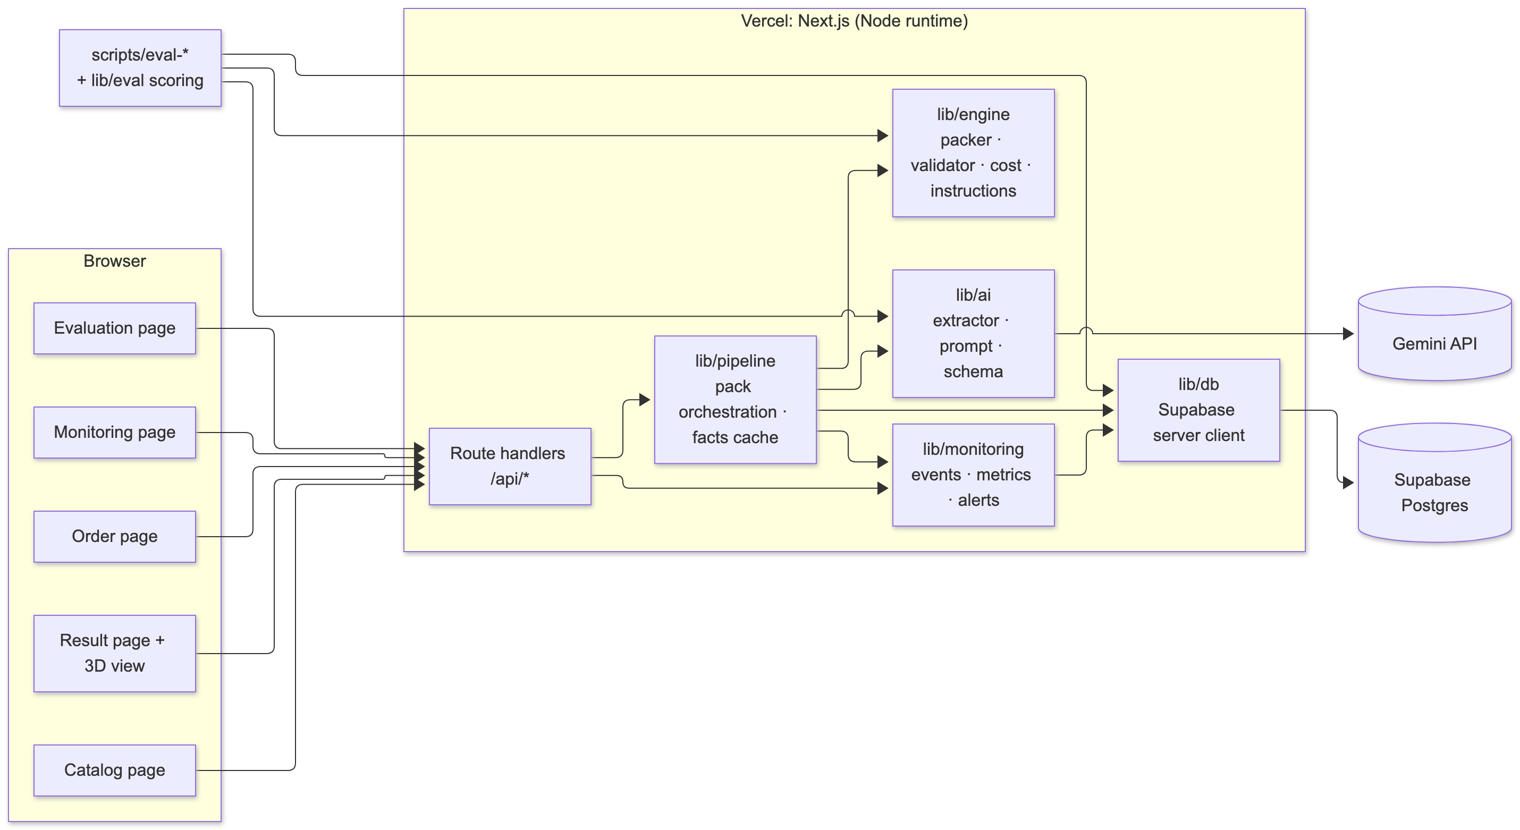
Appendix: system architecture
Notes:
Pages call route handlers; lib/pipeline orchestrates cache → Gemini → engine → validator → events. lib/engine is pure TypeScript with no I/O.

Slide 13
Appendix: development flow
Agent worktrees
Local merge +
local CI gate
Push to main
GitHub Actions CI
(lint, types, data, tests)
Vercel build
on main
Issue → new worktree
Investigate
by run_id
Dashboard
+ alert rules
Production deploy
+ smoke test
Main updated
Prompt or engine change → eval scripts (eval-extraction, eval-packing) → eval_runs in Supabase → evaluation page + report numbers, compared before pushing.
Notes:
As built (docs/decisions.md, 2026-10-21): agents work in worktrees, work is merged locally and must pass the local CI gate (agent-ship ci: secret scan, floor guard, lint, typecheck, tests, build, packing eval) before being pushed straight to main. GitHub Actions CI re-runs and Vercel deploys production from main. There was no per-PR review and no branch protection. Production problems come back through the dashboard as issues. The diagram image docs/report/diagram-dev-flow.png shows the original plan.

Slide 14
Appendix: monitoring flow
Pack request
Events written
Metrics
Alert rules
run_id + timer
cache → Gemini → engine → validator
packer confirm / edit
extraction_events
order_runs
corrections
M1–M7 over a time window
with sample sizes
(eval traffic excluded)
threshold + minimum sample
open once, auto-resolve
→ alerts table
Tables: Supabase Postgres. Recomputed on dashboard load and after each run. Full diagrams: docs/report/diagram-monitoring-*.png
Monitoring dashboard
Alert banner + webhook
metric tiles, charts, run traces
webhook only for real faults, never simulated
Notes:
Each pack request writes extraction events, an order run and any corrections, all linked by run_id. Metrics are computed over a window excluding eval traffic; alert rules need a minimum sample.

Slide 15
Appendix: metric definitions and alerts
# | Metric | Reveals | Alert rule
M1 | AI correction rate (reviewed AI products the packer corrected) | Wrong extractions | > 20% of last 30, warning
M2 | Data-source mix of packed units | Missing store data | > 30% unknown in 24 h, info
M3 | Validator rejections of engine layouts | Engine bugs (must be 0) | Any in 24 h, critical
M4 | No-carton rate + skip reasons | Catalog / margin mismatch | > 15% of last 20, warning
M5 | p50 / p95 latency, cached vs uncached | Slow Gemini vs slow engine / DB | p95 > 8 s uncached / 2 s cached
M6 | Gemini failure rate by status | Key, quota, outage, bad output | > 10% of last 20, critical
M7 | Cost per order + cache-hit rate | Cache broken, prompt bloat | Shown, no alert
Each metric shows its sample size and reads “insufficient data” below its minimum.
Notes:
Definitions from REPORT.md section 7.

Slide 16
Appendix: tools and AI usage
Tool | Used for | Origin | Verified by
Gemini API (Flash tier) | Runtime product extraction | Product feature | Extraction eval vs ground truth (30 products), Zod checks
Claude Code | Code drafts, docs, synthetic data, tests | Generated, team-reviewed | 152 tests, CI, evals, end-to-end run
Next.js 16 + TypeScript | UI + API in one project | Framework | Typecheck, build
Supabase Postgres | Catalog cache, events, eval results | Service | RLS, end-to-end run
Vercel + GitHub Actions | Hosting, production deploy, CI | Service | CI on every push to main
Vitest · R3F · Recharts | Tests, 3D view, charts | Libraries | Tests, screenshots
Full log with limitations per tool: docs/report/TOOLS.md
Notes:
Summary of TOOLS.md.

