Slide 1
AI Lab-Project1:
VALUE ITERATION
Abhinav Singh 22UCS004
Akhil Murarka 22UCS009
Ishita Singhal 22UCS090

Slide 2
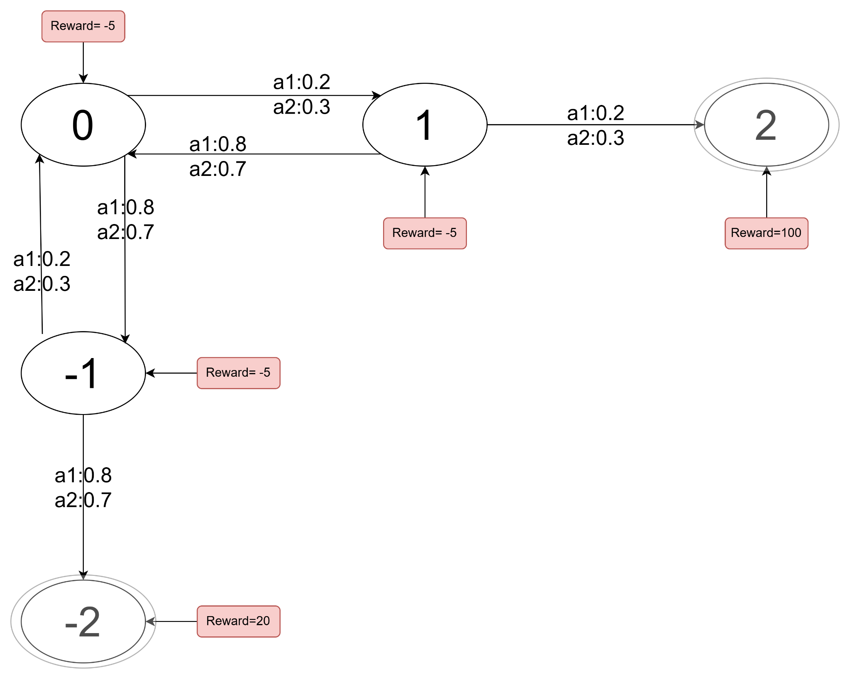
System Model
1. States (S)
The possible states in this game are:
S={−2,−1,0,1,2}
Initial States: 0
Final States: 2,-2
2. Actions (A)
At each state, two actions are available:
A={a1,a2} where a1: s-1
a2: s+1
3.Discount Factor(γ)
γ =1

Slide 3
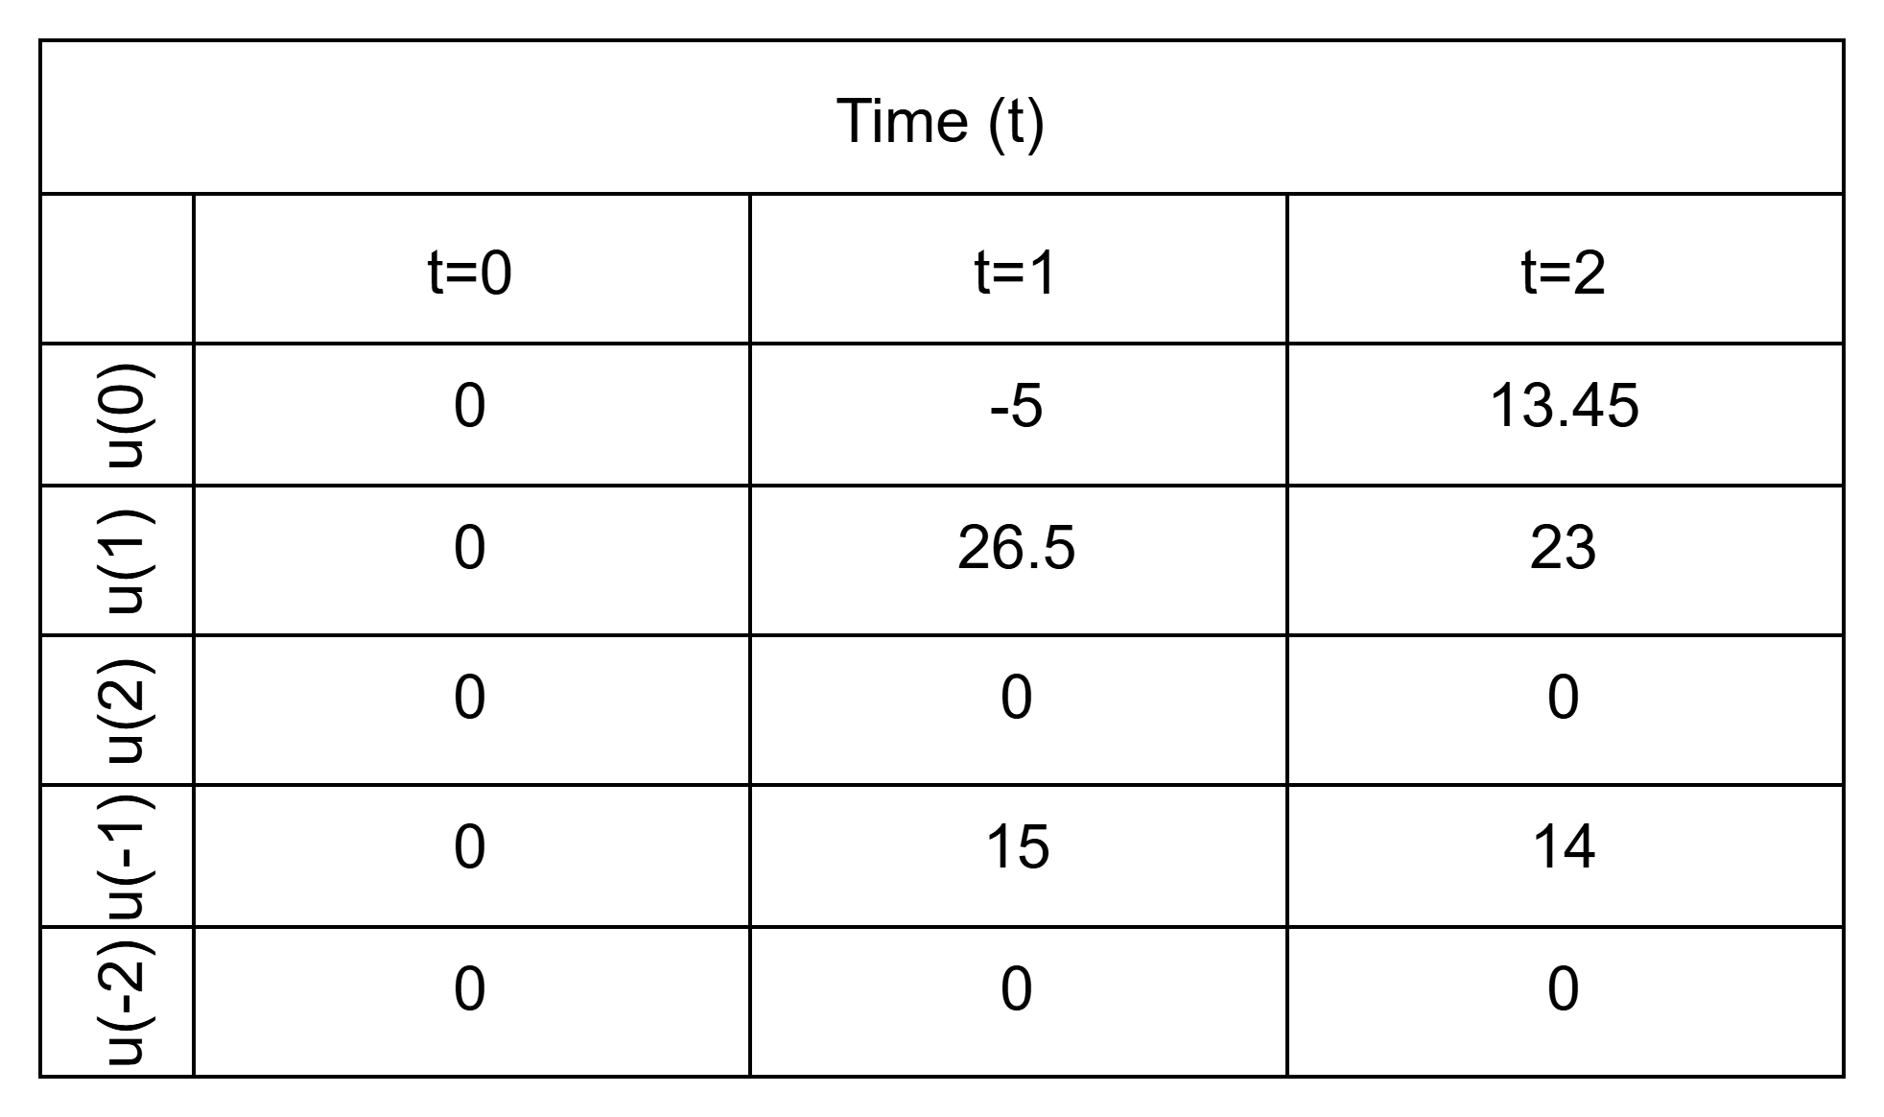
IMPLEMENTATION
By using this equation we calculates the utilities of each state:
u(s) = maxₐ ∑ₛ' P(s'|s, a) [ R(s, a, s') + γ u(s') ]
After calculating the utility values are as shown in the table below:

Slide 4
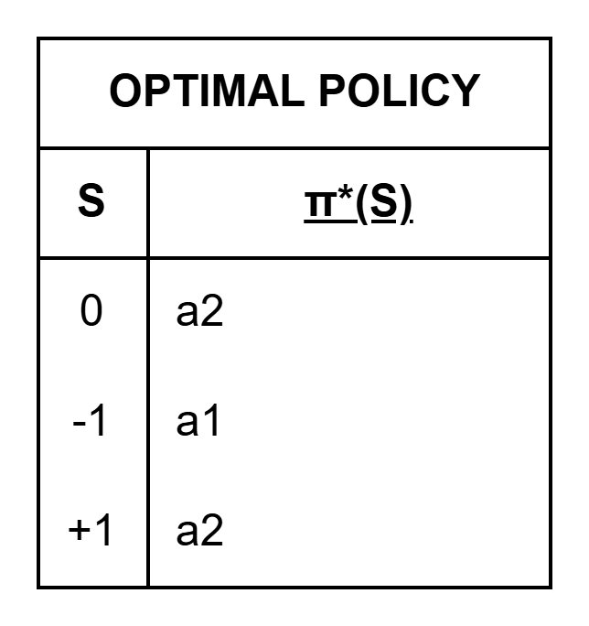
OUTPUT
This is the optimal policy for non-terminal states:

