Slide 1

선
Color:white30#
Size: 1*17px
Franklin gothic medium 18pt
Color:white
#00344d
#cd4450
23px
174px
1200px
550px

Slide 2

Franklin gothic medium 21pt
Color: #00344d
400px
Color : #e6e6e6
517px
379px
본고딕 regular
Color #6f6f6f
Size 16pt
행간 20pt
Color : #eeeeee
Franklin gothic medium 16pt
Color: cd4450
517px
418px
본고딕 regular
Color #00344d
Size 26pt
행간 32pt
본고딕 regular
Color #6f6f6f
Size 16pt
행간 20pt
Size 9px
Color #e4e4e4
Size 9px
Color #adadad

Slide 3
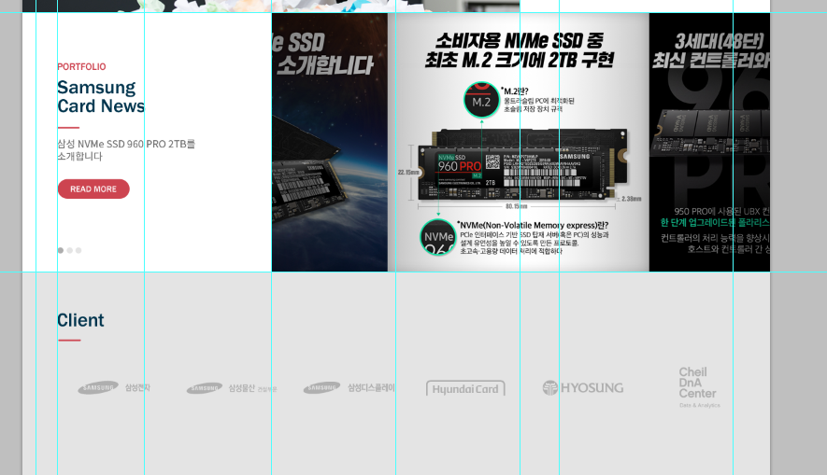
Franklin gothic medium
Size : 31pt
행간:30pt
Color: #00344d
418px
329px
Color : #e4e4e4

