Slide 1
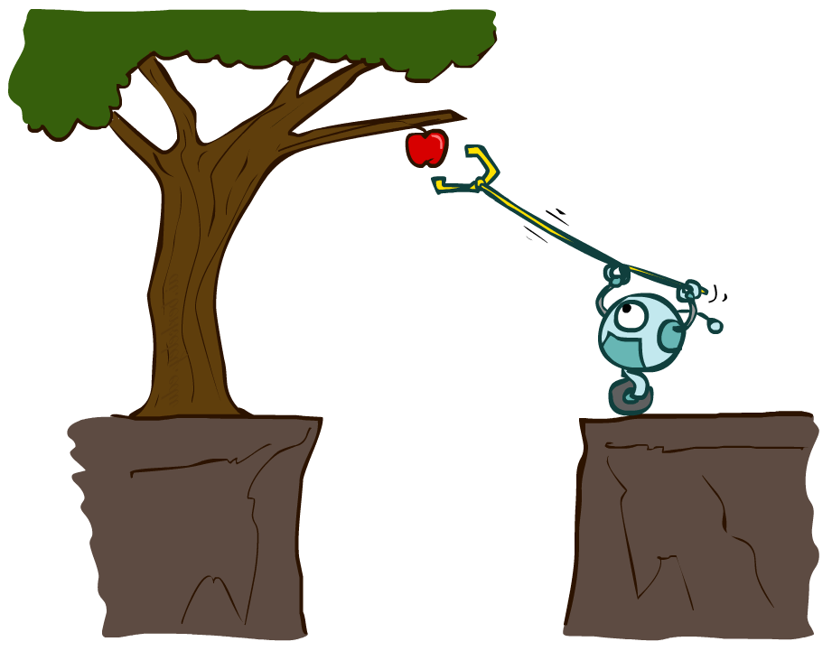
CS 188: Artificial Intelligence
Agents and environments
Chapter 2 from the book
Updated by Dr. Malak Abdullah
Notes:
Please retain proper attribution and the reference to ai.berkeley.edu. Thanks!

Slide 2
Outline
Agents and environments
Rationality
PEAS (Performance measure, Environment, Actuators, Sensors)
Environment types
Agent types

Slide 3
Agents and environments
Agent
Environment
Sensors
Percepts
?
Actuators
Actions
An agent perceives its environment through sensors and acts upon it through actuators (or effectors, depending on whom you ask)

Slide 4
Agents and environments
Agent
Environment
Sensors
Percepts
?
Actuators
Actions
Are humans agents?
Yes!
Sensors = vision, audio, touch, smell, taste, proprioception
Actuators = muscles, secretions, changing brain state

Slide 5
Agents and environments
Agent
Environment
Sensors
Percepts
?
Actuators
Actions
Are pocket calculators agents?
Yes!
Sensors = key state sensors
Actuators = digit display

Slide 6
Agents and environments
Agent
Environment
Sensors
Percepts
?
Actuators
Actions
AI is more interested in agents with large computational resources and environments that require nontrivial decision making

Slide 7
Agent functions
The agent function maps from percept histories to actions:
f : P* → A
I.e., the agent’s actual response to any sequence of percepts
Percept
NEXT
NEXT
NEXT
NEXT
Action
LEFT
LEFT
DROP
RIGHT
Notes:
Is there any reason to pay attention to more than just the current percept?
No – the correct decision depends only on the current percept because the world is fully observable!

Slide 8
Agent programs
The agent program l runs on some machine M to implement f :
f = Agent(l,M)
Real machines have limited speed and memory, introducing delay, so agent function f depends on M as well as l
Percept
NEXT
NEXT
NEXT
NEXT
Action
NOOP
NOOP
NOOP
LEFT

Slide 9
Example: Vacuum world
Percepts: [location,status], e.g., [A,Dirty]
Actions: Left, Right, Suck, NoOp

Slide 10
Vacuum cleaner agent
Agent function
Agent program
Percept sequence | Action
[A,Clean] | Right
[A,Dirty] | Suck
[B,Clean] | Left
[B,Dirty] | Suck
[A,Clean],[B,Clean] | Left
[A,Clean],[B,Dirty] | Suck
etc | etc
function Reflex-Vacuum-Agent([location,status])
returns an action
if status = Dirty then return Suck
else if location = A then return Right
else if location = B then return Left
What is the right agent function?
Can it be implemented by a small agent program?
(Can we ask, “What is the right agent program?”)

Slide 11
Rational Agent
A rational agent is one that does the right thing
What is rational at any given time depends on four things:
• The performance measure that defines the criterion of success.
• The agent’s prior knowledge of the environment.
• The actions that the agent can perform.
• The agent’s percept sequence to date.
We claim that under these circumstances the agent is indeed rational

Slide 12
Rationality
Fixed performance measure evaluates the environment sequence
one point per square cleaned up?
NO! Rewards an agent who dumps dirt and cleans it up
one point per clean square per time step, for t = 1,…,T
A rational agent chooses whichever action maximizes the expected value of the performance measure
given the percept sequence to date and prior knowledge of environment
Does Reflex-Vacuum-Agent implement a rational agent function?
Yes, if movement is free, or new dirt arrives frequently
Notes:
The dirt-dumping problem is an example of the King Midas problem – mis-specifying the objective

Slide 13
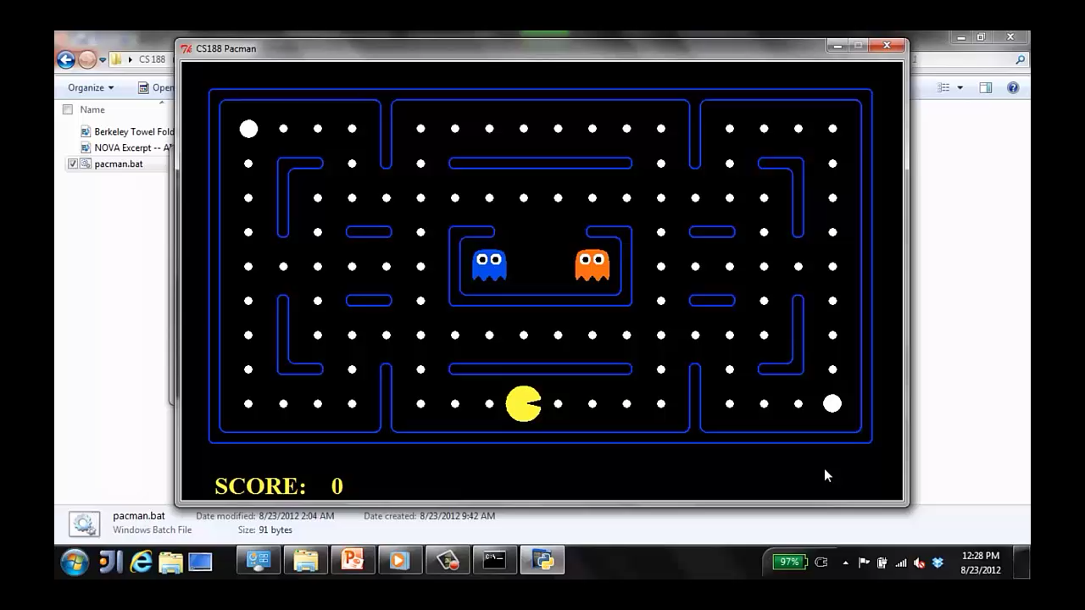
A human agent in Pacman

Slide 14
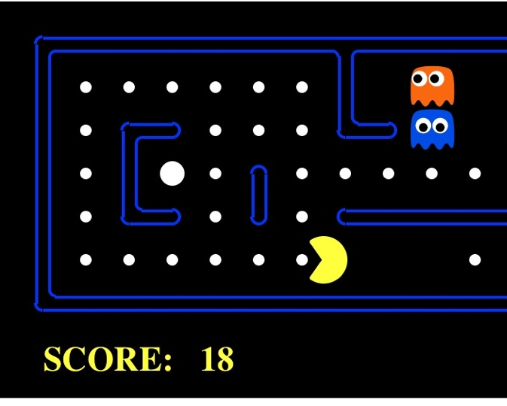
The task environment - PEAS
Performance measure
-1 per step; + 10 food; +500 win; -500 die; +200 hit scared ghost
Environment
Pacman dynamics (incl ghost behavior)
Actuators
Left Right Up Down
Sensors
Entire state is visible (except power pellet duration)

Slide 15
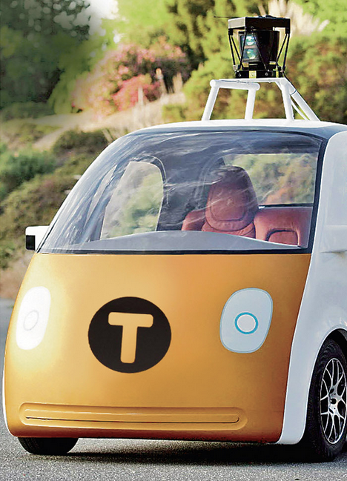
PEAS: Automated taxi
Performance measure
Income, happy customer, vehicle costs, fines, insurance premiums
Environment
US streets, other drivers, customers, weather, police…
Actuators
Steering, brake, gas, display/speaker
Sensors
Camera, radar, accelerometer, engine sensors, microphone, GPS
Image: http://nypost.com/2014/06/21/how-google-might-put-taxi-drivers-out-of-business/

Slide 16

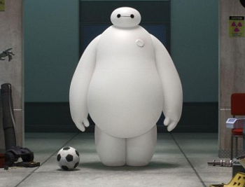
PEAS: Medical diagnosis system
Performance measure
Patient health, cost, reputation
Environment
Patients, medical staff, insurers
Actuators
Screen display, email
Sensors
Keyboard/mouse

Slide 17
Rationality, contd.
Are rational agents omniscient or clairvoyant?
No – they are limited by the available percepts.
No – they may lack knowledge of the environment dynamics (unless we improve the performance of crystal balls or time machines ☺).
Do rational agents explore and learn?
Yes – in unknown environments these are essential
Gathering information, and learn as much as possible from what it perceives

Slide 18
Rationality, contd.
Do rational agents make mistakes?
No – but their actions may be unsuccessful
Are rational agents autonomous (i.e., transcend initial program)?
Yes – as they learn, their behavior depends more on their own experience

Slide 19
Agent design
The environment type largely determines the agent design
Partially observable => agent requires memory (internal state)
- If an agent’s sensors give it access to the complete state of the environment at each point in time, then fully observable.
- If the agent has no sensors at all then the environment is unobservable
Stochastic or deterministic=> Taxi driving vs Chess
Single or Multi-agent => Crossword Puzzle vs Chess
Static or Dynamic => agent has time to compute a rational decision
If the environment can change while an agent is deliberating, then we say the environment is dynamic for that agent; otherwise, it is static.
Crossword puzzle vs Taxi driving or Chess with clock (semi dynamic)

Slide 20
Agent design (Cont.)
The environment type largely determines the agent design
Episodic vs. sequential => the current decision could affect all future decisions. Chess and taxi driving are sequential
Continuous time => continuously operating controller
a finite number of distinct states + a finite number of percepts and actions
Unknown physics => need for exploration
It is quite possible for a known environment to be partially observable—solitaire card games, I know the rules but am still unable to see the cards that have not yet been turned over. Conversely, an unknown environment can be fully observable—in a new video game, the screen may show the entire game state but I still don’t know what the buttons do until I try them.
Unknown perf. measure => observe/interact with human principal

Slide 21
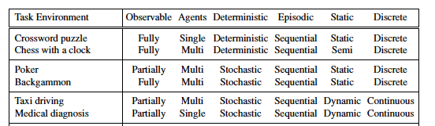
Environment types

Slide 22
Environment types
 | Pacman | Backgammon | Diagnosis | Taxi
Fully or partially observable
Single-agent or multiagent
Deterministic or stochastic
Static or dynamic
Discrete or continuous
Known physics?
Known perf. measure?

Slide 23
Agent types
In order of increasing generality and complexity
Simple reflex agents
Reflex agents with state
Goal-based agents
Utility-based agents
Learning Agents

Slide 24
Simple reflex agents
The simplest kind of agent is the simple reflex agent.
These agents select actions on the basis
of the current percept, ignoring the rest of the percept history.

Slide 25
Simple reflex agents
These agents only succeed in the fully observable environment.
The Simple reflex agent does not consider any part of percepts history during their decision and action process.
The Simple reflex agent works on Condition-action rule, which means it maps the current state to action. Such as a Room Cleaner agent, it works only if there is dirt in the room.
Problems for the simple reflex agent design approach:
They have very limited intelligence
They do not have knowledge of non-perceptual parts of the current state
Not adaptive to changes in the environment.

Slide 26
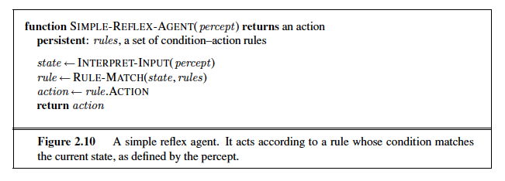

Slide 27
Model-based Reflex agents with state

Slide 28
Model-based reflex agents
The Model-based agent can work in a partially observable environment, and track the situation.
A model-based agent has two important factors:
- Model: It is knowledge about "how things happen in the world," so it is called a Model-based agent.
- Internal State: It is a representation of the current state based on percept history.
These agents have the model, "which is knowledge of the world" and based on the model they perform actions.
Updating the agent state requires information about:
How the world evolves
How the agent's action affects the world.

Slide 29
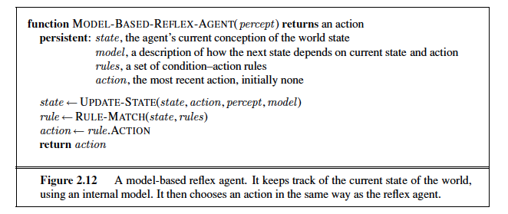

Slide 30
Goal-based agents
Notes:
Act to achieve a goal
Pro: use goal to index into actions that might achieve it, eg “Have milk” -> “buy milk”
Con: cannot handle tradeoffs among goals, failure probability etc.

Slide 31
Goal based agents
The knowledge of the current state environment is not always sufficient to decide for an agent to what to do.
The agent needs to know its goal which describes desirable situations.
Goal-based agents expand the capabilities of the model-based agent by having the "goal" information.
They choose an action, so that they can achieve the goal.
These agents may have to consider a long sequence of possible actions before deciding whether the goal is achieved or not. Such considerations of different scenario are called searching and planning, which makes an agent proactive.

Slide 32
Utility-based agents
These agents are similar to the goal-based agent but provide an extra component of utility measurement which makes them different by providing a measure of success at a given state.
Utility-based agent act based not only goals but also the best way to achieve the goal.
Notes:
Utility is a numeric scale
Pro: can compute expected values for actions, handle tradeoffs and uncertainty
Con: cannot (easily) index into actions

Slide 33
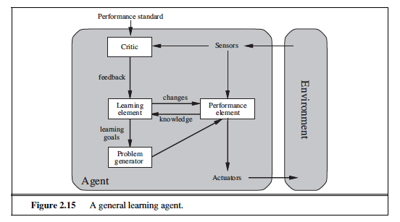
Learning Agents
Learning in intelligent agents can be summarized as a process of modification of each component of the agent to bring the components into closer agreement with the available feedback information, thereby improving the overall performance of the agent.

Slide 34
Example: Learning agents
For example, after the taxi makes a quick left turn across three lanes of traffic, the critic observes the shocking language used by other drivers. From this experience, the learning element is able to formulate a rule saying this was a bad action, and the performance element is modified by installation of the new rule.
The problem generator might identify certain areas of behavior in need of improvement and suggest experiments, such as trying out the brakes on different road surfaces under different conditions.

Slide 35
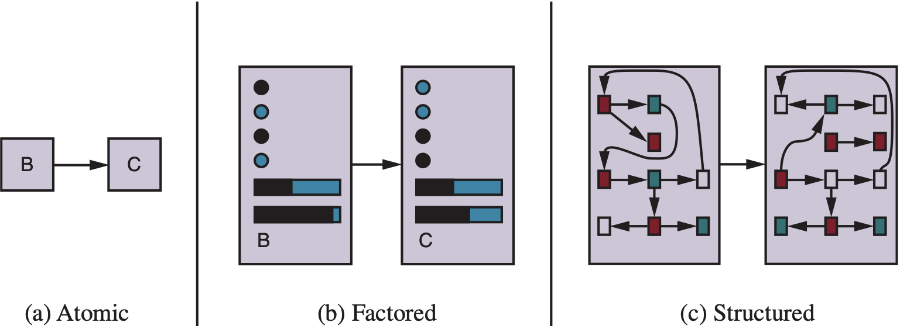
Spectrum of representations

Slide 36
Summary
An agent interacts with an environment through sensors and actuators
The agent function, implemented by an agent program running on a machine, describes what the agent does in all circumstances
Rational agents choose actions that maximize their expected utility
PEAS descriptions define task environments; precise PEAS specifications are essential and strongly influence agent designs
More difficult environments require more complex agent designs and more sophisticated representations

Slide 37
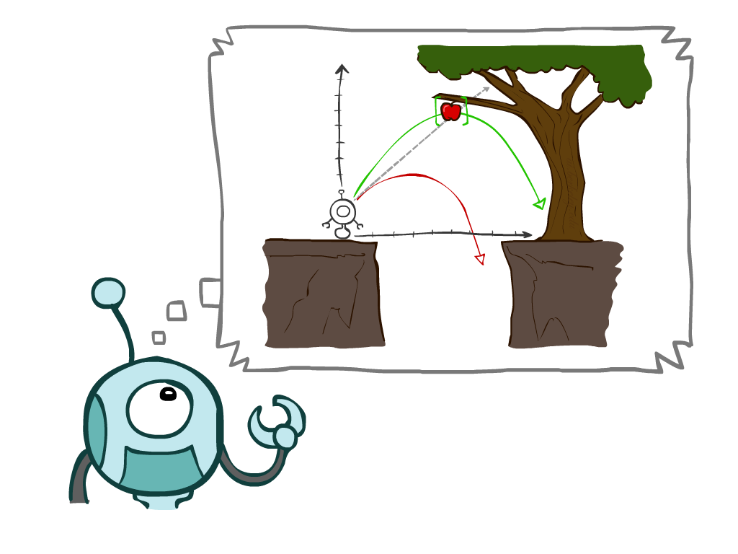
Chapter 3 will be
Chapter 3 describes one kind of goal-based agent called a problem-solving agent.
It describes several general-purpose search algorithms that can be used to solve problems.

Slide 38
Quiz next week
Chapter1 + Chapter 2

