Slide 1
Machine Learning SVM
Dr. Malak Abdullah
Computer Science Department
Jordan University of Science and Technology

Slide 2
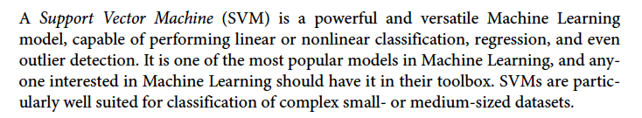
SVM

Slide 3
Classification
Linearly separable classes
Goal: find a linear decision boundary (hyperplane) that separates the classes

Slide 4
Linearly separable classes
One possible solution

Slide 5
Linearly separable classes
Another possible solution

Slide 6
Linearly separable classes
Other possible solutions

Slide 7
Which one is better?
Which one is better? B1 or B2? How do you define better?

Slide 8
Which one is better?
Fitting the widest possible street between classes ☺
Hyperplane that maximizes the margin will have better generalization => B1 is better than B2

Slide 9
Noisy data
Hyperplane that maximizes the margin will have better generalization => B1 is better than B2

Slide 10
Noisy data
The Maximum Margin Classifier is our first SVM. But this SVM requires the two classes to be completely linearly separated. This isn’t always the case so in 1993 Vapnik developed another one of his machines.
This is the Maximum Margin Classifier. It maximizes the margin of the hyperplane. This is the best hyperplane because it reduces the generalization error the most. If we add new data, the Maximum Margin Classifier is the best hyperplane to correctly classify the new data.
Hyperplane that maximizes the margin will have better generalization => B1 is better than B2

Slide 11
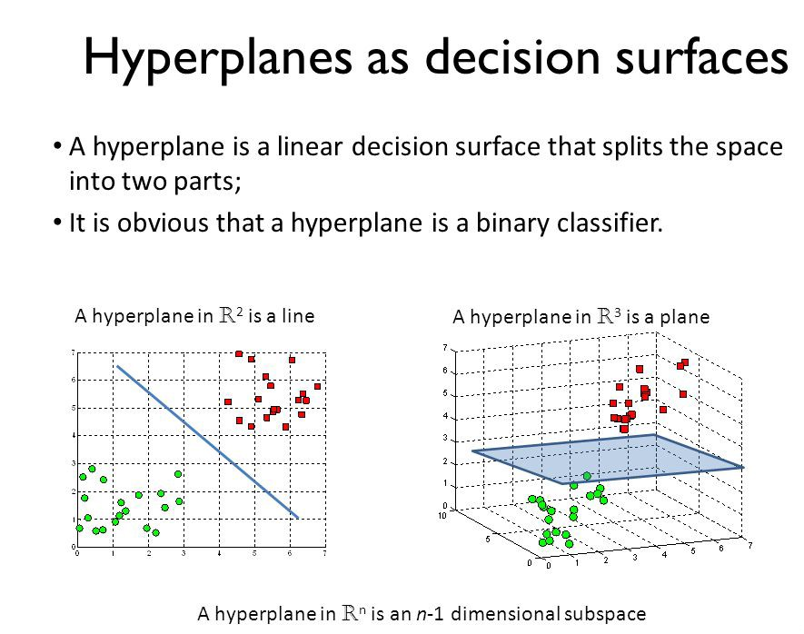
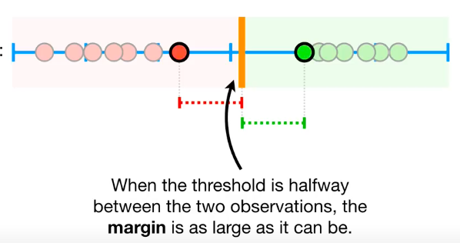

Slide 12
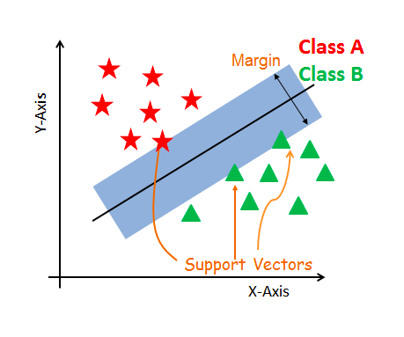
The core idea of SVM
SVM constructs a hyperplane in multidimensional space to separate different classes.
SVM generates optimal hyperplane in an iterative manner, which is used to minimize an error.
The core idea of SVM is to find a maximum marginal hyperplane(MMH) that best divides the dataset into classes.

Slide 13
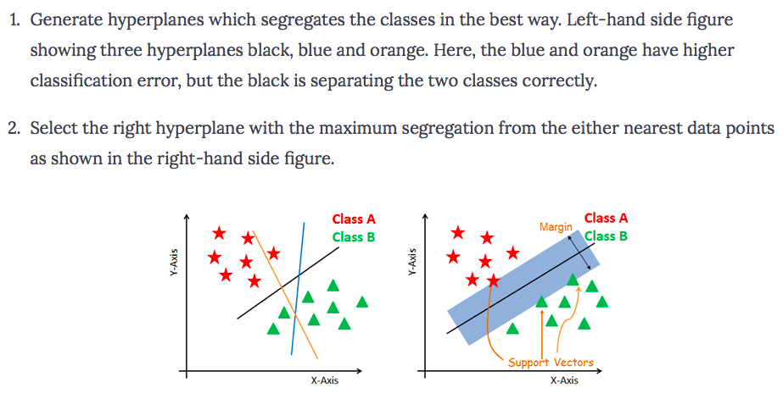
How does SVM work?
The objective is to select a hyperplane with the maximum possible margin between support vectors in the given dataset. Follow these steps:

Slide 14
Terminologies
Support vectors are the data points, which are closest to the hyperplane. These points will define the separating line better by calculating margins.
A hyperplane is a decision plane which separates between a set of objects having different class memberships.
A margin is a gap between the two lines on the closest class points. if the margin is larger in between the classes, then it is considered a good margin, a smaller margin is a bad margin.

Slide 15
Which one is better?
Hard Margin:
we require all data points be classified correctly
No training error
Now which one is better? B1 or B2? How do you define better?

Slide 16
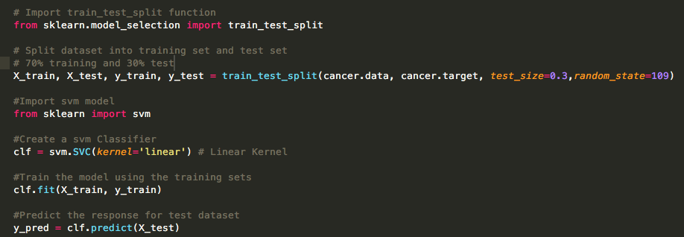
Split, fit, and predict
From sklearn. Svm import linearSVC Is much faster ☺

Slide 17
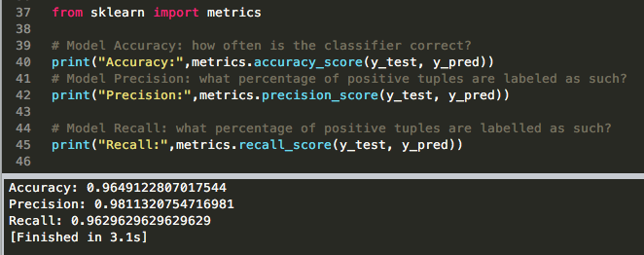
Evaluating

Slide 18
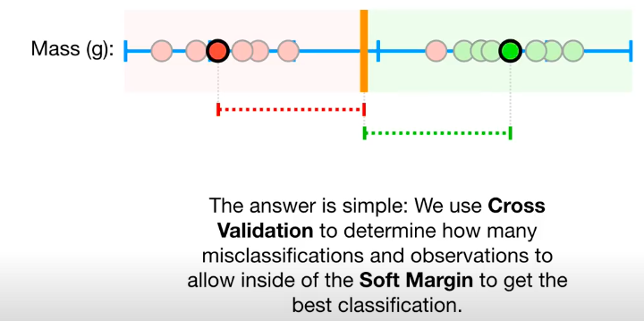
How Do we know which soft margin to choose?

Slide 19
SVM Support Vector Machine
SVM offers very high accuracy compared to other classifiers
It is used in a variety of applications such as face detection, intrusion detection, classification of emails, news articles and web pages, classification of genes, and handwriting recognition
The classifier separates data points using a hyperplane with the largest amount of margin. That's why an SVM classifier is also known as a discriminative classifier. SVM finds an optimal hyperplane which helps in classifying new data points.

Slide 20
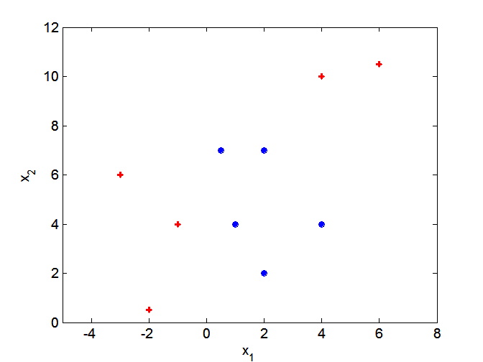
Support vector machines
What if decision boundary is not linear?

Slide 21
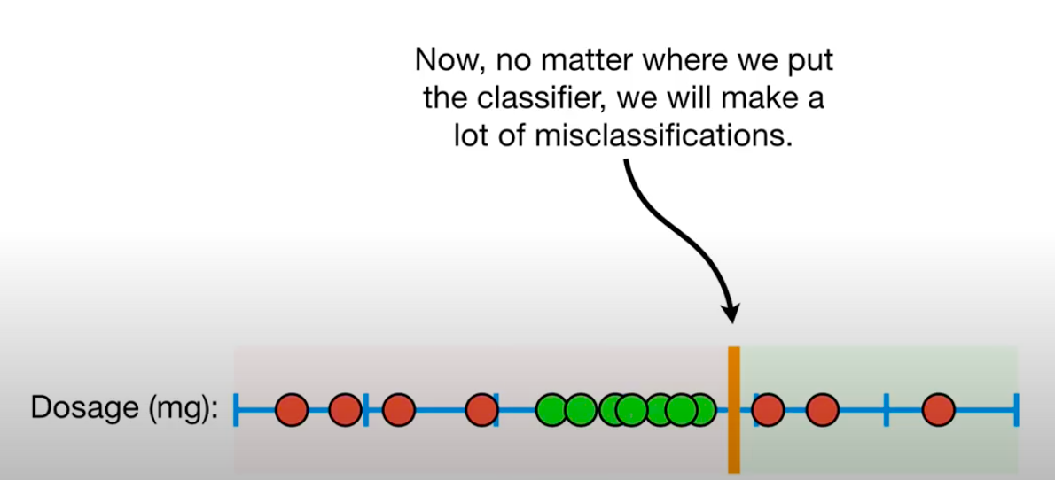

Slide 22
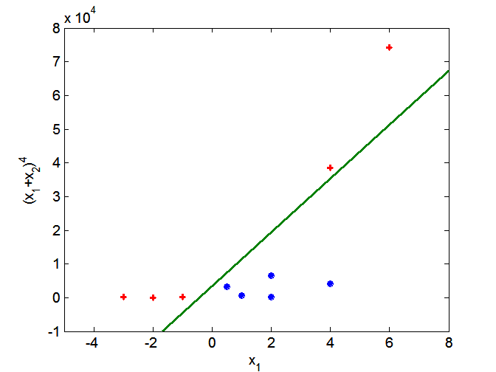
Support vector machines
Solution: nonlinear transform of attributes
One approach to
handling nonlinear datasets is to add more features, such as polynomial features

Slide 23
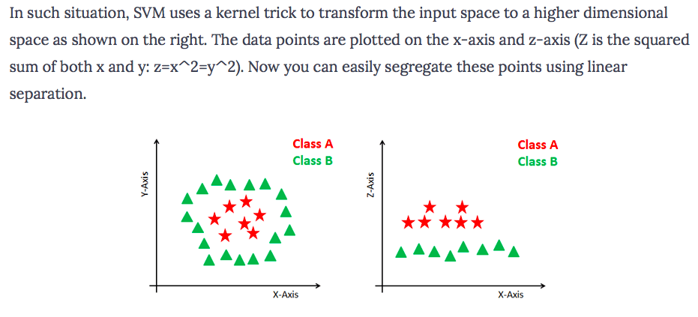
Dealing with non-linear and inseparable planes
Some problems can’t be solved using linear hyperplane:

Slide 24
Support vector machines
Solution: nonlinear transform of attributes

Slide 25
Non-linear SVMs: Feature spaces
General idea: the original feature space can always be mapped to some higher-dimensional feature space where the training set is separable:
Φ: x → φ(x)

Slide 26
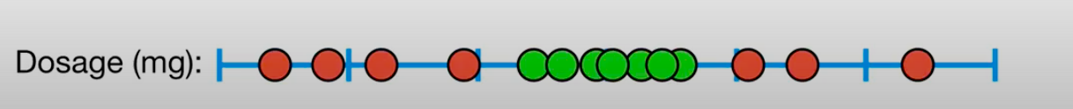
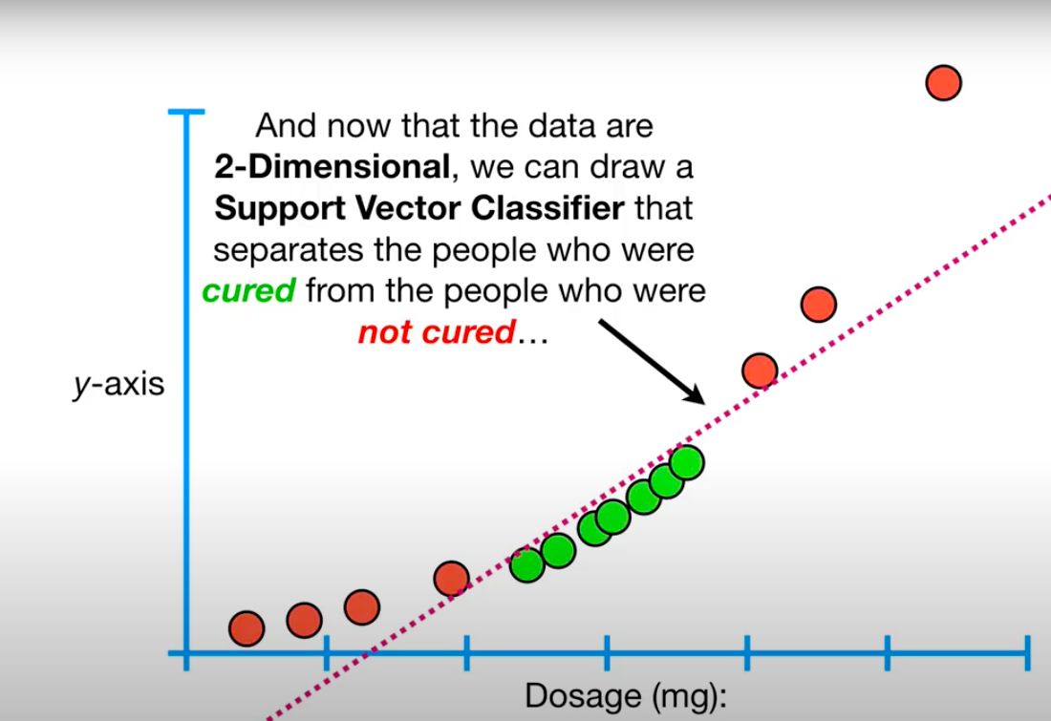
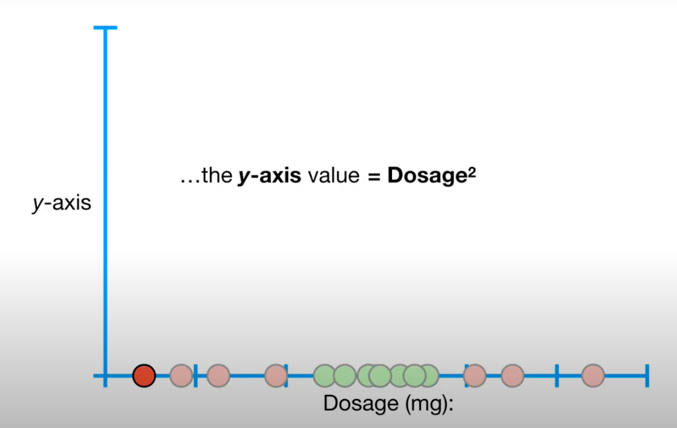

Slide 27
SVM Kernels
The SVM algorithm is implemented in practice using a kernel.
A kernel transforms an input data space into the required form.
SVM uses a technique called the kernel trick. Here, the kernel takes a low-dimensional input space and transforms it into a higher dimensional space.
Kernel trick helps you to build a more accurate classifier.
Kernel: The main function of the kernel is to transform the given dataset input data into the required form. There are various types of functions such as linear, polynomial, and radial basis function (RBF). Polynomial and RBF are useful for non-linear hyperplane.
Polynomial and RBF kernels compute the separation line in the higher dimension. In some of the applications, it is suggested to use a more complex kernel to separate the classes that are curved or nonlinear. This transformation can lead to more accurate classifiers.

Slide 28
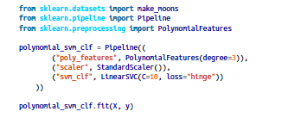
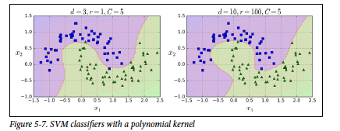

Polynomial Kernel

