Slide 1
Machine Learning 08- Ensemble Learning
Dr. Malak Abdullah
Computer Science Department
Jordan University of Science and Technology

Slide 2

The Wisdom of Crowds
Suppose you ask thousands of random people a complex question and then aggregate their answers. In many cases, you will find that this aggregated answer is better than an expert’s answer.
This phenomenon, where collective wisdom is better than most, if not all, of the individuals in the crowd, has become known as the Wisdom of Crowds.
A more up-to-date example is the “Ask the Audience” part of Who Wants to be a Millionaire, where the studio audience is polled, and the most popular answer is the correct answer 91% of the time.

Slide 3
Value of Ensembles
No free lunch theorem: there is no single ML algorithm that consistently outperforms the others in all domains/tasks
When combing multiple independent and diverse decisions, each of which is at least more accurate than random guessing, random errors cancel each other out; correct decisions are reinforced.
Human ensembles are demonstrably better.
How many jelly beans are in the jar?: Individual estimates vs. group average.
Who Wants to be a Millionaire: Expert friend vs. audience vote.

Slide 4
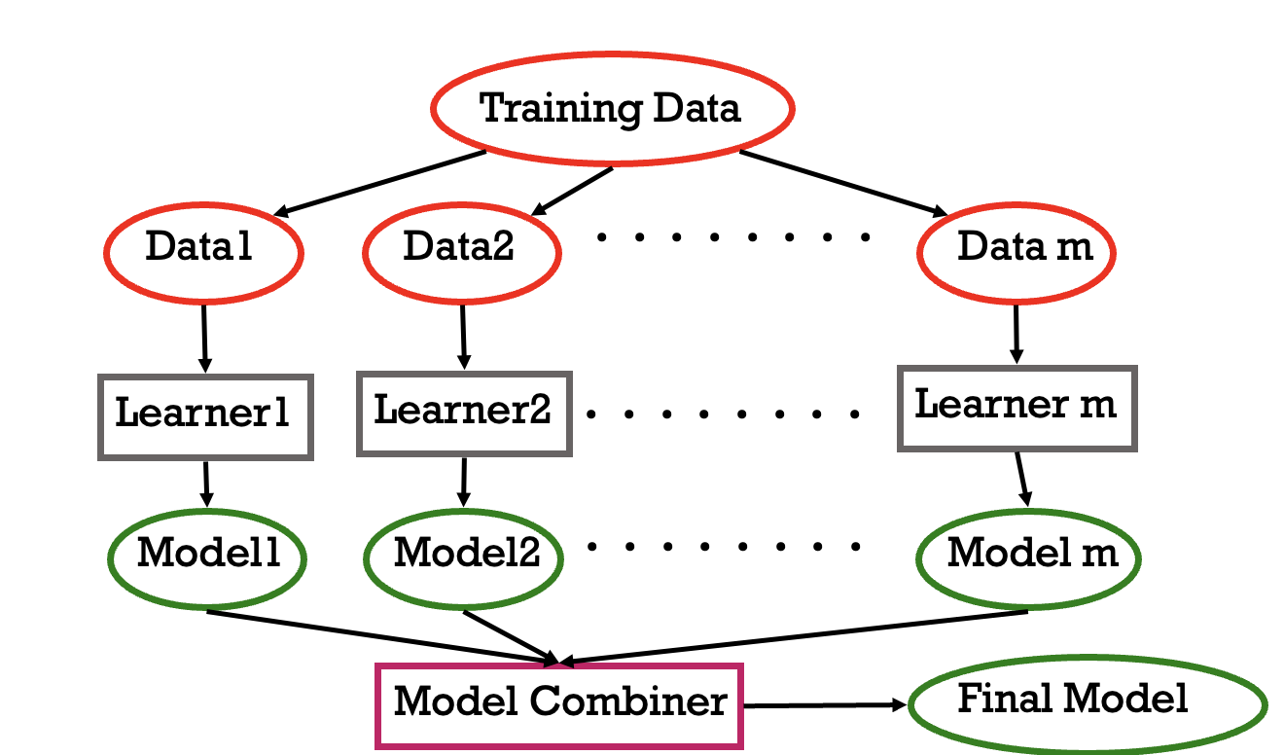
Learning Ensembles
Learn multiple alternative definitions of a concept using different training data or different learning algorithms.
Combine decisions of multiple definitions, e.g. using weighted voting.

Slide 5
Why does it work?
Suppose there are 25 base classifiers
Each classifier has error rate, ε = 0.35
Assume classifiers are independent that are making uncorrelated errors
i.e., probability that a classifier makes a mistake does not depend on whether other classifiers made a mistake
Note: in practice they are not independent!
Probability that the ensemble classifier makes a wrong prediction:

Slide 6
Ensemble Methods
We will talk about the most popular Ensemble methods
Voting
Bagging
Random Forest
Boosting
Stacking

Slide 7
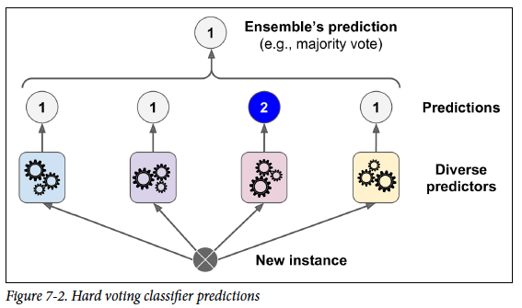
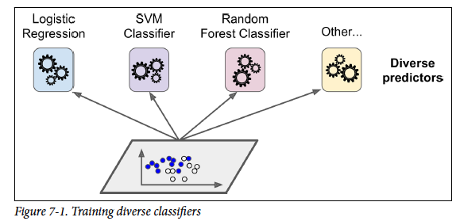
Voting
Suppose you have trained a few classifiers, each one achieving about 80% accuracy.
The aggregate the predictions of each classifier and predict the class that gets the most votes. This majority-vote classifier is called a hard voting classifier
With soft voting, you need to ensure that all classifiers can estimate class probabilities

Slide 8
Good to know
Each base model can be created using different splits of
the same training dataset and same algorithm,
or using the same dataset with different algorithms, or any other method.
Ensemble methods work best when the predictors are as independent from one another as possible.
One way to get diverse classifiers is to train them using very different algorithms. This increases the chance that they will make very different types of errors, improving the ensemble’s accuracy.

Slide 9
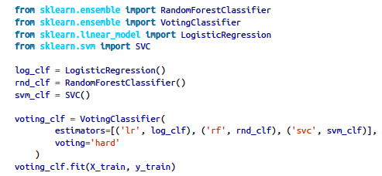

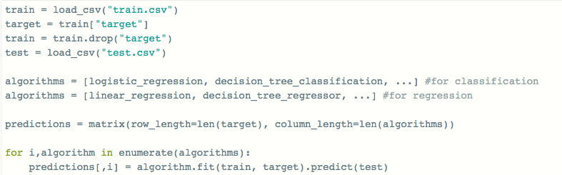
Code Examples

Slide 10
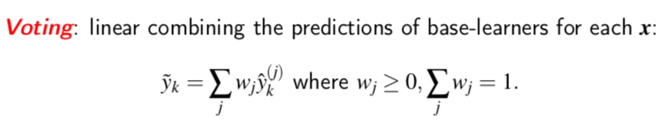
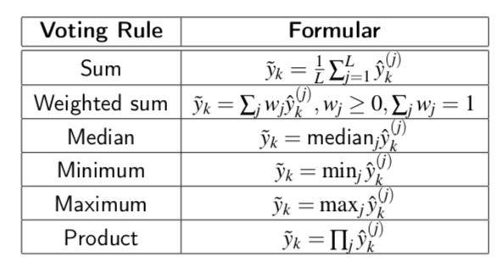
How it works?

Slide 11
Methods of Voting
Majority Voting
Every model makes a prediction (votes) for each test instance and the final output prediction is the one that receives more than half of the votes. If none of the predictions get more than half of the votes, we may say that the ensemble method could not make a stable prediction for this instance. Although this is a widely used technique, you may try the most voted prediction (even if that is less than half of the votes) as the final prediction. In some articles, you may see this method being called “plurality voting”.
Weighted Voting
Unlike majority voting, where each model has the same rights, we can increase the importance of one or more models. In weighted voting you count the prediction of the better models multiple times. Finding a reasonable set of weights is up to you.
Simple Averaging
In simple averaging method, for every instance of test dataset, the average predictions are calculated. This method often reduces overfit and creates a smoother regression model.
Weighted Averaging
Weighted averaging is a slightly modified version of simple averaging, where the prediction of each model is multiplied by the weight and then their average is calculated.

Slide 12
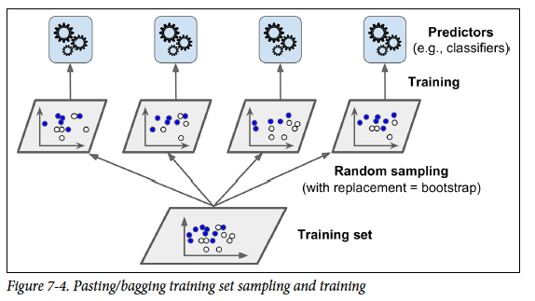
Bagging and Pasting
Instead of running various models on a single dataset, you can use a single model over various random subsets of the dataset.
Random sampling with replacement is called Bagging, short for bootstrap aggregating.
In case of Pasting, the same process applies, only difference being that pasting doesn’t allow training instances to be sampled several times for the same predictors.
SO, When sampling is performed with replacement, this method is called bagging (short for bootstrap aggregating). When sampling is performed without replacement, it is called pasting.
Predictors can all be trained in parallel, via different
CPU cores or even different servers. Similarly, predictions can be made in parallel. This is one of the reasons why bagging and pasting are such popular methods: they scale very well.

Slide 13
Once all predictors are trained, the ensemble can make a prediction for a new instance by simply aggregating the predictions of all predictors.
The aggregation function is typically the statistical mode (i.e., the most frequent prediction, just like a hard voting classifier) for classification, or the average for regression.
Each individual predictor has a higher bias than if it were trained on the original training set, but aggregation reduces both bias and variance.

Slide 14
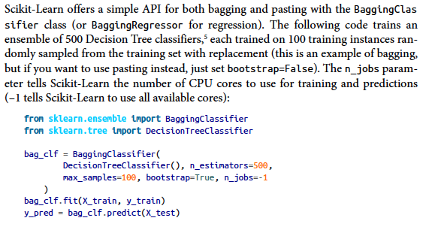
Scikit-learn

Slide 15
Continue …
Random Patches and Random Subspaces
The BaggingClassifier class supports sampling the features as well. This is controlled by two hyperparameters: max_features and bootstrap_features.
They work the same way as max_samples and bootstrap, but for feature sampling instead of instance sampling.
Thus, each predictor will be trained on a random subset of the input features.
This is particularly useful when you are dealing with high-dimensional inputs
Sampling both training instances and features is called the Random Patches method.
Keeping all training instances but sampling features is called the Random Subspaces method.

Slide 16
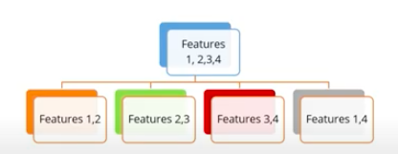
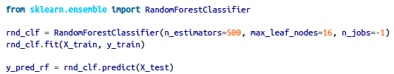
Random Forests
Ensemble of Decision trees is a Random Forest.
Random Forests = Bagging of Decision Trees
Random Forests performs Bagging (or Pasting) internally.
Random Forest creates several trees, sometimes thousands, and calculates the best possible model for a given dataset. Instead of considering all features while splitting a node, Random Forest algorithm selects the best feature out of a subset of all features.
This code trains a Random Forest classifier with 500 trees (each limited to maximum 16 nodes), using all available CPU cores

Slide 17
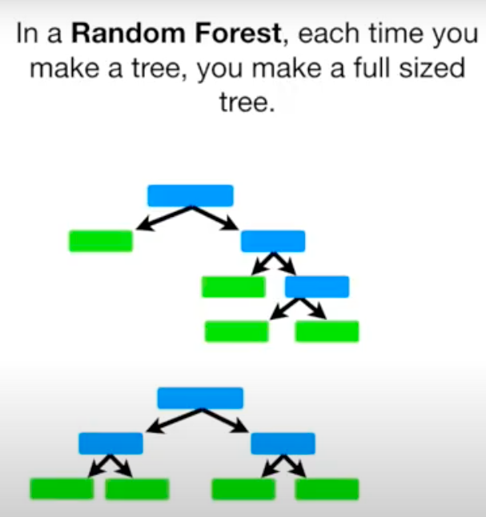
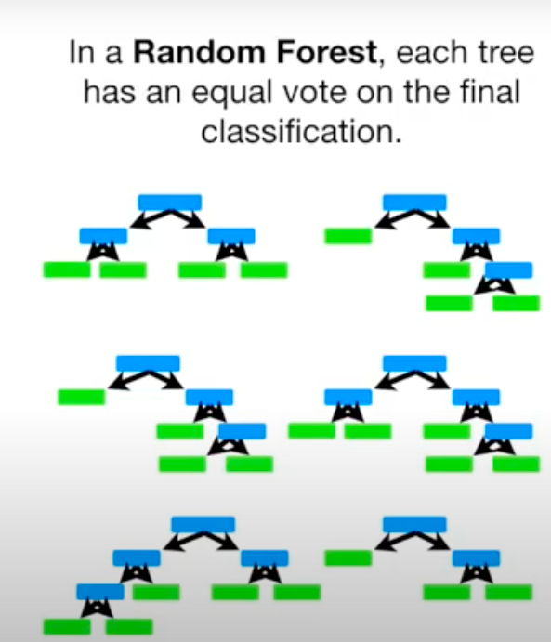

Slide 18
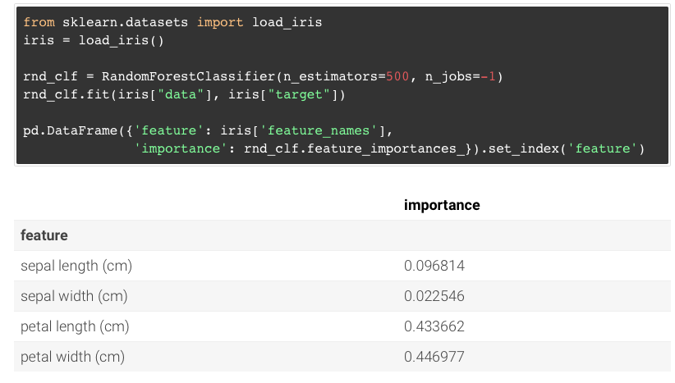
Extra: Feature Importance
One of the great qualities of Random Forests is that they make it easy to measure the relative importance of each feature.
Scikit-Learn measures a feature's importance by looking at how much the tree nodes that use that feature reduce impurity on average (across all trees in the forest). More precisely, it is a weighted average, where each node's weight is equal to the number of training samples that are associated with it.
important features are likely to appear closer to the root of the tree.

Slide 19
Random Forest video
https://youtu.be/J4Wdy0Wc_xQ?t=75
Out-of-Bag Evaluation
With bagging, some instances may be sampled several times for any given predictor, while others may not be sampled at all.
The training instances that are not sampled are called out-of-bag (oob) instances.
Since a predictor never sees the oob instances during training, it can be evaluated on these instances, without the need for a separate validation set.
You can evaluate the ensemble itself by averaging out the oob evaluations of each predictor.
In Scikit-Learn, you can set oob_score=True when creating a BaggingClassifier to request an automatic oob evaluation after training.

Slide 20
Ensemble Methods
We will talk about the most popular Ensemble methods
Voting
Bagging
Random Forest
Boosting.
Stacking

