Slide 1
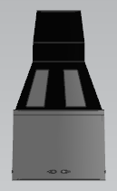
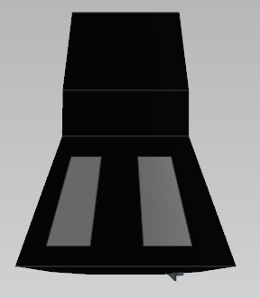

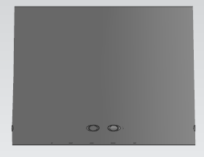

LEO
Ground
Launch
1st stage deploy
Orbit
start
Retrograde
separation
Orbit
end
Mission
end

