Slide 1
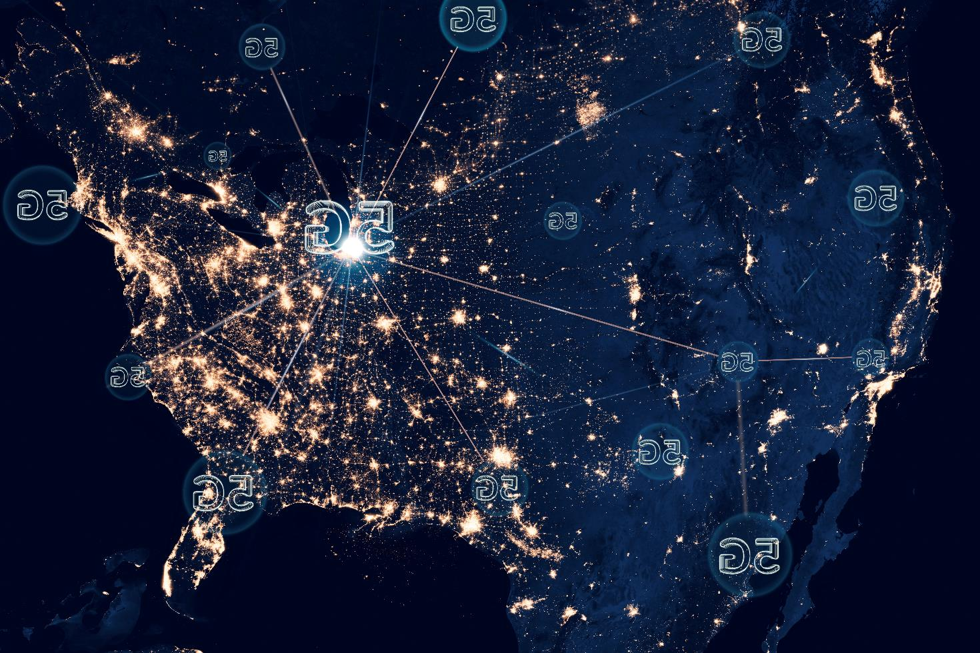
Wavecon Telecom Analysis
Wavecon, a telecommunications provider in India , has introduced its 5G plans.
“5G: A new era of connectivity has arrived, where speed meets possibility, and innovation knows no limits.”

Slide 2
Data Summary ( Year – 2022)
1
2
3
4
<5G
Jan
Feb
Mar
Apr
May – 5G Implementation
>5G
6
7
8
9
Jun
Jul
Aug
Sep

Slide 3
Main KPI’s
Active Users
ARPU
Average Revenue Per User
Unsubscribed Users
Revenue

Slide 4


What is the impact of 5G launch on revenue?
Which KPI is underperforming after 5G launch?
Ad-hoc Analysis
Which 5G plans have been successful and which have not in terms of revenue
Is there any plan affected largely by 5G launch and should we continue or discontinue the plan as a result?
Is there any plan which is discontinued after the 5G launch, if yes then what is the reason for it?

Slide 5
What is the impact of 5G launch on revenue?

Slide 6
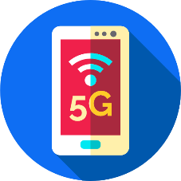
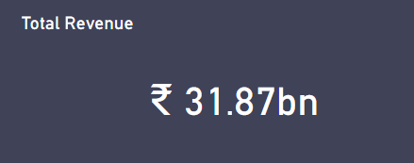

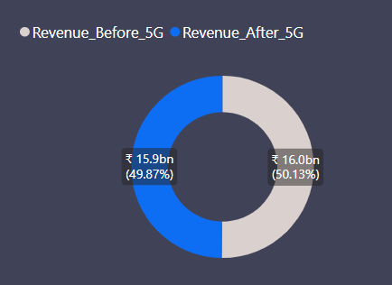
What is the impact of 5G launch on revenue?
The revenue has experienced a decline of 0.5 % following the 5G launch, primarily driven by a significant 5 % decrease in revenue specifically in the Delhi city.

Slide 7
What is the impact of 5G launch on revenue?
Revenue split by cities
Delhi, Chennai, Ahmedabad, Hyderabad, Chandigarh, Kolkata cities revenue has been declined after the 5G launch
The launch of 5G has resulted in a modest rise in revenue for cities such as Lucknow, Patna, Gurgaon, Raipur, Jaipur, Bangalore, Pune, Mumbai, Coimbatore.
Chg % in revenue after 5G launch
Ahmedabad
-2.0%
Delhi
-2.8%
Lucknow
1.8%
Bangalore
0.8%
Gurgaon
1.5%
Mumbai
0.3%
Chandigarh
-0.6%
Hyderabad
-1.3%
Patna
1.5%
Chennai
-2.6%
Jaipur
1.0%
Pune
0.4%
Coimbatore
0.1%
Kolkata
-0.4%
Raipur
1.1%

Slide 8
Which KPI is underperforming after 5G launch?

Slide 9




Which KPI is underperforming after 5G launch?
After the introduction of 5G, two Key Performance Indicators (KPI) have been identified as underperforming
Active Users
Unsubscribed Users

Slide 10

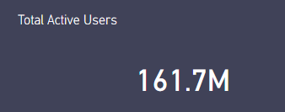


Which KPI is underperforming after 5G launch?
The calculated percentage change is approximately -8.31 %. The value indicated a decrease of approximately 8.31 % in active users after the implementation of 5G compared to the number of users before 5G.

Slide 11
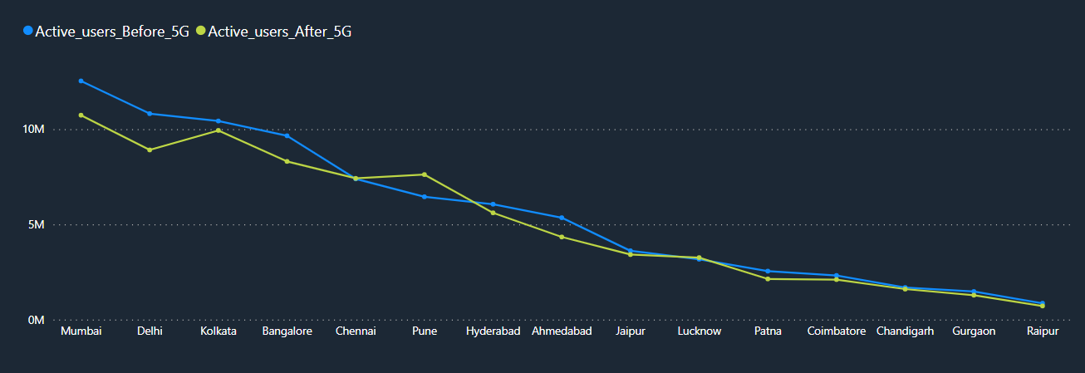
According to the above chart, Pune is the only city that experienced an actual increase in active users of 17 % growth despite having 55 % increase in the unsubscribed users, while Chandigarh remains unchanged after launch of 5G. On the other hand, Mumbai and Delhi witnessed a decrease of -14.4 % and -17.5 % in active users after launch of 5G, respectively. Therefore, it would be beneficial to conduct survey in these two cities to investigate the reasons behind the decline in active users.

Slide 12

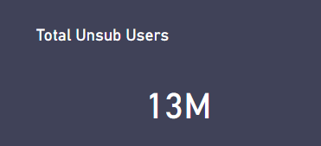


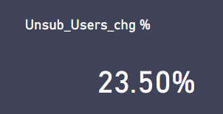
Which KPI is underperforming after 5G launch?
The calculated percentage change is approximately -8.31 %. The value indicated a decrease of approximately 8.31 % in active users after the implementation of 5G compared to the number of users before 5G.

Slide 13
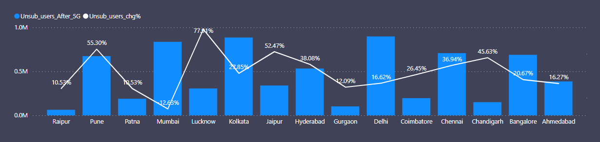
Which KPI is underperforming after 5G launch?
The line chart and stacked column chart above illustrates the percentage change in unsubscribed users after the implementation of 5G, with Lucknow city experiencing an approximate 77.91 % increase in unsubscribed users

Slide 14
Which 5G plans have been successful and which have not in terms of revenue?

Slide 15

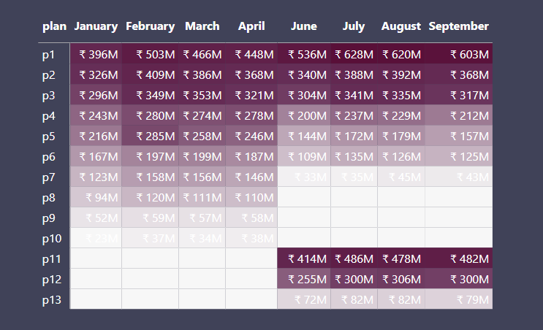
Which 5G plan have been successful and which not in terms of revenue?
From the above matrix table we see that among all the plans, P1, P2 & P11 stand out as the most successful 5G plans and plans P7 and P13 are not performing well, respectively.

Slide 16
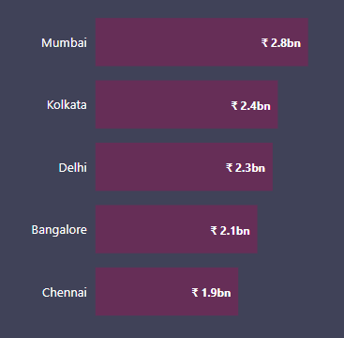
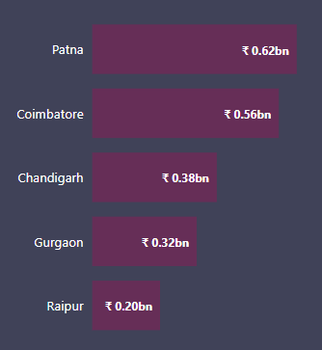
Which 5G plan have been successful and which not in terms of revenue?
Top 5 Cities in terms of plan revenue
Bottom 5 Cities in terms of plan revenue

Slide 17
Is there any plan largely affected by 5G launch, if yes then should we continue or discontinue the plan?

Slide 18


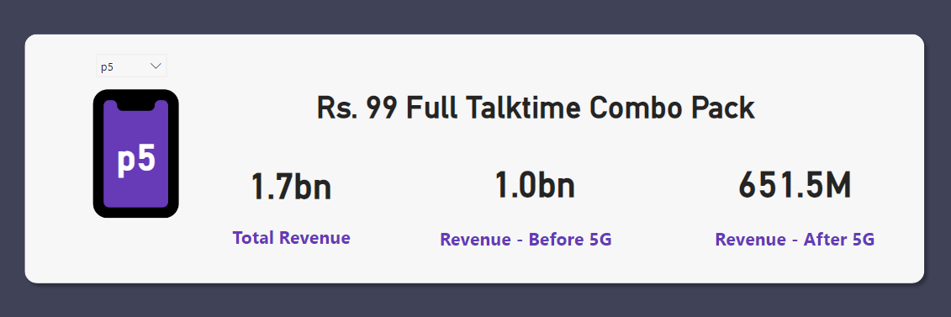
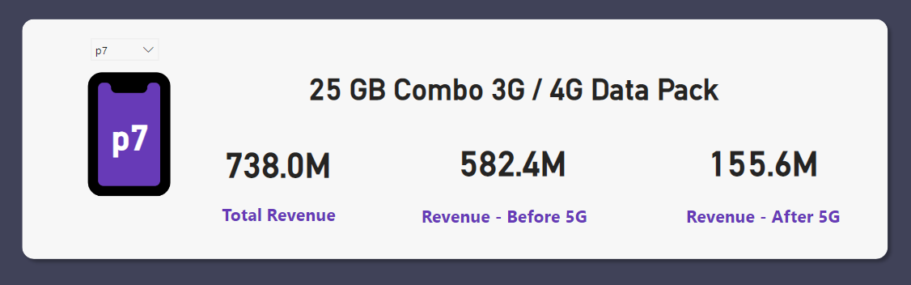
Is there any plan affected largely by 5G launch, if yes then should we continue or discontinue the plan as a result?
The above data indicates that the revenue for plan 5 experienced a decrease of approximately -34.85 % following the introduction of 5G.
The above data indicates that the revenue for plan 7 experienced a decrease of approximately -73.27 % following the introduction of 5G.
Cities such as Bangalore, Delhi, Chennai & Kolkata revenue has drastic decline in Plan 5 in terms of revenue with chg % of -43.36 %, -40.88 %, -32.34 %, and -42.97 % respectively.
After the introduction of 5G, Plan 7 experienced a significant decline in revenue across multiple cities, indicating its substantial impact on the overall revenue of those cities

Slide 19
Market Share

Slide 20

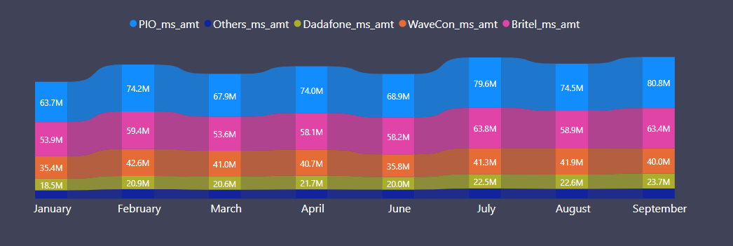
Market Share
Wavecon holds the third position in the market

Slide 21
Thank You

