Slide 1

Drones and GIS: Ethical Considerations
Justan E Dunn
Colorado State University Global
CSC501-1: Ethical Leadership in Software Development
Professor Dong Nguyen
6/8/2025

Slide 2
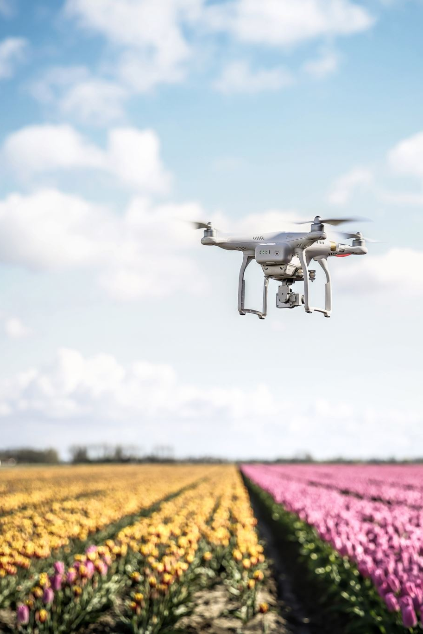
Introduction to Drones and GIS
Drone technologies integrated with GIS are transforming industries from agriculture to emergency response. However, their use raises several ethical challenges involving privacy, surveillance, data rights, and public safety.

Slide 3
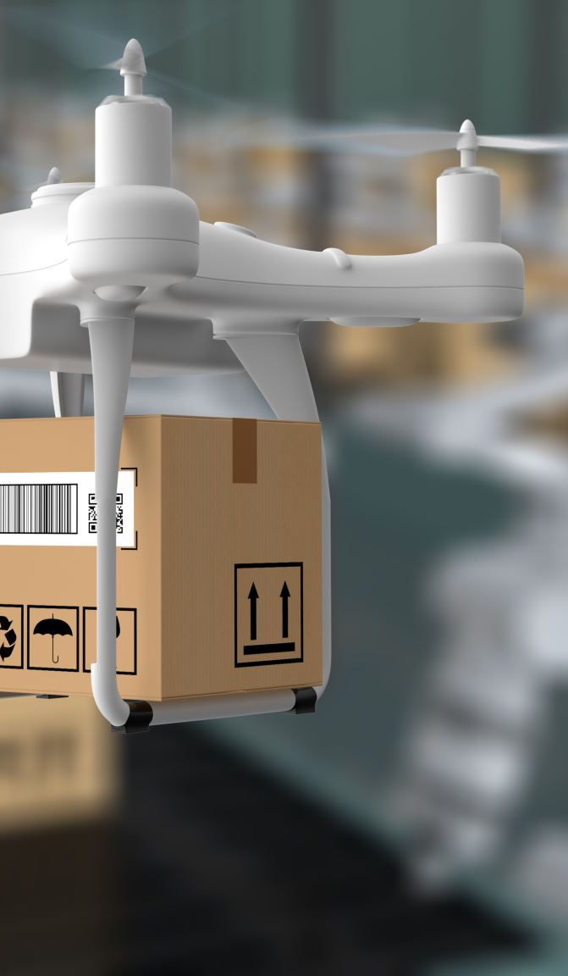
Ethical Issue 1: Privacy Invasion
• Drones equipped with cameras can capture data in public and private spaces without consent.
• Raises concerns under U.S. constitutional protections (e.g., 4th Amendment).
• Example: Real estate and journalism drones capturing footage of private residences.
Notes:
When drones are equipped with high-resolution cameras and geolocation tools, they can unintentionally—or deliberately—invade personal privacy. Imagine drones flying over private property collecting video footage, or drones used in urban areas that record individuals without their knowledge. This becomes a major concern under ethical frameworks such as the right to autonomy and informed consent. Regulations like the Fourth Amendment in the U.S. or GDPR in the EU emphasize the importance of personal space and consent in data collection. The ethical dilemma lies in balancing public interest, like surveillance for safety, with individual privacy rights. Organizations must adopt strict data governance policies, ensure encrypted storage of visual data, and gain explicit consent when necessary.

Slide 4

Ethical Issue 2: Data Ownership and Use
• Who owns the geospatial data collected?
• Issues of data commercialization and misuse.
• Concerns over corporations reselling or sharing sensitive location data without user knowledge.
Notes:
While drones are instrumental in security and monitoring, they also present opportunities for unjustified surveillance—especially by governments or corporations. Ethical surveillance should be proportionate, justified, and transparent. However, drones can blur these lines when deployed without oversight or judicial review. For example, using drones to monitor protestors or neighborhood activity raises questions about civil liberties and mass surveillance culture. Ethical frameworks like deontology and virtue ethics call for respect of individuals' rights over utilitarian "greater good" justifications. Implementing independent audits, public reporting on drone operations, and citizen review boards can help mitigate misuse and rebuild public trust.

Slide 5
Ethical Issue 3: Surveillance and Civil Liberties
• Use by law enforcement for public surveillance can lead to overreach.
• Potential for racial profiling or targeting of protests.
• Ethical frameworks require transparency and oversight.
Notes:
As GIS and drones increasingly rely on AI for decision-making—such as identifying objects or individuals—algorithmic bias becomes a real threat. These algorithms are only as unbiased as the data used to train them. If historical GIS data reflects societal inequality or if facial recognition systems are less accurate for certain demographics, drone-based applications may replicate or even exacerbate these issues. For instance, law enforcement drones may disproportionately target specific communities. The ethical responsibility lies in testing for bias, ensuring datasets are diverse, and continuously auditing AI models for fairness. Ethical AI principles, like those outlined in the EU’s AI Act and IEEE’s Ethically Aligned Design, should guide development and deployment.

Slide 6
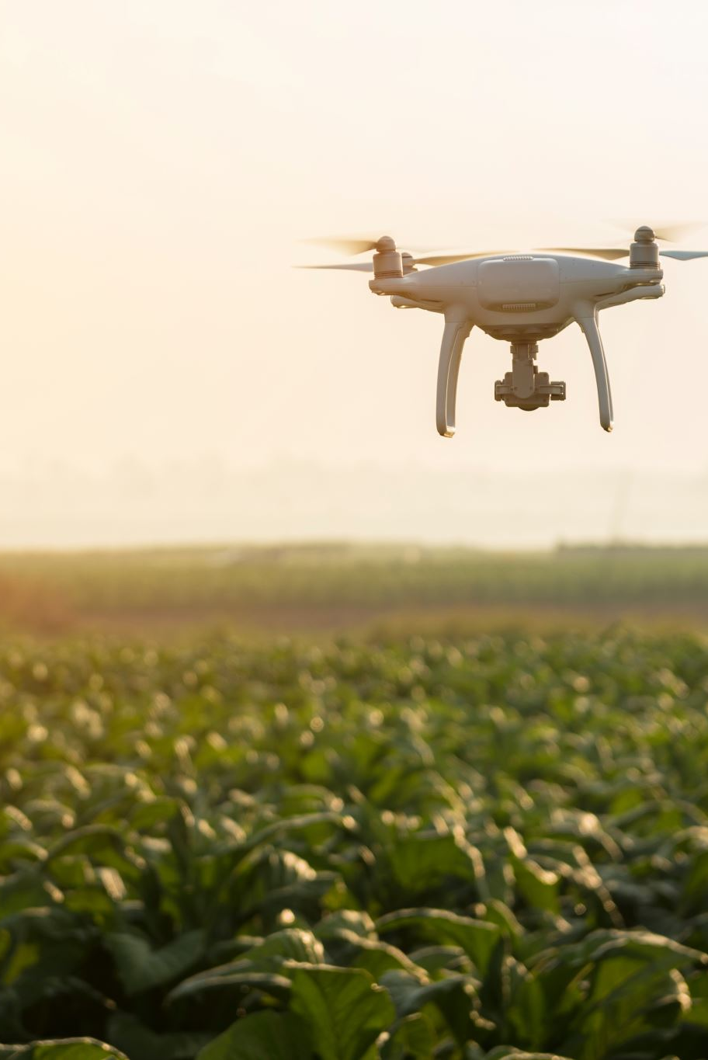
Ethical Issue 4: Military and Law Enforcement Use
• Use of drones in combat or border enforcement raises human rights issues.
• Risk of autonomous weapon systems without human accountability.
• Debate continues on ethical AI and remote decision-making.
Notes:
Drones designed for civilian uses—like delivery or land surveying—can be repurposed for malicious intent or military applications. This dual-use dilemma introduces significant ethical tension. For example, a GIS-equipped drone can be repurposed for surveillance or targeted strikes. The ease with which drones can be weaponized or hacked also increases national security risks. According to Just War Theory and consequentialist ethics, the means and outcomes of drone usage must be weighed heavily—especially when civilian lives are at stake. Developers and policymakers must implement safeguards like geo-fencing, remote shutdown features, and use licensing to prevent the exploitation of these technologies.

Slide 7
Conclusion and Ethical Governance
• Transparency, accountability, and consent are essential pillars.
• Ethical frameworks must evolve with technology.
• Suggested: Ethics boards, public policies, and stronger FAA guidelines for civilian drone use.

Slide 8
References
Cavoukian, A. (2012). Privacy and drones: Unmanned aerial vehicles. Information and Privacy Commissioner of Ontario.
Lin, P., Abney, K., & Bekey, G. A. (2012). Robot ethics: The ethical and social implications of robotics. MIT Press.
Zajko, M. (2020). The ethics of drones in public safety. Journal of Applied Security Research, 15(2), 237-251.
Finn, R. L., & Wright, D. (2012). Unmanned aircraft systems: Surveillance, ethics, and privacy in civil applications. Computer Law & Security Review.

