Slide 1
Proof of Concept for Resilient VLF Navigation “Precision in the invisible spectrum — from sub-kilohertz to sub-degree.”
December 2025

Slide 2
Why Navigation Demands Resilience
GPS is ubiquitous — but fragile under jamming, spoofing, or denial
Navigation failure cascades into mission failure: aviation, maritime, defense, infrastructure
What matters in navigation?
Position — derived from GNSS signals
Heading — via dual GNSS receivers or magnetic compass
Speed and acceleration — estimated using IMU/INS
When GNSS is unavailable:
In GNSS‑denied environments, navigation relies solely on IMU/INS
IMU/INS accumulate errors and require periodic calibration
We need a solution that is un-jammable, available, and reliable
VLF offers a global, low-frequency alternative:
Robust, independent, and deeply penetrating
Capable of extracting precise bearing — even in noisy, imperfect environments

Slide 3
What Is VLF and Why It Matters
Frequency range: 10–80 kHz – ideal for long‑distance propagation
Propagation modes:
Ground wave — hugging the Earth’s surface
Skywave — reflecting from the ionosphere
Penetrates seawater, soil, and dense structures
Applications:
Submarine communication
Time synchronization (e.g., WWVB at 60 kHz, DCF77 at 77.5 kHz)
Resilient navigation — extracting bearing when GPS is denied
Losses:
Daytime attenuation: ~2–3 dB per 1000 km
Nighttime attenuation: ~1–2 dB per 1000 km
Saltwater penetration: ~10 dB per meter (usable only to shallow depths)
Rock/mountain penetration: ~20 dB per 100 m (strongly dependent on geology)

Slide 4
The Problem
Multipath distortion
Multiple Earth–ionosphere modes cause fading and bearing ambiguity
Low SNR
Atmospheric and industrial noise dominate the VLF band
Hardware imperfections
Vibration and misalignment introduce systematic errors
Calibration drift
GNSS denial leads to IMU/INS bias accumulation
Environmental losses
Salt water: ~10 dB/m; rock: ~20–40 dB/100 m
Installation losses
Coil orientation, shielding, and vibration degrade sensitivity

Slide 5
The Solution
Adaptive filtering
LMS/RLS algorithms suppress interference and enhance weak signals
Differential null steering
Multi‑coil arrays cancel dominant noise and multipath arrivals
Calibration routines
Regular reference checks and adaptive calibration during missions to minimize bias and correct IMU/INS drift
Diversity reception
Spatial, temporal, and frequency diversity reduce fading and ambiguity
Installation optimization
Precise coil alignment, shielding, and vibration control improve sensitivity
Environmental awareness
Modeled attenuation guides depth limits and path selection for reliable reception

Slide 6
Applications and Benefits of GNSSless Navigation
Primary Application: Air Drones
Enables GNSS-free navigation with IMU-based accuracy of ~100 m over multi-hour missions
Anti-spoofing sensor for drones, general and commercial aviation
Submarine Drones
Solves the lack of safe underwater navigation solutions
The only passive navigation available for underwater drones
Underground Drones
Enables reliable tunnel navigation where GNSS is unavailable
Key Benefits:
Immune to jamming and spoofing
Accurate heading and true North reporting
Derived Capabilities:
Gyrocompass
Rotation detector

Slide 7
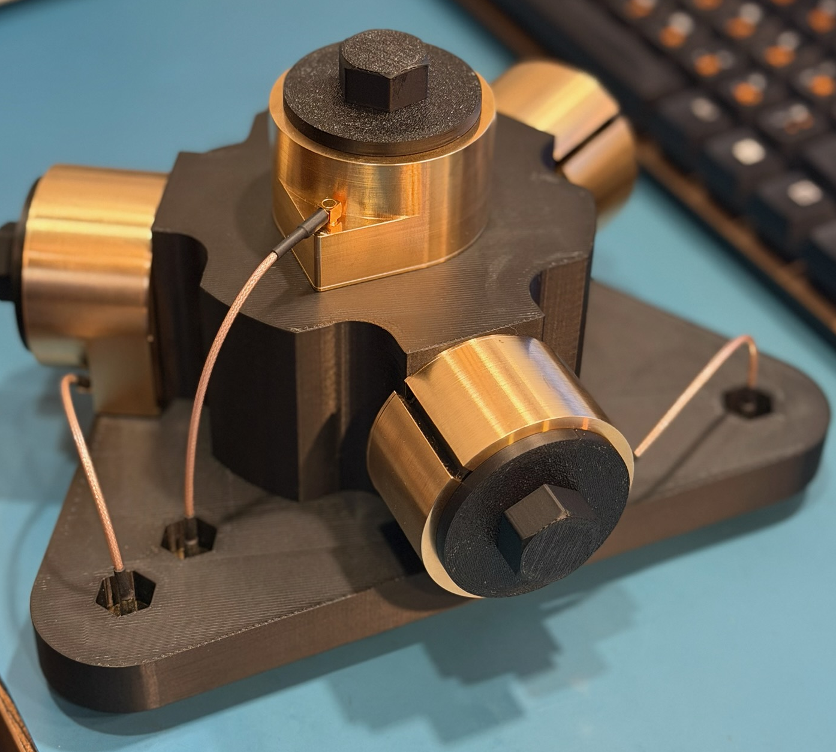
How it works
There are three coils in the system
Signals from each coil are amplified and digitized
Our algorithm extracts line‑of‑bearing (LoB) and finds the direction to each source
There are more than 30 VLF Txs around the world
The RF power of these sources is hundreds of kW, few of them are MW and more
These are un-jammable sources with known locations
We plan to use the LoB to these sources to define:
The heading
The location
The vector of our speed (later)
Coils

Slide 8
Two signals from NAA and WWVB are used for estimation
NAA:
Location: Cutler, Maine (44.65°N, 67.28°W)
Frequency: 24.0 kHz
Power: ~1,000 kW
WWVB:
Location: Fort Collins, Colorado (40.68°N, 105.04°W)
Frequency: 60.0 kHz
Power: ~70 kW
Distances:
Cutler → Leesburg, VA: ~1,000 km
WWVB → Leesburg, VA: ~2,400 km
Field Strength in Leesburg, VA
NAA (24 kHz):
Distance ≈ 1,000 km
Loss ≈ 3 dB
Field ≈ 3–10 mV/m
WWVB (60 kHz):
Distance ≈ 2,400 km
Loss ≈ 8 dB
Field ≈ 0.3–1 mV/m

Slide 9
Transmitters, Locations, Power, Field Strength & SNR
NAA (Cutler, Maine)
Frequency: 24.0 kHz
Transmitter input power: ~1.8–2.0 MW
Antenna: large VLF umbrella array, highly efficient for groundwave/earth‑ionosphere waveguide
Propagation: ~1000 km groundwave path to Leesburg, VA
Estimated field strength at Newtown: ~70–80 dBµV/m (≈ 3–10 mV/m) daytime, higher at night
Induced coil voltage (55 turns, D = 50 mm): ~150–300 µV RMS
Estimated total noise (BW = 220 Hz): ~8–12 µV RMS (at coil), dominated by atmospheric + man-made
SNR ~ 24 to 31dB. We measured SNR~ 26dB in Leesburg, VA
WWVB (Fort Collins, Colorado)
Frequency: 60.0 kHz
Effective radiated power (ERP): ~70 kW
Antenna: phased vertical monopoles, optimized for LF time service
Propagation: ~2,400 km groundwave/skywave path to Leesburg, VA
Estimated field strength at Newtown: ~50–60 dBµV/m (≈ 0.3–1 mV/m), stronger during nighttime dark‑path conditions
Induced coil voltage (55 turns, D = 50 mm): ~20–60 µV RMS
Estimated total noise (BW = 10 Hz): ~0.5–0.8 µV RMS (at coil), dominated by atmospheric + man-made
SNR ~ 32 to 41dB. We measured SNR~ 35dB in Leesburg, VA

Slide 10
Available VLF transmitters

Slide 11
Are the signals available anywhere?
Lagos worst cases (NAA, NWC low ends) and Jakarta (DHO38) clearly drop below 20 dB during thunderstorms
São Paulo, weaker daytime paths (e.g., DHO38 low end) land near or under 20 dB tropical storm
Other places have better signal strength
Our accuracy will be limited to +/-0.5deg RMS with SNR ~20dB

Slide 12
What was done
We developed small current‑source antennas (diameter 50 mm)
Built and optimized Trans Impedance Amplifiers (TIA) with gain of 10/100k
The system with 3 antennas (0, 120, 240 deg)
We digitize the signal with 500ksps/8 bit digital scope
This is a bottleneck in terms of noise
We plan to use 32-bit ADC ($3 for 4 inputs) for a product
We optimize the algorithm for direction finding
We finished the calibration and measured the accuracy
Built a GUI and analyze the results

Slide 13
Proof of Concept Test
Setup
Simple multi‑coil array, basic filtering, minimal calibration
Test frequency range: 10–80 kHz
Key observations
Bearing extraction feasible despite multipath and noise
Installation losses measurable but manageable with calibration
Performance metrics
Bearing accuracy: <1° RMS with 1 sec reporting, <0.3deg with 10sec reporting
Target: <0.5deg per sec and 0.2 deg per 10sec
SNR improvement: 12 dB after adaptive filtering
Implications
Confirms viability of VLF for resilient navigation
Provides baseline for advanced filtering and calibration routines

Slide 14
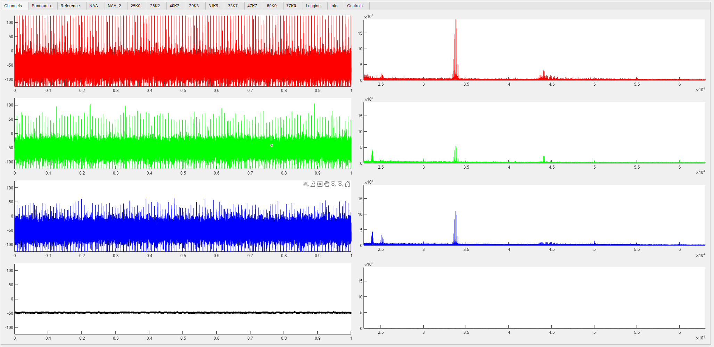
Channel signals
Left:
Received signal time waveform. Duration 1.4 second, Sample rate 500 kHz.
Right:
Power spectrum of the received signal from 23 to 63 kHz.
Colors:
Red: Channel 1 – the antenna oriented at 0 deg.
Green: Channel 2 – the antenna oriented at +120 deg.
Blue: Channel 3 – the antenna oriented at -120 deg.
Black: Channel 4 - Not currently used, reserved for future development

Slide 15
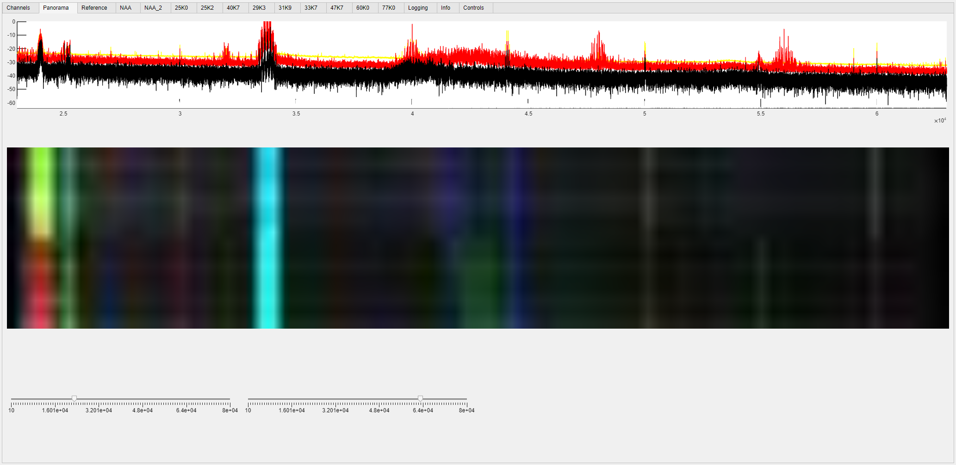
Signal Spectrum with Color-Coded AoA
Top figure:
Black: Signal FFT
Yellow: FFT mean
Red: FFT max.
White: FFT min.
Bottom:
Spectrum history showing power and direction of last 16 measurements.
Frequency increases left to right from 23 to 63 kHz.
Most recent measurement is on top, oldest – on the bottom.
Power level is coded with brightness.
Direction is coded with combining colors: Ant.1-red,2-green,3-blue.
Antenna was rotated 30 deg. at the middle.

Slide 16
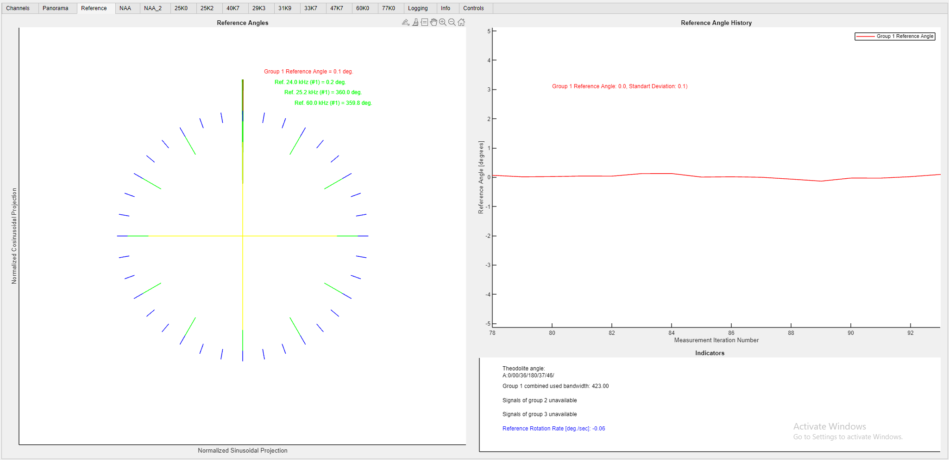
Reference at 0 degree true angle
Left figure:
Ticks
Blue – 10 deg.
Green – 30 deg.
Yellow – 90 deg.
Measurements
Green – sources reference angles
Red – combined reference angle
Right top:
Combined reference angle history for last 16 consecutive measurements
Right bottom:
Signal detection parameters
Theodolite availability and readings

Slide 17
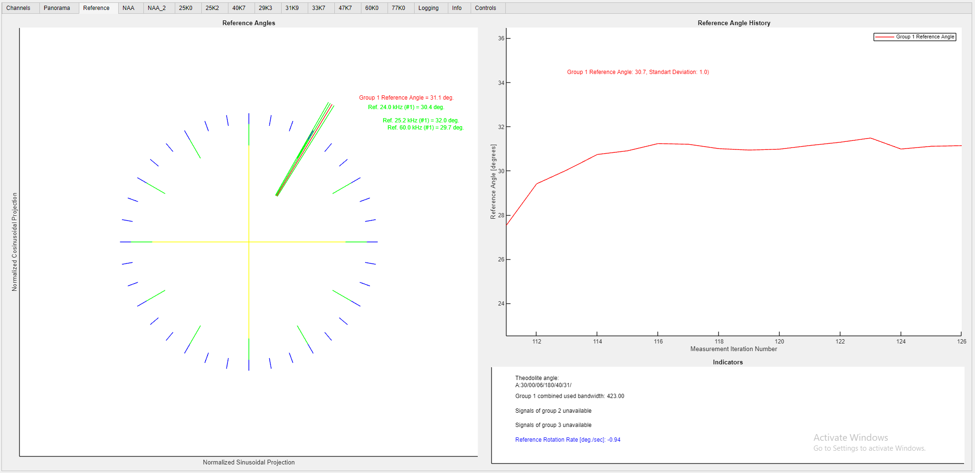
Reference immediately after 0 to 30 degree rotation
Left figure:
Ticks
Blue – 10 deg.
Green – 30 deg.
Yellow – 90 deg.
Measurements
Green – sources reference angles
Red – combined reference angle
Right top:
Combined reference angle history for last 16 consecutive measurements
Right bottom:
Signal detection parameters
Theodolite availability and readings

Slide 18
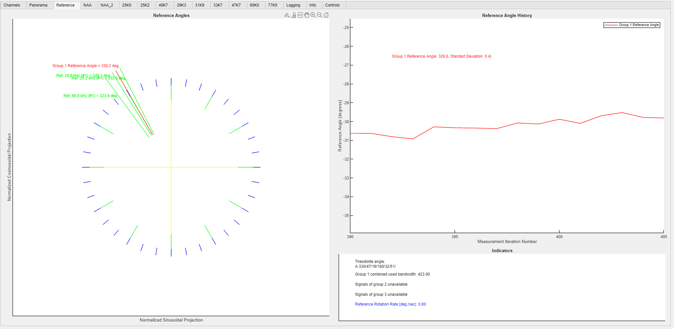
Reference at 330 degree true angle
Left figure:
Ticks
Blue – 10 deg.
Green – 30 deg.
Yellow – 90 deg.
Measurements
Green – sources reference angles
Red – combined reference angle
Right top:
Combined reference angle history for last 16 consecutive measurements
Right bottom:
Signal detection parameters
Theodolite availability and readings

Slide 19
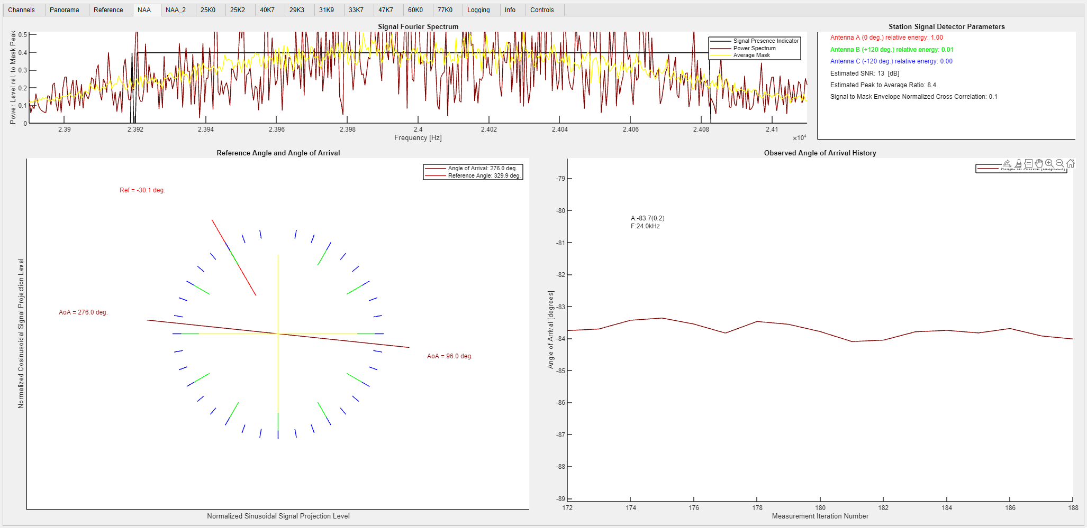
24 kHz Source at 30 degree true angle
Left top figure:
Brown: Src. FFT,
Yellow: FFT mean
Black: Signal presence indicator
Left bottom:
Brown: Measured current source arrival angle
Red: Source reference angle
Right top:
Detector Parameters (SNR, Peak to Average Ratio, FFT-Mean NCC)
Right bottom:
Reference angle history for last 16 consecutive measurements

Slide 20
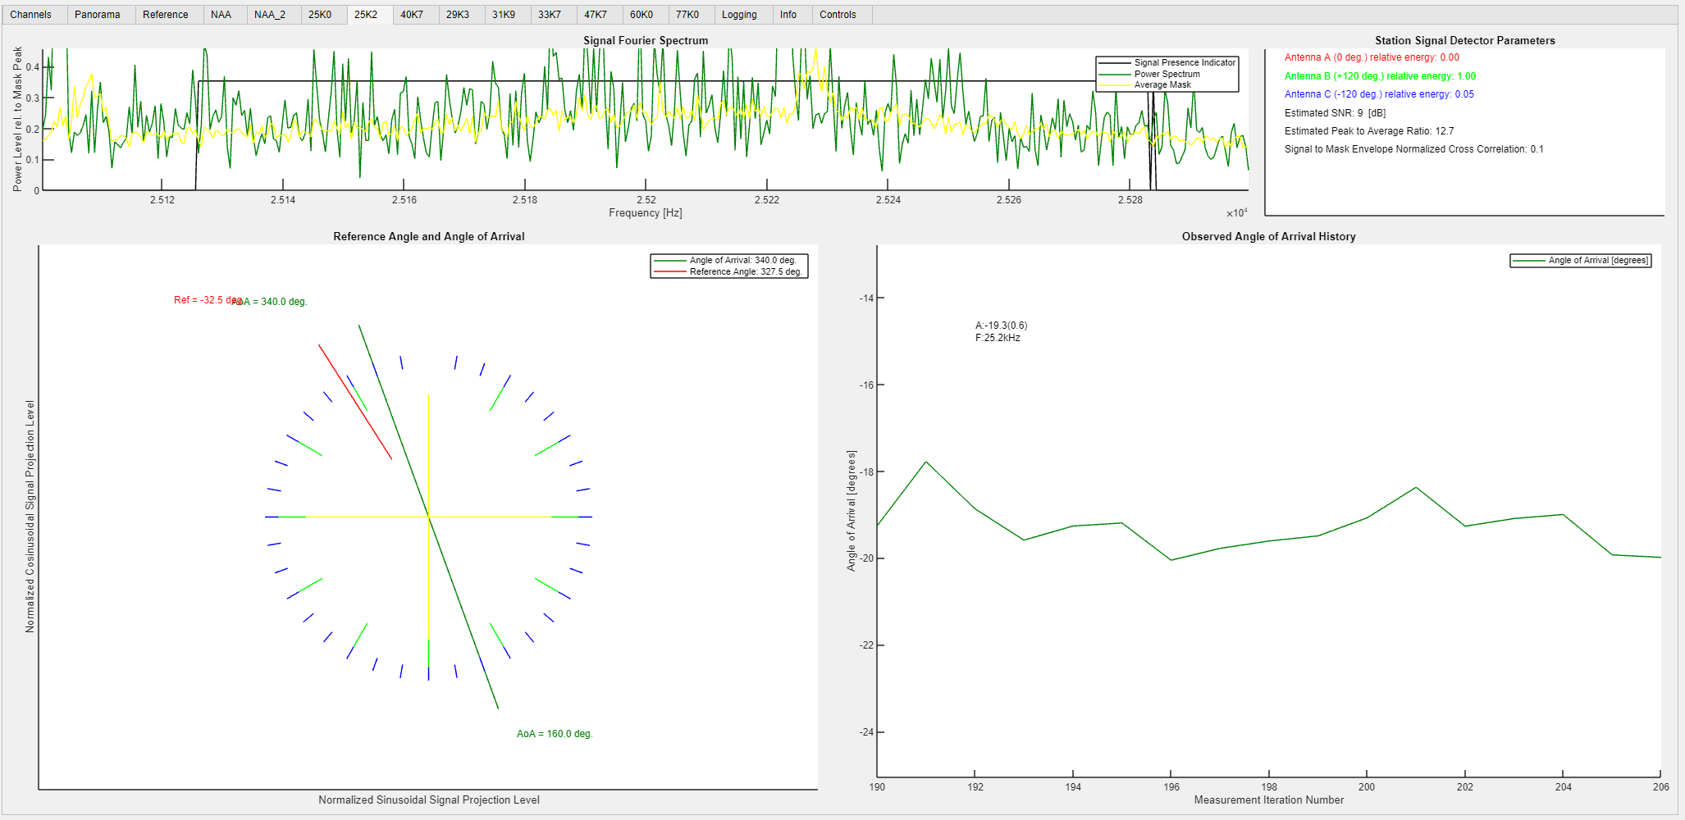
25.2 kHz Source at 30 degree true angle
Left top figure:
Green: Src. FFT
Yellow: FFT mean
Black: Signal presence indicator
Left bottom:
Green: Measured current source arrival angle
Red: Source reference angle
Right top:
Detector Parameters (SNR, Peak to Average Ratio, FFT-Mean NCC)
Right bottom:
Reference angle history for last 16 consecutive measurements

Slide 21
Proof of Concept Results: Bearing Accuracy for uncalibrated system
All measurements are done without pre-calibration
The integration of 16 samples, which corresponds <1sec in real HW (DSP+CPU)
The accuracy of 0.1 deg could be achieved within 10sec or with more sources
All angles are in deg

Slide 22
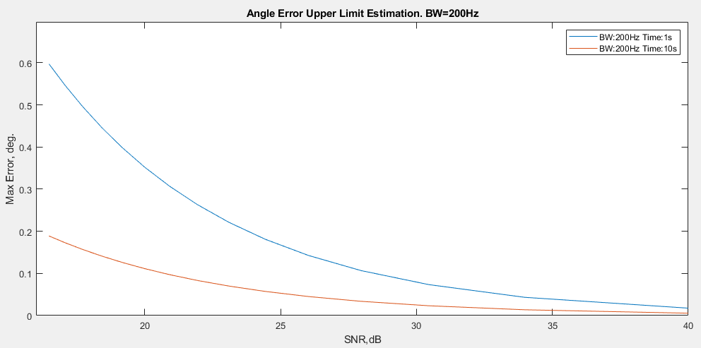
Bearing Error (peak) vs. SNR (best and simulated)
The simulation corresponds to the observations on the hardware

Slide 23
Next steps
Collect the information for all sources in the world
Build a test head: VLF detector with an Internet interface
Deploy these units globally to collect data
Process the data and optimize the direction finding
Develop a four‑antenna product (see next slide)
Low cost, small size, light weight
Test VLF with IMU in GNSS denied environment
Calibrate over the tilt, temperature, and elevation
Integrate VLF with IMU and build INS on this integration
File two non-provisional applications
Prepare for carrier phase tracking, which allow to see any horizontal displacements with the accuracy of few meters

Slide 24
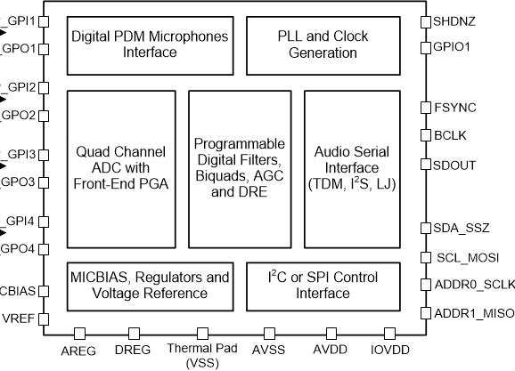
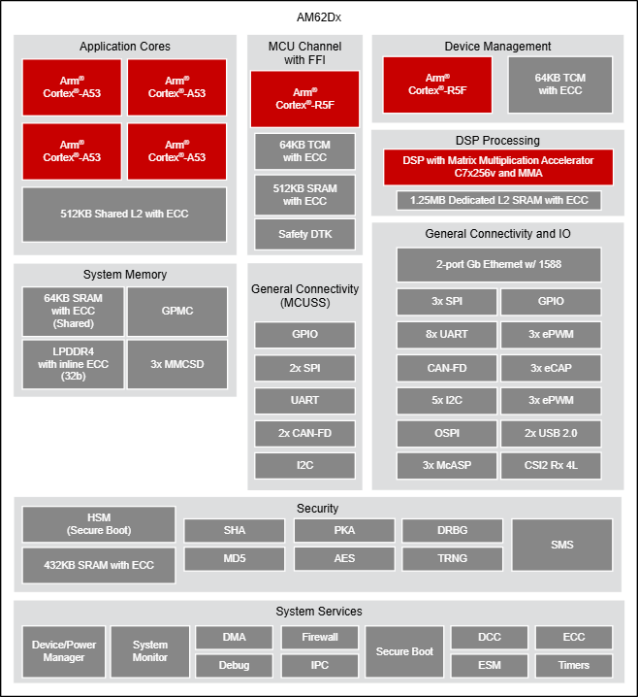
Next product: VLF receiver
Reports LoB to all visible sources
Report heading
Report the speed (vector)
Calculate the location
All information from VLF sources, no GNSS
Interfaces
4 VLF antennas
4 audio ADCs
AM62D TI DSP
Build 4 antenna system, print antennas on PCB (~$10) plus 4LNAs ($10)
The signals from 4 antennas are digitized by PCM6140-Q1 quad ADC (~$5)
Then processed by AM62D (DSP + 4 ARMs) (~$25)
Sent to the interfaces (~$10)
Expected cost of goods (CoG): ~$100
Expected size 100x100x60mm

Slide 25
Crazy approach for low-cost navigation
Market Context
Worldwide annual production of military low-cost drones: hundreds of thousands
Market value: $40B in 2024, projected to nearly double by 2030
Drone unit cost: as low as $2,000
Navigation budget per drone: < $1,000
Current Limitations
Advanced navigation technologies (TwoSents, PAA, CRPA) → Too expensive for low-cost drones
Proposed Solution
Hybrid Navigation System (Unspoofable + Unjammable):
VLF Navigation – ~$100
Low-Cost GNSS Receiver – ~$100
Low-Cost IMU – ~$100
Total CoG < $500 including assembly and test (at 100k units/year)
Acknowledgment: Big thanks to Anton B. for his ideas

Slide 26
Emerging Applications
Aviation resilience
Backup heading and positioning when GNSS is jammed or denied
Integration with cockpit INS for long‑haul flights
Maritime safety
Bearing extraction for ships in GNSS‑denied regions
Complementary to gyro‑compass and radar systems
Submarine navigation
Very Low Frequency signals penetrate seawater (~10 dB/m).
Limitation: only works at shallow depths ~3 to 5m, not deeper with small antennas (D=200mm N=24 turns)

Slide 27
Emerging Applications cont’d
Critical infrastructure
Time synchronization for power grids and telecom networks
Independent of GNSS, robust against spoofing
Autonomous systems
VLF‑based navigation for drones and unmanned vehicles in contested environments
Provides un-spoofable and un‑jammable reference signals
Geophysical exploration
VLF penetration into rock/soil for subsurface mapping
Potential synergy with existing geophysical survey methods
Tunnel navigation system
Good coverage for Polar regions

Slide 28
Highlights
VLF navigation subsystem integrated with IMU can form a stable INS
VLF navigation detects the bearing towards many VLF high power transmitters with predefined locations and calculates the position
Based on the information from VLF we can calculate
Our location, heading, create a gyro-compass
Global coverage: >30 transmitters worldwide, radiating hundreds of kW to MW
Un‑jammable:
Extremely low frequency, high power, fixed locations, huge antennas
Cross‑domain utility:
Same infrastructure supports airborne, marine, submarine, ground and underground drones
Combination of TwoSents with VLF and INS will provide un-jammable, un-spoofable solution with the reliability and performance exceeding any market offerings today

Slide 29
Many thanks to all who have assisted with this project

