Slide 1
A simple way of multimodal and arbitrary style transfer
Duc Nguyen
Seonghwa Choi
Woojae Kim
Sanghoon Lee
Yonsei University

Slide 2
Problem formulation
Style transfer concerns how a machine can replicate a “style” of a source image on the target image without modifying the contents
This is an artistic problem, so the result should not be deterministic as different people judge a photo differently
Ideally, a style transfer algorithm should produce an infinite number of outputs so that users can choose the most satisfying results
The outputs should have the same contents but different details regarding color, strokes, etc.

Slide 3
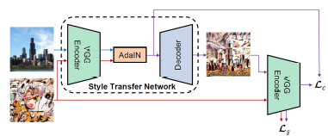
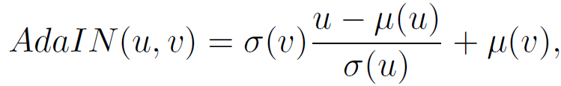
Previous work [1]
Adaptive Instance Normalization: arbitrary style transfer
Intuition
Both the style and target images are processed by a pretrained VGG to obtain the corresponding feature maps
The feature maps of the target image are first Gaussianized
The statistics of the style image’s feature maps are transferred to those of the source image
VGG is a pretrained model on ImageNet and kept fixed
[1] “Arbitrary style transfer in real-time with adaptive instance normalization,” – Huang et al.

Slide 4
Previous work [2]
In a trained neural network, the feature maps in a layer form a natural basis of the feature space.
It has been observed that a random vector in the feature space can give rise to interpretable semantic properties similar to the natural basis.
This means that the space itself, not the basis, is semantically meaningful.
It should follow that a linear combination of the basis must also be semantically similar but different in representation.
[2] “Intriguing properties of neural networks,” – Szegedy et al.

Slide 5
Multimodal and arbitrary style transfer
The mean represents the style and the variance represents the magnitude of the style
Keeping the mean fixed and modifying the variance of the feature maps can result in different feature without distorting the contents
From above, it is feasible because a linear combination of feature maps is as good as the natural basis
However, because the weights are fixed, it is not possible to combine the features totally randomly as the weights cannot account for the change in magnitude.

Slide 6
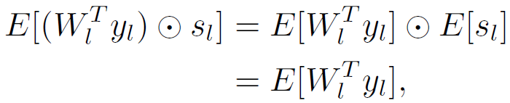
Multimodal and arbitrary style transfer
Taking random combinations of feature maps results in a complete failure as the encoder is not trained, so the activations in each layer might malfunction
We want the following to hold
which implies the expectation of the noise should be 1.
To preserve the mean we use the following update to the feature maps

Slide 7
Network architecture
The encoder is a VGG pretrained on ImageNet.
The encoder is kept fixed during training.
The decoder is mostly symmetric to the encoder.
We encountered difficulty training with noise from beginning, so we trained the network without noise for 15 epochs and trained with noise for 5 epochs.

Slide 8



Cost functions
The cost functions should take the noise into account
Style loss
The mean and variance of the source image’s feature maps should be the same as those of the output’s
Content loss
The latent code of the output should be the same as the AdaIN output between the source and style feature maps
Total loss

Slide 9
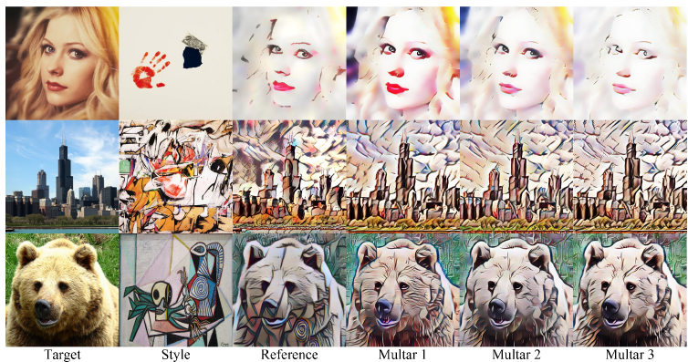
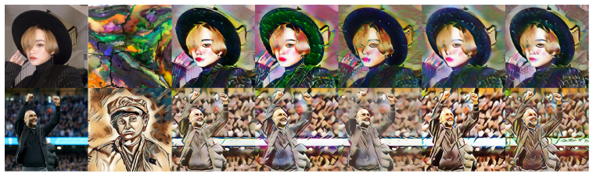
Qualitative results
Multimodal style transfer with references
Multimodal style transfer for random images from Internet

Slide 10
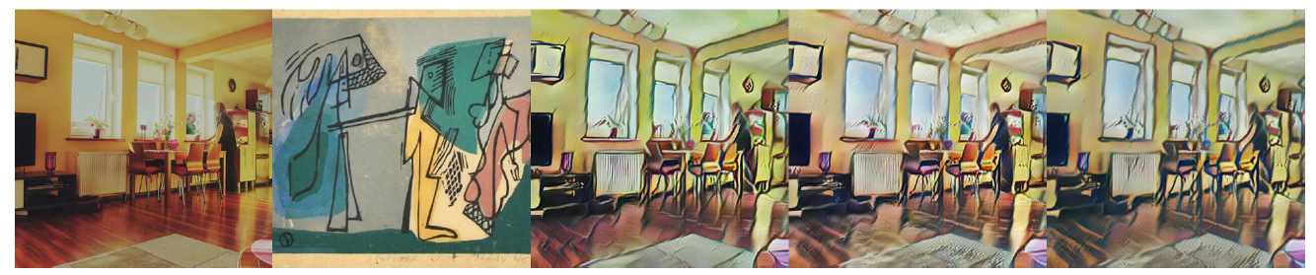
Ablation study
When the noise level is different from 1, the magnitude is amplified by the weights, so the optimization is difficult or fails.
When the noise range is broader, the features seem more diverse. However, the images appear noisier.

Slide 11
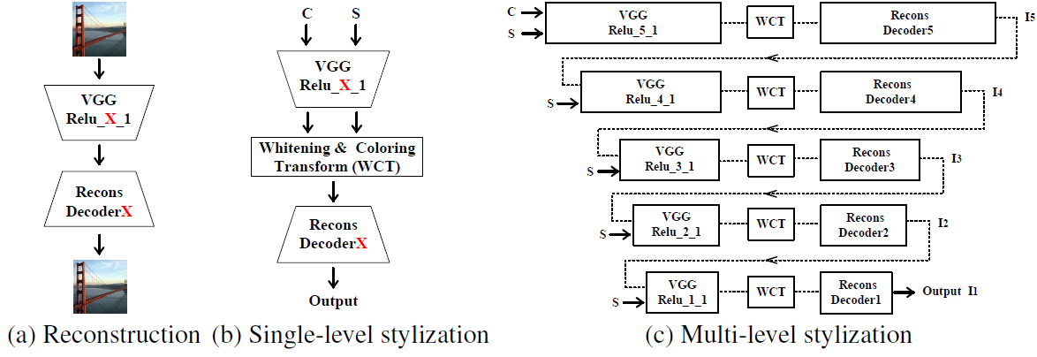
Beyond the paper
In the paper, we conjecture that our method can succeed in any case using an encoder-decoder architecture.
We tested our method with Whitening and Coloring Transform Network (WCTNet).
Input and style are encoded by the encoder
The feature maps are processed by WCT
Output is obtained by decoding the processed feature map
The process can be done in multiple levels to yield a better looking output
Pretrained encoder
Trained
decoder

Slide 12

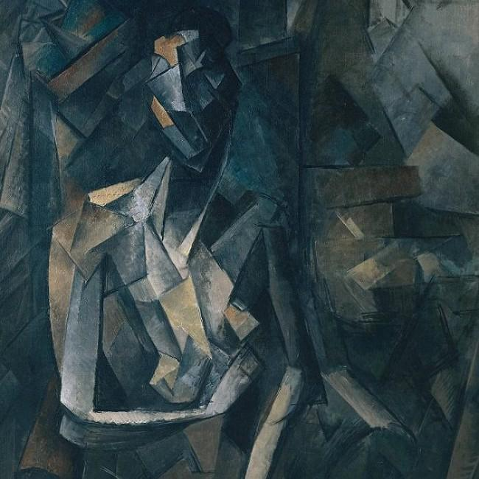

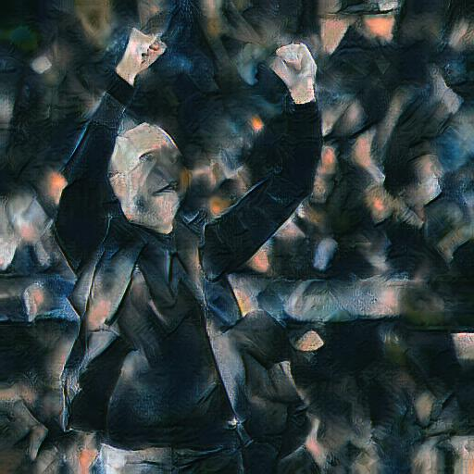
Beyond the paper
We inject noise to the encoded feature maps of the style image at all levels.
All other steps are kept the same. We note that the style transfer is not even a training process.

Slide 13
Conclusion
We defined a new multimodal and arbitrary image style transfer
The output is stochastic to satisfy a wide range of users.
The multimodal is obtained by using a combination of the encoded feature maps of the style image
The strategy is proposed based on an observation that a linear combination in feature space is as good as the natural basis.
The weights of the linear combination should sum up to 1 to avoid malfunctioning of the network activations.
We showed that the method works for any encoder-decoder architectures.
Code to reproduce the paper: https://github.com/justanhduc/multar

Slide 14

Thank you for listening!

