Slide 1

AI & LLMs for Software Engineers
Engineering Academy · Professional Transition Workshop
Notes:
• Welcome everyone and explain the goal: understand what LLMs do, then learn how to use them safely in software work.
• This workshop starts with the model itself. It then adds prompts, tools, reusable skills, and engineering controls.
• Set expectations: participants do not need machine-learning experience. The examples build from simple ideas.
• By the end, participants should be able to explain why an answer can sound confident and still be wrong.

Slide 2
What We'll Cover
01
What AI and LLMs Are
05
Skills
AI, ML, tokens, predictions, and model size
Package repeatable workflows
02
Running a Model
06
Agents, RAG & More
Docker Model Runner and a local model
Agent loops and retrieval
03
Prompting as Programming
07
AI in SDLC
Five prompting techniques and practice
Safe AI-assisted engineering
04
MCP
08
Stuff Worth Stealing
Connect models to external tools
Tools, guides, and next steps
Notes:
• Walk through all eight parts so participants understand the path.
• Parts 1 and 2 explain the model and let participants run one locally.
• Parts 3 to 5 show how to guide the model, connect tools, and reuse workflows.
• Parts 6 and 7 cover agents, retrieval, and the engineering controls needed for real systems.
• The final part gives resources for continued practice.

Slide 3
01
PART 01
What Is AI?
Artificial intelligence is a branch of computer science focused on building systems that can perform tasks that typically require human intelligence.
Notes:
• AI is the broad name for software that performs tasks which normally require human judgment or perception.
• Examples include recognising a face, recommending a product, planning a route, or generating text.
• AI does not mean that the machine thinks like a person. It means the system produces useful behaviour for a task.
• Some AI systems follow hand-written rules. Others learn patterns from data.
• Use a familiar example: a navigation app chooses a route using map data, traffic information, and an optimisation method.
Icon source: Lucide Icons (ISC License), https://lucide.dev/icons/

Slide 4
Inside AI
AI
Machine Learning (ML)
A method that trains models to learn patterns from data and make predictions on new data
ML
Deep Learning (DL)
DL
A subset of ML that uses neural networks with many layers to learn patterns from large amounts of data
Generative AI (Gen AI)
Gen AI
AI that creates new content, such as text, images, audio, or code
Notes:
• AI is the outer category. It includes any system designed to perform tasks associated with human intelligence.
• Example of AI outside modern machine learning: a rule-based chess program can examine legal moves and choose one using programmed rules.
• Machine learning is a way to build AI by learning patterns from examples instead of writing every rule manually.
• Example of machine learning: train a spam filter on messages labelled spam or not spam. It learns patterns and predicts the label for a new message.
• Deep learning is a type of machine learning that uses neural networks with many layers. Each layer transforms the data and learns increasingly useful features.
• Example of deep learning: early layers in an image model may react to edges, while later layers combine them into shapes and objects such as a bicycle.
• Generative AI is usually built with deep learning and creates new content that resembles patterns in its training data.
• Examples of generative AI include writing an email, producing an image from a description, generating speech, or suggesting code.
• Emphasise the nesting: all generative AI shown here is deep learning, but most deep-learning systems are not generative. A fraud classifier predicts a label; it does not create new content.

Slide 5
Inside AI
Gen AI
Large Language Model (LLM)
A generative AI model trained on large amounts of text so it can process and generate language as tokens.
LLM
GPT: Generative Pretrained Transformer
GPT
A family of generative LLMs built with the Transformer architecture. GPT models generate text by predicting which token should come next.
ChatGPT
ChatGPT
A conversational AI assistant built on GPT models that lets people interact with them through natural language.
Notes:
• Start with generative AI from the previous slide: it is the broad category for systems that create new content.
• A large language model, or LLM, is a generative model trained mainly on text. It reads and produces tokens, which are small pieces of text.
• Example of an LLM task: continue 'The deployment failed because...' with a likely explanation, or answer a question using the text placed in its context.
• GPT stands for Generative Pretrained Transformer. Generative means it produces content. Pretrained means it first learns from a large dataset. Transformer names the neural-network architecture. GPT refers to a family of LLMs built this way.
• Example: different GPT model versions can have different sizes and capabilities, but they use the same broad next-token prediction idea.
• ChatGPT is a product, not just a raw model. It provides the chat interface and may add system instructions, tools, file handling, safety controls, and other application features around one or more models.
• Example: a raw GPT model receives text and returns text. ChatGPT can also manage a conversation, accept a file, call an available tool, and display the result.
• Clarify the diagram: it shows the relationship conceptually. ChatGPT uses GPT models, but a product is not literally a smaller model category inside GPT.

Slide 6
LLM - Tokens and tokenization
Tokens are the small pieces of text that an LLM reads and generates
Tokens can be whole words, parts of words, punctuation, or spaces.
"Hello, I am learning to code" tokenised:
Hello
,
I
am
learn
ing
to
code
8 tokens (≈ 6 words — tokens ≠ words)
Notes:
• An LLM cannot read text directly. The tokenizer first splits text into tokens and converts each token into an ID.
• A token can be a whole word, part of a word, punctuation, or a space. Common text may use fewer tokens than unusual names or code.
• In the example, 'learning' becomes 'learn' and 'ing'. Another tokenizer may split the same word differently.
• Token count matters because model limits and API costs are usually measured in tokens, not words.
• Example: a long JSON document may use many tokens because punctuation, field names, and repeated values all count.

Slide 7
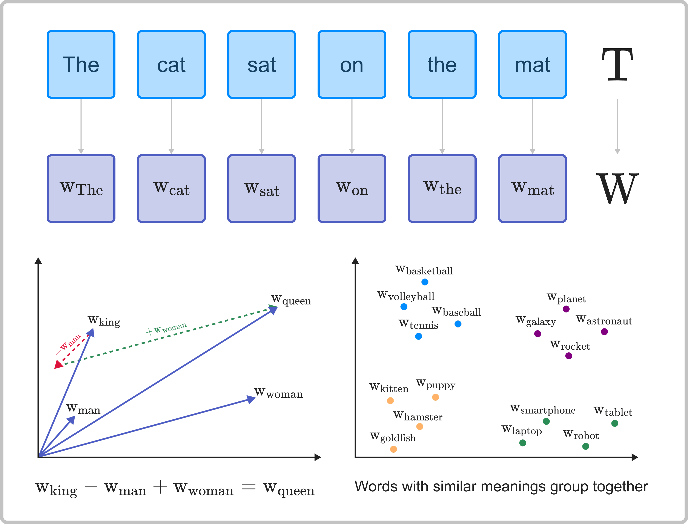
LLM - Embedding

Slide 8
LLM - Predictions
The cat sat on the
The
cat
sat
on
the
[?]
The
[0.2, 0.4]
cat
[0.8, 0.7]
sat
[0.6, 0.3]
[Token vectors]
on
[0.3, 0.5]
the
[0.2, 0.4]
Notes:
• After tokenisation, the model turns every token ID into a vector: a list of numbers.
• The numbers are learned representations. They let the model calculate relationships and transform information mathematically.
• Do not assign a simple human label to every number. Meaning is distributed across many dimensions.
• Example: the representation of 'bank' changes with context. 'River bank' and 'bank account' use the same word but surrounding tokens push the representation toward different meanings.
• The model then uses all current token representations to predict what should follow the sentence.

Slide 9
LLM - Predictions
[0.2, 0.4]
[0.4, 0.3]
[0.8, 0.7]
[0.7, 0.8]
[0.6, 0.3]
× Weights → [new vectors] × Weights → … →
[0.8, 0.5]
[0.3, 0.5]
[0.5, 0.7]
[0.2, 0.4]
[0.9, 0.8]
Notes:
• Weights are the learned numbers stored in the model file. Training adjusts them by showing the model many examples and measuring prediction errors.
• During inference, which means normal model use, the model applies those fixed weights to the token vectors layer after layer.
• Each layer produces new vectors that contain more information about the surrounding context.
• Example: the vector for 'it' can absorb information from earlier words and come to represent the object that 'it' refers to.
• The model is not searching a database of complete answers. It is calculating a new continuation from tokens, vectors, and weights.
However, the formula itself is a way more complex, more detailed explanation couold be found here: https://www.youtube.com/watch?v=zxQyTK8quyY

Slide 10
LLM - Predictions
[0.9, 0.8]
× Output weights → Scores → Probabilities
mat
[1.0, 0.9]
1.62
41.9%
“The” in a context of “The cat sat on the”
floor
[0.8, 0.7]
1.28
29.8%
chair
[0.6, 0.3]
0.76
17.7%
car
[0.3, 0.5]
0.25
10.6%
Notes:
• The final layers convert the current representation into a score for every possible next token.
• A softmax calculation turns those scores into probabilities that add up to 100 percent.
• In this example, 'car' has the highest probability, but the model may choose another likely token depending on its sampling settings.
• Temperature controls how strongly generation favours the highest-probability choices. Lower temperature is usually more predictable; higher temperature allows more variation.
• After choosing one token, the model adds it to the context and repeats the whole process. That repetition produces sentences one token at a time.

Slide 11
What is GPT in the context of LLM?
Attention is all you need!
01
Attention is the mechanism that lets each token vector use information from other relevant tokens.
Transformers architecture
02
The overall neural-network architecture made of many layers containing attention and other learned transformations.
GPT is an autoregressive LLM
03
Predicts the next token from previous tokens, then repeats.
Notes:
• "Attention Is All You Need" is a 2017 research paper on machine learning authored by eight scientists and engineers working at Google. The paper introduced a new deep learning architecture known as the transformer, based on the attention mechanism proposed in 2014 by Bahdanau et al.
• Attention lets each token representation use information from other relevant tokens in the same context.
• Example: in 'The animal did not cross the road because it was tired', the representation of 'it' needs information from earlier words to capture the likely meaning.
• The Transformer is the full architecture. It combines attention with other learned transformations and repeats them across many layers.
• GPT is an autoregressive LLM. Autoregressive means it predicts the next token using the tokens that came before, adds the new token, and predicts again.
• The model does not plan an entire paragraph first and then reveal it. Generation happens step by step, even when the final answer looks carefully written.
• Source: https://arxiv.org/abs/1706.03762

Slide 12

Context Window
A context window is the token limit for one model request.
It includes instructions, messages, tool definitions, documents, and generated output.
When content exceeds the limit, the application must shorten it, split it, or reject the request.
System prompt
Current prompt
Previous chat messages
Documents you provided
Generated text
Long chats do not guarantee full recall. The application decides which earlier information to send again.
Notes:
• The context window is the maximum number of tokens the model can process in one request.
• Think of it as the model's working desk. Only the material placed on the desk for this request is available while it answers.
• The context may contain the system prompt, current question, selected earlier messages, tool descriptions, retrieved documents, and space for generated output.
• Example: if the limit is reached, an application may remove old messages or summarise them before sending the next request.
• A long chat does not guarantee perfect memory. The application decides which previous information to send again, and summarisation can lose detail.
• Source: https://platform.openai.com/docs/concepts#context-window

Slide 13


Three Consequences Worth Knowing
Hallucination
It produces fluent text. Fluency and correctness are not the same thing.
Prompting works
You're not configuring software. You're shaping the context the model continues.
No memory by default
Each call starts fresh. It only knows what's in the current context window.
Notes:
• Hallucination means the model produces unsupported or incorrect information in a fluent form. Confidence is a writing style, not a certificate of truth.
• Example: ask for a function from a library that does not exist. The model may invent a plausible function name because it fits the text pattern.
• Prompting works because the prompt changes the context from which the model predicts its answer.
• Example: adding the database type, expected traffic, and failure requirements produces a more relevant architecture answer than asking only 'Which database should I use?'.
• No memory by default means a model call only knows the input supplied with that call. An application can create memory by storing information and adding selected parts to later requests.
• Example: saving a user's preferred language in a database and adding it to the next prompt is application memory, not a permanent change inside the model.

Slide 14
How Precision Changes Model Size
Same 8 BILLION learned weights
FP32
FP16
INT8
INT4
4 bytes / weight
2 bytes / weight
1 byte / weight
0.5 byte / weight
~32 GB
~16 GB
~8 GB
~4 GB
Notes:
• A model contains billions of weights. Precision describes how many bits are used to store each weight.
• FP32 uses four bytes per weight and preserves more numeric detail. FP16 uses two bytes and is common for efficient model execution.
• INT8 and INT4 are quantised formats. Quantisation stores a simplified approximation of the original weights using fewer bits.
• Example: eight billion weights at two bytes each require about sixteen gigabytes before file-format overhead.
• Lower precision usually reduces memory use and can improve speed. It may also reduce accuracy or change output quality, especially with aggressive quantisation.
• Use an image analogy: fewer colour levels make a file smaller, but too much reduction can remove useful detail.

Slide 15
02
PART 02
Running a Model
No UI. No wrapper. Just the model.
Notes:
• Transition from theory to practice: participants will now run a model without a chat product around it.
• The goal is to see the raw relationship between a prompt, a local model, and the generated answer.
• Running locally also makes model size, download time, memory use, and hardware limits more concrete.
Icon source: Lucide Icons (ISC License), https://lucide.dev/icons/

Slide 16


Docker Model Runner
Built into Docker Desktop
No extra install — available in recent versions of Docker Desktop out of the box
Pull and run from the CLI
Same workflow as pulling containers — model weights download like any other image
Runs entirely locally
No API keys, no internet required at runtime, no data leaves your machine
Notes:
• Docker Model Runner lets Docker Desktop download and run supported AI models through Docker commands.
• A model image contains model weights and the files needed to serve the model. It is similar to pulling a container image, although the contents and runtime are different.
• The first pull needs internet access because the weights may be several gigabytes. Later prompts can run locally when the model is already downloaded.
• Local execution means prompt data is processed on the machine by the local runtime. Remind participants to check their organisation's policies before using sensitive data anywhere.
• Example command flow: pull the model, start it, send a small prompt, then watch local CPU, GPU, and memory use.
• Source: https://docs.docker.com/ai/model-runner/

Slide 17
Practice 1: Local Model
# Clone the branch
git clone https://github.com/justasbuzaitis/sourcery_2026_autumn_ai.git
# Checkout Practice 1
git fetch origin
git switch practice-1
# Start reading MD guidelines
Notes:
• Ask participants to clone the repository and switch to the practice branch.
• Explain each command briefly: clone creates a local copy, fetch updates remote branch information, and switch changes the working branch.
• A successful result is simple: the model starts, accepts one prompt, and returns text.
• Help with installation or hardware problems first. Prompt quality comes in the next section.
• If a participant finishes early, ask them to try the same prompt twice and compare the outputs.

Slide 18
03
PART 03
Prompting as Programming
Five techniques — and why each one works. Less magic. More structure.
Notes:
• Introduce prompting as input design. A prompt supplies instructions and information that guide the model's continuation.
• Good prompting does not unlock hidden intelligence. It reduces ambiguity and makes the expected result easier to predict.
• The five techniques are role, visible working steps, examples, output format, and system instructions.
• Each technique solves a different problem, so participants should learn when it helps instead of adding every technique to every prompt.
Icon source: Lucide Icons (ISC License), https://lucide.dev/icons/

Slide 19
One Mental Model for All of It
Context shapes the next token.
A prompt supplies the instructions and information the model uses to predict a response.
Every technique in this section is a different way to shape that context.
Role prompting
Structured reasoning
Few-shot
Steers tone, priorities,
and assumptions
Adds a plan or checks
before the final answer
Shows the pattern you
want the model to continue
Notes:
• Use one mental model for the whole section: context shapes the next token, and repeated next-token choices shape the answer.
• Role prompting steers tone, priorities, and assumptions. Example: a security engineer role makes security concerns more prominent.
• Structured reasoning asks for an explicit plan, calculation, or final check. Example: show the calculation before giving the total.
• Few-shot prompting supplies examples. Example: two sample review comments teach the desired labels and tone.
• These techniques can improve consistency, but none of them prove that the answer is correct.

Slide 20
Technique 1 · Role & Persona
You're not giving it an identity — you're loading a context heavily associated with a certain kind of output.
No role
Security engineer
UX designer
What should I think about when
storing user passwords?
You are a senior security engineer.
What should I think about when
storing user passwords?
You are a UX designer reducing signup
friction. What should I think about
when storing passwords?
Generic, shallow, misses key points
Hashing, salting, bcrypt, timing attacks, logging risks
Still valid — just optimises for a different concern
Notes:
• A role tells the model which perspective should be prominent in the answer.
• The security engineer focuses on hashing, input handling, and attack paths. The UX designer focuses on user friction and recovery flows.
• Both perspectives can be useful because the task has several valid concerns.
• A role does not add private knowledge or guarantee expertise. The model can still miss a vulnerability or repeat outdated advice.
• Use roles when perspective matters. For a simple factual task such as converting units, a role usually adds noise rather than value.

Slide 21
Technique 2 · Structured Reasoning
For harder tasks, ask for a short plan, the calculation, or a final check. Treat the explanation as evidence to review, not proof.
Direct answer
With working steps
I went to the market and bought 10 apples.
I gave 2 to my neighbour and 2 to the
repairman. I then bought 5 more and ate 1.
How many apples do I have left?
I went to the market and bought 10 apples.
I gave 2 to my neighbour and 2 to the
repairman. I then bought 5 more and ate 1.
How many apples do I have left?
Show the calculation, then check the result.
A direct answer can hide skipped steps.
Visible working steps make mistakes easier to spot. They can still be wrong.
Notes:
• For a difficult task, ask for a short plan, the necessary calculation, or a final verification step.
• Visible steps help the reviewer find where an error entered the answer.
• In the apple example, write the calculation as 10 minus 2 minus 2 plus 5 minus 1. The result is 10.
• The explanation can still be wrong. A neat calculation is evidence to inspect, not proof to trust.
• For code or architecture, ask for assumptions and a short trade-off check instead of demanding a long private chain of thought.
• Source: https://platform.openai.com/docs/guides/reasoning-best-practices

Slide 22
Technique 3 · Few-Shot Examples
Show the pattern you want continued. The model will match the format, tone, and structure of your examples.
Without examples
With two examples
Write a code review comment for:
def get_user(id):
return db.query(
"SELECT * FROM users "
"WHERE id=" + id
)
# Example 1
Code: return items[0]
Comment: [BUG] No bounds check.
Suggest: return items[0] if items else None
# Example 2
Code: password = request.get("password")
Comment: [SECURITY] Never log this.
Suggest: treat as sensitive from entry.
# Now review:
def get_user(id): ...
Result: some kind of comment — format varies every run.
Result: consistent format, severity tag, actionable fix — every time.
Notes:
• Few-shot means giving the model a small number of examples before the real task.
• The examples demonstrate the desired structure more clearly than abstract instructions alone.
• Here, the examples teach three things: a severity label, a concise explanation, and an actionable suggestion.
• Choose examples that resemble the real input. Include an edge case when the edge case matters to the output.
• Poor examples also teach poor behaviour. If examples contradict the written instruction, the model may imitate the examples.

Slide 23
Technique 4 · Output Format Control
Specify the structure — JSON, table, numbered steps. The model has seen these formats and will continue them reliably.
Review this function. Respond ONLY with a JSON object with these exact fields:
"severity" (low | medium | high), "issue" (one sentence), "suggestion" (one sentence),
"example_fix" (code only). No explanation outside the JSON.
def calculate_discount(price, discount):
return price - discount
{
"severity": "high",
"issue": "No validation — negative discount or discount > price produces wrong results.",
"suggestion": "Add guard clauses for discount range and type before computing.",
"example_fix": "if not (0 <= discount <= price): raise ValueError('Invalid discount')"
}
This is now a
program interface:
review = json.loads(result)
if review["severity"] == "high":
block_merge(review["suggestion"])
Notes:
• Output format control defines the structure that the answer must follow.
• JSON is useful when software must parse the result. Tables are useful for comparison. Numbered steps are useful for a human procedure.
• The example defines exact field names and allowed severity values so the result behaves more like an interface.
• The model may still return invalid JSON, omit a field, or place unexpected text around the object.
• Treat model output as untrusted external input. Parse it, validate field types and allowed values, and reject invalid results.

Slide 24
Technique 5 · System Prompt vs User Prompt
The application sends system instructions before the user message. They define general behaviour for the request or session.
System prompt A
System prompt B
You are a senior engineer mentoring a junior dev.
Explain everything with everyday analogies.
Never use jargon without defining it first.
You are a code reviewer for a senior team.
Be terse. Identify issues only.
Output as bullet points. No encouragement.
User prompt (identical):
What is a database index and when should I use one?
> docker model run ai/smollm2
> /set system "You are a terse code reviewer. Identify issues only. Bullet points."
Notes:
• The system prompt contains application-level instructions sent before the user's message.
• The user prompt contains the current request. The application normally sends both to the model in the same context.
• System prompt A asks for teaching behaviour. System prompt B asks for terse review behaviour. The same user question therefore produces different styles.
• A system prompt has higher instructional priority in many model APIs, but it cannot guarantee compliance or replace validation.
• It is not permanent model memory. The application must send the instructions again in later requests or sessions when it wants the same behaviour.

Slide 25
Practice 2: Prompting techniques
# Checkout Practice 2
git fetch origin
git switch practice-2
# Start reading MD guidelines
Notes:
• Ask participants to try one technique at a time before combining them.
• Keep the task identical so the effect of each change is easier to see.
• Compare usefulness, consistency, factual quality, and whether code could parse the result.
• Remind participants to save interesting failures. A failed prompt often teaches more than a lucky answer.

Slide 26
Build a Prompt in Layers
Rewrite task using 5 different techniques
1
Bare prompt
Just the question — observe the default
2
+ Role
Add senior engineer mentor — observe the shift
3
+ Working steps
Ask for a short plan and a final trade-off check
4
+ Format constraint
Require JSON: { definition, use_when, avoid_when, analogy }
5
Role → System prompt
Move role + format to system prompt; keep only the question
Notes:
• Step 1 establishes the default answer. Without a baseline, there is nothing useful to compare.
• Step 2 adds a role and checks whether the model changes emphasis or depth.
• Step 3 asks for a short plan and a final trade-off check. This exposes useful working steps without requesting private hidden reasoning.
• Step 4 adds a JSON structure. Check whether the output is valid and contains every required field.
• Step 5 moves stable application rules into the system prompt and leaves the changing question in the user prompt.
• After every step, ask what improved and what remained unreliable. More prompt text is not automatically better. Sometimes it is just more text wearing a tie.

Slide 27
Practice 2: Answers
# Pull the answers
git fetch origin
git switch practice-2-solution
Notes:
• Review the solution as one reasonable implementation rather than the only correct prompt.
• Ask which change produced the largest improvement and whether that improvement was consistent across repeated runs.
• Check that structured output is parsed and validated by code.
• Discuss what the application should do when the model returns invalid data or ignores an instruction.

Slide 28
04
PART 04
MCP
Giving the model hands, not just a mouth.
Notes:
• Transition from guiding the model with text to giving the application access to external capabilities.
• A raw model can only generate output from its current context. It cannot independently open a database, send an email, or check live weather.
• MCP provides a standard way for an AI application to expose approved tools and data to the model.
Icon source: Lucide Icons (ISC License), https://lucide.dev/icons/

Slide 29
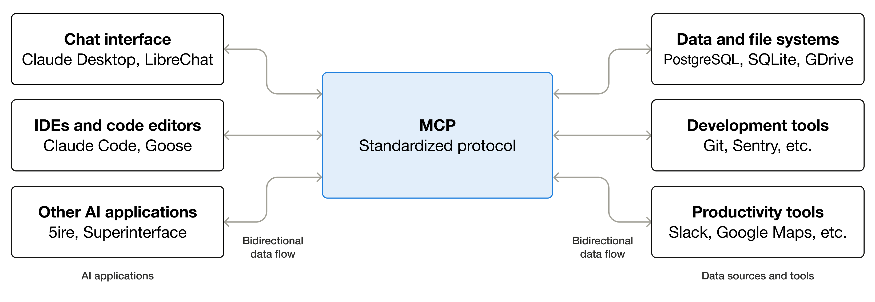
MCP
Model Context Protocol (MCP) is an open standard that lets AI applications connect models to external tools and data sources.
Notes:
• MCP stands for Model Context Protocol. It is an open standard for connecting AI applications to tools and data sources.
• The model does not directly connect to a database or service. The host application manages the connection and executes approved operations.
• An MCP server describes its available tools, required inputs, and returned results in a standard form.
• Example: a weather server may expose a get_weather tool that accepts a city and returns current conditions.
• A useful analogy is a common adapter: applications and servers agree on one connection pattern instead of inventing a new integration for every pair.

Slide 30
MCP: Motivation
Tools can be complete systems, API operations, database queries, or small functions
A single agent may use many tools
The model needs a clear description of what each tool does
Without a standard, every tool requires custom integration
Tools can ground answers in live data and reduce unsupported guesses
Notes:
• A tool can represent a complete system, one API operation, a database query, or a small local function.
• Example: 'find_customer' may search a CRM, while 'send_email' may call a separate mail service.
• The model needs a clear name and description so it can choose the right tool. It also needs a schema that defines valid arguments.
• Without a standard, every host and every tool provider needs custom discovery, input mapping, result handling, and error handling.
• Tools can provide live or private data and reduce unsupported guesses, but only when the returned data is correct and the model uses it properly.

Slide 31
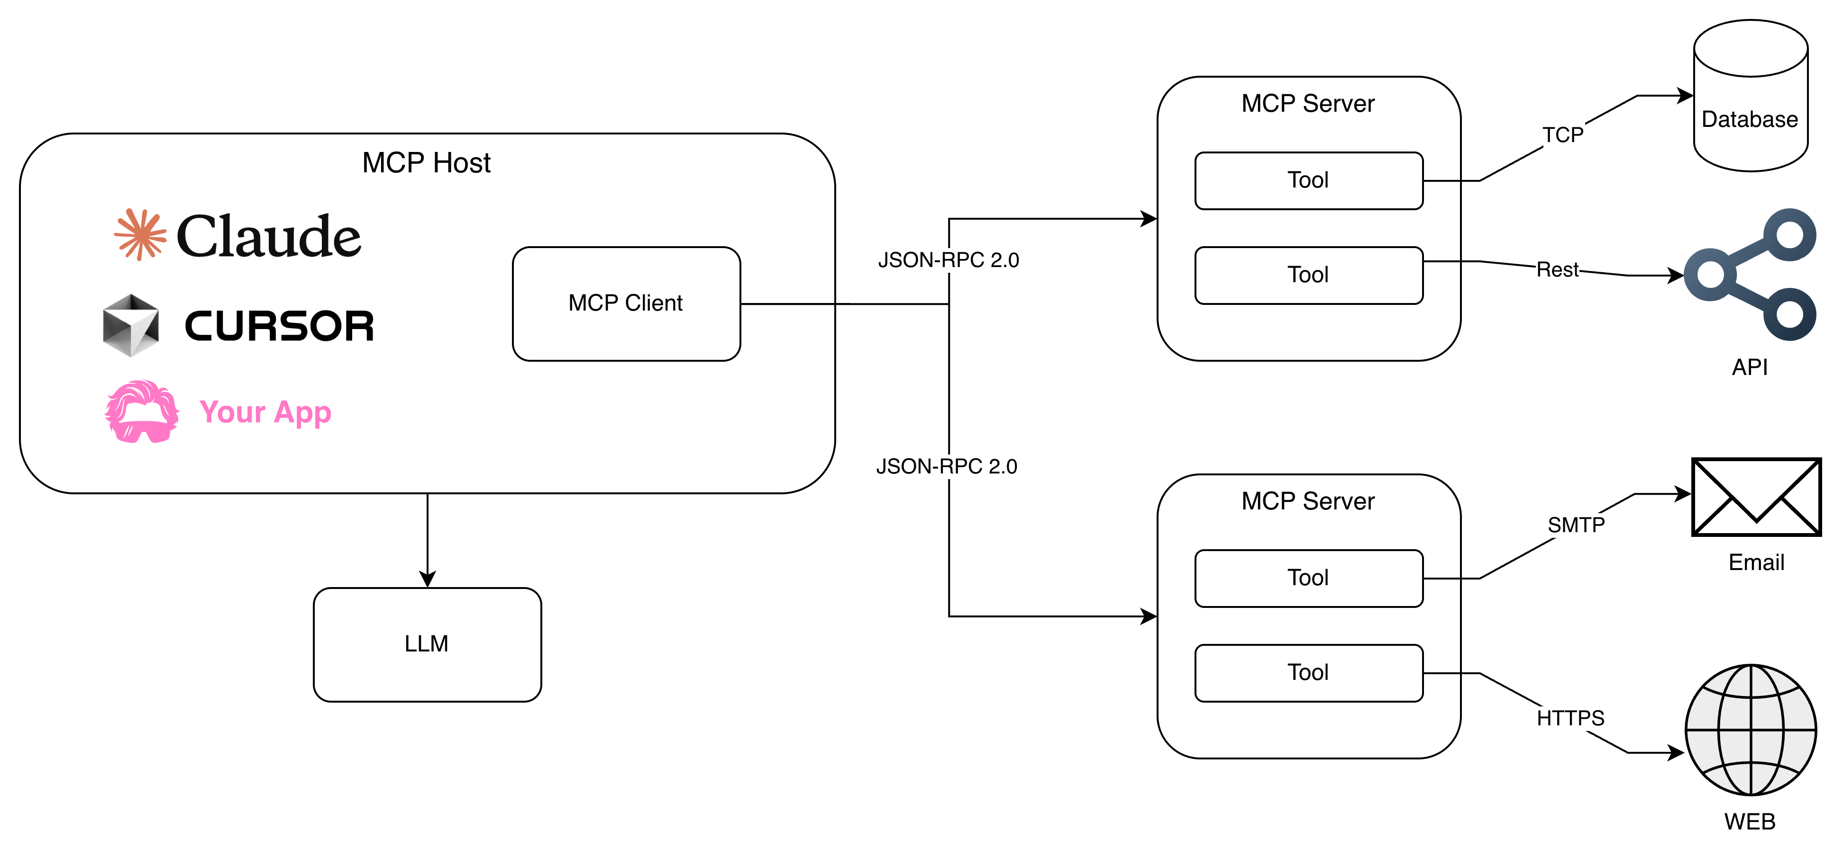
MCP: Architecture
Notes:
• The host is the application the user interacts with, such as an IDE or desktop assistant.
• The MCP client lives inside the host and manages connections to MCP servers.
• An MCP server exposes tools, resources, or prompts from one service or data source.
• The model sees tool descriptions and may request a call. The host checks the request, runs the tool through the client, and returns the result to the model.
• Example: an IDE host connects to a GitHub MCP server. The model requests issue details, but the application performs the actual GitHub operation.

Slide 32
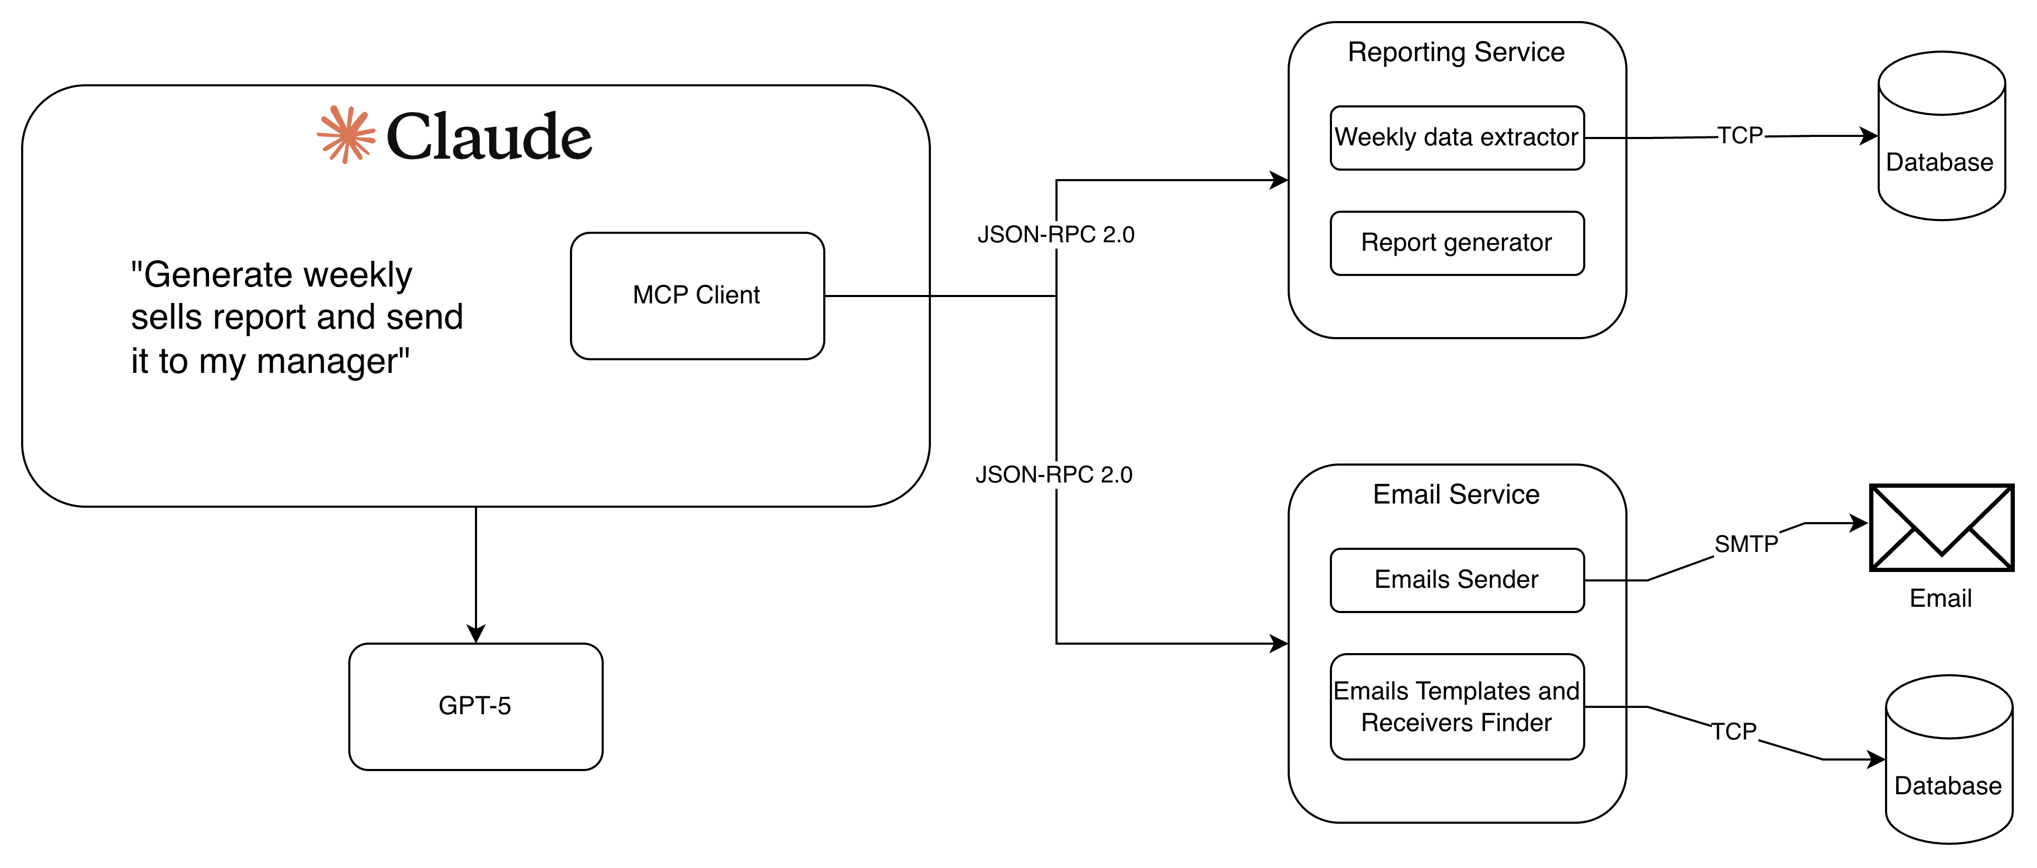
MCP: Example
"Generate weekly
sales report and send
it to my manager"
Email templates and
recipient finder
Notes:
• Walk through the sales-report request from left to right.
• The model first needs sales data. It requests the reporting tool with a time range or other required arguments.
• The application runs the tool and adds the returned data to the context.
• The model creates the report, then may request a recipient lookup or email tool.
• Sensitive actions such as sending email should require clear permissions and, when appropriate, user approval.

Slide 33
Practice 3: MCP with Kit
# Checkout Practice 3
git fetch origin
git switch practice-3
# Start reading MD guidelines
Notes:
• Ask participants to connect the MCP server and inspect the list of exposed tools before calling anything.
• Read the tool description and input schema together. Participants should understand what the model sees.
• Success means they can verify that a tool call occurred and inspect the arguments and returned result.
• A natural-language answer alone does not prove the model used the tool. Models are perfectly capable of confidently role-playing a weather service.

Slide 34
Practice 3: MCP with Kit
Create a simple weather MCP server, connect it to Kit, and verify that the local model can use the new weather tool.
KIT (Host + Client)
Weather MCP Service
“What is the current weather in Kaunas? Use an available tool and do not guess.”
LLM
Notes:
• The user asks for current weather and explicitly says not to guess.
• The model reads the available tool description and requests the weather tool with Kaunas as the argument.
• The host sends the request to the weather MCP service. The service calls its weather data source and returns structured data.
• The host adds the tool result to the model context, and the model turns it into a clear answer.
• If the service fails, the correct behaviour is to report that current weather could not be retrieved, not to invent conditions.

Slide 35
Practice 3: Answers
# Pull the answers
git fetch origin
git switch practice-3-solution
Notes:
• Review the server definition, input validation, response format, and error handling.
• Show how a vague tool description can cause the model to choose the wrong tool or pass poor arguments.
• Discuss permissions: expose only the operations needed for the task. Read access does not magically need delete access, despite software's occasional enthusiasm for drama.
• Ask how the host should display tool failures and whether any calls require user confirmation.

Slide 36
05
PART 05
Skills
Reusable playbooks that teach the model how to do a job. Instructions that make AI useful.
Notes:
• Introduce skills as reusable instructions for a task that follows a repeatable process.
• A skill can contain the workflow, templates, examples, schemas, and checks needed to complete that task.
• The goal is consistency: define the process once, then reuse it instead of rewriting a long prompt every time.
Icon source: Lucide Icons (ISC License), https://lucide.dev/icons/

Slide 37
Skills
A skill is a reusable, shareable workflow that tells the model how to perform a specific task. Instead of starting from scratch each time, you define the process once and apply it whenever the task comes up.
A skill typically includes:
Name and description
Workflow instructions
Resources
Helps the model recognize when the skill is relevant.
Step-by-step guidance for the workflow, usually written in a file called SKILL.md.
Supporting materials such as templates, examples, schemas, brand guidelines, and tool access.
Notes:
• A skill is a reusable package that tells the model how to perform a specific job.
• The name and description help the application or model recognise when the skill is relevant.
• Workflow instructions define the steps. Supporting resources provide templates, examples, rules, or tool access.
• Example: a meeting-summary skill can define how to separate discussion, decisions, and actions.
• The skill can also state what must never be invented, such as an owner or deadline that was not present in the notes.

Slide 38
Skills: Motivation
Consistency
Fewer missed sections, less drift in tone or format, and closer adherence to preferred format.
Sharing the playbook
Teams can use the same standard process instead of relying on informal or undocumented knowledge.
Reuse across surfaces
Build once and apply across different chats, use cases, and models.
Notes:
• Consistency means repeated requests produce the same required sections and checks, even when different people start them.
• Example: every code review can check security, error handling, tests, and edge cases in the same order.
• Sharing the playbook turns informal team knowledge into written instructions that others can inspect and improve.
• Example: a senior engineer's release checklist becomes available to the whole team instead of living only in that person's memory.
• Reuse across surfaces means the same workflow can support different chats, coding agents, or models, although each environment may need small adjustments.

Slide 39
SKILL.md
# Skill: Meeting Summary
## Description
Turns messy meeting notes into clear decisions and actions.
## Required inputs
- Meeting notes or transcript
## Instructions
1. Identify key topics discussed.
2. Extract decisions that were made.
3. Extract action items and owners.
4. Ignore small talk and repetition.
## Output format
- **Summary:** 3–5 bullets
- **Decisions:** what was agreed
- **Actions:** owner + task + deadline
## Final checks
- Every action has an owner if known.
- Do not invent decisions or deadlines.
- Keep the result concise.
What the skill does
Required inputs
Step-by-step instructions
Required output format
Final checks before completion
Notes:
• The description states the job in plain language and helps identify when the skill applies.
• Required inputs prevent the workflow from starting without necessary material. Here, the skill needs meeting notes or a transcript.
• Instructions describe the order of work: identify topics, extract decisions, then extract actions and owners.
• The output format gives the result a stable structure that people and software can use.
• Final checks catch common mistakes. Here, they prevent invented decisions or deadlines and check that known action owners are included.
• Use this example to show that a skill should contain operational guidance, not a motivational essay about the majestic beauty of meeting summaries.

Slide 40
Practice 4: Skills
# Checkout Practice 4
git fetch origin
git switch practice-4
# Start reading MD guidelines
Notes:
• Ask participants to inspect the skill structure before running it.
• They should identify the trigger description, required inputs, workflow, output format, and final checks.
• Test one request that should use the skill and one unrelated request that should not.
• Compare the outputs and note whether the skill improves consistency without removing useful judgment.

Slide 41
Practice 4: Skills
Create a code-reviewer skill for Kit, validate it, and compare code-review results produced with and without the skill.
KIT
.agents/skills/code-reviewer/SKILL.md
“/code-reviewer Review the following Node.js function….”
LLM
Notes:
• Without the skill, the model relies mainly on the current prompt and its general training.
• With the skill, the model loads a defined code-review process and expected output format.
• Compare coverage: did both versions find the same bugs, security issues, and missing tests?
• Compare format: did the skill produce a result that is easier to review or automate?
• A skill improves the process, but the model can still miss an issue. Human review and tests remain necessary.

Slide 42
06
PART 06
The Rabbit Hole Goes Deeper
More AI topics worth exploring
Notes:
• Introduce agents and RAG as application patterns built around a model.
• Agents combine model decisions with tools and a control loop.
• RAG retrieves relevant information and adds it to the model context before generation.
• Both patterns depend on application code for data access, permissions, retries, logging, and failure handling.
Icon source: Lucide Icons (ISC License), https://lucide.dev/icons/

Slide 43
Agent AI
Notes:
Agentic AI is an advanced form of artificial intelligence focused on autonomous decision-making and action

Slide 44

Agent AI
An agent uses a model to choose actions, run tools, inspect results, and continue until it stops.
Goal +
Context
Model Chooses
Action
Tool Result →
Context
Code Runs
Tool
Your code controls permissions, retries, stop conditions, approval steps, and logs.
Notes:
• An agent is a loop in which a model chooses an action, receives the result, and chooses what to do next.
• Example: a coding agent reads a failing test, opens the relevant file, proposes a patch, runs the test, and stops when the test passes or a limit is reached.
• The model chooses actions, but application code performs them. This separation is important for security and reliability.
• The application controls available tools, permissions, approval steps, retry limits, stop conditions, and logs.
• An agent is not an independent digital employee. It is a probabilistic decision component inside a software-controlled loop.
• Source: https://openai.com/business/guides-and-resources/a-practical-guide-to-building-ai-agents/

Slide 45
Retrieval-Augmented Generation
Retrieve relevant information, add it to the prompt, then ask the model to answer from it.
User
Question
Retrieve
Relevant Chunks
Build
Context
Generate
Answer
RAG can ground an answer in retrieved sources. Retrieval can miss useful text, and the model can misread it.
docs = vector_search(query, k=5) # your code retrieves
context = "\n".join([d.text for d in docs]) # your code formats
response = model.complete( # now the model answers
system="Use only the provided context.",
user=f"Context:\n{context}\n\nQuestion: {query}"
)
Notes:
• RAG stands for retrieval-augmented generation. Retrieval finds relevant information; generation uses that information to create the answer.
• Example: a user asks about company leave policy. The application retrieves relevant policy paragraphs and places them in the prompt.
• Chunking splits documents into searchable pieces. Retrieval selects a small number of pieces that appear relevant to the question.
• The model then answers from those pieces and can cite them when traceability matters.
• RAG has two main failure points: retrieval may miss the right text, and generation may misread or ignore retrieved text.
• Evaluate retrieval quality separately from answer quality. A perfect answer is impossible when the correct source never entered the context.
• Source: https://arxiv.org/abs/2005.11401

Slide 46
07
PART 07
AI in SDLC
What changes when AI joins the engineering team
Notes:
• SDLC means software development lifecycle: planning, design, coding, testing, deployment, and maintenance.
• AI can help in every stage. It may summarise requirements, suggest code, create tests, review changes, or explain incidents.
• The speed increase changes the amount of output a team can produce. It does not transfer responsibility away from the team.
• Use the next slides to focus on review habits and controls rather than a list of shiny tools that will be renamed by next Tuesday.
Icon source: Lucide Icons (ISC License), https://lucide.dev/icons/

Slide 47

Engineering Practices
AI can speed up work. Engineering practices keep that speed safe.
Review generated code
Treat it like an unfamiliar pull request. Read it and test it.
Validate structured output
Treat model output as untrusted external data. Parse and validate it.
Verify the result
Ask for evidence, run tests, and check important claims independently.
Design for failure
Identify the worst outcome if the model is wrong. Add controls for that risk.
Notes:
• Review generated code as if it came from an unfamiliar contributor. Read it, understand it, and test it.
• Validate structured output because a model can return missing fields, wrong types, or unexpected values.
• Verify important claims with tests, logs, or trusted sources. Asking the model to check itself can help, but it is not independent verification.
• Design for failure by asking what happens when the model is wrong, unavailable, slow, or inconsistent.
• Example: before allowing a model to update production data, restrict the allowed operation, validate arguments, require approval, and keep an audit log.

Slide 48
The Code Review Habit
Treat generated code like a PR from a junior dev you haven't met.
You review it. You test it. You don't merge it because it compiled.
What the model consistently misses:
Edge cases (empty lists, null inputs, out-of-bounds) Security issues (injection, unvalidated input) Error handling (happy path only)
Notes:
• Compilation proves that code follows language rules. It does not prove correct business behaviour or safe data handling.
• Check edge cases such as empty input, null values, large values, duplicates, and concurrency.
• Check security-sensitive paths such as authentication, authorisation, injection, secret handling, and logging.
• Check error handling: timeouts, failed dependencies, partial updates, and retries.
• Example: an AI-generated database function may work for one record but fail under concurrent updates because it forgot the transaction boundary.

Slide 49

What This Means for Your Career
You are designing context
Structuring prompts, wrapping model calls, validating outputs — that is the engineering skill
Craft protects velocity
The faster AI lets you go, the more damage a skipped review or missing test can cause
Fundamentals compound
Testing, reviewing, reasoning about correctness — these habits are more valuable with AI, not less
Notes:
• Designing context is an engineering skill because model behaviour depends on instructions, supplied data, examples, and constraints.
• AI can produce a first draft quickly. That makes review discipline more important because mistakes can also be produced quickly and at scale.
• Fundamentals still compound: testing, security, data modelling, transactions, distributed-system behaviour, and clear communication remain valuable.
• Example: generating a service may take minutes, but understanding failure modes determines whether the service is safe to ship.
• The strongest engineers will combine domain knowledge with the ability to design and verify AI-assisted workflows.

Slide 50
08
PART 08
Stuff Worth Stealing
Tools, sites, and resources you should actually try
Notes:
• Introduce the final section as a short list of resources participants can actually use after the workshop.
• Encourage them to choose one resource based on their next practical task.
• One completed experiment is more useful than twenty-seven browser tabs performing a convincing imitation of progress.
Icon source: Lucide Icons (ISC License), https://lucide.dev/icons/

Slide 51


2026 sprint: Where to Go Next
Docker Model Runner docs
Experiment with other models locally — try a 7B model with the same prompts
docs.docker.com/desktop/features/model-runner
Prompt Engineering guides
Anthropic and OpenAI both publish excellent, free guides — start with Anthropic's
docs.anthropic.com/en/docs/build-with-claude/prompt-engineering
Dive into mathematics
Some interesting videos to look at:
https://youtube.com/playlist?list=PLZHQObOWTQDNU6R1_67000Dx_ZCJB-3pi A playlist by 3Blue1Brown with visualizations
https://www.youtube.com/watch?v=7xTGNNLPyMI a very deep dive into specifics by Andrej Karpathy
Explore tool use & agents
LangChain and LlamaIndex have good introductory tutorials — focus on the loop design
python.langchain.com/docs/tutorials
docs.langchain.com/oss/javascript/langchain/overview
Notes:
• Docker Model Runner documentation is the next step for trying different local models and understanding runtime options.
• Prompt-engineering guides provide patterns and examples. Compare advice across model providers because behaviour can differ.
• The mathematics resources explain vectors, attention, and model training in greater depth.
• Agent tutorials are useful when participants already understand tools and context. Focus on the control loop and failure handling, not only framework syntax.
• Suggested small project: run one local model, connect one safe tool, require structured output, and test the failure path.

Slide 52
Stuff Worth Stealing
Hugging Face
Explore models, datasets, Spaces, and practical machine-learning documentation.
huggingface.co
Matt Pocock: AI coding skills
A popular developer workflow for planning, implementation, testing, and code review.
Video: youtube.com/watch?v=M6mYodf0dJM Skills: aihero.dev/skills
GPT mathematics, clearly explained
A visual explanation of decoder-only Transformers and the mathematics behind GPT.
youtube.com/watch?v=bQ5BoolX9Ag
Windsurf / Devin Desktop
My favourite IDE so far for coding with AI.
windsurf.com (now redirects to devin.ai/desktop)
Notes:
• Hugging Face is a broad platform for finding models, datasets, demos, and documentation. Example: compare model size, licence, and intended use before downloading one.
• Matt Pocock's resources show reusable developer workflows for planning, implementation, testing, and review across coding agents.
• The GPT mathematics video explains decoder-only Transformers visually. Recommend it to participants who want to understand the calculations behind the diagrams in this workshop.
• Windsurf and Devin Desktop represent AI-first coding environments. Use them as examples of products that combine models, repository context, tools, and workflow controls.
• Remind participants to evaluate tools against their organisation's security rules and data policies before using private code or data.
• Sources:
- https://huggingface.co
- https://www.youtube.com/watch?v=M6mYodf0dJM
- https://www.aihero.dev/skills
- https://www.youtube.com/watch?v=bQ5BoolX9Ag
- https://windsurf.com
Icon source: Lucide Icons (ISC License), https://lucide.dev/icons/

Slide 53
Two Things to Keep
Context shapes continuation.
This explains everything: why prompting works, why the model hallucinates, why structured prompts help, why system prompts matter. It is one mental model for the whole field.
AI makes you faster.
Engineering practices make that speed safe.
Review generated code. Test outputs. Validate schemas. Design for failure. These habits are part of using AI well.
Notes:
• First takeaway: context shapes continuation. This connects prompting, system instructions, tool results, retrieved documents, and chat history.
• Example: supplying current API documentation changes the likely answer because those facts now appear in the model's working context.
• Second takeaway: AI increases speed, while engineering practices control the risk created by that speed.
• Example: generated code becomes useful only after review, tests, validation, and safe deployment controls.
• Ask each participant to name one technique they will try and one verification step they will keep.

Slide 54
Questions?
Thank you. Go build something.
Notes:
• Invite questions about both concepts and practical setup.
• If the room is quiet, ask: Which part still feels least intuitive: token prediction, context windows, MCP, skills, agents, or RAG?
• Ask where participants expect the greatest risk in their own work and which control would reduce it.
• Close by reminding them that products will change, but clear context, verification, limited permissions, and safe failure handling remain useful.

