Slide 1
Analysis and Design of Algorithms

Slide 2
Introduction
The word algorithm is derived from the mathematician of the ninth century Abdullah Jafar Muhammad ibn Musa Al-khowarizmi.
The word ‘alkhowarizmi’ is ‘Algorismus’ in Latin which became Algorithm after his name.
He defined Algorithm as:
An algorithm is a set of rules for carrying out calculation either by hand or on a machine.
An algorithm is a well-defined computational procedure that takes input and produces output.
An algorithm is a finite sequence of instructions or steps (i.e. inputs) to achieve some particular output.

Slide 3
What is an Algorithm?
An algorithm is a finite, ordered sequence of well-defined instructions designed to solve a specific problem or perform a computation. It takes some input, processes it through a series of steps, and produces an output.
An algorithm is step-by-step logic, not code
It is language-independent (can be implemented in any programming language)
Must be precise and unambiguous
Designed to solve a problem efficiently

Slide 4
Basic Structure
Input → Data given to the algorithm
Process → Sequence of operations
Output → Result produced
Making Tea Algorithm:
Boil water
Add tea leaves
Add sugar and milk
Stir and filter
Serve

Slide 5
Characteristics of an Algorithm
Introduction
For any procedure to be considered a true algorithm, it must satisfy certain fundamental characteristics. These properties ensure that the solution is correct, reliable, and executable.
1. Input
An algorithm must take zero or more inputs
Inputs are the data values required to solve the problem
Example:
Finding sum → Inputs: two numbers (A, B)
Searching → Input: list + key value
2. Output
An algorithm must produce at least one output
Output is the result of computation
Example:
Sum algorithm → Output: A + B
Search algorithm → Output: position or “not found”

Slide 6
3. Definiteness (Unambiguity)
Each step must be clearly defined and precise, No confusion or multiple interpretations
Example:
“Add A and B and store in SUM”
4. Finiteness
Algorithm must terminate after a finite number of steps, It should not run forever
Example:
Loop from 1 to n → finite, Infinite loop without condition to be avoided
5. Effectiveness
Each step must be simple and executable
Should be doable in finite time with available resources
Example:
“Multiply two numbers”
6. Generality (Additional Property)
Algorithm should work for all valid inputs, not just one case
Example:
Sorting algorithm should sort any list, not just one specific list

Slide 7
Problem Statement
Find the maximum element in a list of numbers
Understanding the Problem
Input: A list/array of numbers
Output: The largest number in the list
Example Input:
[3, 7, 2, 9, 5]
Expected Output:
9
Step-by-Step Algorithm
Start
Assume the first element is the maximum (Max = first element)
Compare Max with the next element
If the next element is greater, update Max
Repeat steps 3–4 for all elements in the list
Display Max
Stop

Slide 8
Following are desirable characteristics of an algorithm:
The algorithm should be general and is able to solve several cases.
The algorithms should use resources efficiently, i.e. takes less time and memory in producing the result.
The algorithms should be understandable so that anyone can understand and apply it to own problem.
The algorithm should follow the uniqueness such that each instruction of the algorithm is unambiguous and clear.

Slide 9
Notion of an Algorithm
Introduction The notion of an algorithm refers to the conceptual understanding of what an algorithm is, beyond just code. It emphasizes the logical structure, correctness, and efficiency of a solution rather than its implementation in a specific programming language.
An algorithm is:
A well-defined computational procedure
A step-by-step transformation of input into output
A problem-solving blueprint that can be implemented in multiple ways
Key Aspects of the Notion of an Algorithm
1. Abstraction Focuses on what to do, not how to code it
Removes unnecessary details
Example:
“Sort a list” is the idea; implementation could be Bubble Sort, Merge Sort, etc.
2. Language Independence
Algorithms are not tied to any programming language
Can be written as:
  Pseudocode
  Flowcharts
  Natural language steps

Slide 10
3. Correctness
Algorithm must produce the right output for all valid inputs
Example:
A sorting algorithm must correctly sort any list
4. Efficiency
Concerned with:
  Time taken
  Memory used
Two algorithms solving the same problem may differ in efficiency
Example:
Linear Search vs Binary Search
5. Finiteness and Feasibility
Must terminate in finite steps
Must be practically executable
Illustrative Example
Problem: Sorting a list
Different algorithms:
Bubble Sort → Simple but slow
Merge Sort → Faster but complex
👉 The notion focuses on:
Both solve the same problem
But differ in approach and efficiency

Slide 11
Representation of an Algorithm
Algorithms can be expressed in different forms:
Natural Language
  Easy to understand
  May be ambiguous
Pseudocode
  Structured and precise
Flowchart
  Visual representation
Example (Same Algorithm in Different Forms)
Natural Language:
“Compare adjacent elements and swap if needed”
Pseudocode:
FOR i = 1 to n
FOR j = 1 to n-i
IF A[j] > A[j+1]
SWAP

Slide 12
Fundamentals of Algorithmic Problem Solving
Algorithm design follows a systematic approach:
Understand the problem
  Identify input and output
Ascertain capabilities
  What operations are allowed?
Choose a design strategy
  Brute force
  Divide and conquer
  Greedy
  Dynamic programming
Design the algorithm
  Write pseudocode or flowchart
Prove correctness
  Ensure it works for all inputs
Analyze efficiency
  Time and space complexity
Implement and test

Slide 13
Important Problem Types
Algorithms are designed for different categories of problems:
1. Sorting Problems
Arrange data in a specific order
Example Algorithms:
Bubble Sort → O(n²)
Merge Sort → O(n log n)
2. Searching Problems
Find an element in data
Examples:
Linear Search → O(n)
Binary Search → O(log n)
3. String Processing
Work with text data
Example:
Pattern matching
Finding substring
4. Graph Problems
Data represented as nodes and edges
Examples:
Shortest path (Dijkstra’s algorithm)
Minimum spanning tree
5. Numerical Problems
Mathematical computations
Example:
Finding GCD
Matrix multiplication

Slide 14
Fundamentals of Algorithmic Efficiency
What is Algorithmic Efficiency?
Algorithmic efficiency measures how effectively an algorithm uses:
Time (execution speed)
Space (memory usage)
👉 It helps us determine how well an algorithm scales as input size increases.
Why Efficiency is Important
Large Input Sizes
  Modern applications deal with millions of records
  Inefficient algorithms become impractical
Limited Resources
  CPU time and memory are finite
Real-Time Systems
  Systems like banking, healthcare, and navigation require fast responses
Example
Sorting 1 million numbers:
O(n²) → very slow
O(n log n) → much faster

Slide 15
Types of Efficiency
1. Time Efficiency (Time Complexity)
Measures how long an algorithm takes relative to input size (n).
Basic Idea is to Count the number of elementary (important) operations:
Comparisons
Assignments
Arithmetic operations
Example 1: Linear Search
for i in range(n):
if arr[i] == key:
return i
Worst case → n comparisons
👉 Time Complexity = O(n)
Example 2: Nested Loop
for i in range(n):
for j in range(n):
Executes n × n times
👉 Time Complexity = O(n²)

Slide 16
Space Efficiency (Space Complexity)
Measures memory usage of an algorithm.
Types of Space
Input Space → memory required for input
Auxiliary Space → extra memory used
Example
sum = 0
for i in range(n):
sum += arr[i]
Uses only one variable
👉 Space Complexity = O(1) (constant space)
Example with Extra Memory
new_arr = [0]*n
👉 Space Complexity = O(n)

Slide 17
Time vs Space Trade-off
Sometimes we sacrifice one for the other.
Example
Using extra memory to store computed values
Saves time but increases space
👉 Common in dynamic programming
Measuring Efficiency
Efficiency is measured in terms of:
Input size (n)
Number of operations performed
Example
If an algorithm performs:
5n² + 3n + 10 operations
For large n:
👉 Dominant term = n²
👉 Efficiency = O(n²)

Slide 18
Introduction to Asymptotic Analysis
Asymptotic analysis is a mathematical approach used to evaluate the performance of algorithms by studying how their running time or space requirement grows as the input size (n) becomes very large.
Instead of focusing on exact execution time, which depends on hardware and implementation, asymptotic analysis focuses on the rate of growth of the algorithm’s complexity function.
Purpose of Asymptotic Analysis is To provide a machine-independent measure of efficiency
To compare different algorithms objectively
To predict performance for large input sizes
To simplify complexity expressions by ignoring insignificant factors

Slide 19

Basic Idea
Let T(n) represent the time complexity of an algorithm.
Asymptotic analysis studies:
while:
Ignoring constants
Ignoring lower-order terms
Example
T(n) = 5n²+3n+10
For large n:
T(n) ≈ 5n²
👉 Growth rate is proportional to n²

Slide 20
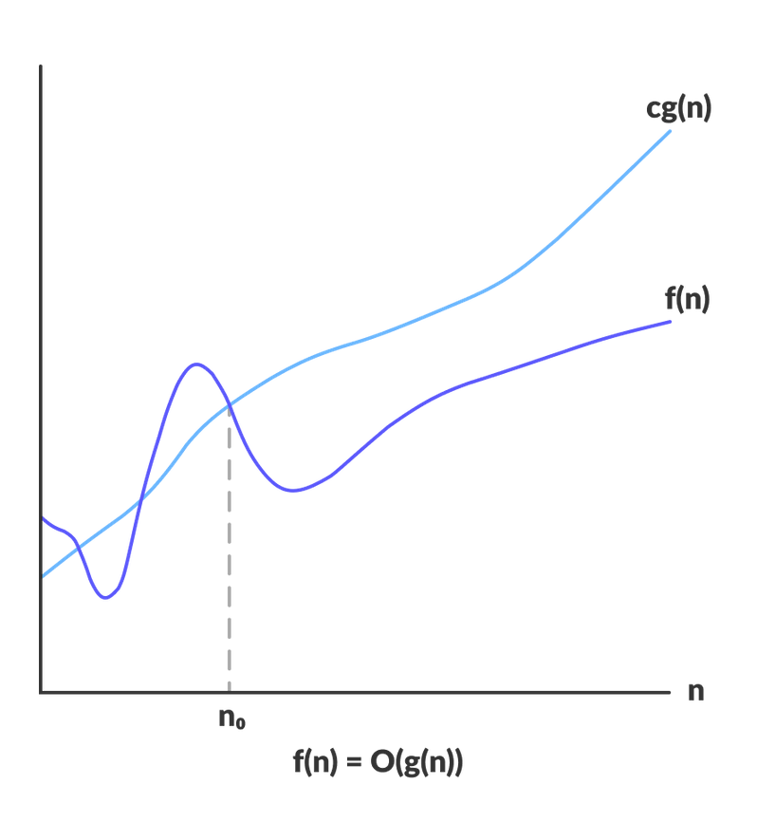
Asymptotic Notations
Asymptotic notations provide a formal way to express the growth rate of functions.
Big-O Notation (O)
Big-O notation is a mathematical tool used in algorithm analysis to describe the upper bound on the growth rate of a function, typically representing the time or space complexity of an algorithm.
It characterizes how an algorithm behaves as the input size (n) becomes very large, focusing on the worst-case scenario.
Formal Definition
Let f(n) and g(n) be two functions mapping positive integers to positive real numbers.
We say:
f(n) = O(g(n))
if there exist positive constants c and n₀
such that:
0 ≤ f(n) ≤ c⋅g(n) ,∀n ≥ n₀

Slide 21
The above expression can be described as a function f(n) belongs to the set O(g(n)) if there exists a positive constant c such that it lies between 0 and cg(n), for sufficiently large n.
For any value of n, the running time of an algorithm does not cross the time provided by O(g(n)).
Since it gives the worst-case running time of an algorithm, it is widely used to analyze an algorithm as we are always interested in the worst-case scenario.
This notation gives the tight upper bound of the given function.
Generally, it is represented as f (n ) = O(g (n )).
That means, at larger values of n , the upper bound of f (n ) is g (n ).
For example,
if f (n ) = n ⁴ + 100n ² + 10n + 50 is the given algorithm,
then n ⁴ is g (n ).
That means g (n ) gives the maximum rate of growth for f (n ) at larger values of n .

Slide 22
Example
f(n) = 4n² + 3n + 7
For large n:
f(n) ≤ 5.n² (c.g(n)) for n ≥ n₀)
Hence:
f(n) = O(n²)
Big-O | Meaning | Example
O(1) | Constant time | Array access
O(log n) | Logarithmic | Binary search
O(n) | Linear | Linear search
O(n log n) | Efficient sorting | Merge sort
O(n²) | Quadratic | Bubble sort
O(2ⁿ) | Exponential | Recursive Fibonacci

Slide 23
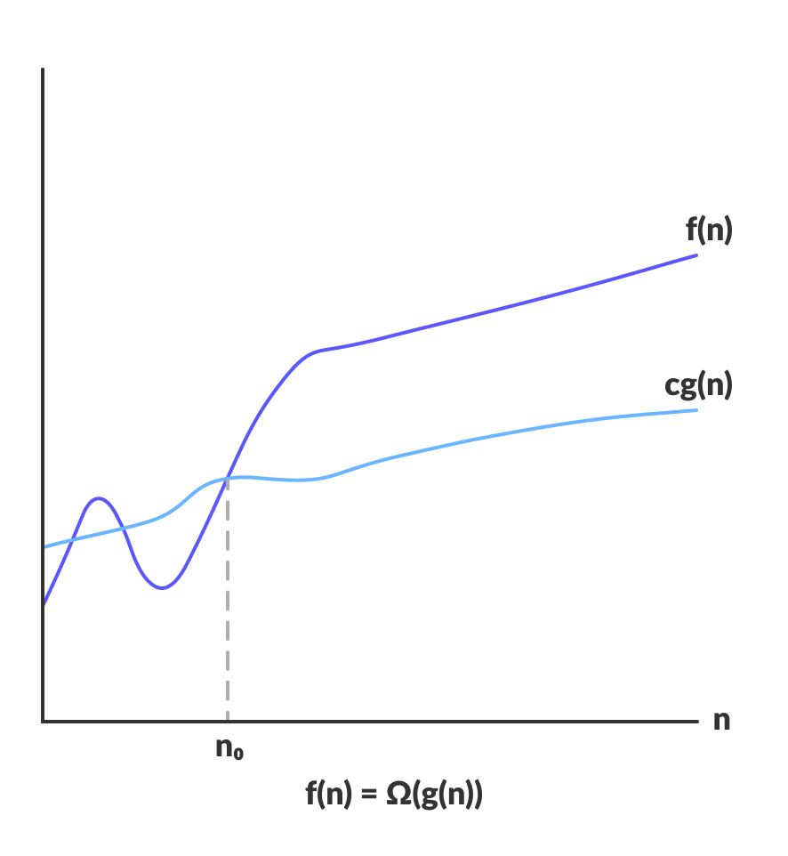
OMEGA NOTATION (Ω-NOTATION)
Omega notation represents the lower bound of the running time of an algorithm. Thus, it provides the best case complexity of an algorithm.
Ω(g(n)) = { f(n): there exist positive constants c and n0
such that 0 ≤ cg(n) ≤ f(n) for all n ≥ n0 }
The above expression can be described as a function f(n) belongs to the set Ω(g(n)) if there exists a positive constant c such that it lies above cg(n), for sufficiently large n.
For any value of n, the minimum time required by the algorithm is given by Omega Ω(g(n)).

Slide 24
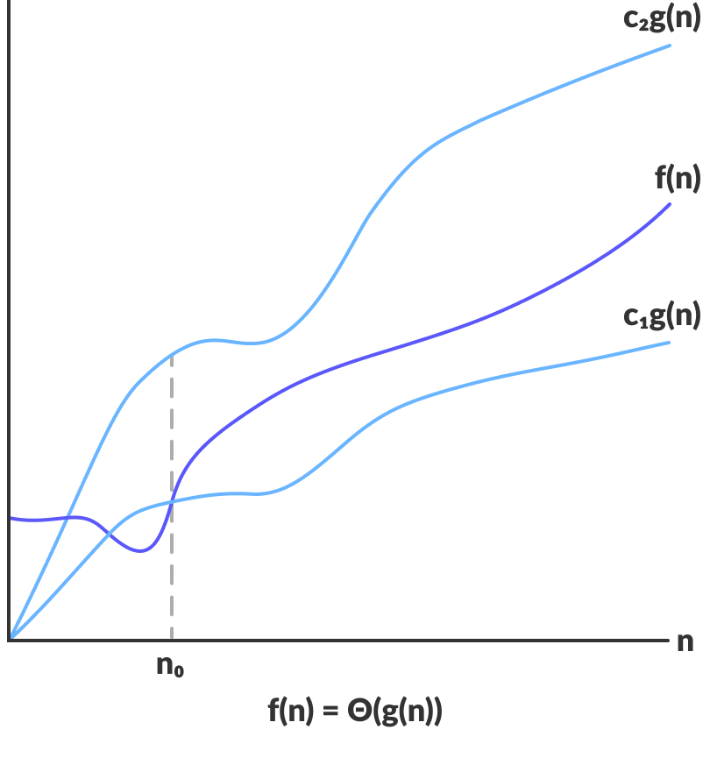
THETA NOTATION (Θ-NOTATION)
Theta notation encloses the function from above and below. Since it represents the upper and the lower bound of the running time of an algorithm, it is used for analyzing the average-case complexity of an algorithm.
Θ(g(n)) = { f(n): there exist positive constants c1, c2 and n0
such that 0 ≤ c1g(n) ≤ f(n) ≤ c2g(n) for all n ≥ n0 }
The above expression can be described as a function f(n) belongs to the set Θ(g(n)) if there exist positive constants c1 and c2 such that it can be sandwiched between c1g(n) and c2g(n), for sufficiently large n.
If a function f(n) lies anywhere in between c1g(n) and c2g(n) for all n ≥ n0, then f(n) is said to be asymptotically tight bound.

Slide 25
Analysis Framework
The Analysis Framework in Design and Analysis of Algorithms (DAA) is a structured approach used to evaluate how efficient an algorithm is in terms of time and space before actually implementing it (or independent of hardware and programming language). It provides a theoretical foundation to compare algorithms and predict their performance.
What is an Analysis Framework?
An analysis framework is a systematic method to:
Measure algorithm efficiency
Compare multiple algorithms solving the same problem
Predict performance for large inputs
Understand scalability
Instead of running code on a machine (which depends on hardware, compiler, etc.), the framework focuses on mathematical analysis.

Slide 26
Key Components of the Analysis Framework
Input Size (n)
The performance of an algorithm depends on the size of the input
Denoted by n
Examples:
Array → number of elements (n)
Matrix → number of rows/columns
Graph → number of vertices/edges
Basic Operation
A basic operation is the most important operation that contributes the most to execution time.
Examples:
Comparison (e.g., a[i] > a[j])
Assignment
Arithmetic operation
👉 Instead of counting all operations, we count how many times the basic operation executes.

Slide 27
Time Complexity
Time complexity measures how execution time grows with input size.
We express it using functions like:
T(n) = number of basic operations
Space Complexity
Space complexity measures memory usage:
Input space
Auxiliary space (extra memory used)

Slide 28
Types of Analysis in the Framework
Worst-Case Analysis
Maximum number of operations
Most commonly used
Guarantees performance
Example:
Linear search → element not found → O(n)
Best-Case Analysis
Minimum number of operations
Example:
Linear search → element found at first position → O(1)
Average-Case Analysis
Expected performance over all inputs
More realistic but harder to compute

Slide 29
Mathematical Modelling of Algorithms
The framework converts algorithms into mathematical expressions.
Example: Linear Search
for i = 0 to n-1:
if A[i] == key:
return i
Basic operation: comparison
Number of comparisons:
  Worst case: n Best case: 1
So: T(n) = n → O(n)
5. Growth of Functions
The framework focuses on how functions grow as n → ∞, ignoring constants.
Example:
3n² + 5n + 2 → O(n²)
10n + 50 → O(n)
👉 Only the dominant term matters.

Slide 30
Asymptotic Notations (Core Part)
These notations describe algorithm efficiency:
1 Big-O (Upper Bound)
Worst-case growth
2 Theta (Θ)
Tight bound (exact growth)
3 Omega (Ω)
Lower bound (best case)
Steps in Applying the Analysis Framework
Identify input size (n)
Choose basic operation
Count number of times it executes
Formulate T(n)
Simplify using asymptotic notation

Slide 31
Example: Nested Loop
for i = 1 to n:
for j = 1 to n:
print(i, j)
Basic operation: print
Executed n × n times
So:
T(n)=n²
👉 Time Complexity = O(n²)
Importance of Analysis Framework
Helps choose the best algorithm
Predicts performance for large data
Avoids inefficient implementations
Essential for optimization problems
Practical Insight
Two algorithms may work for small inputs, but:
Algorithm A → O(n)
Algorithm B → O(n²)
For large n:
A is significantly faster
👉 This is why analysis framework is critical.
Limitations
Ignores constants and lower-order terms
Assumes uniform cost of operations
Does not consider real-world factors like:
  Cache
  CPU architecture

Slide 32
Empirical Analysis of Algorithms
What is Empirical Analysis?
Empirical analysis (also called experimental analysis) evaluates an algorithm by actually implementing and running it on a computer.
Instead of theoretical estimation, we measure real performance.
Key Characteristics
Based on real execution
Depends on:
  Machine configuration (CPU, RAM)
  Programming language
  Compiler/interpreter
  Input data
Produces actual runtime and memory usage

Slide 33
Steps in Empirical Analysis
Implement the algorithm
Choose input datasets
  Best case
  Average case
  Worst case
Run the algorithm
Measure metrics
  Execution time
  Memory usage
Analyze results
  Plot graphs (Input size vs Time)
Example (Linear Search)
for i in range(n):
if arr[i] == key:
return i
Run for different values of n
Measure execution time
Observe:
  Time increases linearly → O(n)

Slide 34
Advantages
Reflects real-world performance
Easy to understand
Useful for comparing implementations
Limitations
Machine-dependent
Time-consuming
Cannot test all input sizes
Does not give general formula

Slide 35
Mathematical Analysis of Algorithms
What is Mathematical Analysis?
Mathematical analysis determines time and space complexity using mathematical models, without executing the algorithm.
Key Idea
Count:
Number of operations
Growth rate as input size increases
Types of Analysis
Worst case → Maximum time
Best case → Minimum time
Average case → Expected time
Asymptotic Notations
Big-O → Upper bound
Theta → Tight bound
Omega → Lower bound

Slide 36
Analysis of Non-Recursive Algorithms
Approach:
Count how many times each statement executes.
Example 1: Single Loop
for i in range(n):
print(i)
Executes n times
👉 Time Complexity = O(n)
Example 2: Nested Loops
for i in range(n):
for j in range(n):
print(i, j)
Inner loop runs n times for each i
Total = n × n = n²
👉 Time Complexity = O(n²)

Slide 37

Example 3: Triangular Loop
for i in range(n):
for j in range(i):
print(i, j)
Total operations:
👉 Time Complexity = O(n²)
General Rules
Sequential statements → Add complexities
Nested loops → Multiply complexities
Conditional statements → Consider worst case

Slide 38
Analysis of Recursive Algorithms
What is a Recursive Algorithm?
An algorithm that calls itself to solve smaller sub problems.
Key Tool: Recurrence Relation
We express time complexity using a recurrence.
Example 1: Factorial
def fact(n):
if n == 0:
return 1
return n * fact(n-1)
Recurrence:
T(n)=T(n−1)+1
Solution:
T(n)=O(n)

Slide 39
Empirical vs Mathematical Analysis
Feature | Empirical | Mathematical
Method | Run program | Analyze theoretically
Output | Actual time | Growth rate
Dependency | Machine dependent | Machine independent
Accuracy | Real-world | Generalized
Cost | High | Low
Recursive vs Non-Recursive Analysis
Feature | Non-Recursive | Recursive
Method | Loop counting | Recurrence relations
Complexity | Direct | Indirect
Tools | Summations | Master theorem, recursion tree
Difficulty | Easier | More complex

