Slide 1
Divide and Conquer

Slide 2
Divide and Conquer Approach
This is one of the popular approaches in which a problem is divided into smaller sub problems.
These sub problems are further divided into smaller sub problems until they can no longer be divided.
It is a top down approach in which the algorithm logically progresses from the initial instance down to the smallest sub-instances via intermediate sub-instances.
An algorithm, following divide & conquer technique, involves following steps:
Step 1. Divide the problem (top level) into a set of sub-problems (lower level).
Step 2. Solve every sub-problem individually by recursive approach.
Step 3. Merge the solution of the sub-problems into a complete solution of the problem.
Following are the examples of the problems that can efficiently be solved using divide and conquer approach.
Binary Search.
Quick Sort.
Merge Sort.
Strassen's Matrix Multiplication.

Slide 3

Basic Idea
The Divide and Conquer approach follows three main steps:
1. Divide
Break the given problem into smaller subproblems of the same type.
2. Conquer
Solve the sub problems recursively.
If the sub problem is small enough (base case), solve it directly.
3. Combine
Merge the solutions of the sub problems to get the final solution.
General Structure
A typical Divide and Conquer algorithm can be written as:
​ Where:
a = number of subproblems
n/b = size of each subproblem
f(n) = cost of dividing and combining

Slide 4
Advantages of Divide and Conquer
1. Efficiency
Reduces time complexity significantly
Often leads to logarithmic or n log n solutions
2. Simplicity
Breaks complex problems into simpler parts
3. Parallelism
Sub problems can be solved independently
Ideal for multi-core and distributed systems
4. Scalability
Works well for large inputs
Disadvantages
1. Recursion Overhead
Function calls consume memory (stack space)
2. Extra Space
Some algorithms (like Merge Sort) need additional memory
3. Not Always Optimal
Sometimes iterative solutions are faster (e.g., simple loops)

Slide 5
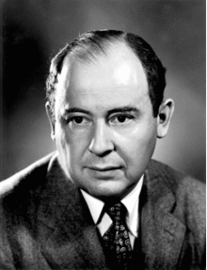
Merge Sort
Invented by John Von Neumann
Uses “Divide & Conquer” technique of sorting element i.e.,
  Divide up the numbers in the middle Sort each half recursively
  Merge the two sorted halves into one sorted output
Example of external sorting
One of most efficient sorting algorithm
Time Complexity is O(n log(n))

Slide 6
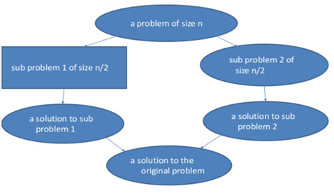
In terms or algorithms, this method has three distinct steps:
  Divide: If the input size is too large to deal with in a straightforward manner, divide the data into two or more disjoint subsets.
  Recursive: Use divide and conquer to solve the sub problems associated with the data subsets.
  Conquer: Take the solutions to the sub problems and “merge” these solutions into a solution for the original problem.

Slide 7
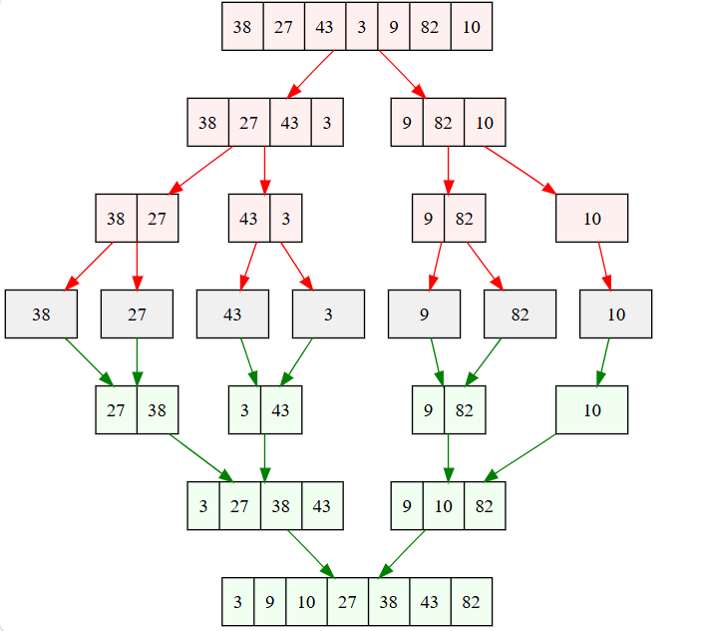

Slide 8
Merge Sort is a Divide and Conquer algorithm.
It divides the input array into two halves, calls itself recursively for the two halves, and then merges the two sorted halves.
MergeSort(arr[ ], l, r)
If l <= r
Find the middle point to divide the array into two halves: middle m = (l+ r)/2
Call mergeSort for first half:
mergeSort(arr, l, m)
Call mergeSort for second half:
  mergeSort(arr, m+1, r)
Merge the two halves sorted in step 2 and 3:
  merge(arr, l, m, r)

Slide 9
A merge() function is used for merging two halves.
The merge(arr, l, m, r) is a key process that assumes that arr[l..m] and arr[m+1..r] are sorted and merges the two sorted sub-arrays into one.
merge(arr[ ] , l , m , r)
// Copy data to temp arrays L[ ] and R[ ]
for (i = 0; i < n1; i++)
L[i] = arr[l + i]
for (j = 0; j < n2; j++)
R[j] = arr[m + 1 + j]
i = 0
j = 0
k = l

Slide 10
while ((i < n1) && (j < n2))
{
if (L[i] <= R[j])
{ arr[k] = L[i]
i++
}
else
{ arr[k] = R[j];
j++
}
k++
}

Slide 11
// Copy the remaining elements of L[ ], if there are any
while (i < n1)
{ arr[k] = L[i]
i++
k++
}
// Copy the remaining elements of R[ ], if there are any
while (j < n2)
{ arr[k] = R[j]
j++
k++
}

Slide 12

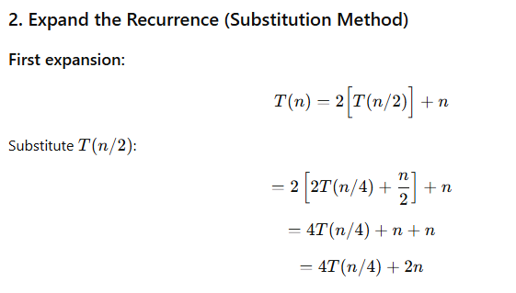
Time Complexity of Merge Sort

Slide 13
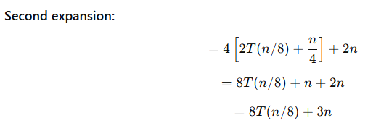
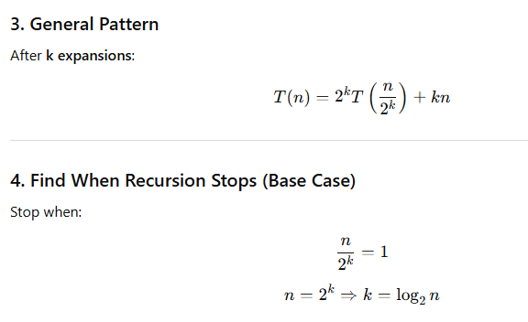

Slide 14
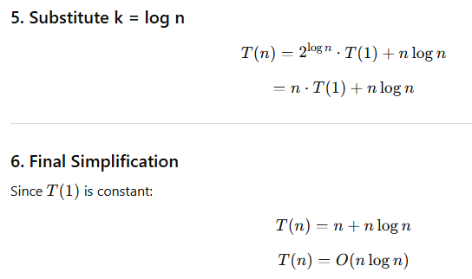

Slide 15
Quick Sort
Quick Sort is also based on the concept of Divide and Conquer, just like merge sort. But in quick sort all the heavy lifting(major work) is done while dividing the array into subarrays, while in case of merge sort, all the real work happens during merging the subarrays. In case of quick sort, the combine step does absolutely nothing.
Pivot Value: Assigns an arbitrary pivot value (left most or rightmost or any value in the middle)
Rest of the array is positions around the pivot value (by further breaking the array into smaller units)

Slide 16
Algorithm
Step 1: Choose the highest index value has pivot
Step 2: Take two variables to point left and right of the list excluding pivot
Step 3: left points to the low index
Step 4: right points to the high
Step 5: while value at left is less than pivot move right
Step 6: while value at right is greater than pivot move left
Step 7: if both step 5 and step 6 does not match swap left and right
Step 8: if left ≥ right, the point where they met is new pivot
  Assign a Pivot value to divide the array into two parts
  Quick sort left half of the pivot
  Quick sort right half of the pivot

Slide 17
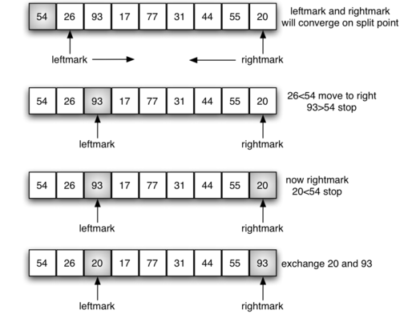
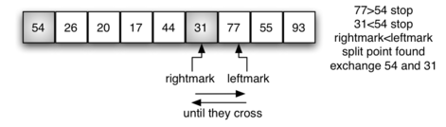

Slide 18
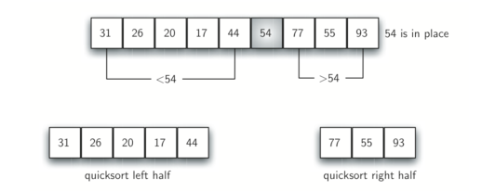

Slide 19
Quick_Sort( A, low, high)
Given an array a of high - low +1 elements, this procedure sorts the elements in the ascending order using the method described above. The variables low and high are used to identify the positions of the first and last elements in each partition.
Step 1: If ( low< high ) then
Step 2: Call Partition( A , low , high, pos)
Step 3: Call Quick_sort( A , low, pos -1 )
Step 4: Call Quick_sort( A , pos + 1, high)
Step 5: [EndIf]
Step 6: Exit

Slide 20
Step 1: x = a[ low]
Step 2: up = high
Step 3: down = low
Step 4: While ( down< up ) Do
Step 5: While ( a [ down] < = x) and ( down < high )Do
Step 6: down = down + 1
[End of Step 5 While loop]
Step 7: While ( a [ up] > x) Do
Step 8: up = up - 1
[End of Step 7 While loop]
Step 9: If ( down< up ) Then
Step 10: temp = a [ down ]
Step 11: a [ down ] = a[ up]
Step 12: a [ up] = temp
[EndIf]
[End of Step 4 While loop]
Step 13: a [ low ] = a [ up ]
Step 14. a [ up ] = x
Step 15: pos = up /* position to be returned */
Step 16: Exit

Slide 21
Analysis of Quick Sort
1. The elements of the array are distinct.
2. The partition element is chosen using a random selection process.
3. The proper position for the pivot element always turns out to be the middle of the sub array.
4. The array size is assumed to be a power of 2 , say n = 2 ^{m} or m = log 2 n.
O(n) = n + 2 * ( n / 2 ) + 4 * ( n / 4 ) + ...............+ n * ( n / n )
= n + n + n + ........................+ n ( m times )
= O ( n * m )
= O ( n log n)

Slide 22
Binary Search
Binary search is an efficient algorithm for finding an item from a sorted list of items.
Binary search algorithm works on the principle of divide and conquer
Binary search looks for a particular item by comparing the middle most item of the collection. Based on the comparison with middle item it moves searching towards left or right half.
Conditions to apply Binary Search Algorithm in a Data Structure
The array must be sorted.
Access to any element of the data structure should take constant time.
Binary Search Algorithm
Divide the search space into two halves by finding the middle index "mid".
Compare the middle of the search space with the key.
If the key is found at middle, the process is terminated.
If the key is not found at middle, choose which half will be used as the next search space.
If the key is smaller than the middle, then the left side is used for next search.
If the key is larger than the middle, then the right side is used for next search.
This process is continued until the key is found or the total search space is exhausted.

Slide 23
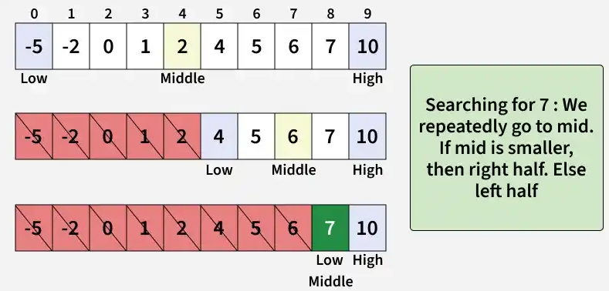

Slide 24
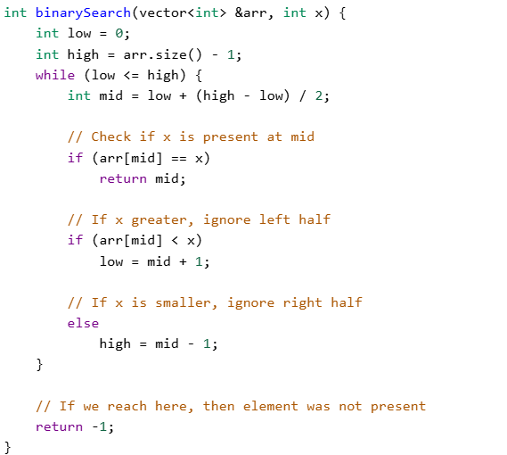
Algorithm
Step 1: LOW = 0
Step 2: HIGH = N - 1
Step 3: While (LOW <= HIGH) Do
Step 4: MID = (LOW + HIGH) / 2
Step 5: If (ele == A[MID]) Then
Step 6: return(MID)
Step 7: If (ele < A[MID]) Then
Step 8: HIGH = MID – 1
Else
Step 9: LOW = MID + 1
[End od Step While loop]
Step 10: return(-1)

Slide 25
Analysis
Since the binary search algorithm performs searching iteratively, calculating the time complexity is not as easy as the linear search algorithm.
The input array is searched iteratively by dividing into multiple sub-arrays after every unsuccessful iteration. Therefore, the recurrence relation formed would be of a dividing function.
To explain it in simpler terms
During the first iteration, the element is searched in the entire array. Therefore, length of the array = n.
In the second iteration, only half of the original array is searched. Hence, length of the array = n/2.
In the third iteration, half of the previous sub-array is searched. Here, length of the array will be = n/4.
Similarly, in the i^{th} iteration, the length of the array will become n/2^{i}

Slide 26
To achieve a successful search, after the last iteration the length of array must be 1.
Hence,
n/2i = 1
That gives us
n = 2i
Applying log on both sides,
log n = log 2i
log n = i. log 2
i = log n
The time complexity of the binary search algorithm is O(log n)

Slide 27
What You Need To Know About Binary Search
Binary search is an algorithm that finds the position of a target value within a sorted array.
A binary search cuts down the search to half as soon as the middle of a sorted list is found.
Binary search can be recursive or iterative method
In the binary search, the worst case scenario is O(Log₂n) number of similarities.
The best case scenario is to find the element in the middle position O(1). It occurs when the searching key is in the middle of the sorted list.
The time complexity of binary search is O(log₂n). Where n is the number of elements in the input range.

Slide 28
Strassen’s Matrix Multiplication
Strassen’s Matrix Multiplication is an advanced algorithm used to multiply two matrices faster than the traditional matrix multiplication method.
It was developed by Volker Strassen in 1969.
It is an important example of the Divide and Conquer technique in Design and Analysis of Algorithms.
Why do we need Strassen’s Algorithm?
Traditional Matrix Multiplication
For multiplying two n × n matrices, the normal method takes:
O(n³) because each element requires:
n multiplications
repeated for n² elements
So total operations:
n³
For large matrices, this becomes expensive.

Slide 29
Strassen’s Idea
Strassen reduced the number of recursive multiplications.
Instead of 8 multiplications, it uses 7 multiplications.
This reduces time complexity to:
O(n^{2.81}) which is faster for large matrices.

Slide 30
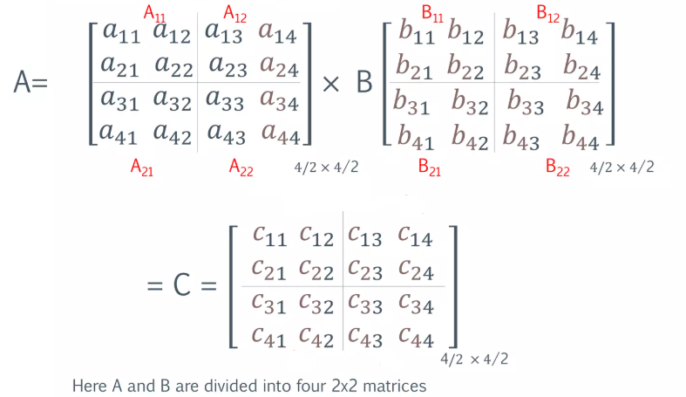
Divide and Conquer Approach

Slide 31
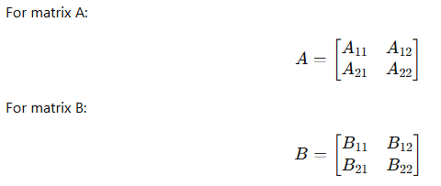
Divide and Conquer Approach
Strassen follows the three Divide and Conquer steps:
1. Divide
Split each matrix into 4 submatrices

Slide 32
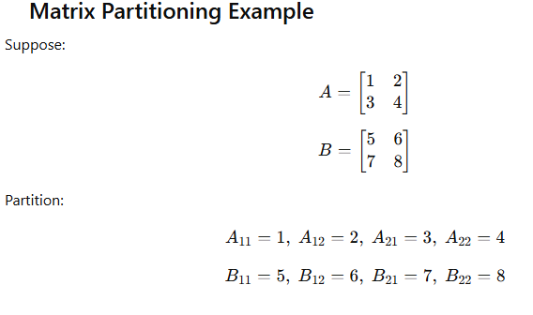
2. Conquer
Compute 7 products recursively.
3. Combine
Use those 7 products to build final result.

Slide 33
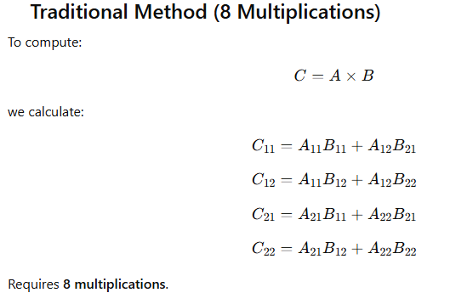

Slide 34
Strassen’s 7 Multiplications
Instead of 8 multiplications, compute:
M1
M1=(A₁₁+A₂₂)(B₁₁+B₂₂)
=(1+4)(5+8)=5×13=65
M2
M2=(A₂₁+A₂₂)B₁₁
=(3+4)×5=35
M3
M3=A₁₁(B₁₂−B₂₂)
=1(6−8)=−2
M4
M4=A₂₂(B₂₁−B₁₁)
=4(7−5)=8
M5
M5=(A₁₁+A₁₂)B₂₂
=(1+2)×8=24
M6
M6=(A₂₁−A₁₁)(B₁₁+B₁₂)
=(3−1)(5+6)=22
M7
M7=(A₁₂−A₂₂)(B₂₁+B₂₂)
=(2−4)(7+8)=−30

Slide 35
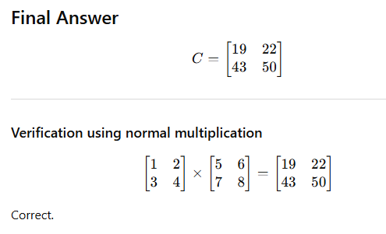
Compute Final Matrix
C₁₁
C₁₁ = M1+M4−M5+M7
= 65+8−24−30 = 19
C₁₂
C₁₂=M3+M5
=−2+24=22
C₂₁
C₂₁=M2+M4
=35+8=43
C₂₂
C₂₂=M1−M2+M3+M6 ​
=65−35−2+22=50

Slide 36
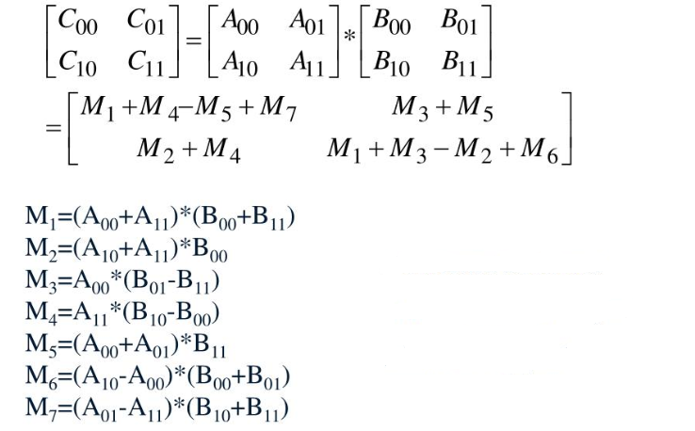

Slide 37

Time Complexity Calculation
At each recursion:
7 recursive multiplications + Matrix additions/subtractions: O(n²)
Recurrence relation:
T(n) = 7 T(n/2) + O(n²)
Using Master Theorem:
Where
a=7, b=2, f(n)=n²
Compute:
Since:
n² < n^{2.81}
T(n) = O(n^{2.81})

