Slide 1
Greedy

Slide 2
Greedy Algorithms
Greedy algorithms are a class of algorithms that make locally optimal choices at each step with the hope of finding a global optimum solution.
At every step of the algorithm, we make a choice that looks the best at the moment. To make the choice, we sometimes sort the array so that we can always get the next optimal choice quickly. We sometimes also use a priority queue to get the next optimal item.
After making a choice, we check for constraints (if there are any) and keep picking until we find the solution.
Greedy algorithms do not always give the best solution. For example, in coin change and 0/1 knapsack problems, we get the best solution using Dynamic Programming.

Slide 3
Greedy is an algorithmic paradigm that builds up a solution piece by piece, always choosing the next piece that offers the most obvious and immediate benefit. Greedy algorithms are used for optimization problems.
An optimization problem can be solved using Greedy if the problem has the following property:
At every step, we can make a choice that looks best at the moment, and we get the optimal solution to the complete problem.
Some popular Greedy Algorithms are Fractional Knapsack, Dijkstra’s algorithm, Kruskal’s algorithm, Huffman coding and Prim’s Algorithm
Also used to get an approximation for Hard optimization problems. For example, the Traveling Salesman Problem is an NP-Hard problem. A Greedy choice for this problem is to pick the nearest unvisited city from the current city at every step.
These solutions don't always produce the best optimal solution but can be used to get an approximately optimal solution.

Slide 4
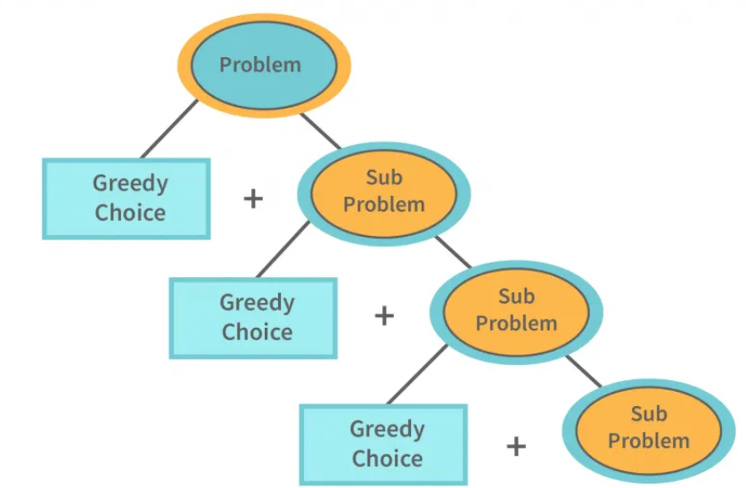

Slide 5
How does a Greedy Algorithm work?
Greedy Algorithm solve optimization problems by making the best local choice at each step in the hope of finding the global optimum. It's like taking the best option available at each moment, hoping it will lead to the best overall outcome.
Here's how it works:
Start with the initial state of the problem.
Consider all the options available at that specific moment.
Choose the option that seems best at that moment, regardless of future consequences. This is the "greedy" part, you take the best option available now, even if it might not be the best in the long run.
Move to the new state based on your chosen option. This becomes your new starting point for the next iteration.
Repeat steps 2-4 until you reach the goal state or no further progress is possible.

Slide 6
Example:
Let's say you have a set of coins with values [1, 2, 5, 10] and you need to give minimum number of coin to someone change for 39.
The greedy algorithm for making change would work as follows:
Step-1:Start with the largest coin value that is less than or equal to the amount to be changed. In this case, the largest coin less than or equal to 39 is 10.
Step- 2: Subtract the largest coin value from the amount to be changed, and add the coin to the solution. In this case, subtracting 10 from 39 gives 29, and we add one 10-coin to the solution.
Repeat steps 1 and 2 until the amount to be changed becomes 0.

Slide 7
Characteristics of Greedy Algorithm
Here are the characteristics of a greedy algorithm:
Greedy algorithms are simple and easy to implement.
They are efficient in terms of time complexity, often providing quick solutions. Greedy Algorithms are typically preferred over Dynamic Programming for the problems where both are applied. For example, Jump Game problem and Single Source Shortest Path Problem (Dijkstra is preferred over Bellman Ford where we do not have negative weights).
These algorithms do not reconsider previous choices, as they make decisions based on current information without looking ahead.

Slide 8
Prim’s Minimum Spanning Tree (MST)
1. Introduction
Robert C. Prim proposed Prim’s Algorithm in 1957 for finding the Minimum Spanning Tree (MST) of a weighted connected graph.
A Minimum Spanning Tree is a subset of edges in a connected weighted graph that:
Connects all vertices
Contains no cycles
Has minimum possible total edge weight

Slide 9
2. What is a Spanning Tree?
For a graph with V vertices:
A spanning tree contains:
  All vertices
  Exactly V − 1 edges
No cycles are allowed
If weights are assigned to edges, the spanning tree with the smallest total cost is called the Minimum Spanning Tree (MST).
3. Real-Life Applications of MST
Prim’s Algorithm is used in:
Network cable layout
Road and railway design
Electrical wiring
Water pipelines
Telecommunication networks
Cluster analysis in machine learning

Slide 10
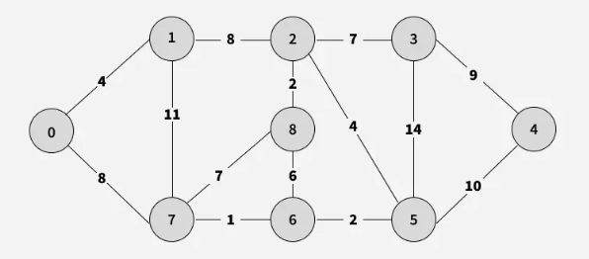
Prim’s Algorithm for Minimum Spanning Tree (MST)
Prim’s algorithm is a Greedy algorithm. This algorithm always starts with a single node and moves through several adjacent nodes, in order to explore all of the connected edges along the way.
The algorithm starts with an empty spanning tree.
The idea is to maintain two sets of vertices. The first set contains the vertices already included in the MST, and the other set contains the vertices not yet included.
At every step, it considers all the edges that connect the two sets and picks the minimum weight edge from these edges. After picking the edge, it moves the other endpoint of the edge to the set containing MST.

Slide 11
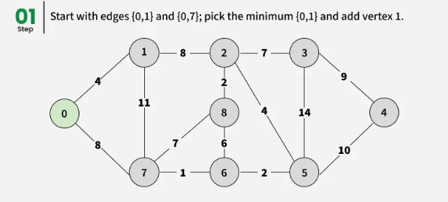
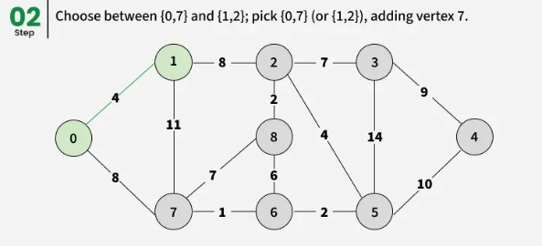
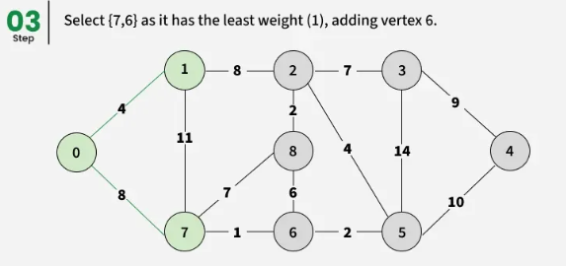
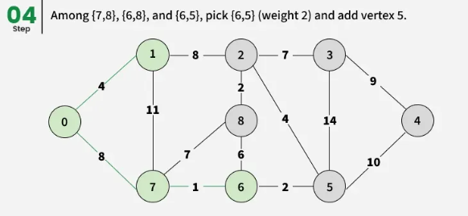
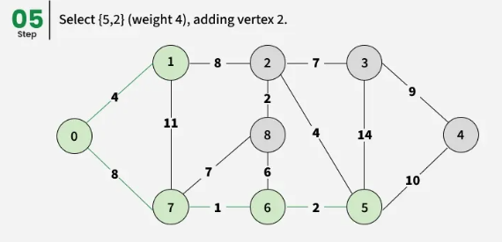
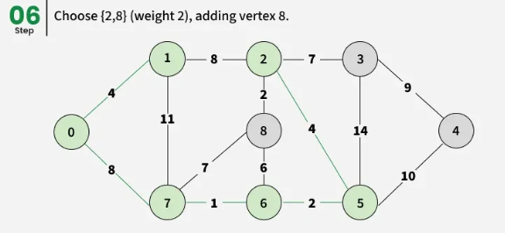

Slide 12
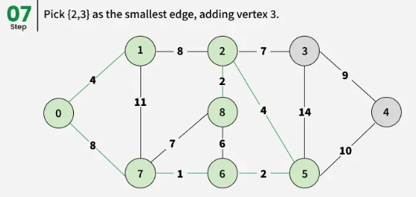
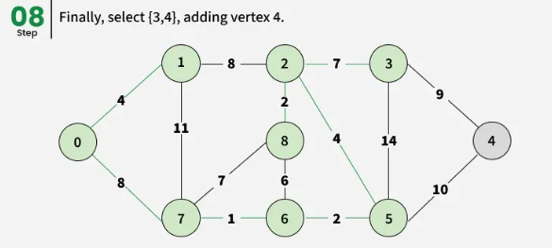
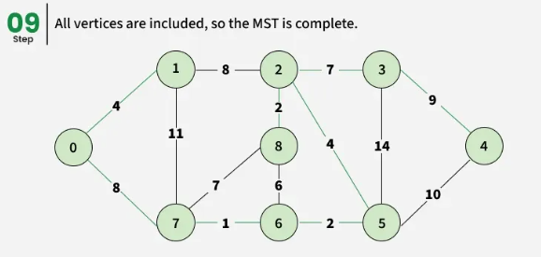
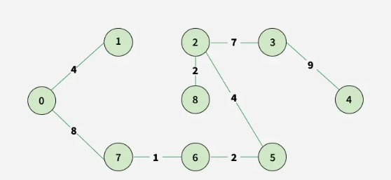

Slide 13
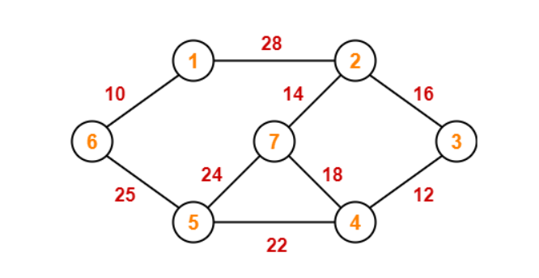
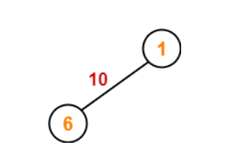
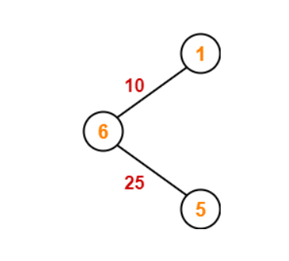
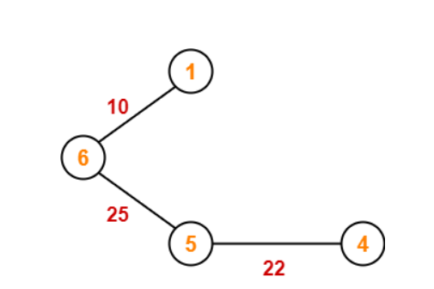
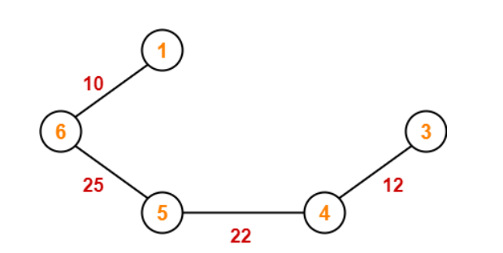

Slide 14
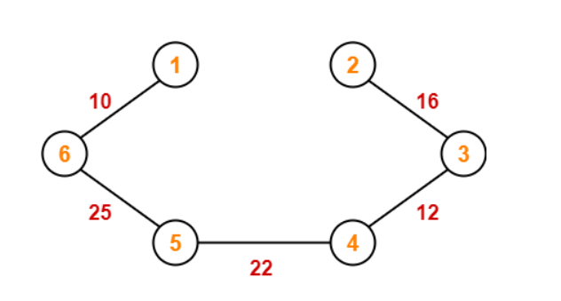
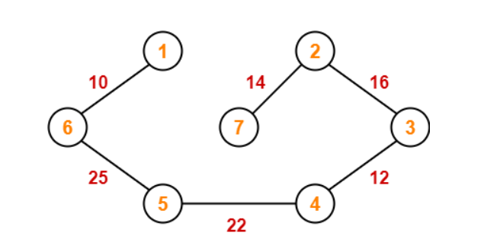
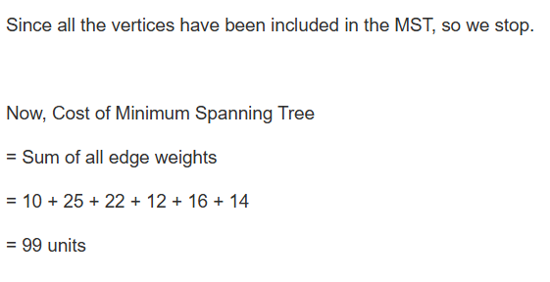

Slide 15
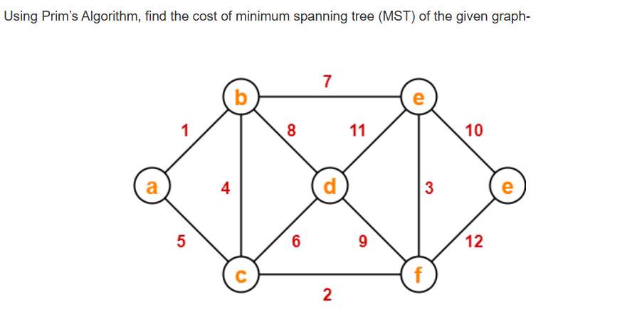

Slide 16
Prim's Algorithm
Create a set mstSet that keeps track of vertices already included in MST.
Assign a key value to all vertices in the input graph. Initialize all key values as INFINITE.
Assign the key value as 0 for the first vertex so that it is picked first.
While mstSet does not include all vertices
1. Pick a vertex u that is not there in mstSet and has a minimum key value.
2. Include u in the mstSet.
3. Update the key value of all adjacent vertices of u. To update the key values, iterate through all adjacent vertices. For every adjacent vertex v, if the weight of edge u-v is less than the previous key value of v, update the key value as the weight of u-v.
The idea of using key values is to pick the minimum weight edge from the cut. The key values are used only for vertices that are not yet included in MST, the key value for these vertices indicates the minimum weight edges connecting them to the set of vertices included in MST.

Slide 17
Kruskal’s Minimum Spanning Tree (MST) Algorithm
1. Introduction
Joseph Kruskal introduced Kruskal’s Algorithm in 1956 for finding the Minimum Spanning Tree (MST) of a connected weighted graph.
It is one of the most important Greedy Algorithms in graph theory.
2. Basic Idea of Kruskal’s Algorithm
Kruskal’s algorithm works by:
Sorting all edges in increasing order of weight
Selecting the smallest edge
Adding it if it does not create a cycle
Repeating until MST contains: V−1 edges.

Slide 18
A minimum spanning tree (MST) or minimum weight spanning tree for a weighted, connected, and undirected graph is a spanning tree (no cycles and connects all vertices) that has minimum weight. The weight of a spanning tree is the sum of all edges in the tree.
Below are the steps for finding MST using Kruskal's algorithm:
Sort all the edges in a non-decreasing order of their weight.
Pick the smallest edge. Check if it forms a cycle with the spanning tree formed so far. If the cycle is not formed, include this edge. Else, discard it. It uses the Disjoint Sets to detect cycles.
Repeat step 2 until there are (V-1) edges in the spanning tree.

Slide 19
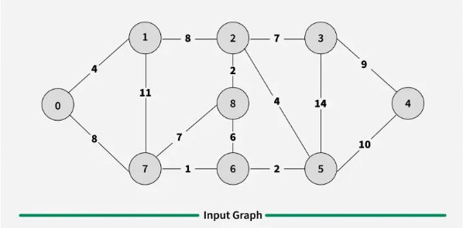
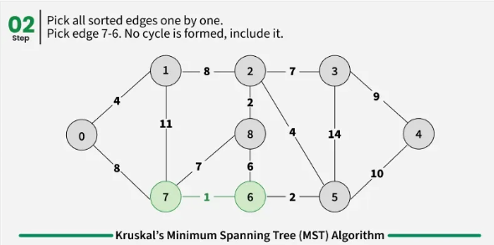
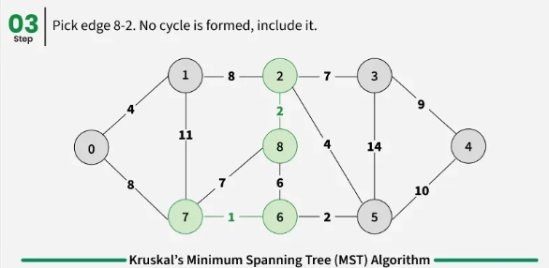
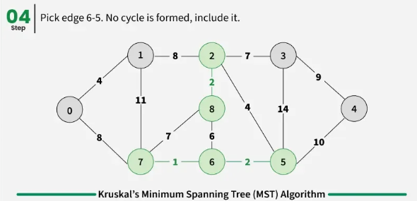
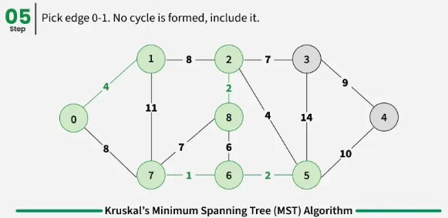
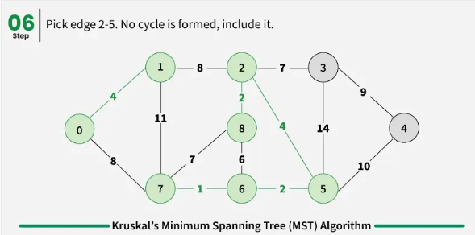

Slide 20
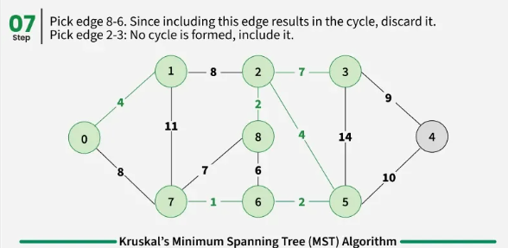
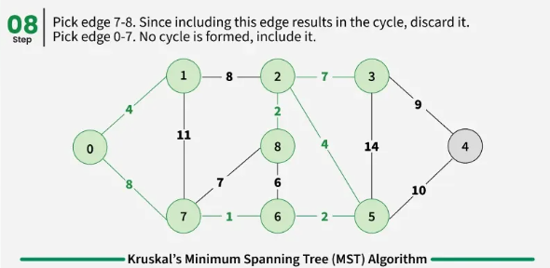
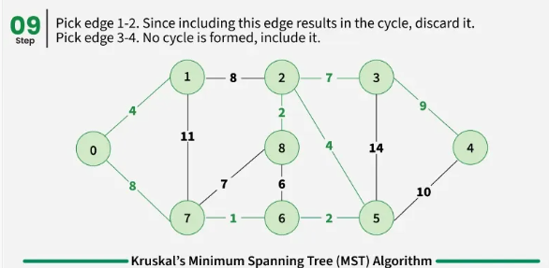
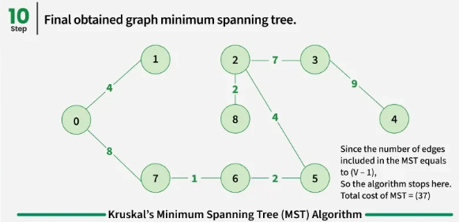

Slide 21
Time Complexity: O(E * log E) or O(E * log V)
Sorting of edges takes O(E*logE) time.
After sorting, we iterate through all edges and apply the find-union algorithm. The find and union operations can take at most O(logV) time.
So overall complexity is O(E*logE + E*logV) time.
The value of E can be at most O(V²), so O(logV) and O(logE) are the same. Therefore, the overall time complexity is O(E * logE) or O(E*logV)

Slide 22
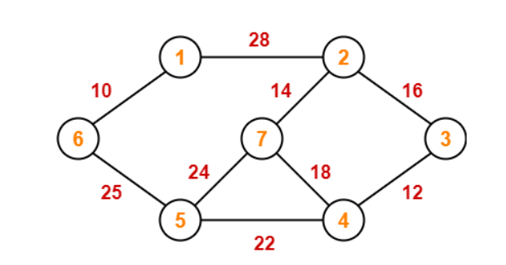
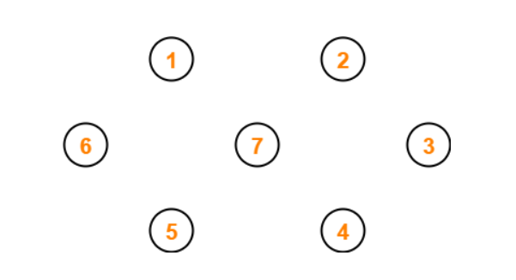
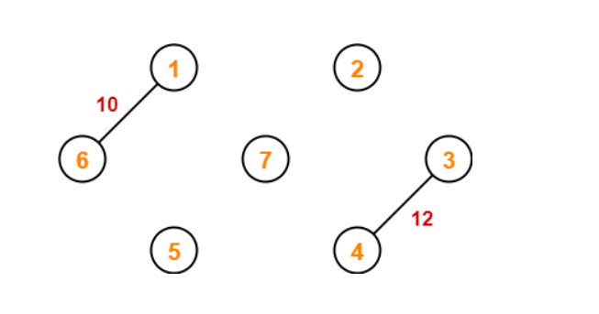
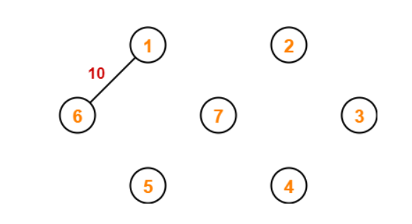

Slide 23
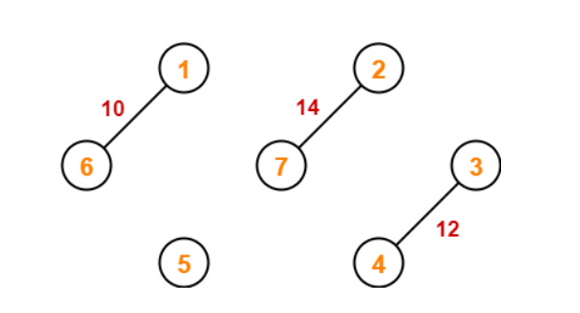
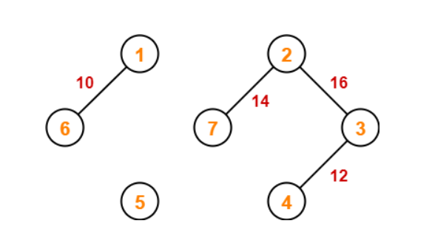
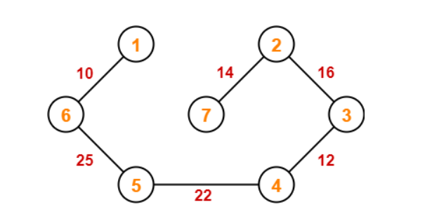
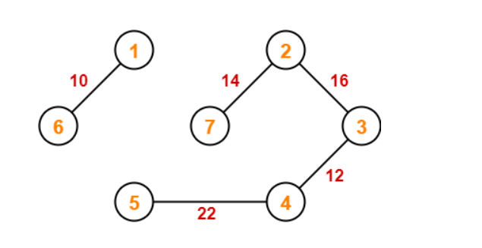
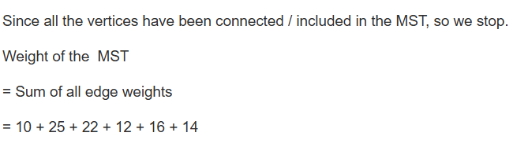

Slide 24
Dijkstra’s Shortest Path Algorithm
Edsger W. Dijkstra developed this algorithm in 1956. It is one of the most important greedy algorithms used to find the shortest path from a source vertex to all other vertices in a weighted graph.
It works only when all edge weights are non-negative.
What is the Purpose?
Dijkstra’s algorithm finds:
The shortest distance from a starting node to every other node
The actual shortest path
It is commonly used in: GPS navigation systems, Network routing protocols, Airline route optimization, Robotics path finding

Slide 25
Basic Idea
The algorithm works greedily.
At every step:
Choose the vertex with the smallest known distance
Mark it as visited
Update distances of its neighboring vertices
This process continues until all vertices are processed.
Working Principle
Suppose we are at a source node S.
Initially:
Distance to source = 0
Distance to all other vertices = ∞
Then repeatedly:
Select the nearest unvisited node
Relax all its edges

Slide 26
Relaxation means:
If going through current node gives a shorter path to a neighbor, update it.
Mathematically:
d[v] = min⁡(d[v], d[u]+w(u,v))
Where:
d[v] = shortest distance to vertex v
d[u] = shortest distance to vertex u
w(u,v) = weight of edge

Slide 27
Dijkstras Algorithm
The dijkstras algorithm is designed to find the shortest path between two vertices of a graph. These two vertices could either be adjacent or the farthest points in the graph. The algorithm starts from the source. The inputs taken by the algorithm are the graph G {V, E}, where V is the set of vertices and E is the set of edges, and the source vertex S. And the output is the shortest path spanning tree.
Algorithm
Declare two arrays, distance[] to store the distances from the source vertex to the other vertices in graph and visited[] to store the visited vertices.
Set distance[S] to 0 and distance[v] = ∞, where v represents all the other vertices in the graph.
Add S to the visited[] array and find the adjacent vertices of S with the minimum distance.
The adjacent vertex to S, say A, has the minimum distance and is not in the visited array yet. A is picked and added to the visited array and the distance of A is changed from ∞ to the assigned distance of A, say d₁, where d₁ < ∞.
Repeat the process for the adjacent vertices of the visited vertices until the shortest path spanning tree is formed.

Slide 28
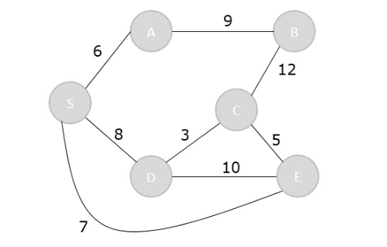
Step 1
Initialize the distances of all the vertices as ∞, except the source node S.
Vertex | S | A | B | C | D | E
Distance | 0 | ∞ | ∞ | ∞ | ∞ | ∞
Previous Node
Visited = {} UnVisited = {S,A,B,C,D,E}
Step 2
The vertex S has three adjacent vertices with various distances update all of them in the table and marks S as visited.
Vertex | S | A | B | C | D | E
Distance | 0 | 6 | ∞ | ∞ | 8 | 7
Previous Node |  | S |  |  | S | S
Visited = {S} UnVisited = {A,B,C,D,E}

Slide 29
Step 3
Among the unvisited vertices the vertex with minimum distance among them all is A. Hence, A is the next visited and the adjacent vertex of A is B and dist[B] is changed from ∞ to 15.
Vertex | S | A | B | C | D | E
Distance | 0 | 6 | 15 | ∞ | 8 | 7
Previous Node |  | S | A |  | S | S
Visited = {S,A} UnVisited = {B,C,D,E}

Slide 30
Step 4
Among the unvisited vertices the vertex with minimum distance among them all is E. Hence, Select E, Distance to E = 7
From E: E → C = 5 and E → D = 10
For C: 7+5=12 So: C = 12
For D: 7+10=17 But D already has distance 8, so we keep 8.
Vertex | S | A | B | C | D | E
Distance | 0 | 6 | 15 | 12 | 8 | 7
Previous Node |  | S | A | E | S | S
Visited = {S,A,E} UnVisited = {B,C,D}

Slide 31
Step 5
Smallest unvisited vertex = D Select D, Distance to D = 8
From D: To C 8+3=11 Previously C = 12. Since 11 < 12, update: C = 11
To E 8+10=18 But E already has distance 7. So no update.
Vertex | S | A | B | C | D | E
Distance | 0 | 6 | 15 | 11 | 8 | 7
Previous Node |  | S | A | D | S | S
Visited = {S,A,E,D}
UnVisited = {B,C}
Step 6
Smallest unvisited vertex = C Distance to C = 11
From C: To B: 11+12=23 But B already has distance 15. Therefore, no update.
To E 11+10=21 But E already has distance 7. So no update.
Vertex | S | A | B | C | D | E
Distance | 0 | 6 | 15 | 11 | 8 | 7
Previous Node |  | S | A | D | S | S
Visited = {S,A,C,D,E}
UnVisited = {B}

Slide 32
Step 7
Recalculate the distances of unvisited vertices and if the distances minimum than existing distance is found, replace the value in the distance array.
S → B = S → A + A → B = 6 + 9 = 15
S → B = S → D + D → C + C → B = 8 + 3 + 12 = 23
dist[B] = minimum (15,23) = 15
Vertex | S | A | B | C | D | E
Distance | 0 | 6 | 15 | 11 | 8 | 7
Previous Node |  | S | A | E | S | S
Visited = {S,A,B,C,D,E}
UnVisited = {}

Slide 33
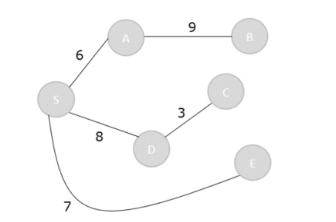
Step 6
Finally
Visited = {S, A, B, C,D, E}

