Slide 1
Cloud Computing
Cloud computing is a technology that provides computing resources such as servers, storage, databases, networking, software, and analytics over the Internet instead of relying on local computers or on-premises infrastructure.
It enables organizations and individuals to access these resources on demand without purchasing or maintaining expensive hardware.

Slide 2
Advantages of Cloud Computing
Cost savings (pay-as-you-use)
Scalability and flexibility
Access from anywhere
High availability
Automatic updates
Backup & disaster recovery
Easy collaboration
Rapid deployment
Better performance
Supports remote work

Slide 3
Disadvantages of Cloud Computing
Internet dependency
Security risks
Privacy concerns
Possible downtime
Vendor lock-in
Limited infrastructure control
Compliance issues
Performance variability
Unexpected costs
Data transfer limitations

Slide 4
Advantages vs Disadvantages
Advantages:
• Lower cost
• Scalable
• Accessible
• Reliable
Disadvantages:
• Internet required
• Security/privacy
• Downtime
• Vendor lock-in

Slide 5
Parallel Computing vs Distributed Computing
Parallel and distributed computing helps in handling large data and complex tasks in modern computing.
Both divide tasks into smaller parts to improve speed and efficiency.
Parallel computing uses multiple processors within a single system.
Distributed computing uses multiple independent machines over a network.

Slide 6
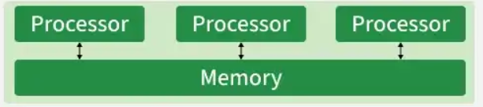
Parallel Computing
It is an approach where multiple processors execute parts of a task in a single connected system to reduce execution time.
It uses multi-core CPUs and multiprocessors.
Mostly follows a shared memory model.
Processors are connected with high-speed interconnections.
Tasks are executed simultaneously to improve speed.

Slide 7
Real-World Examples
Scientific simulations (weather forecasting, space research).
Image and video processing systems.
High-performance computing (HPC) clusters.
Graphics processing using GPUs.
Advantages
Faster Computation: Reduced overall execution time by dividing tasks and processing them at the same time.
Efficient CPU Utilization: Multiple processors are used effectively instead of remaining idle.
Lower Communication Overhead: Communication is faster, since processors are closely connected.
Improved Throughput: Multiple operations can be completed in a shorter time frame.
Disadvantages
Limited Scalability: Adding more processors beyond a limit does not significantly improve performance.
Complex Synchronization: Managing shared memory requires handling race conditions and deadlocks.
Expensive Hardware: High-performance processors and interconnects increase system cost.
Single Point of Failure: If the main system fails, all parallel processes stop.

Slide 8
Distributed Computing
It is a model where multiple independent computers work together over a network to achieve a common goal while coordinating through software communication.
Consists of multiple independent machines connected via a network.
Communication occurs through message passing.
Each node has its own local memory and processing power.

Slide 9
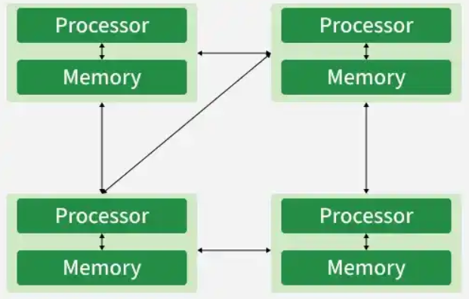

Slide 10
Real-World Examples
Cloud computing platforms (AWS, Azure).
Distributed databases (MongoDB).
Web applications running on multiple servers.
Online multiplayer games and streaming services.
Advantages
High Scalability: New nodes can be added easily to handle increased workload (horizontal scaling).
Better Fault Tolerance: If one node fails, other nodes can continue operating without stopping the entire system.
Cost-Effective: Uses commodity hardware instead of expensive high-end machines.
Geographic Distribution Support: Systems can operate across multiple locations worldwide.
High Availability: Services remain accessible even during partial failures.
Disadvantages
Network Dependency: System performance heavily relies on network reliability and speed.
Higher Latency: Communication over a network is slower compared to shared memory systems.
Complex Consistency Management: Maintaining data consistency across multiple nodes is difficult.
Security Challenges: More vulnerable to cyber threats due to network exposure.
Difficult Debugging and Monitoring: Diagnosing issues across multiple machines is complex

Slide 11
Elements of Parallel Computing
Parallel computing involves executing multiple computations simultaneously to improve performance. The fundamental elements are:
1. Parallelism
Simultaneous execution of multiple tasks.
Improves computational speed and throughput.
Types:
  Data Parallelism – Same operation on different data.
  Task Parallelism – Different tasks executed concurrently.
2. Processing Elements (PEs)
Individual computing units such as CPU cores, GPUs, or processors.
Each PE performs part of the overall computation.

Slide 12
3. Task Decomposition
Breaking a large problem into smaller independent tasks.
Allows multiple processors to work simultaneously.
4. Load Balancing
Even distribution of workload among processors.
Prevents some processors from being idle while others are overloaded.
5. Communication
Exchange of data between processors.
Methods:
  Shared Memory
  Message Passing

Slide 13
6. Synchronization
Coordinates execution among processors.
Prevents data inconsistencies and race conditions.
Common techniques:
  Locks
  Semaphores
  Barriers
  Mutex
7. Memory Architecture
Shared Memory: All processors access the same memory.
Distributed Memory: Each processor has its own local memory.
8. Scalability
Ability to maintain performance as processors increase.
Types:
  Strong Scalability
  Weak Scalability

Slide 14
9. Performance Metrics
Speedup (S) = Sequential Execution Time / Parallel Execution Time
Efficiency (E) = Speedup / Number of Processors
Throughput = Number of tasks completed per unit time
10. Parallel Programming Models
OpenMP
MPI (Message Passing Interface)
OpenCL (Open Computing Language)
Pthreads (POSIX-portable Operating System Interface)

Slide 15
Elements of Distributed Computing
Distributed computing consists of multiple independent computers connected through a network that work together as a single system.
1. Distributed Nodes
Independent computers connected through a network.
Each node has its own processor and memory.
2. Network Communication
Nodes communicate using:
  TCP/IP
  HTTP
  RPC (Remote Procedure Call)
  REST APIs
  gRPC

Slide 16
3. Resource Sharing
Sharing of files, databases, applications, and computing resources across nodes.
4. Transparency
Users perceive the distributed system as a single system.
Access Transparency
Location Transparency
Migration Transparency
Replication Transparency
Failure Transparency
5. Concurrency
Multiple users and applications execute simultaneously across different nodes.
6. Fault Tolerance
System continues functioning despite node or network failures.
Techniques:
  Replication
  Backup
  Checkpointing
  Failover

Slide 17
Fault Tolerance Techniques
Concept | Purpose | Benefit | Example
Replication | Maintain multiple copies of data/services | High availability and fault tolerance | Database replicated across multiple servers
Backup | Create recoverable copies of data | Data recovery after loss or corruption | Daily database backup to cloud storage
Checkpointing | Save application/process state periodically | Resume execution after failure | Simulation resumes from last checkpoint
Failover | Automatically switch to a standby system | Continuous service during failures | Secondary server takes over when primary fails

Slide 18
7. Scalability
Easily adds more machines without major redesign.
Types:
  Horizontal Scaling
  Vertical Scaling
8. Distributed Data Management
Data stored across multiple machines.
Supports:
  Replication
  Partitioning (Sharding)
  Consistency Management
9. Security
Authentication
Authorization
Encryption
Secure Communication
Access Control

Slide 19
10. Middleware
Software layer that enables communication and coordination among distributed components.
Examples:
Apache Kafka
RabbitMQ
CORBA
Java RMI
11. Time and Clock Synchronization
Maintains consistent timing among distributed nodes.
Methods:
  Network Time Protocol (NTP)
  Logical Clocks
  Lamport Timestamps
12. Distributed Algorithms
Algorithms designed for coordination among nodes.
Examples:
Leader Election
Consensus Algorithms (Raft, Paxos)
Distributed Mutual Exclusion

Slide 20
Parallel Computing vs. Distributed Computing
Feature | Parallel Computing | Distributed Computing
Definition | Multiple processors execute tasks simultaneously within one system | Multiple computers collaborate over a network
Memory | Shared or distributed | Separate memory on each node
Communication | High-speed internal communication | Network-based communication
Goal | Increase computational speed | Resource sharing, scalability, and reliability
Coupling | Tightly coupled | Loosely coupled
Failure Impact | Failure of one processor may affect the system | Other nodes can continue operating despite failures
Examples | Multi-core CPU, GPU, Supercomputer | Cloud Computing, Hadoop Cluster, Distributed Databases

Slide 21
Technologies for Distributed Computing
Distributed computing relies on various technologies, frameworks, and tools to enable multiple computers to work together efficiently. The major technologies include:
1. Remote Procedure Call (RPC)
Enables a program to execute procedures on a remote system as if they were local.
Examples: gRPC, XML-RPC, JSON-RPC.
2. Remote Method Invocation (RMI)
Java-specific technology for invoking methods on remote Java objects.
Supports object-oriented distributed applications.
3. Web Services
Enable communication between heterogeneous systems over the Internet.
Types:
  SOAP (Simple Object Access Protocol)
  UDDI

Slide 22
4. Message-Oriented Middleware (MOM)
Facilitates asynchronous communication between distributed applications.
Examples:
  RabbitMQ
  Apache Kafka
  ActiveMQ
5. Distributed File Systems (DFS)
Store and manage data across multiple machines.
Examples:
  Hadoop Distributed File System (HDFS)
  Google File System (GFS)
  Ceph
  GlusterFS
6. Service-Oriented and Microservices Technologies
Build distributed applications as independent services.
Examples:
  Spring Boot
  Spring Cloud

Slide 23
7. Grid Computing
Shares geographically distributed computing resources.
Examples:
  Globus Toolkit
  BOINC
8. Cloud Computing Platforms
Provide scalable distributed infrastructure over the Internet.
Examples:
  Amazon Web Services (AWS)
  Microsoft Azure
  Google Cloud Platform (GCP)
9. Blockchain Technology
Provides decentralized, distributed ledgers for secure transactions.
Examples:
  Hyperledger Fabric
  Ethereum
  Corda

Slide 24
10. Edge and Fog Computing
Process data closer to the source, reducing latency.
Examples:
  AWS IoT Greengrass
  Azure IoT Edge
  Cisco IOx
11. Distributed Databases
Store data across multiple servers while ensuring consistency and availability.
Examples:
  Cassandra
  MongoDB
  CockroachDB
  Amazon DynamoDB
12. Distributed Caching
Improves application performance by storing frequently accessed data.
Examples:
  Redis Cluster
  Memcached

Slide 25
Role of Distributed Computing in cloud environment
Distributed computing is a computing paradigm in which multiple independent computers (called nodes) work together over a network to achieve a common objective. These systems share resources, divide workloads, and communicate with each other to solve complex computational problems efficiently.
Distributed computing is widely used in cloud computing, big data analytics, IoT, artificial intelligence, scientific simulations, and enterprise applications.

Slide 26
Cluster Computing
Cluster computing is a distributed computing technology where multiple
interconnected computers work together as a single system.
Each computer (node) contributes its processing power to execute a task.
Architecture
+----------------------+
| Master Node |
+----------+-----------+
|
-----------------------------------------
| | | |
+------------+ +------------+ +------------+ +------------+
| Worker 1 | | Worker 2 | | Worker 3 | | Worker 4 |
+------------+ +------------+ +------------+ +------------+
Features
  High performance computing
  Parallel execution
  Load balancing
  Fault tolerance
  Resource sharing

Slide 27
Advantages
  Faster execution
  Cost-effective
  Easy scalability
  High availability
Applications
  Weather forecasting
  Scientific simulations
  Financial modeling
  Machine learning

Slide 28
Grid Computing
Grid computing connects geographically distributed computers to solve large
computational problems. Resources belong to different organizations and collaborate
through the Internet.
Architecture
Organization A | ------------ | | Node1 Node2 \ / \ / Internet/Grid / \ / \ Node3 Node4 | | Organization B
Features
Distributed ownership
Resource sharing
Heterogeneous systems
Dynamic resource allocation
Advantages
Better resource utilization
Low infrastructure cost
Supports large-scale computing
Applications
Research laboratories
Medical research
Engineering simulations
Space research

Slide 29
Cloud Computing
Cloud computing delivers computing services over the Internet.
Resources such as servers, storage, networking, and software are provided on
demand.
Users | Internet | +-------------------+ | Cloud Provider | +-------------------+ | | | Compute - Storage - Database
Service Models
Infrastructure as a Service (IaaS)
  Virtual machines
  Storage
  Networking
Examples:
  AWS EC2
  Microsoft Azure VM

Slide 30
Platform as a Service (PaaS)
    Application development environment
    Runtime platform
Examples:
    Google App Engine
    Azure App Service
Software as a Service (SaaS)
    Ready-to-use software
Examples:
    Gmail
    Microsoft 365

Slide 31
Hadoop Ecosystem
Hadoop is an open-source framework for storing and processing large datasets
across distributed clusters.
Hadoop | ------ | | HDFS MapReduce | | Distributed Storage Distributed Processing
HDFS
  Stores large files
  Replicates data
  Fault tolerant
MapReduce
  Map Phase
  Shuffle Phase
  Reduce Phase
Advantages
  Handles petabytes of data
  Fault tolerant
  Scalable
Applications
  Search engines
  Data mining
  Social media analytics

Slide 32
Cloud Computing
Cloud computing is a computing paradigm that delivers IT resources such as servers, storage, databases, networking, software, and analytics over the Internet on a pay-as-you-go basis. Instead of owning and maintaining physical infrastructure, users can access computing resources whenever required from cloud service providers.
Features
  On-demand self-service
  Broad network access
  Resource pooling
  Rapid elasticity
  Measured service
  High availability
  Scalability
  Cost efficiency

Slide 33
Advantages and Applications
Advantages
  Reduced infrastructure cost
  Faster deployment
  Improved collaboration
  Automatic software updates
  Enhanced disaster recovery
  Global accessibility
Applications
  Google Drive
  Microsoft Azure
  Amazon Web Services (AWS)
  Dropbox
  Salesforce
  Netflix
  Zoom

Slide 34
Building Cloud Computing Environments
A cloud environment consists of hardware, virtualization software, networking, storage systems, management software, and applications working together to deliver cloud services.
Components
1. Physical Infrastructure
Includes:
  Servers
  Storage devices
  Network equipment
  Data centers
2. Virtualization Layer
Creates multiple virtual machines from one physical server.
Examples:
  VMware
  Hyper-V
  KVM
  Xen

Slide 35
3. Cloud Operating System
Manages cloud resources.
Examples:
  OpenStack
  CloudStack
  OpenNebula
4. Storage Systems
  Object Storage
  Block Storage
  File Storage
5. Networking
Provides secure communication using:
  Virtual Networks
  Load Balancers
  Firewalls
  VPN

Slide 36
6. Management Layer
Responsible for:
  Resource allocation
  Monitoring
  Billing
  Security
  User management
7. Applications
Applications delivered to users through cloud platforms.
Examples:
  Gmail
  Office 365
  Google Docs

Slide 37
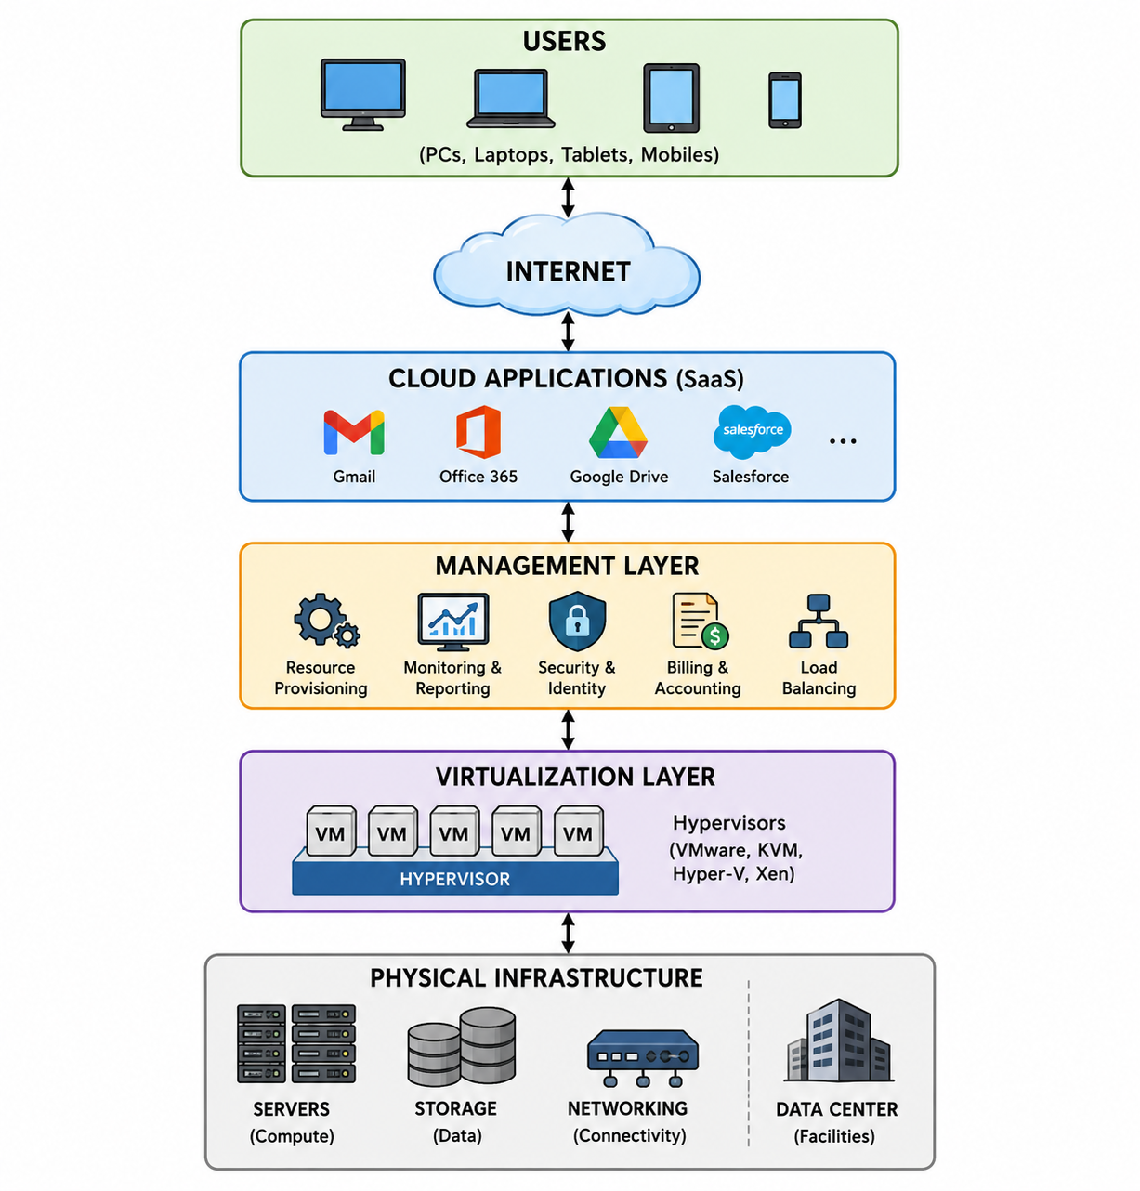

Slide 38
UNIT II

Slide 39
Fundamental Concepts and Models
Cloud concepts form the foundation for understanding Cloud Computing and explain how cloud services are designed, delivered, managed, and consumed.
1. Roles and Boundaries
Cloud computing involves different stakeholders with clearly defined responsibilities.
Major roles:
Cloud Provider: Owns and manages cloud infrastructure and provides computing services.
Cloud Consumer: Uses cloud services such as storage, applications, platforms, or virtual machines.
Cloud Broker: Acts as an intermediary between providers and consumers and may help select, integrate, or manage services.

Slide 40
Fundamental Concepts and Models
Cloud Auditor: Independently evaluates security, performance, compliance, and service operations.
Cloud Carrier: Provides network connectivity through which cloud services are accessed.
Cloud boundaries define which resources and responsibilities are controlled by the provider and which remain with the consumer.
For example, in SaaS, the provider manages almost everything, while the consumer mainly manages application usage and data.

Slide 41
Cloud Computing Roles — One Real time example
Example: A University Uses a Cloud-Based Learning Management System (LMS)
Suppose Cloud University uses a cloud-based LMS where teachers upload study materials, conduct online classes, and students submit assignments.
The complete cloud environment can be represented as:
University → Cloud Carrier → Cloud Provider → Cloud Services
The different roles are:

Slide 42
1. Cloud Provider
The Cloud Provider owns and manages the cloud infrastructure and provides computing services to the university.
Example: A cloud service provider hosts ABC University's LMS on its cloud servers.
The provider manages:
Physical servers
Data centers
Storage
Networking
Virtual machines
Backup
Infrastructure security
Availability
In our example: The cloud provider hosts the university's LMS and makes it available through the Internet.

Slide 43
The Cloud Consumer is the organization or user that consumes the cloud services.
Example: ABC University is the cloud consumer because it uses the cloud-hosted LMS.
The university uses the service for:
Uploading course materials
Managing students
Conducting online classes
Collecting assignments
Storing academic data
Teachers and students are end users of the cloud service.

Slide 44
The Cloud Broker acts as an intermediary between the university and cloud provider.
Suppose ABC University does not have sufficient expertise to select the most suitable cloud service. A cloud broker can:
Compare different cloud providers
Select suitable services
Negotiate pricing
Integrate cloud services
Help manage multiple cloud services
Example: A cloud consulting company helps ABC University select a suitable cloud provider and configure the LMS environment.

Slide 45
The Cloud Auditor independently evaluates the cloud environment.
For ABC University, the auditor may verify:
Whether student data is properly protected
Whether security controls are implemented
Whether the provider meets compliance requirements
Whether backup and recovery mechanisms work
Whether the agreed service levels are being maintained
Example: An independent security auditing organization examines the cloud environment and reports whether the university's student data is adequately protected.

Slide 46
The Cloud Carrier provides the network connectivity between ABC University and the cloud provider.
Example: ABC University uses an Internet connection provided by Airtel, Jio, or BSNL to access the cloud-hosted LMS.
The carrier provides:
Internet connectivity
Network bandwidth
Data transmission
Reliable communication between the university and cloud infrastructure

Slide 47
Role | Responsibility | Example in LMS
Cloud Provider | Provides cloud infrastructure/services | Hosts the LMS
Cloud Consumer | Uses cloud services | ABC University
Cloud Broker | Helps select/integrate/manage services | Cloud consulting company
Cloud Auditor | Checks security, compliance and performance | Independent auditing organization
Cloud Carrier | Provides network connectivity | Airtel/Jio/BSNL Internet

Slide 48
Cloud Characteristics
Cloud computing has several fundamental characteristics:
On-Demand Self-Service – Users can provision computing resources whenever required without direct human interaction with the provider.
Broad Network Access – Services are accessible through networks using standard devices and protocols.
Resource Pooling – Provider resources are shared among multiple consumers using virtualization and dynamic allocation.
Rapid Elasticity – Resources can be rapidly increased or decreased according to workload.
Measured Service – Resource usage is monitored and measured, enabling pay-per-use or subscription-based billing.
Example: An e-commerce application can automatically obtain additional computing resources during a festival sale and release them after demand decreases.

Slide 49
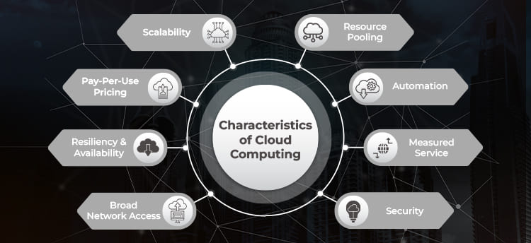

Slide 50
Cloud Delivery Models
Cloud delivery models describe how cloud computing services are provided to users. The three major delivery models are:
1. Infrastructure as a Service (IaaS)
IaaS provides fundamental computing infrastructure such as:
Virtual machines
Servers
Storage
Networks
Firewalls
The cloud provider manages the physical infrastructure, while the customer manages the operating system, applications, and data.
Examples: Amazon EC2, Microsoft Azure Virtual Machines, Google Compute Engine.
Use: Suitable for organizations that need flexible infrastructure without purchasing physical hardware.

Slide 51
2. Platform as a Service (PaaS)
PaaS provides a complete development and deployment environment. Developers can develop, test, and deploy applications without managing the underlying hardware and operating system.
Components include:
Operating environment
Databases
Development tools
Runtime environments
Middleware
Examples: Google App Engine, Microsoft Azure App Service.
Use: Suitable for software developers who want to focus mainly on application development.

Slide 52
3. Software as a Service (SaaS)
SaaS provides complete software applications through the internet. Users generally access the application through a web browser without installing or maintaining the underlying software infrastructure.
Examples:
Gmail
Microsoft 365
Salesforce
Google Workspace
Use: Suitable for end users and organizations that need ready-to-use software applications.

Slide 53
Feature | IaaS | PaaS | SaaS
Provides | Infrastructure | Development platform | Complete software
User manages | OS, applications, data | Applications and data | Mainly application usage/data
Flexibility | High | Medium | Low
Technical expertise | High | Medium | Low
Example | AWS EC2 | Google App Engine | Microsoft 365
Main users | System administrators | Developers | End users

Slide 54
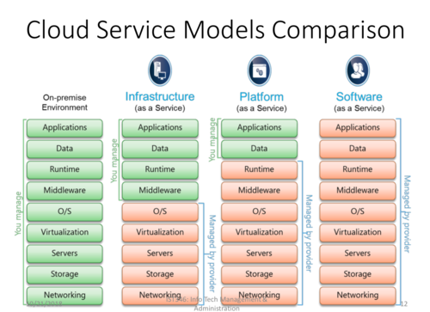

Slide 55
Types of Cloud Computing
Cloud computing can mainly be classified based on deployment models. There are four major types:
1. Public Cloud
A public cloud is a cloud infrastructure provided by a third-party service provider and shared among multiple customers.
Examples: AWS, Microsoft Azure, Google Cloud.
Advantages:
Low initial cost
Highly scalable
Easy to access
No need to maintain physical infrastructure
Example: A startup hosting its website on Amazon Web Services.

Slide 56
2. Private Cloud
A private cloud is dedicated to a single organization. The infrastructure may be hosted within the organization's premises or by an external provider.
Advantages:
Greater control
Enhanced security and privacy
Customizable infrastructure
Suitable for sensitive data
Example: A bank maintaining its own private cloud for financial applications.

Slide 57
3. Hybrid Cloud
A hybrid cloud combines public and private clouds, allowing data and applications to move between the two environments.
Advantages:
Flexibility
Better resource utilization
Security for sensitive workloads
Scalability during peak demand
Example: A hospital stores sensitive patient information in a private cloud while using a public cloud for general applications.

Slide 58
4. Community Cloud
A community cloud is shared by several organizations that have common requirements, security concerns, or regulatory requirements.
Advantages:
Shared infrastructure costs
Common security policies
Suitable for organizations with similar objectives
Supports collaboration
Example: Several government departments sharing a cloud infrastructure designed specifically for government applications.

Slide 59
Type | Users | Main Feature
Public Cloud | General organizations/users | Shared infrastructure
Private Cloud | Single organization | Dedicated infrastructure
Hybrid Cloud | Single organization using both | Combination of public + private
Community Cloud | Organizations with common needs | Shared by a specific community
Public → Everyone
Private → One organization
Hybrid → Public + Private
Community → Organizations with common needs

Slide 60
The Cloud Provider Perspective
The cloud provider perspective focuses on how a cloud service provider designs, manages, and delivers computing resources and services to customers over the Internet.
A cloud provider owns or manages the underlying data centres, servers, storage systems, networking infrastructure, virtualization technologies, security mechanisms, and cloud management platforms.

Slide 61
Major Responsibilities of a Cloud Provider
1. Resource Provisioning
Provides computing resources such as CPU, memory, storage, and network bandwidth.
Resources can be dynamically allocated according to customer demand.
2.Virtualization
Uses virtual machines, containers, and other technologies to divide physical resources among multiple customers.
Improves resource utilization and scalability.
3.Service Management
Provides services such as:
  Infrastructure as a Service (IaaS)
  Platform as a Service (PaaS)
  Software as a Service (SaaS)

Slide 62
4. Security and Privacy
  Protects customer data and cloud infrastructure.
  Implements authentication, authorization, encryption, firewalls, monitoring, and security policies.
5. Availability and Reliability
  Ensures services remain available with minimum downtime.
  Uses redundancy, backup systems, load balancing, and disaster recovery mechanisms.
6. Monitoring and Performance Management
  Continuously monitors resource utilization, network performance, service availability, and system health.
7. Billing and Service-Level Management
  Measures resource consumption and charges customers according to their usage.
  Provides Service Level Agreements (SLAs) defining expected service availability and performance.
Example: A provider such as Amazon Web Services operates large-scale infrastructure and provides computing, storage, database, networking, and other cloud services.

Slide 63
The Cloud Consumer Perspective
The cloud consumer perspective focuses on the requirements and responsibilities of individuals or organizations that use cloud services.
Instead of purchasing and maintaining their own complete IT infrastructure, consumers obtain computing resources and services from cloud providers.

Slide 64
Major Concerns of a Cloud Consumer
Service Selection
Selects appropriate cloud services based on business and technical requirements.
For example, an organization may choose IaaS for virtual machines or SaaS for business applications.
Cost
Evaluates pricing models and selects services based on budget.
Cloud computing generally follows pay-as-you-use or subscription-based models.
Performance
Consumers expect adequate processing speed, storage capacity, network performance, and application responsiveness.

Slide 65
Security
  Consumers must ensure that their data and applications are appropriately protected.
  Security responsibilities may be shared between the provider and consumer.
Availability
  Consumers expect cloud services to remain available according to the agreed SLA.
Scalability
  Consumers can increase or decrease resources depending on workload requirements.
Data Management
  Consumers are responsible for appropriate management of their data, including access permissions, backups, and compliance requirements.
Service-Level Agreement
  Consumers evaluate the provider's SLA before selecting a service.
  SLA may specify availability, performance, support, and service commitments.

Slide 66
Provider vs Consumer Perspective
Aspect | Cloud Provider | Cloud Consumer
Main role | Provides cloud services | Uses cloud services
Infrastructure | Owns/manages infrastructure | Usually does not own infrastructure
Resource management | Provisions and manages resources | Requests and uses resources
Security | Protects cloud infrastructure | Protects data, accounts, and configurations
Cost | Charges for services | Pays according to usage/subscription
Scalability | Provides scalable resources | Scales resource consumption
SLA | Defines service commitments | Evaluates and accepts SLA

Slide 67
Cloud Deployment Models
A cloud deployment model describes where cloud infrastructure is deployed, who owns it, and who can access it.
The major deployment models are:
Public Cloud
Private Cloud
Hybrid Cloud
Community Cloud

Slide 68
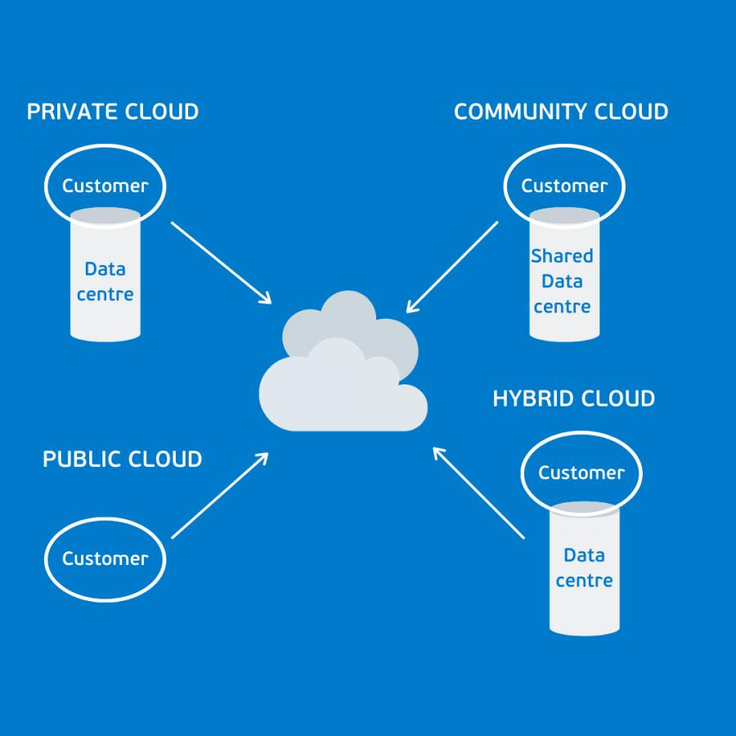

Slide 69
Hybrid Cloud Deployment
Hybrid Cloud Deployment is a cloud deployment model that combines two or more different cloud environments, typically a Private Cloud and a Public Cloud, and enables them to work together through appropriate connectivity and integration mechanisms.
Private Cloud ↔ Secure Network / API / VPN ↔ Public Cloud

Slide 70
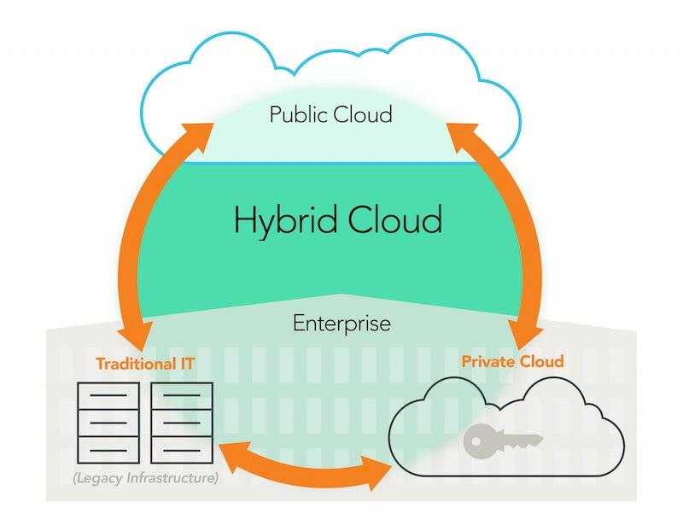

Slide 71
Key Characteristics
Combination of Clouds – Integrates private and public cloud infrastructure.
Data Security – Sensitive information can remain in the private cloud.
Scalability – Public cloud resources can be used when additional computing
capacity is required.
Flexibility – Organizations can decide where to deploy particular applications
and workloads.
Workload Portability – Certain workloads can be moved between private and
public environments.
Cost Optimization – Organizations can use private infrastructure for critical
workloads and public cloud resources for variable workloads.

Slide 72
Example: Hybrid Cloud Deployment
A bank can use a private cloud to store sensitive customer information and a public cloud to host its mobile banking application.
Private Cloud: Customer data and transaction records
Public Cloud: Mobile banking app and website
So, Private Cloud + Public Cloud = Hybrid Cloud.

Slide 73
BANK CUSTOMERS
|
+----------+----------+
| |
Mobile App Web App
| |
+----------+----------+
|
INTERNET
|
+----------v----------+
| PUBLIC CLOUD |
| |
| Load Balancer |
| | |
| Web/Application |
| Servers |
| | |
| API Gateway |
+----------+----------+
|
Secure VPN / Direct
Private Connection
|
+----------v----------+
| PRIVATE CLOUD |
| |
| Customer Database |
| Transaction DB |
| Account Records |
| Banking Services |
| |
| 🔒 Secure |
+---------------------+

Slide 74
Components Used
Component | Cloud | Purpose
Mobile Banking App | Public | Customer access
Banking Website | Public | Online banking
Web Server | Public | Handles requests
Application Server | Public | Runs banking application
Load Balancer | Public | Distributes traffic
API Gateway | Public | Controls API access
Customer Database | Private | Stores customer information
Transaction Database | Private | Stores transactions
Authentication Server | Private | Secure authentication
Backup Server | Private | Data backup
VPN/Direct Connection | Both | Secure communication
Firewall | Both | Network protection

Slide 75
Example Scenario
Suppose a customer wants to transfer ₹10,000 to another account.

Slide 76
Customer
|
| Transfer ₹10,000
↓
Mobile Application
↓
Public Cloud API
|
| Secure Connection
↓
Private Cloud
↓
Transaction Service
|
+---- Check Account Balance
|
+---- Validate Account B
|
+---- Authenticate Customer
|
+---- Deduct ₹10,000
|
+---- Credit ₹10,000
|
+---- Record Transaction
↓
Transaction Database

Slide 77
Advantages
Security
Sensitive customer and transaction data remain in the private cloud.
Scalability
The public cloud can handle increasing numbers of customers.
Cost Efficiency
Public-cloud resources can be increased or decreased according to demand.
Performance
Applications and web services can be deployed close to customers.
Disaster Recovery
Backup and recovery mechanisms can use both environments.
Flexibility
The bank can move selected workloads between private and public infrastructure when appropriate.

Slide 78
HYBRID CLOUD
|
+-----------+-----------+
| |
↓ ↓
PRIVATE CLOUD PUBLIC CLOUD
Customer Data Mobile App
Transaction Data Web Application
Account Database Application Servers
Authentication Load Balancer
Backup API Gateway
| |
+----------+------------+
|
Secure VPN
|
Data Exchange

Slide 79
Conclusion
The bank keeps sensitive customer, account, and transaction data in a Private Cloud while using the Public Cloud for its mobile application, website, and scalable application services, with secure VPN/API communication connecting both environments.

Slide 80
Module Assessment
1.Under the Infrastructure as a Service (IaaS) model, which of the following remains the responsibility of the Cloud Consumer?
A) Physical host security and datacenter power
B) Hypervisor installation and host server updates
C) Operating system patch management and application configuration
D) Network cable maintenance and physical storage arrays

Slide 81
Answer
C) Operating system patch management and application configuration
Explanation: In IaaS, the provider manages the physical infrastructure, power, network hardware, and hypervisor layer. The consumer is responsible for everything from the operating system upward (OS patches, middleware, applications, and data).

Slide 82
2. Which cloud service model provides a pre-configured execution environment (runtimes, databases, web servers) allowing developers to build and deploy applications without managing OS or hardware layers?
A) Infrastructure as a Service (IaaS)
B) Platform as a Service (PaaS)
C) Software as a Service (SaaS)
D) Storage as a Service (STaaS)

Slide 83
Answer:
B) Platform as a Service (PaaS)
Explanation: PaaS abstracts away underlying servers, storage, and operating systems so developers can focus strictly on writing application code and configuring application-level settings.

Slide 84
3. What is the primary responsibility of a Cloud Consumer when using a Software as a Service (SaaS) application like Microsoft 365 or Salesforce?
A) Applying security patches to the web server
B) Configuring user access controls and managing uploaded data
C) Provisioning virtual machines to balance application loads
D) Updating the database runtime engine

Slide 85
Answer
B) Configuring user access controls and managing uploaded data
Explanation: In SaaS, the provider owns and maintains the entire software stack. The consumer is only responsible for managing their own data, user identities, and access permissions.

Slide 86
4.Which essential cloud characteristic refers to the ability to automatically expand or shrink compute capacity to instantly match incoming workload demand?
A) Resource Pooling
B) Measured Service
C) Broad Network Access
D) Rapid Elasticity

Slide 87
Answer
D) Rapid Elasticity
Explanation: Rapid Elasticity enables resources to be provisioned and released automatically or dynamically to scale seamlessly with demand.

Slide 88
A cloud platform monitors resource usage (such as bandwidth, storage space, or active VM hours) to automatically bill consumers based strictly on what they consume. Which characteristic does this describe?
A) On-Demand Self-Service
B) Measured Service
C) Broad Network Access
D) Multi-tenancy

Slide 89
Answer:
B) Measured Service
Explanation: Measured Service provides metering capabilities that support pay-per-use billing models, transparent monitoring, and resource optimization.

Slide 90
6. From the Cloud Provider perspective, what is the primary architectural goal of implementation?
A) Avoiding long-term hardware ownership and upfront CapEx
B) Maintaining multi-tenant hardware density and maximizing resource utilization
C) Delegating all data privacy responsibility entirely to end-users
D) Ensuring end-users can customize kernel drivers on shared physical servers

Slide 91
Answer
B) Maintaining multi-tenant hardware density and maximizing resource utilization
Explanation: Cloud providers focus on building multi-tenant environments, high availability, hardware efficiency, and scalable infrastructure to maximize profitability while delivering SLAs.

Slide 92
7. Several healthcare institutions join together to build a shared cloud environment configured specifically to satisfy strict HIPAA compliance rules and shared medical research standards. What deployment model is this?
A) Public Cloud
B) Private Cloud
C) Community Cloud
D) Hybrid Cloud

Slide 93
Answer:
C) Community Cloud
Explanation: A Community Cloud infrastructure is shared by several organizations with common compliance, security, or mission requirements.

Slide 94
8. An organization runs its confidential financial databases inside a dedicated, on-premises private datacenter, but automatically bursts web traffic out to AWS/Azure during holiday sales surges. What deployment model are they using?
A) Public Cloud
B) Private Cloud
C) Community Cloud
D) Hybrid Cloud

Slide 95
Answer:
D) Hybrid Cloud
Explanation: Hybrid Cloud connects two or more distinct cloud infrastructures (e.g., Private and Public), allowing data and applications to be shared between them (often called "cloud bursting").

Slide 96
9.Which component is ALWAYS the sole responsibility of the Cloud Consumer regardless of whether IaaS, PaaS, or SaaS is selected?
A) Physical Datacenter Security
B) Hypervisor Patching
C) Customer Data & Identity/Access Management
D) Server Hardware Replacement

Slide 97
Answer:
C) Customer Data & Identity/Access Management
Explanation: Regardless of the service model (IaaS, PaaS, or SaaS), data classification, account security, and user access permissions remain the responsibility of the customer.

Slide 98
10.Which financial shift is a key motivation for organizations moving from traditional on-premises infrastructure to public cloud services?
A) Moving from OpEx (Operational Expenses) to CapEx (Capital Expenses)
B) Moving from CapEx (Capital Expenses) to OpEx (Operational Expenses)
C) Eliminating software licensing fees completely
D) Shifting network security responsibilities entirely to Internet Service Providers

Slide 99
Answer
B) Moving from CapEx (Capital Expenses) to OpEx (Operational Expenses)
Explanation: Cloud computing reduces upfront capital expenditures (purchasing physical servers and hardware) in favor of predictable operational expenses (pay-as-you-go subscription pricing).

