Slide 1
2020 Data Challenge
Siyuan Luo
Jie Wu
Xueling Lin

Slide 2
Content
Behavior
Trust Profile
Measure
How do people’s self-rated health relate to their health-related information behavior?
What are people’s trust profiles towards health problems?
What should government do to carry out some pointed measures for the target people to improve communication efficiency within healthcare field.

Slide 3
How do people’s self-rated health relate to their health-related information behavior?

Slide 4
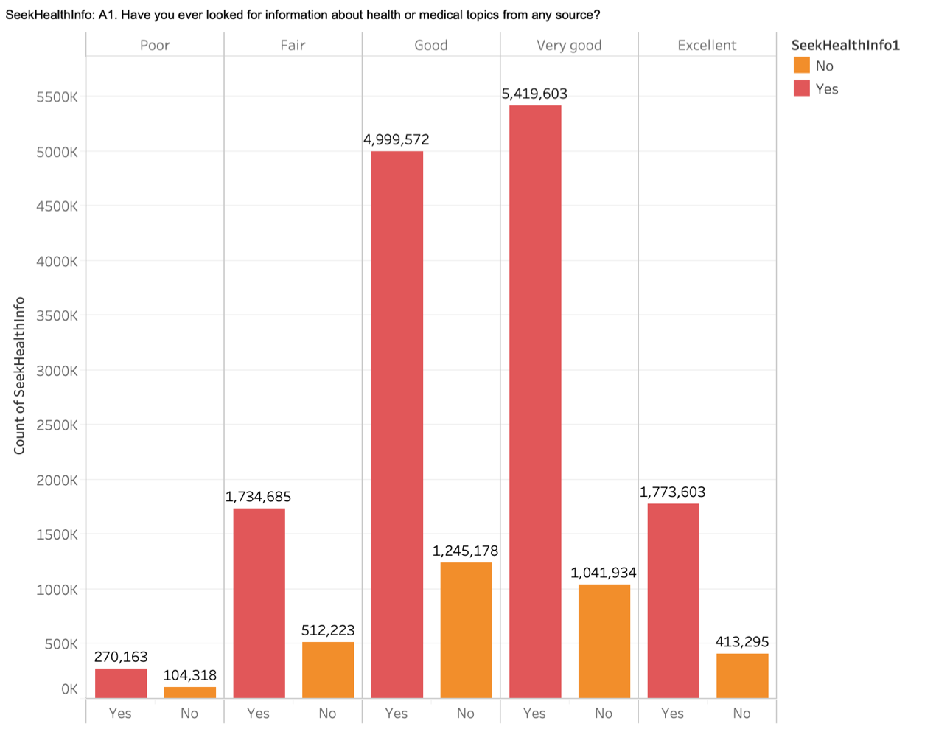
People’s health are good if they seek health information?
Then more details about their health-related information behavior:
What type of source they turned to the most recent time they looked for health information?
What are the barriers they faced while searching for health information?
Where they would turn if they had a strong need to get health information?
Have they used a computer, smartphone, or electronic means to look for health information?
Do they have shared health information on social networking sites, such as Facebook or Twitter?
Notes:
Are there any relationships between people’s self-rated health (question F1) and their health-related information behavior [e.g., whether they have ever looked up health information using any type of source (A1);

Slide 5
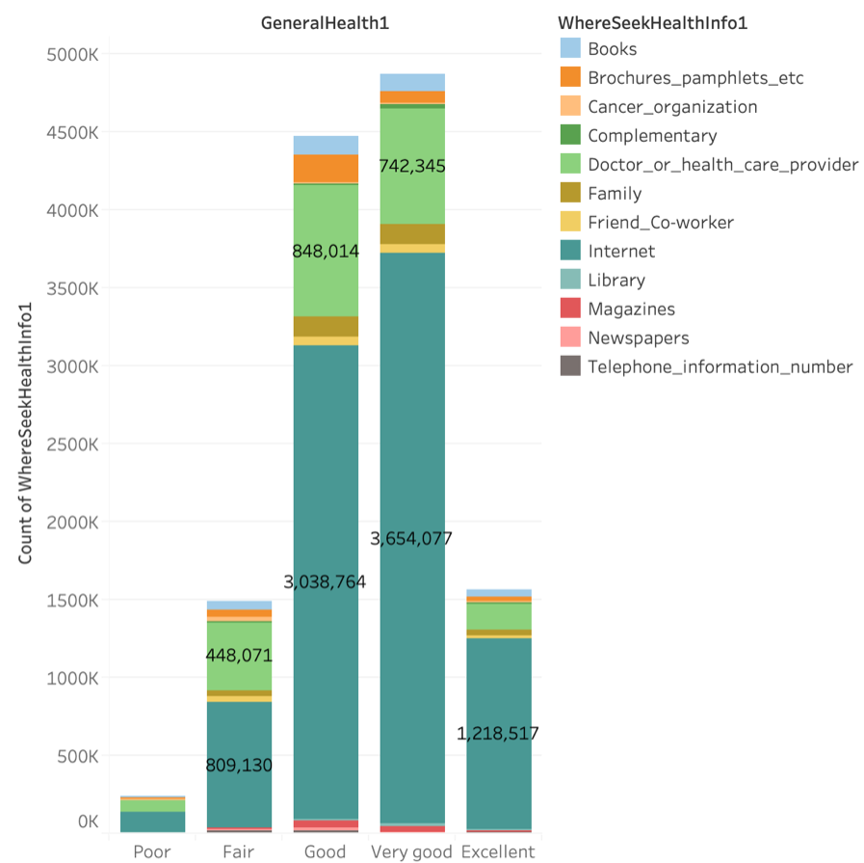
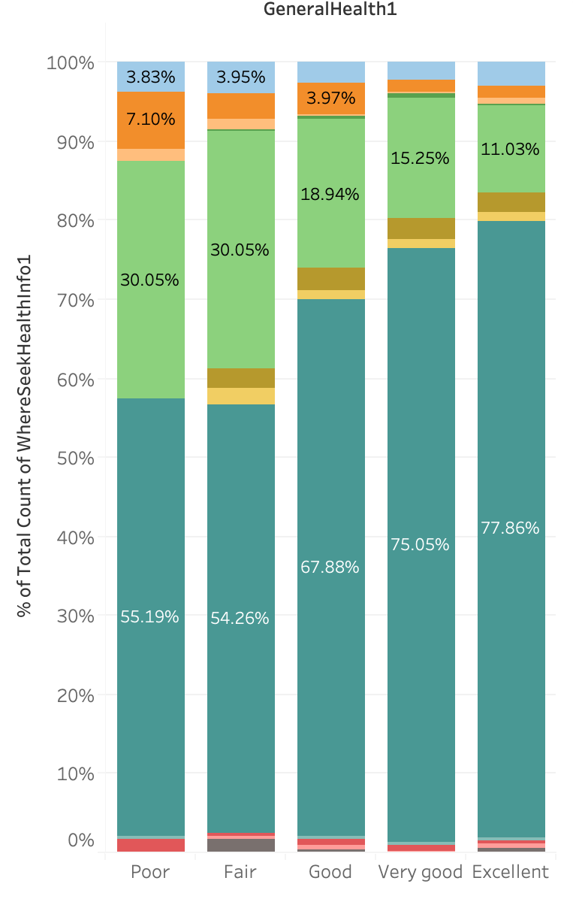
What type of source?
Notes:
what type of source they turned to the most recent time they looked for health information (A2)

Slide 6
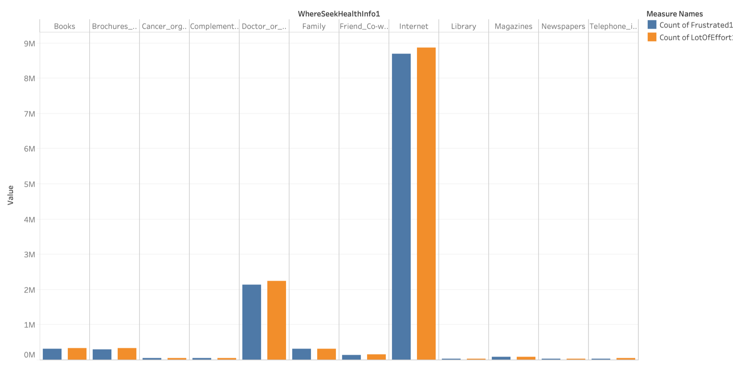
b. What are the barriers? -Frustrated and a lot of effort?
Notes:
LotOfEffort: A4a. It took a lot of effort to get the information you needed:
Frustrated: A4b. You felt frustrated during your search for the information:

Slide 7
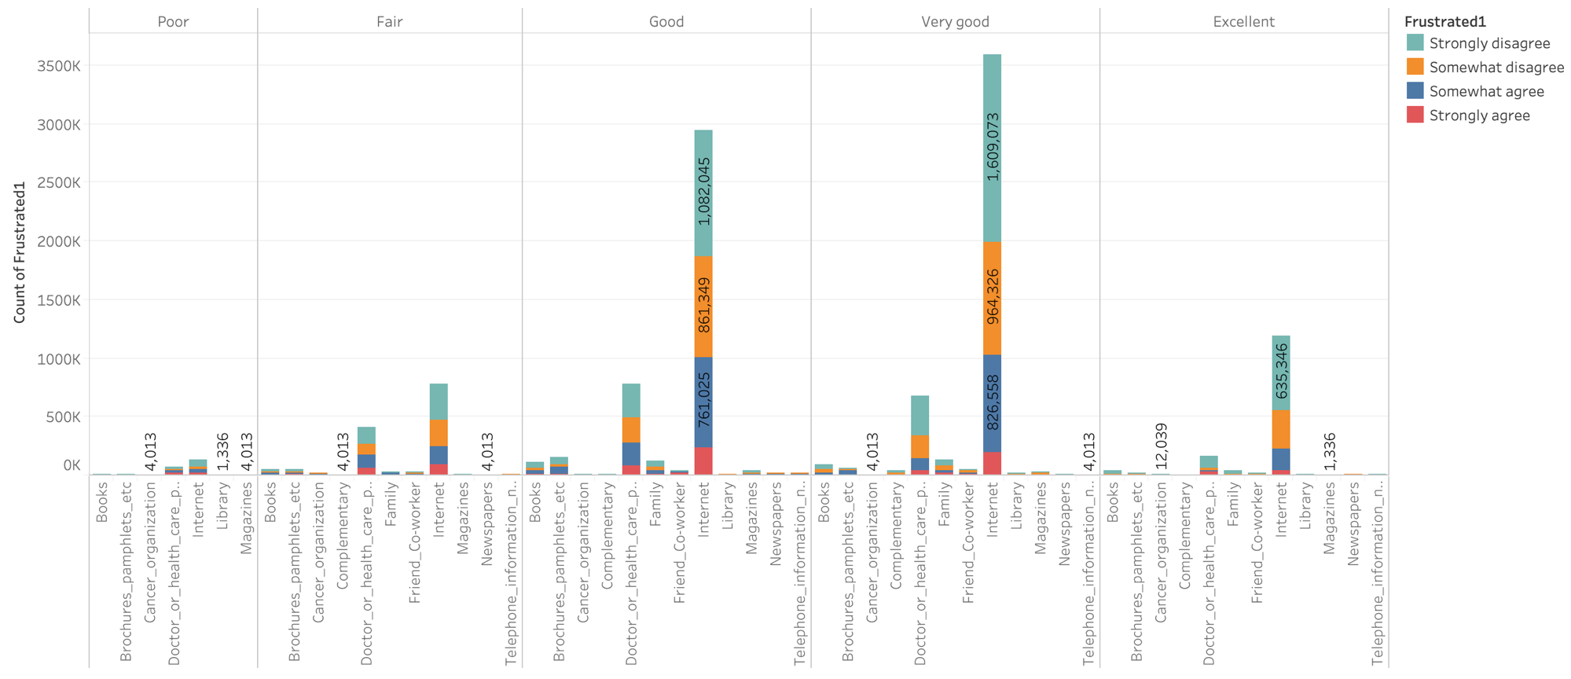
b. What are the barriers? -Frustrated

Slide 8
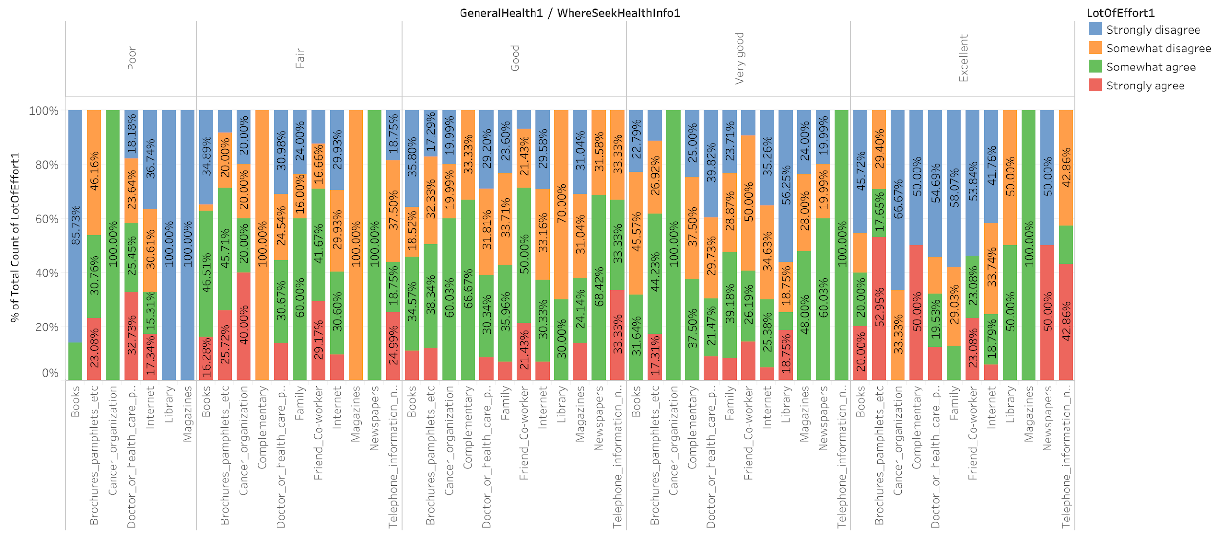
b. What are the barriers? -A lot of effort

Slide 9
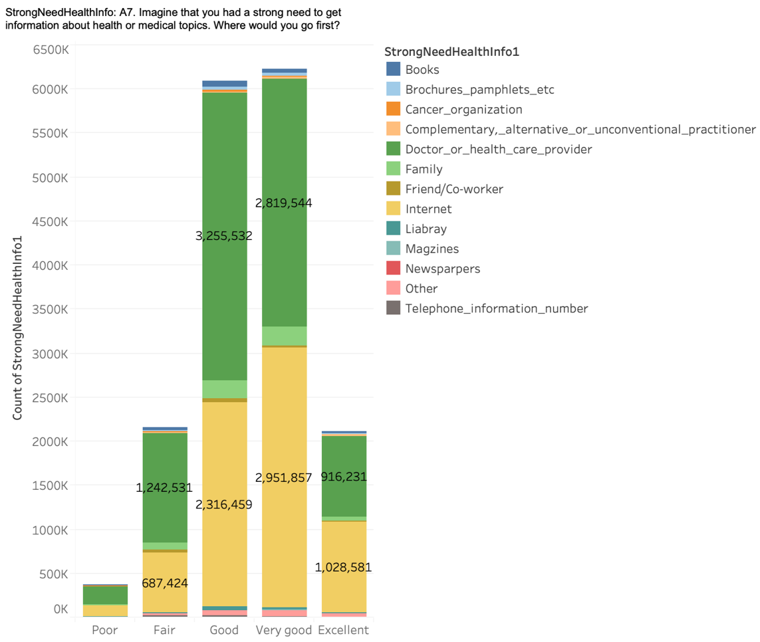
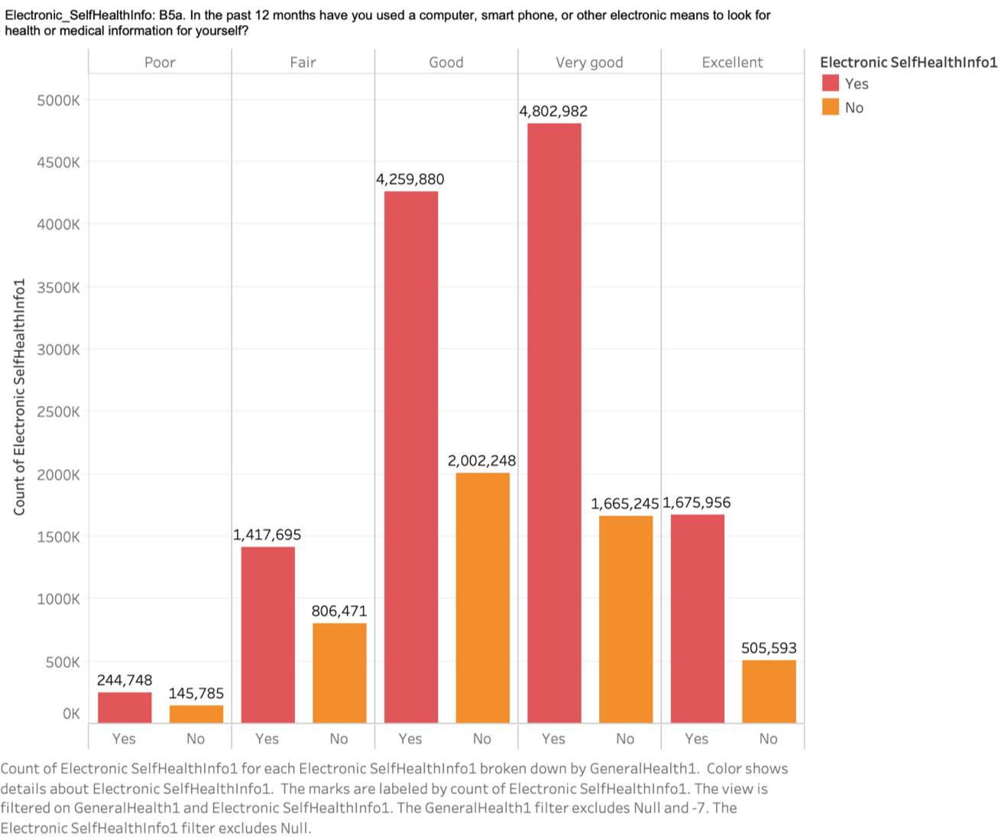
c. Where would they turn?
d. Do they have used a computer, smartphone, or electronic means to look for health information?
Notes:
StrongNeedHealthInfo_OS: A7. Imagine that you had a strong need to get information about health or medical topics. Where would you go first? Electronic_SelfHealthInfo: B5a. In the past 12 months have you used a computer, smart phone, or other electronic means to look for health or medical information for yourself?

Slide 10
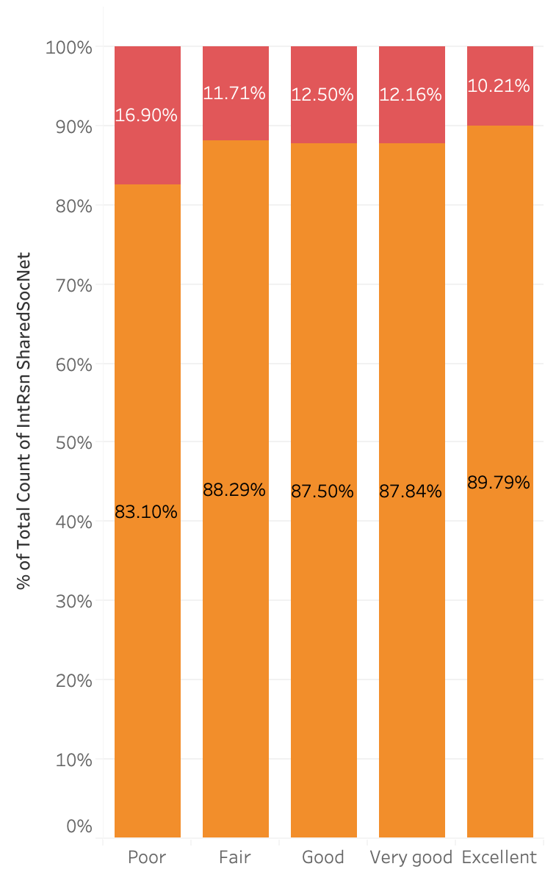
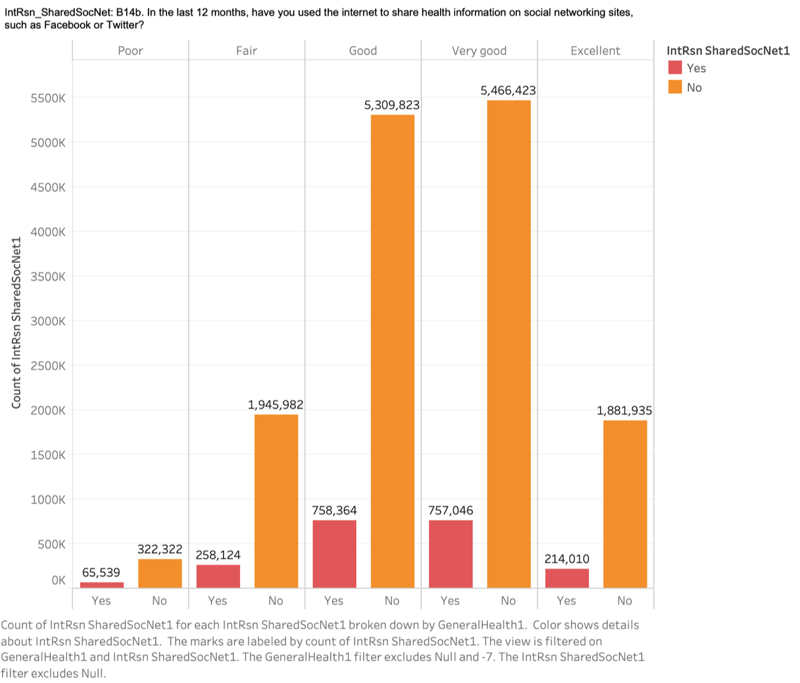
e. Have they shared health information on social networking sites, such as Facebook or Twitter?
Notes:
whether they have shared health information on social networking sites, such as Facebook or Twitter (B14b)]?

Slide 11
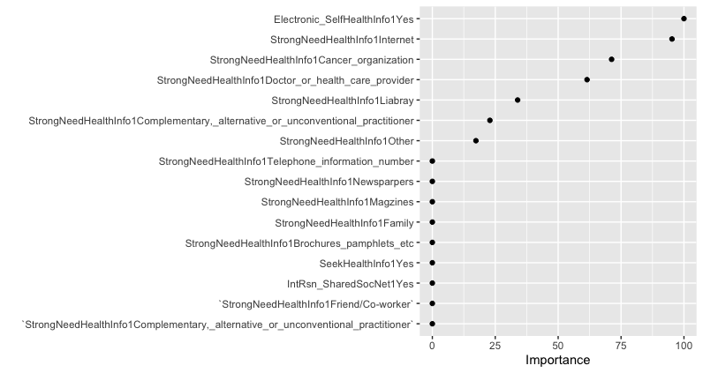
Decision Tree:
Notes:
decision trees perform automated feature selection where uninformative features are not used in the model. Variable importance based on the total reduction in MSE for the decision tree.

Slide 12
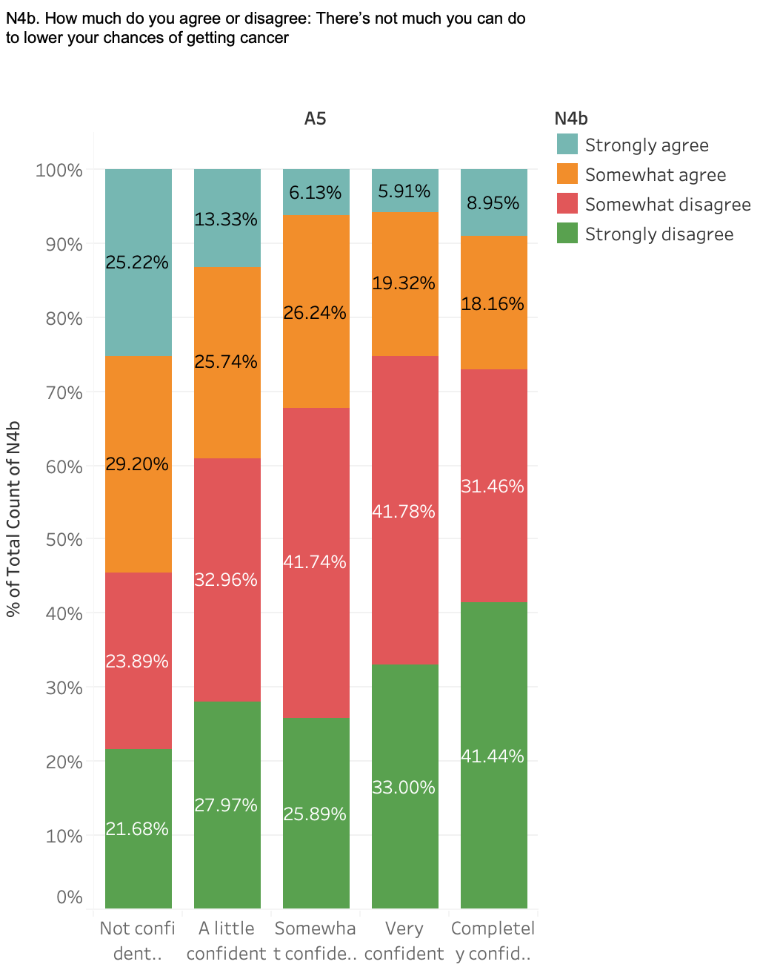
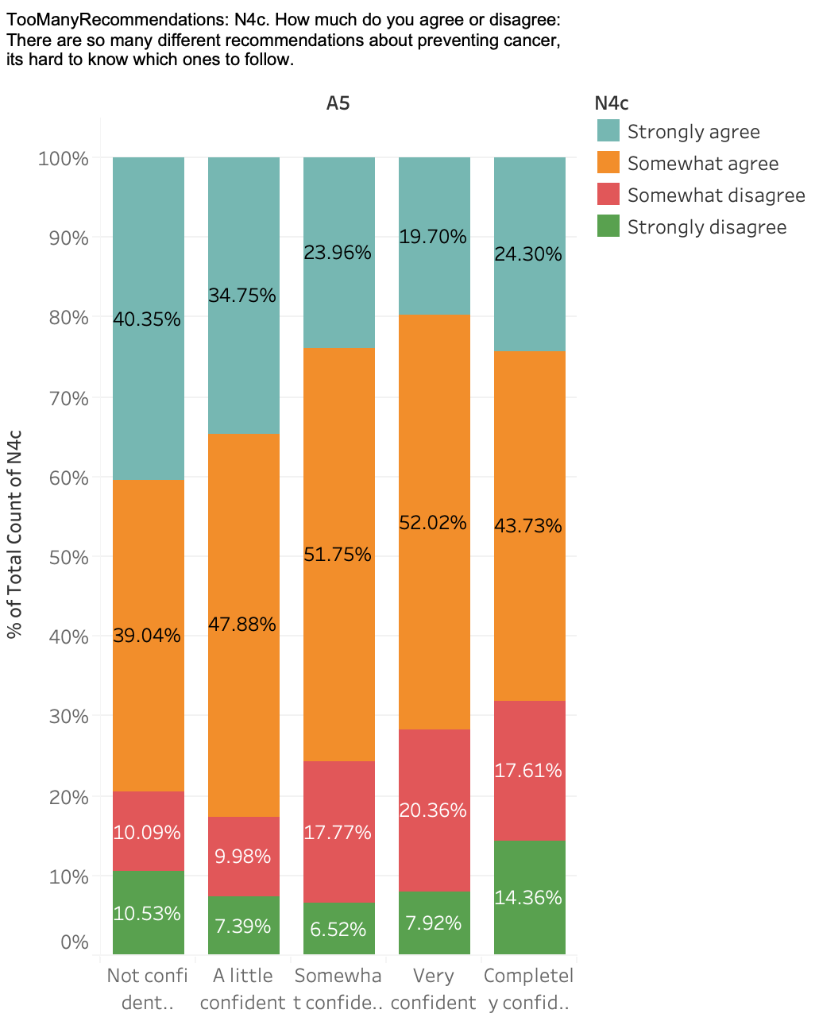
How do people’s information-related self-efficacy and their health-related self-efficacy?
Notes:
A5. Overall, how confident are you that you could get advice or information about health or medical topics if you needed it?
N4c. How much do you agree or disagree: There are so many different recommendations about preventing cancer, its hard to know which ones to follow
N4b. How much do you agree or disagree: There’s not much you can do to lower your chances of getting cancer

Slide 13
What are people’s trust profiles towards health problems?

Slide 14
China alerts WHO to several pneumonia cases
WHO reports case in Thailand, the first outside China
Egypt confirms Africa’s first case
12.31.2020
1.11.2020
1.13.2020
2.2.2020
2.14.2020
China announces first death
First death outside China recorded in the Philippines

Slide 15
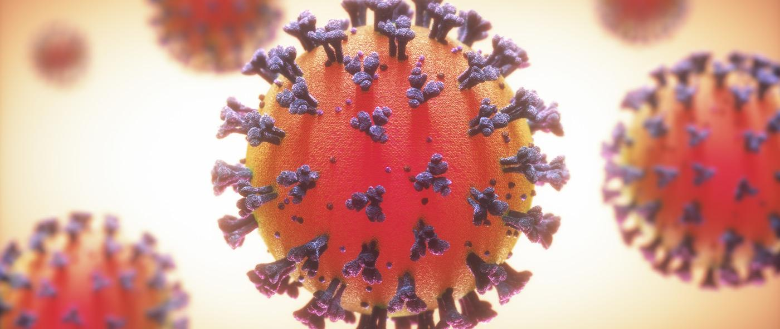
Trust Doctor?
In December, a Wuhan doctor posted message in WeChat that seven patients from a local seafood market had been diagnosed with a SARS-like illness and were quarantined in his hospital in Wuhan. However, soon after he posted the message, he was accused of rumor-mongering by the Wuhan police.

Slide 16
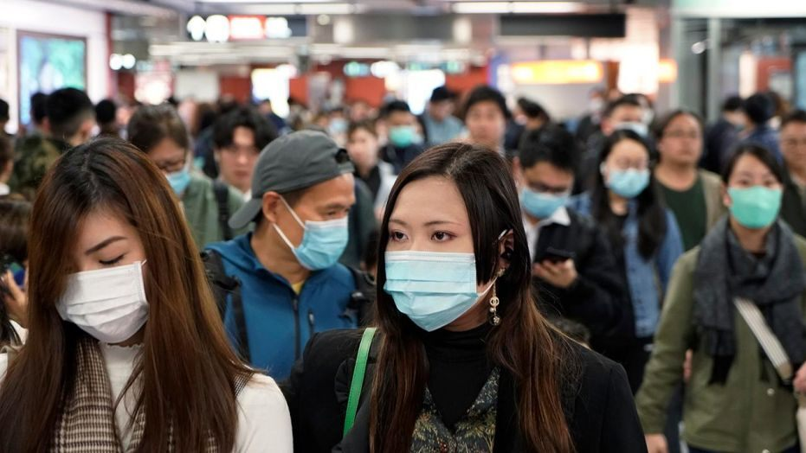
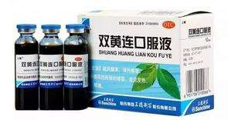
Trust Government?
Should we avoid places where people are displaced?
Should we wear a mask?
Should we go back home in Spring Festival?
Should we take this medicine?

Slide 17
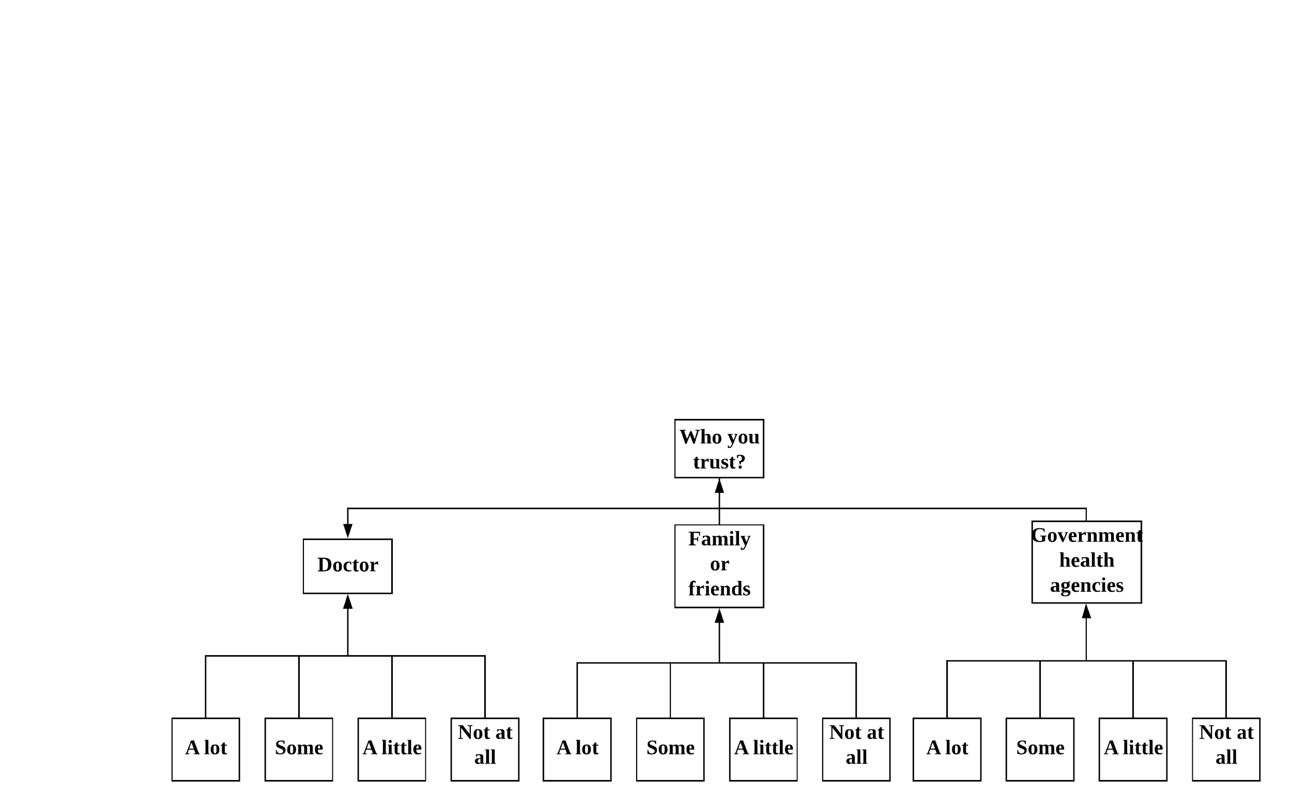
Logistic Model Classification:

Slide 18
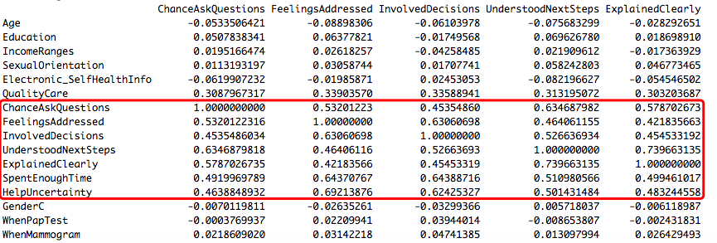
Result Analysis:

Slide 19
Significant features
Trust doctor:
Higher education level, income ranges, received better health care
Not trust doctor:
Elder people, lower education level, income ranges, received bad health care
Trust Government:
Younger people, higher education level, Filipino, received better health care, homosexual, the more health professionals involved in his/her decision
Not trust Government:
Lower education level, received bad health care, dot not use electronic wearable device to track health, don’t feel like being paying attention to his/her feelings and emotions

Slide 20
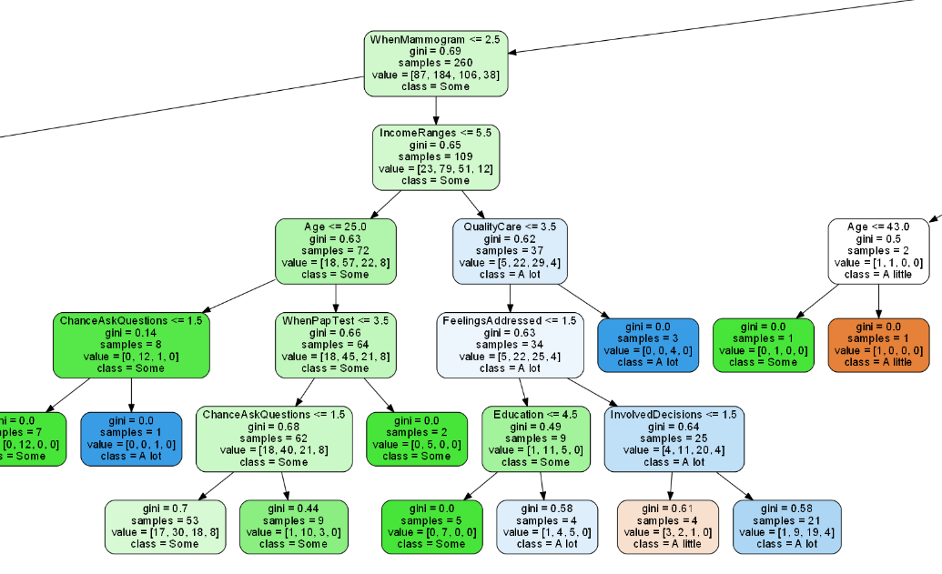
Model training——Random forest

Slide 21
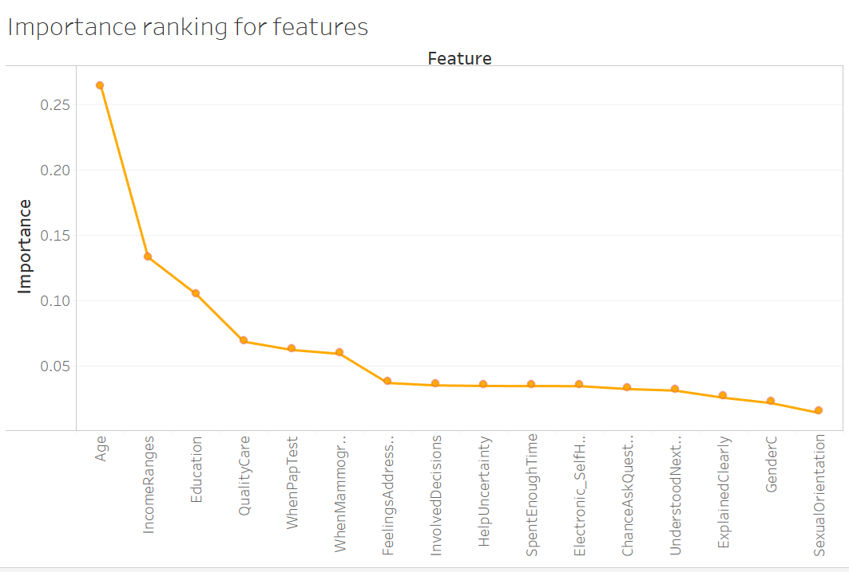
Feature Importance Evaluation
Most influential features:
Age
Income
Education
CareQuality
WhenHaveTest

Slide 22
So what?

Slide 23
What should government do?
Ensure communications are accessible
-Effective media: international news media; website; social media like Youtube, Google+ and LinkedIn
Support an appropriate understanding of the risk
-Show the health problems effect on people who are likely to be target audience(elderly people)
Increase awareness of potential threat
-Increase the level of understanding of health risks and promote the steps that protect people’s health
-Widely disseminate messages that are simple, easy to recall, repeated and attention-getting.

Slide 24
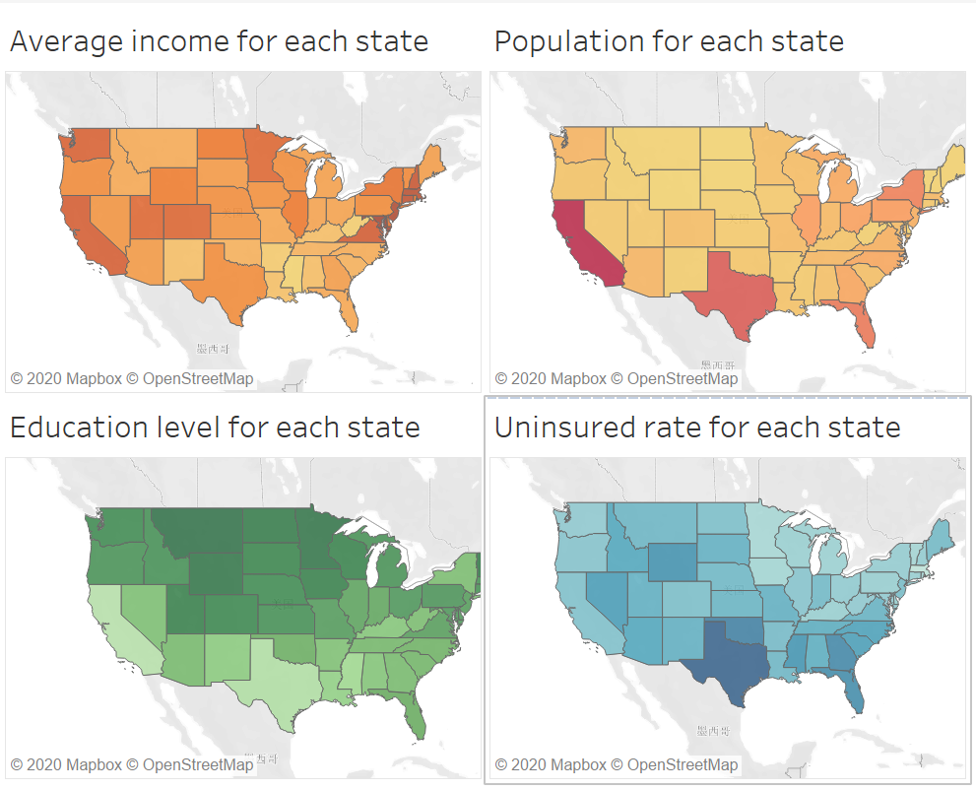
Let’s have a look at statistical data
Government should focus on the states that do not have high level education level, because people there do not tend to firmly trust government.
So according to the statistical data, government should pay more attention to California and Texas, because the people there may lack awareness of some potential health threats.

Slide 25
Thank you for listening!

