Slide 1
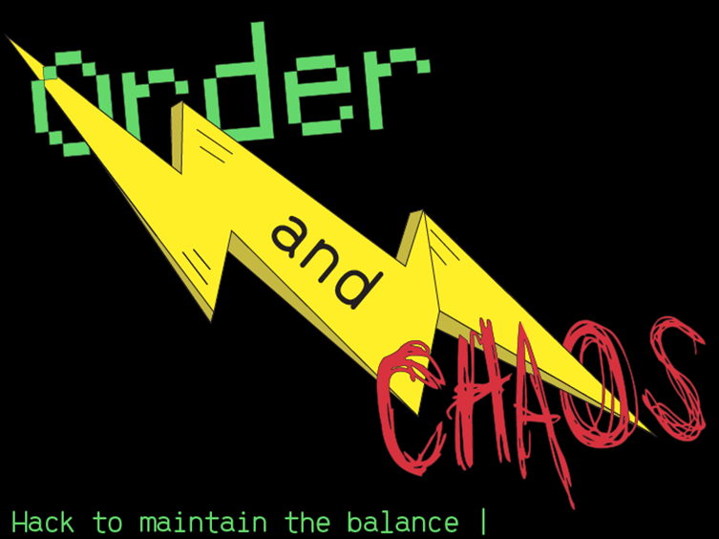
Charles Brown
Jacob Burnett
Kevin Gross
Ann Howell
June 2022

Slide 2
Overview of Proof of Concept
Order and Chaos is token-based game that leverages FinTech blockchain technology and gaming tokens called OACs.
Blockchain technology includes Solidity, Ethereum ERC-20 Fungible Tokens, and the ERC-721 Nonfungible Tokens.
This fits into a growing genre of FinTech, combining gaming with opportunities to earn by playing that appeals to gamers, blockchain enthusiasts and gamblers. Current barrier to entry or some people is the need to have a token wallet.
This POC presents a working model of the game that is deployed on a test network with a focus on the blockchain components.
Ultimately the goal for the product would be to improve the gameplay to generate revenue by monetizing the game and building the value of the OAC tokens and character NFTS.

Slide 3
user stories
As a gamer, I want to:
Have fun while having the chance to earn tokens so I feel that my time is well spent.
Be able to create a character as an NFT so that I have the possibility of re-selling the NFT in the future.
Know the game to be set up in a transparent way so that I can compete and trust the result, win or lose.
Ensure that the transfer of tokens is secure so that I do not lose value.
As a game administrator, I want to:
Ensure that the treasury component of the blockchain is accurately accounting for token transfers so that no tokens are misdirected.
Make sure that the game code is secure so that no unauthorized people can mint new tokens or steal tokens.
As a game designer, I want to:
Ensure that all of the technology works together to create a seamless and easy experience for gamers.
Create a game that is fun to play and encourages gamers to return.
Provide a visually stunning and fun set of graphics in the game interface and character NFTs that create a unique look and brand for the game.
Charge a fee to make a profit from owning and running the game.
Market the game and create a strong community of passionate users who continue to play the game over time.

Slide 4
Acceptance criteria
The game must:
Have an enticing story, theme, and user interface in order to attract players.
Provide gameplay that offers reasonable challenge and rewards in order to keep players coming back.
Produce a token and NFTs that are designed with appropriate standards so that they could be publicly traded in a future release.
Have security for the data storage, minting of tokens, and transfer of tokens according to Ethereum blockchain standards.
Function properly to allow game play and token transfers while being gas efficient.
Work across the various technology platforms and networks.

Slide 5
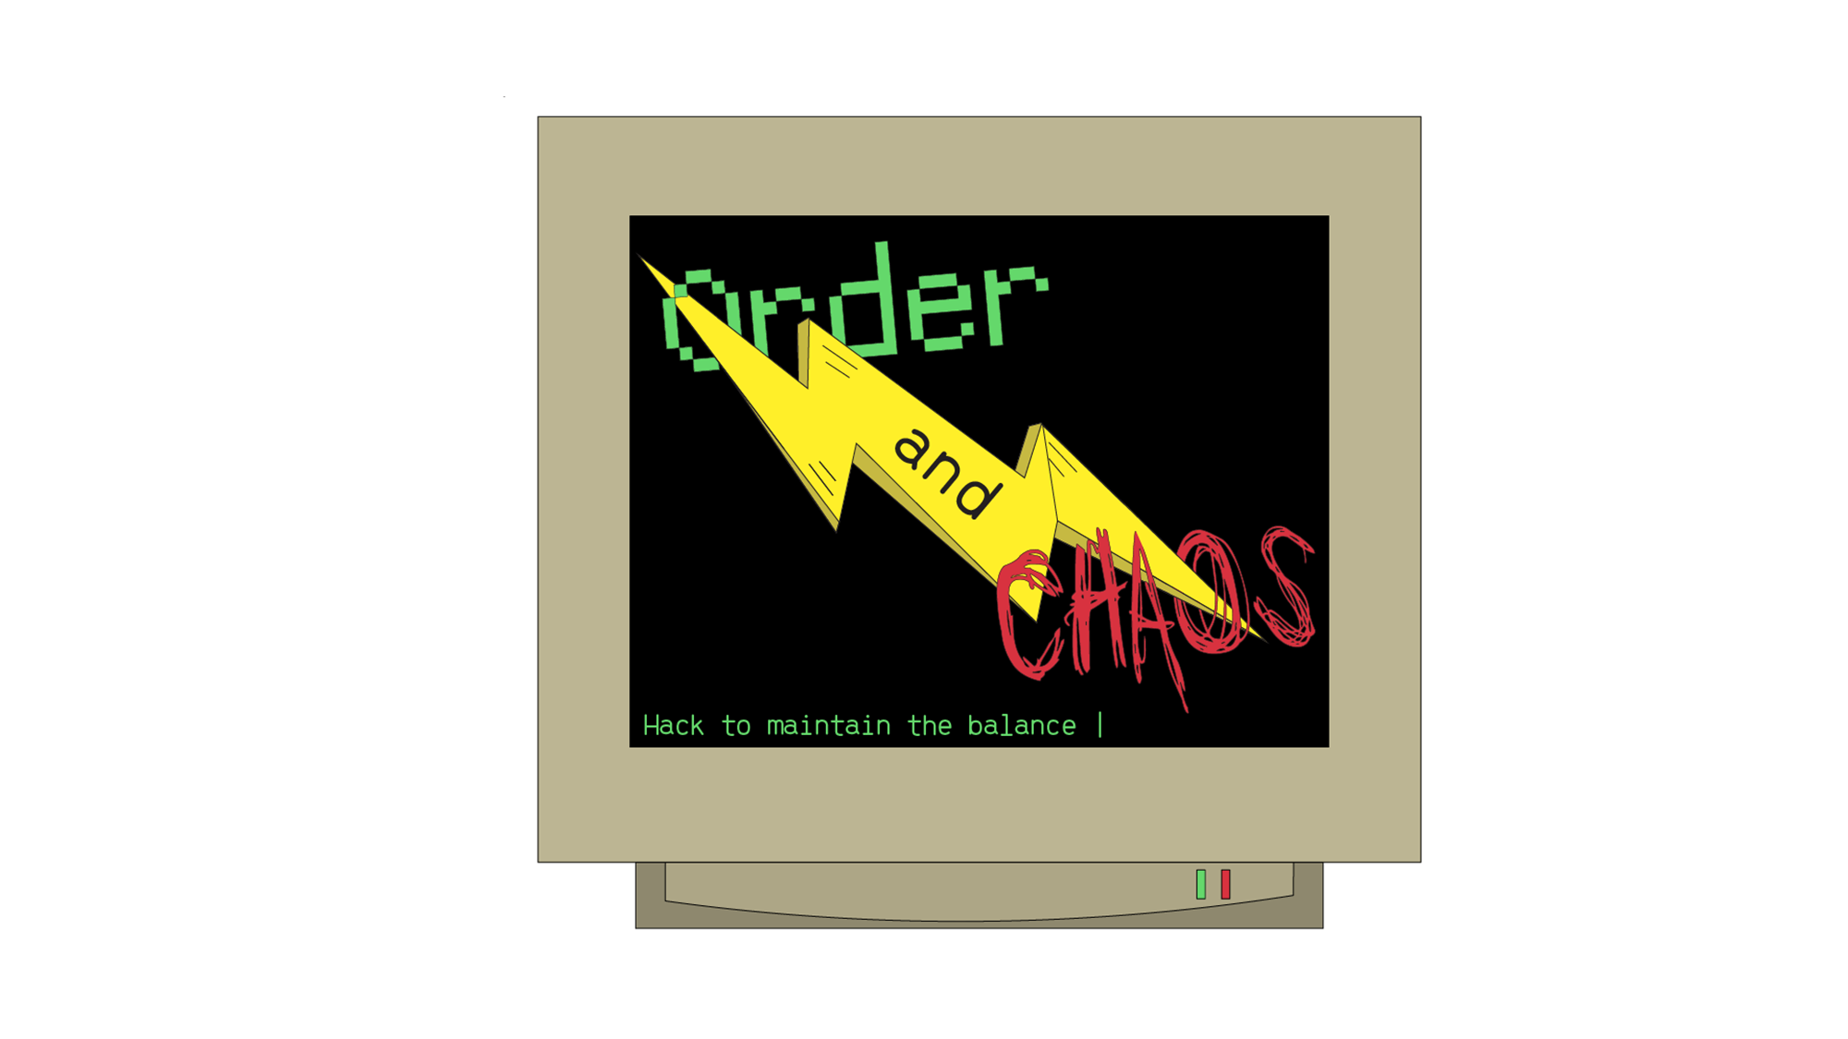
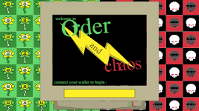
Game walkthrough
Game Demo

Slide 6
Game walkthrough: Attach wallet & pay fee

Slide 7
Game walkthrough: mint nft characters

Slide 8
Game walkthrough: Enter Arena & Fight

Slide 9
Game walkthrough: Fight results

Slide 10
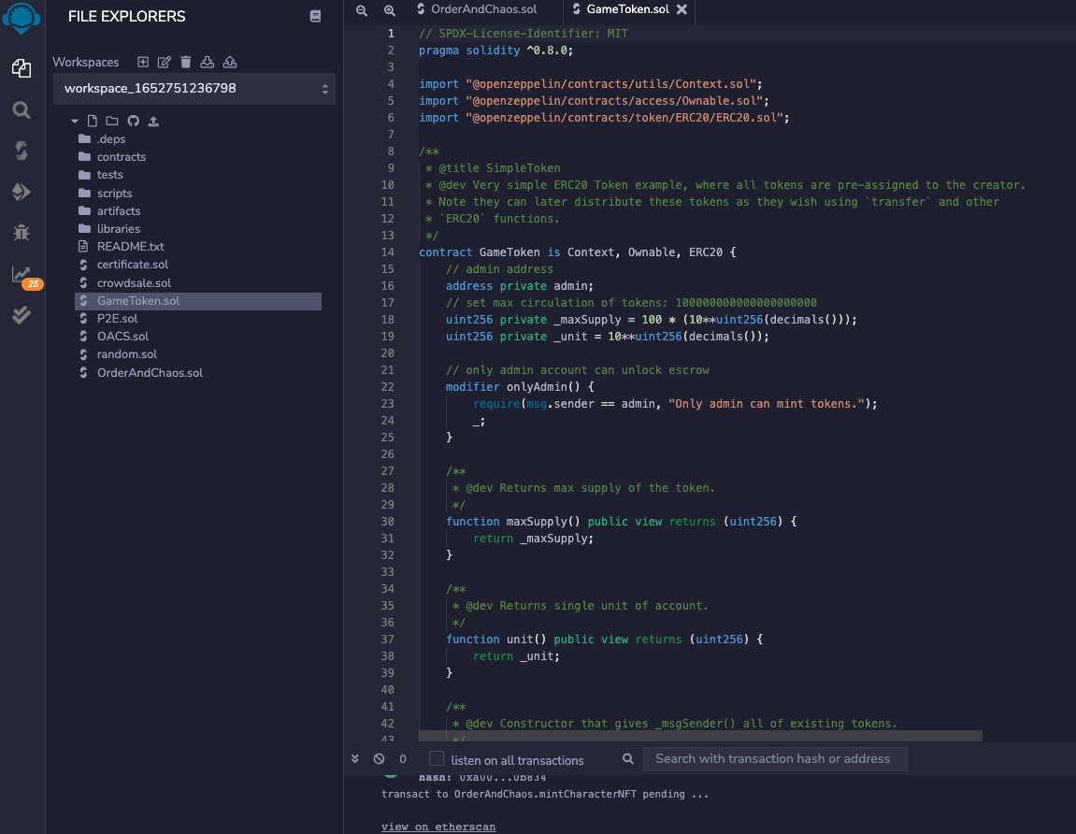
Backend game setup
Remix Solidity
GameToken Contract (ERC20)
Minting tokens

Slide 11
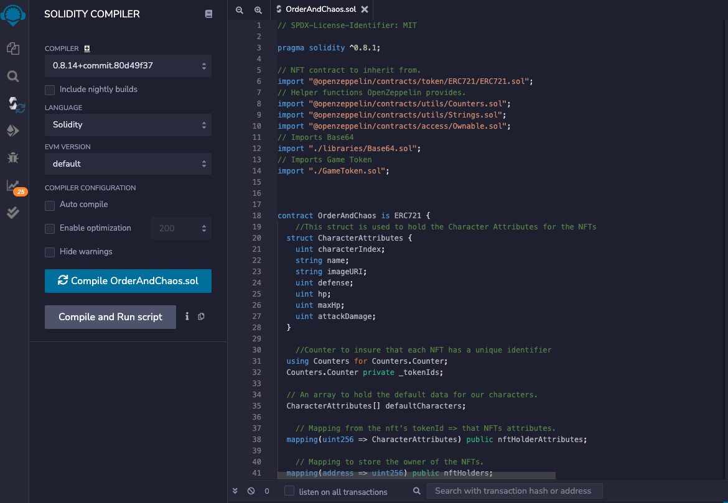
Backend game setup
Remix Solidity
Compile contract (ERC721)
OrderAndChaos.sol

Slide 12
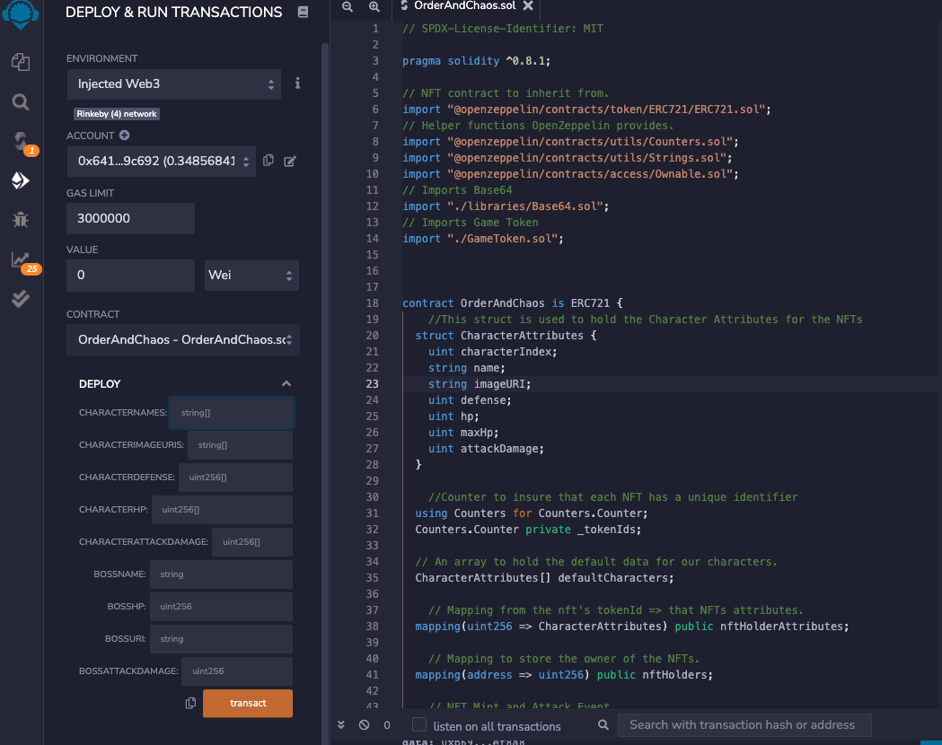
Backend game setup
Remix Solidity
Deploy and Run
OrderAndChaos.sol

Slide 13
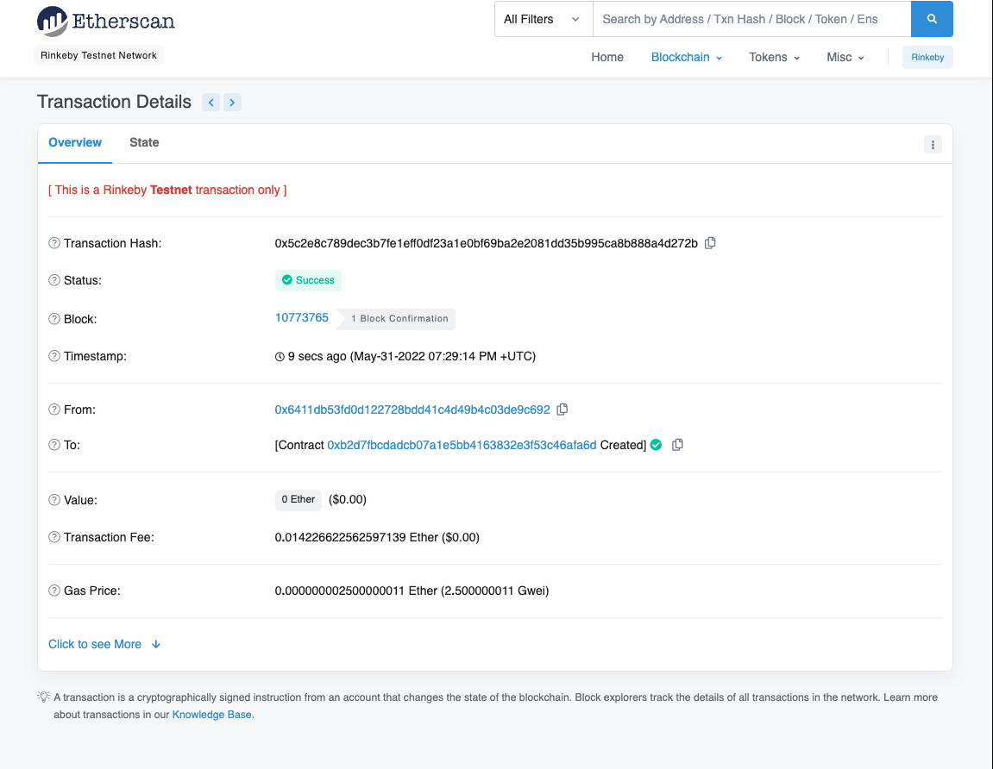
Backend game setup
Etherscan
Proof of transaction on Rinkeby Testnet Network

Slide 14
Backend game setup
X
X

Slide 15
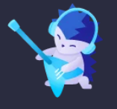



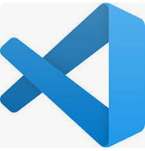
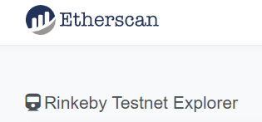

Technology
Technology Platforms
Remix IDE with Solidity
Metamask to manage wallets
Ganache Truffle Suite for test wallet accounts
React Javascript library
Visual Studio Code
Etherscan Rinkeby Testnet Explorer for test network
DigitalOcean as a cloud computing host

Slide 16
Cost Estimate
Cost Estimation
Scoping for a 6 month engagement to build the Order versus Chaos app and prepare for launch.
Staffing costs
Role | Annual Salary + (estimate) | Contract Rate | 6 month contract cost
Sr Blockchain Developer* | Range: $147K-$305K Target: $200K | $75 per hour | $78,000
Blockchain Developer* | Range: $83K-$175K Target: $110K | $55 per hour | $57,200
Project Manager* (Metaverse Delivery Manager) | Range: $111K-$250K Target: $140K | $60 | $62,400
Graphic Artist** | Range: $40K-55K Target: $48K | $20 per hour | $20,800
Total |  |  | $218,400
Contract Salaries: $218,400
Equipment: $8000 (4 * $2000 computers)
Costs to launch Ethereum contracts: $2500
(~ 5*$500)
Estimated Total: $228,500 + 10% contingency
Budget: $251,350
*Developer & PM salaries based on salary estimates in job postings from Accenture
**Graphic Artist salary from various companies on Indeed.com
Contract rates assume 2080 hours per year (40 hours over 52 weeks)

Slide 17
Barriers & Next steps
Barriers
Had trouble with the token transfers – focused on NFT component instead
Complications of new language (javascript REACT) and css for graphics
Next Steps
Develop support for gamers who are new to blockchain wallets get set up for the game via instructional guides – written and video
Improve gameplay to include more actions and strategy and establishment of clans
Make the OAC token available on tradeable cryptocurrency Ethereum-based exchanges – once game is live
Continue to develop the graphics for the game
Build out the NFT component to allow for customizations that can increase the value of NFTs
Make the NFTs available to be traded or sold in open marketplaces
Develop spin-off products like t-shirts and stickers

Slide 18


Slide 20
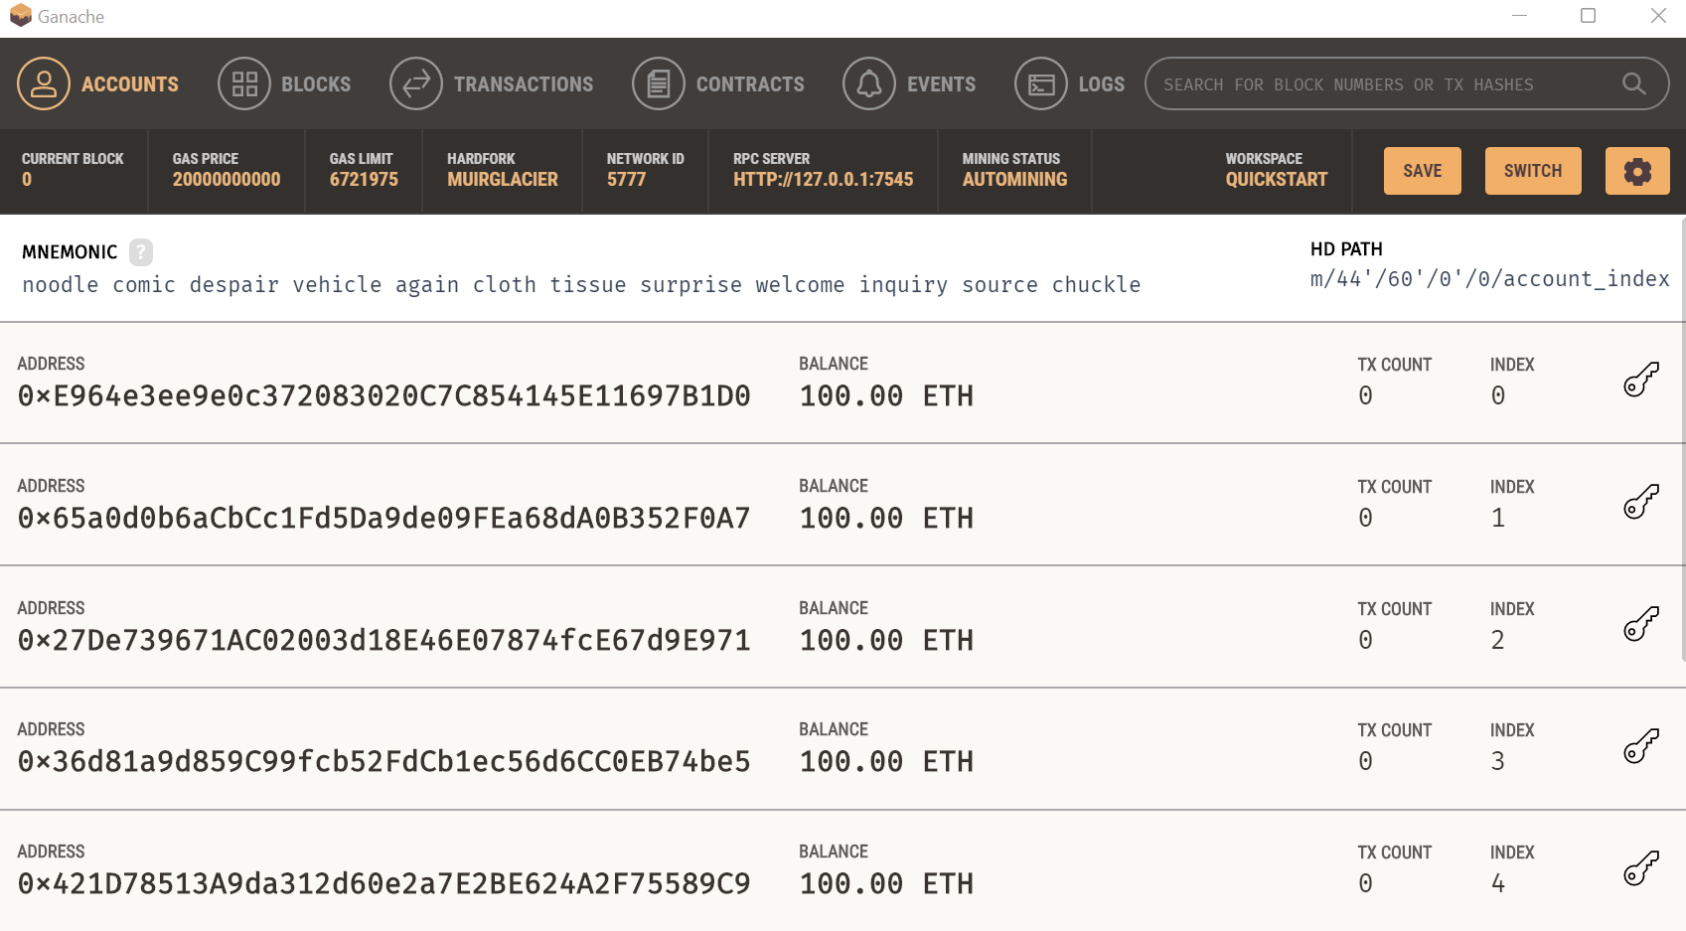
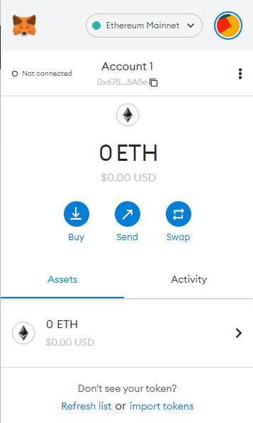
Pre-game set up
To join the fight to hack for balance, you must prepare! Follow these steps to get set up and play the proof of concept version of Order and Chaos. As a POC, this version requires no actual investment or gas money and returns no actual rewards.
Step 1: Use Ganache to create test
Ethereum accounts
Step 2: Set up a Metamask wallet
Step 3: Connect Ganache accounts to Metamask
Step 4: Get Metamask on the X test Network
Use these accounts to fund your ETH costs for the game thru Metamask
Follow the directions to set up a wallet.
https://metamask.zendesk.com/hc/en-us/articles/360015489531-Getting-started-with-MetaMask
https://trufflesuite.com/docs/ganache/quickstart/

Slide 21
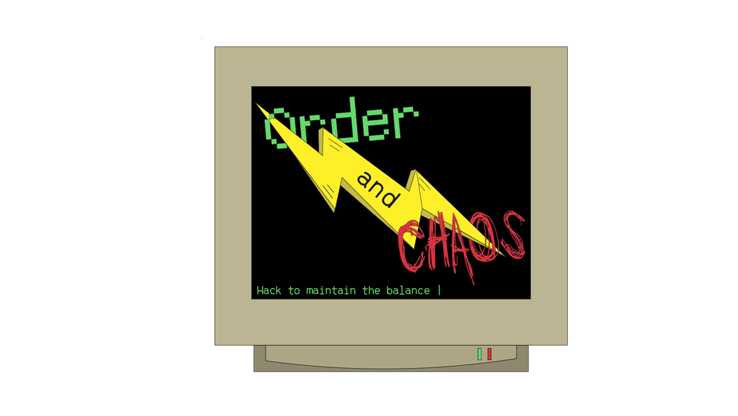
Pre-game set up
To join the fight to hack for balance, you must prepare! Follow these steps to get set up and play the proof of concept version of Order and Chaos. As a POC, this version requires no actual investment or gas money and returns no actual rewards.
Step 5: Go to Remix to connect Metamask Wallet & Network
Step 6: Launch game thru contract
Start Game Play!
x
x
In the game, you will:
Take a quiz to align with Order or Chaos
Mint a NFT character – which requires a ETH fee thru the wallet
Enter the arena and battle
View results

