Slide 1

Fake News Detection using Machine Learning and Sentiment Analysis
School of Computer Science and Engineering
Department of Computer Science and Engineering
Submitted By:
Vaishnavi Kaushal
23FE10CSE00480
Supervised By:
Dr. Babita Tiwari

Slide 2
Outline
1. Introduction
2. Literature Review
3. Problem Statement
5. Objectives
6. Proposed Methodology

Slide 3
Introduction
Fake news has become a major challenge in today’s digital world, spreading rapidly across social media and influencing public opinion, elections, and societal stability.
Manual fact-checking is slow and cannot keep up with the scale and speed of online misinformation.
Machine Learning (ML) and Natural Language Processing (NLP) offer automated and scalable solutions for detecting fake news.
Classical ML models such as Naïve Bayes, Logistic Regression, SVM, Random Forest, and XGBoost are widely used due to their efficiency and strong performance on text classification tasks.

Slide 4
However, a key limitation in prior research is lack of interpretability—many models predict fake/real labels but do not explain why.
Fake news often contains emotional or sentiment-laden language, making sentiment analysis a promising tool for interpretation.
This project evaluates six ML models for fake news detection and introduces post-hoc sentiment analysis (VADER) to understand the emotional tone behind predictions.
The approach aims to achieve high accuracy and provide a meaningful explanation, aligning with recent research trends in explainable and interpretable AI.

Slide 5
LITERATURE REVIEW
S.No. | Citation | Year | Technique(s) | Dataset(s) | Key Finding
1. | Alonso et al. | 2021 | Sentiment + ML | Custom | Fake news has strongly negative sentiment; emotions help classification
2. | Hamed et al. | 2023 | BiLSTM + Sentiment + Emotion | Fakeddit | AUC ≈ 96.8%; emotion cues boost performance
3. | Farhoudinia et al. | 2025 | Emotion mining + BERT | Twitter (COVID) | Fake tweets show sharply negative emotional tone
4. | Kaliyar et al., (FakeBERT) | 2021 | BERT + CNN | FakeNewsNet | Hybrid transformer achieves ~99% accuracy

Slide 6
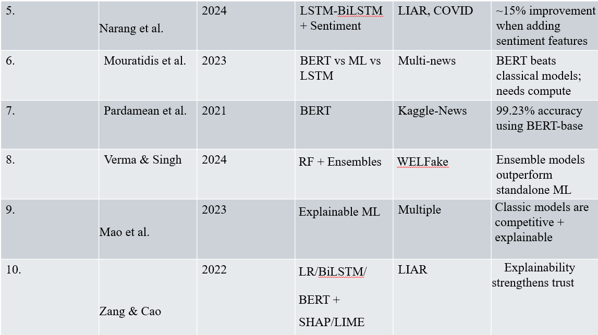

Slide 7
Key Findings from Literature Review
Transformer Dominance
BERT-based models (FakeBERT, TruthSeeker) achieve >98–99% accuracy.
However, they require heavy computational resources and fine-tuning.
Not always practical for lightweight deployment.
Classical ML Remains Competitive
Logistic Regression, SVM, and ensemble models still achieve accuracy >96–98%.
Efficient with TF-IDF features.
Faster training and easier deployment.
Sentiment as a Strong Signal
Multiple studies confirm fake news contains stronger negative emotional tone.
Emotion-based features improve detection.
Sentiment enhances interpretability.
Growing Need for Explainability
SHAP and LIME increasingly used.
Trust in AI systems depends on interpretability.
Multimodal & Multilingual Gap
Most research focuses on English text.
Real-world fake news is multilingual and multimodal.

Slide 8
Gaps found in Literature Review
Research Gaps Addressed in This Work
Overemphasis on Deep Learning
  Most studies focus on BERT/LLMs.
  Limited comparative evaluation of classical ML models under uniform conditions.
Lack of Interpretability in Classical Models
  Many models predict labels but do not explain reasoning.
  Sentiment rarely used as post-hoc explanation.
Performance vs Practicality Tradeoff
  High accuracy models are often computationally heavy.
  Few studies compare performance vs computational cost..
Limited Post-hoc Sentiment Evaluation
  Rarely used for analyzing prediction behavior after classification.
  Sentiment is often used as feature input.
Comparative evaluation of six classical ML models under uniform TF-IDF representation.
Introducing post-hoc sentiment analysis (VADER) for interpretability.
Performance vs computational feasibility analysis.
Empirical validation of emotional polarity trends in fake news
This bridges the gap between high accuracy and interpretability

Slide 9
Problem Statement
To develop and comparatively evaluate multiple machine learning models for fake news detection under uniform feature representation, and to enhance interpretability through post-hoc sentiment analysis, while balancing predictive performance and computational feasibility.

Slide 10
Objectives
To evaluate six machine learning classifiers (NB, LR, KNN, SVM, RF, XGBoost) for fake news detection using TF-IDF features.
To compare performance using stratified 5-fold cross-validation and standard classification metrics.
To analyze sentiment polarity using VADER as a post-hoc interpretability mechanism.
To investigate whether emotional negativity correlates with fake news predictions.
To compare findings with recent transformer-based and sentiment-enhanced approaches in literature.

Slide 11
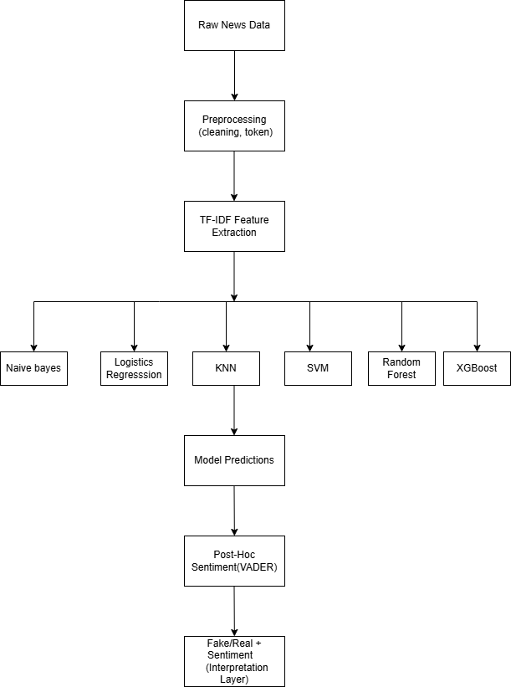
Proposed Methodology
Data Collection & Preprocessing
  Balanced fake & real news dataset
  Text cleaning (HTML removal, tokenization)
  TF-IDF vectorization (uni/bi-grams)
Model Training
  Six classifiers: NB, LR, KNN, SVM, RF, XGBoost
  80/20 train-test split
  Stratified 5-fold cross-validation
  Hyperparameter tuning (GridSearchCV)
Evaluation
  Accuracy, Precision, Recall, F1-score
  Confusion Matrix
  ROC Curve & Precision-Recall Curve
Sentiment-Based Interpretability
  Compute VADER compound scores (-1 to +1)
  Compare sentiment distribution for predicted Fake vs Real
  Analyze emotional polarity trends

Slide 12
References
Aphiwongsophon & Chongstitvatana (2020)
Singh et al. (2020)
Pardamean & Pardede (BERT)
Mouratidis et al.
Tan & Bakir (TruthSeeker)
Kaliyar et al. (FakeBERT)
Cui et al.
Dementieva & Panchenko
Farhoudinia et al.
SHAP/LIME works (Dua et al.)
Multimodal survey (Lv et al.)

Slide 13
Thank You

